Slide 1
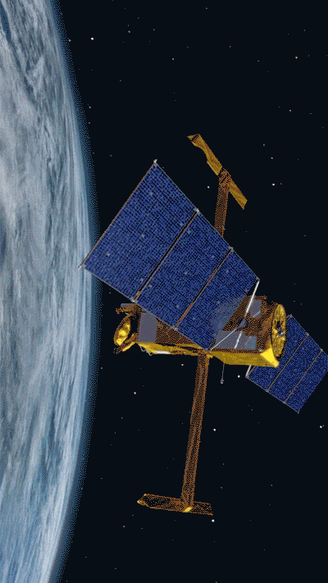
Lecture 10
Convolutional Neural Networks
For Computer Vision

Slide 2
Why yet another algorithm, again?
Last week(s): Full Connected Artificial Neural Networks (ANN)
Linear numerical and logistic regression often insufficiently complex
Polynomial features quickly become too expensive, especially due to cross-terms between many features
Need more efficient way to introduce high degree of non-linearity: neural networks

Slide 3
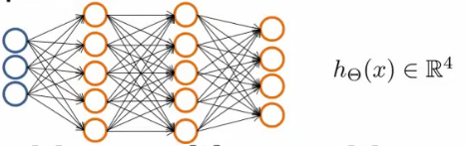
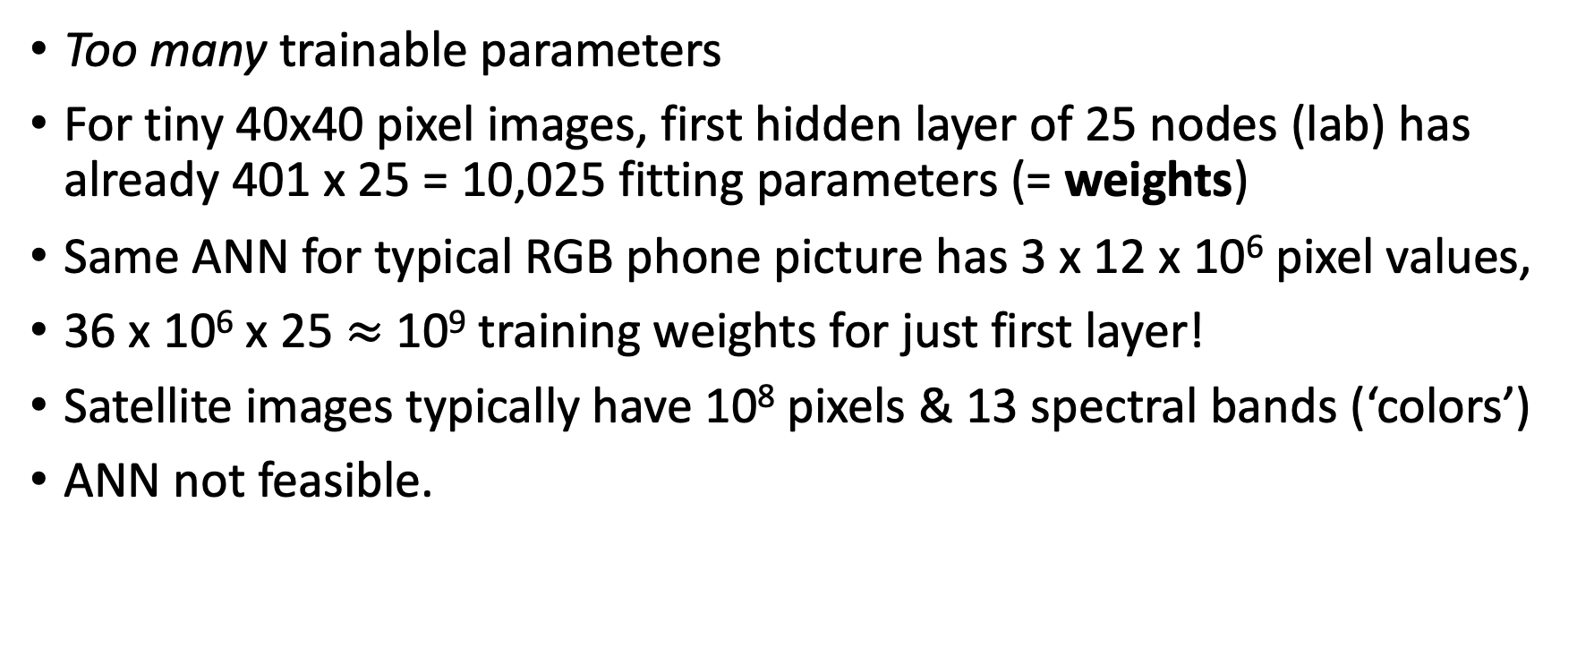
Limitations of ANN
Too many trainable parameters
For tiny 40x40 pixel images, first hidden layer of 25 nodes (lab) has already 401 x 25 = 10,025 fitting parameters (= weights)
Same ANN for typical RGB phone picture has 3 x 12 x 10⁶ pixel values,
36 x 10⁶ x 25 $≈$ 10⁹ training weights for just first layer!
Satellite images typically have 10⁸ pixels & 13 spectral bands (‘colors’)
ANN not feasible.

Slide 4
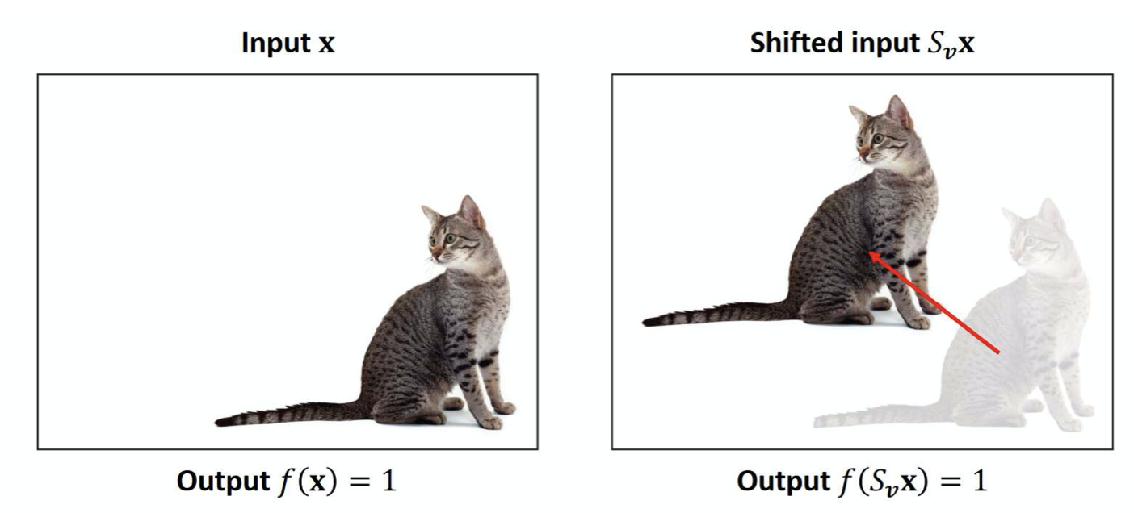
Limitations of ANN
To an ANN, two image below are completely different,
Every pixel is different; difficult for ANN to have same weights for each pixel to detect cat in both pictures
We’d like a NN that is ‘translation invariant’
Same for size of cat

Slide 5
Inspiration for Solution
Take cue from ‘old school’ image processing techniques
Filters in Photoshop, Gimp, and now your phone, are all based on convolutions of your photo with some small kernel.
What does all this mean?

Slide 6
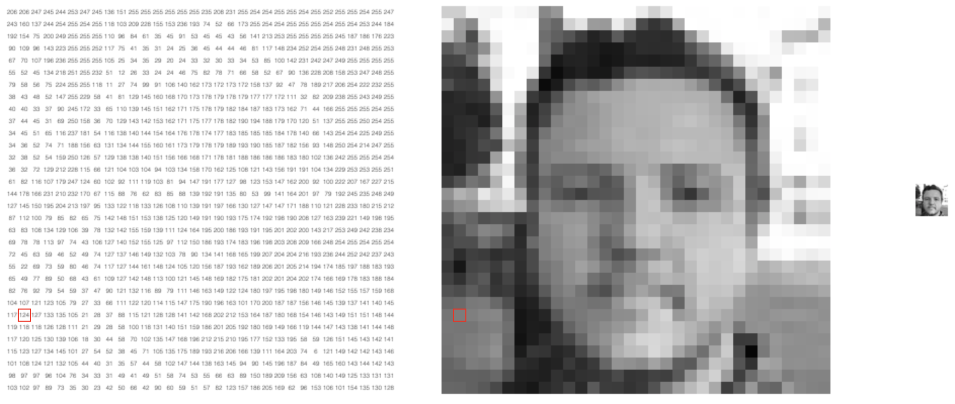
What is an image..?
Image/photo is just light intensity for each image pixel, i.e. an array of numbers; often stored as integers 0 – 255 (8-bit = 1 byte)
1 value per pixel for grayscale, 3 values for Red-Green-Blue (RGB), many more for multi- and hyper-spectral satellite imagery: channels/bands

Slide 7
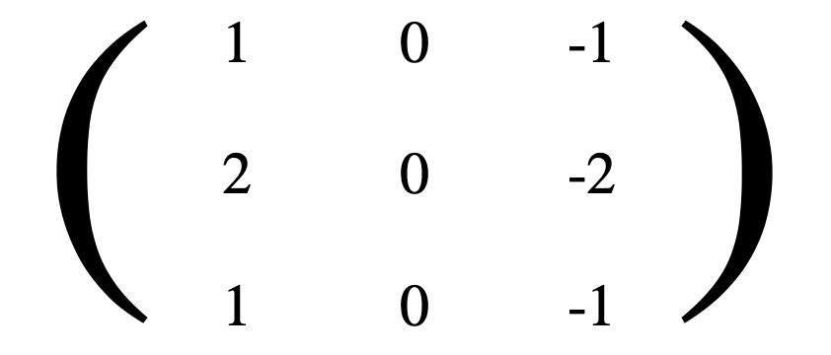
What is a kernel?
Just a small matrix, typically square and typically of odd dimensions, e.g., 3x3, 5x5, or –less common– larger.
Example, Left-Sobel kernel:

Slide 8
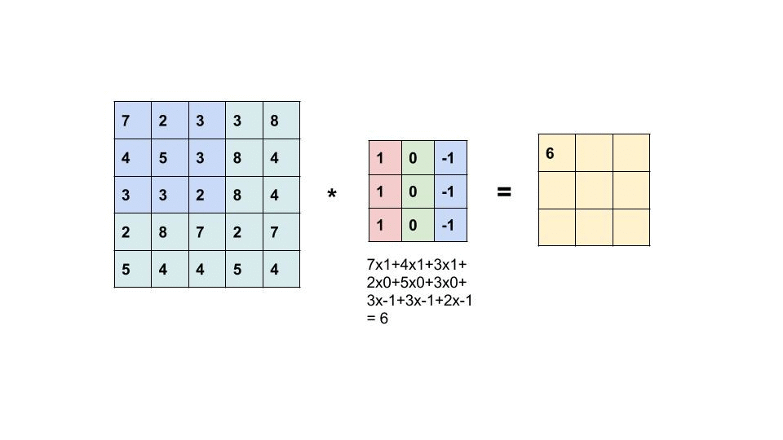
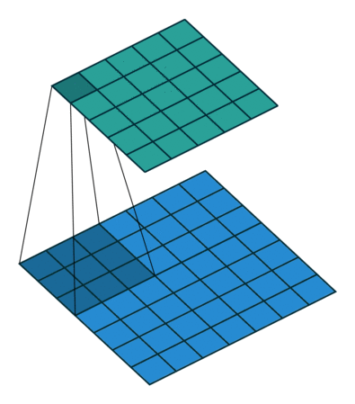
What is a Convolution?
‘Slide’ kernel over image, one (or more) pixel at a time horizontally, then vertically
Multiply each element of kernel with each element in image and sum
For (square) image width n_{w} and kernel size n_{f}, output is w = n_{w} – n_{f} + 1
But why convolutions??

Slide 9
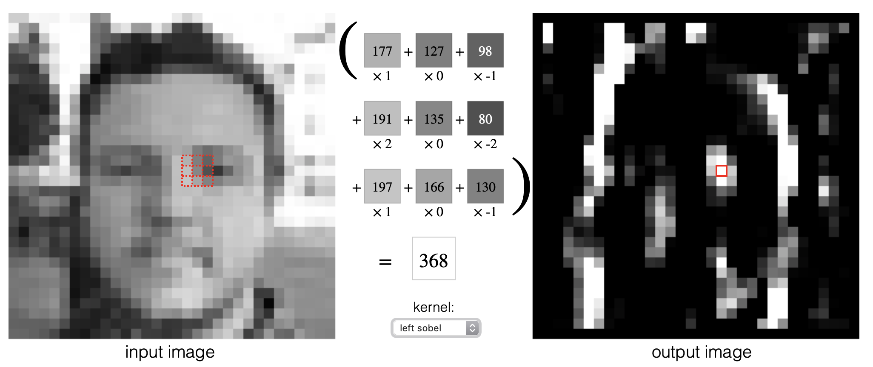
This is how image processing filters work!
Vertical edge detection:

Slide 10
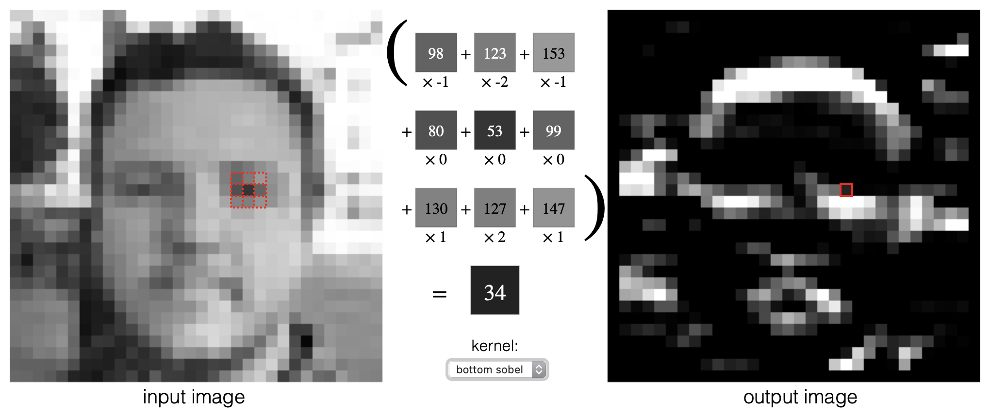
This is how image processing filters work!
Horizontal edge detection:

Slide 11
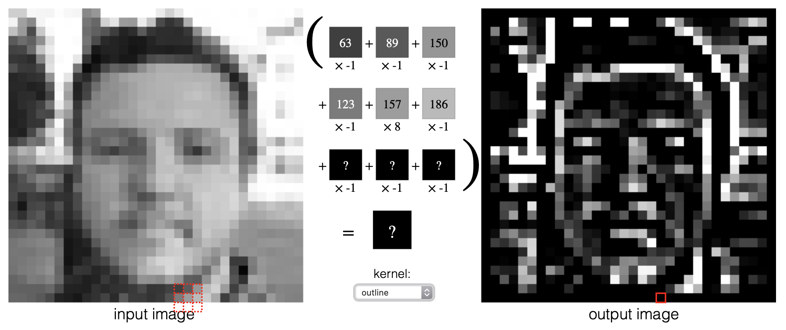
This is how image processing filters work!
Outline:

Slide 12
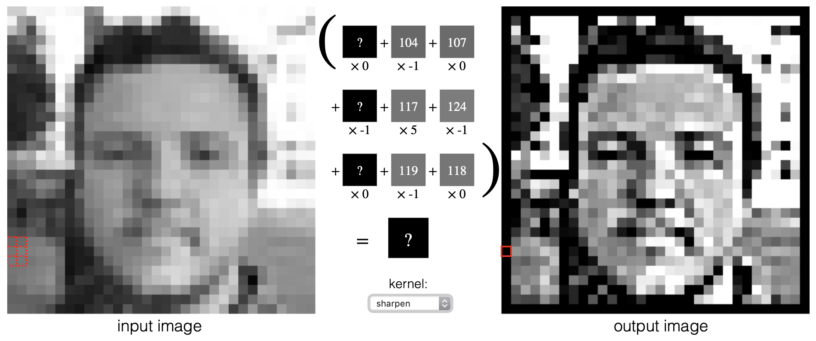
This is how image processing filters work!
Sharpen:

Slide 13
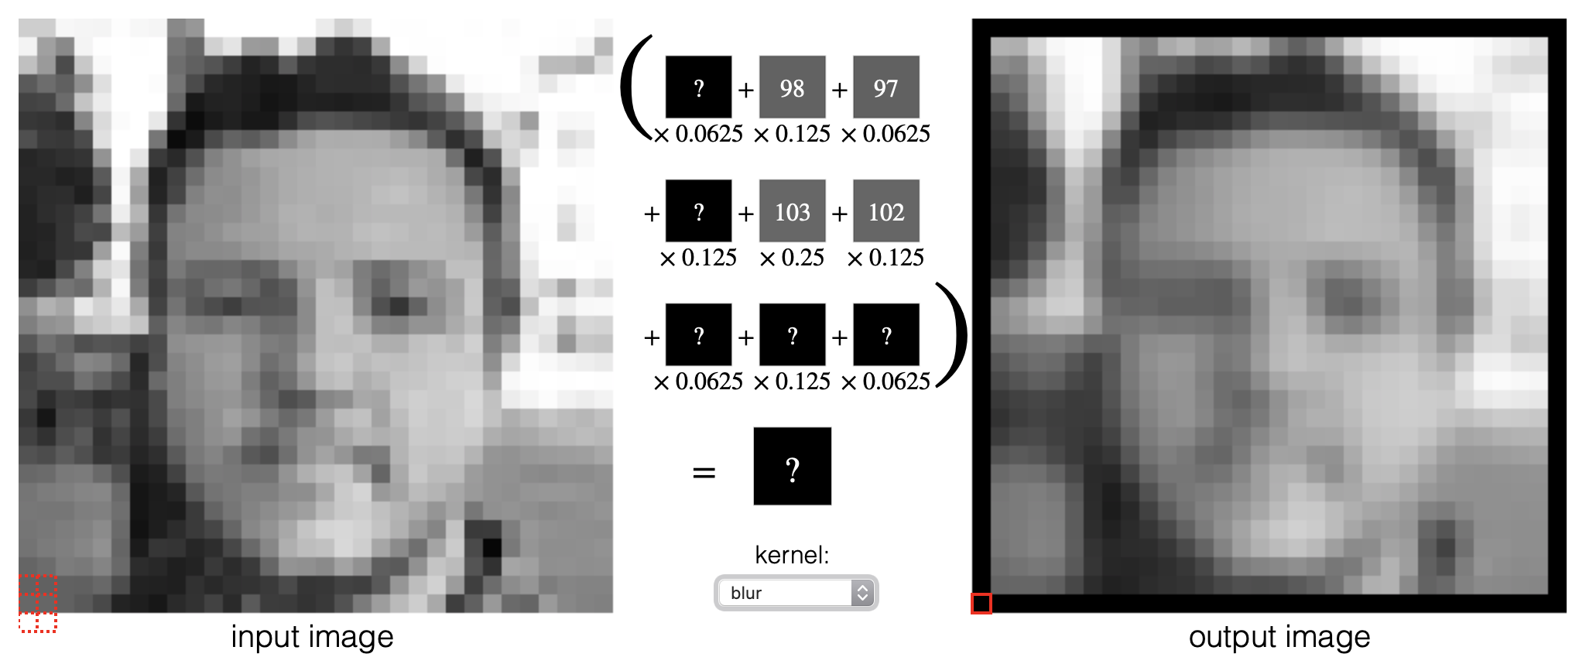
This is how image processing filters work!
Blur:

Slide 14
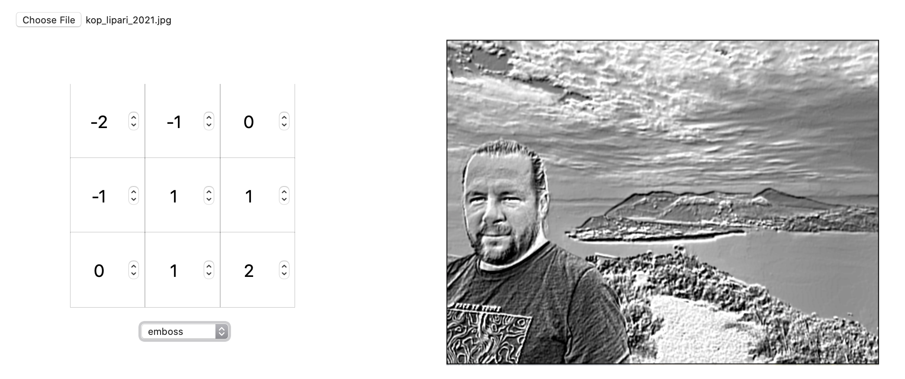
This is how image processing filters work!
Design your own:

Slide 15
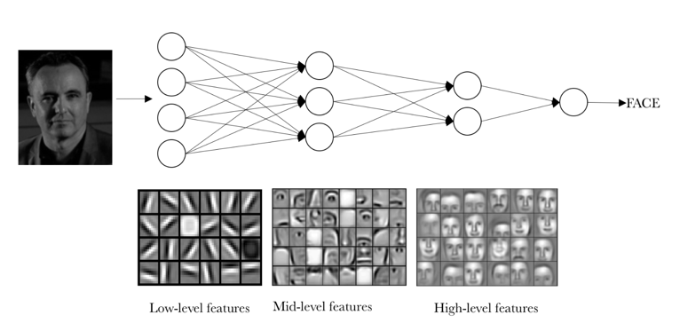
Image processing -> Convolutional NN
Observation: tiny filter/kernel of, e.g., 3 x 3 = 9 parameters is able to extract important features from images of any size
Idea: can we combine a whole bunch of such filters to extract enough features to identify what’s in a picture (automatically, by a NN)?

Slide 16
Equivalency between ANN & CNN

Slide 17
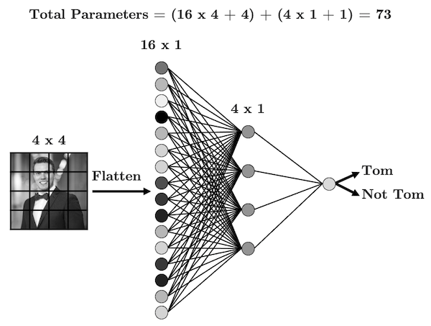
Consider simplest possible example
4x4 pixel grayscale image
ANN with just 1 hidden layer, 4 nodes
Binary output
73 trainable parameters/weights

Slide 18
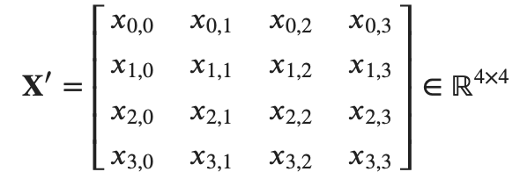




Remember process/steps of ANN
‘Unroll’ 2D image to 1D feature vector
to:
Add bias and multiply with 17 x 4 matrix of weights for all connections
Linear combination:
Non-linear activation:
Next layer, again linear combo:
Final (output) layer, non-linear activation function:

Slide 19
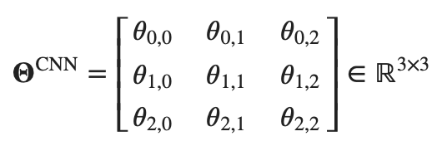
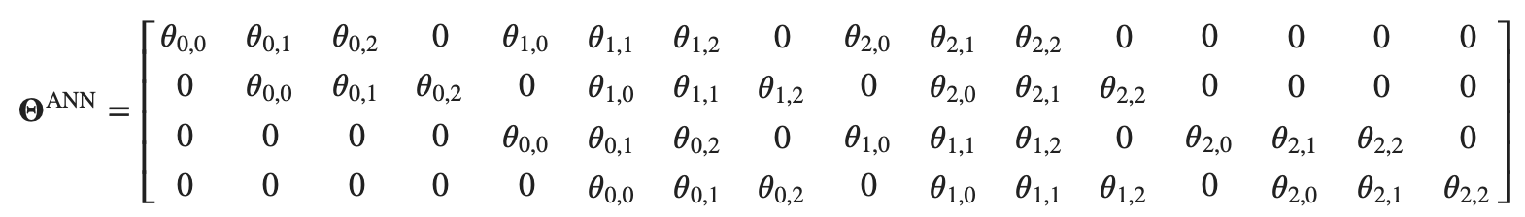
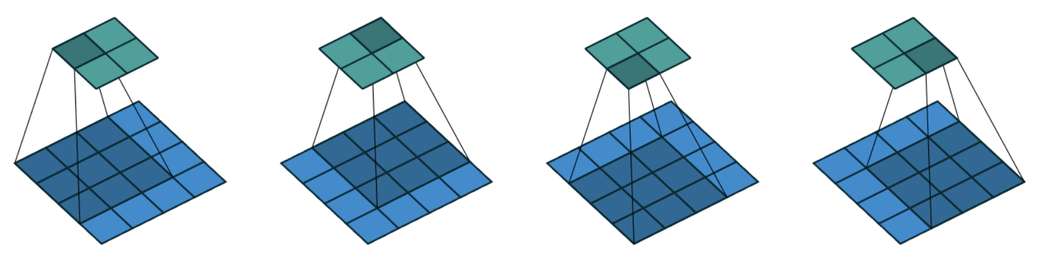
CNN
3x3 kernel:
Can be re-written as 16 x 4 matrix (special kind, circulant/Toeplitz)
Everything else the same, but above matrix only has 9 unique values (vs. 73)
4x9 = 36 connections instead of 73; other steps basically the same.

Slide 20
Two (or more) filters in CNN
Typically, hidden layer has multiple channels for different filters
Example: two 3x3 kernels (say, horizontal and vertical edges)
For our 4x4 input image, hidden layer has 8 nodes but stacked as 2 x 4 nodes
Algebraically, we can vertically stack 2 similar Toeplitz matrices into a 8x16 matrix
Or use 2 separate 4x16 Toeplitz matrices (more efficient)
In real applications: many automatically determined filters

Slide 21
CNN for image classification
After one or more convolutional layers, output of channels are flattened
One or more fully connected layers combine features in different parts of image
Combination (with trainable weights) gives final image class.

Slide 22
Technical Details

Slide 23
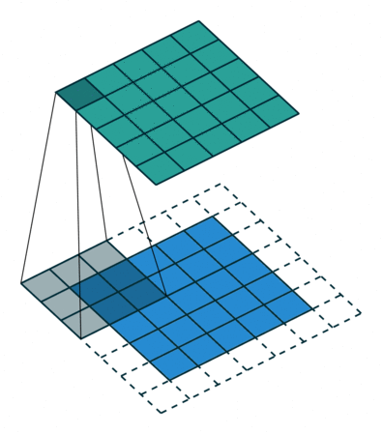
Padding
Sometimes, we may want output to be same size as input
‘Pad’ image with one or more ‘dummy’ pixels, typically zero-valued
This also applies filter ‘better’ near edges
Sometimes we like to have, say, even pixel dimensions
Padding can be
  valid (no padding),
  same (giving same size of output image), or
  full (making sure every pixel is covered n_{p}² times)

Slide 24
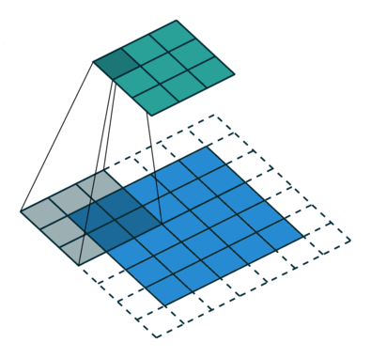
Stride
Instead of moving kernel 1 pixel at a time, we can move 2 or more pixels (n_{s} ) at a time; this is called the stride
This reduces output size roughly by a factor n_{s} in each dimension (e.g. n_{s}² in total): compression

Slide 25
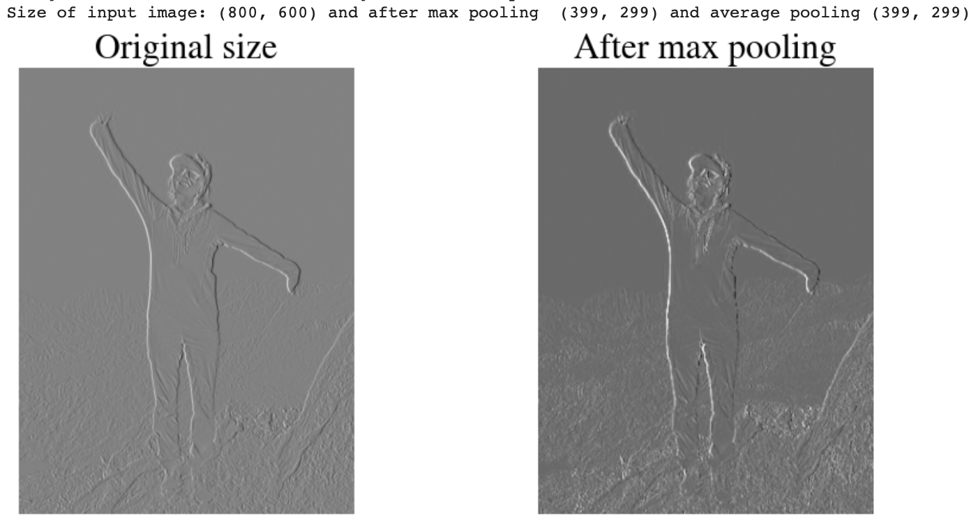
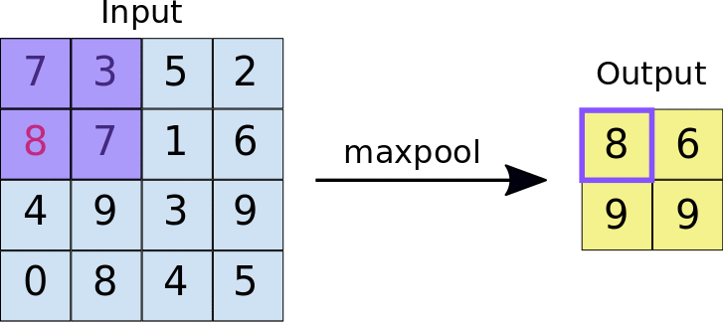
Max-Pooling (and Average Pooling)
Special type of convolution that takes maximum (or average) value inside kernel window (no adjustable weights!)
Usually, stride is same as max-pool size such that there is no overlap
Pooling again reduces data (compression), while enhancing features

Slide 26
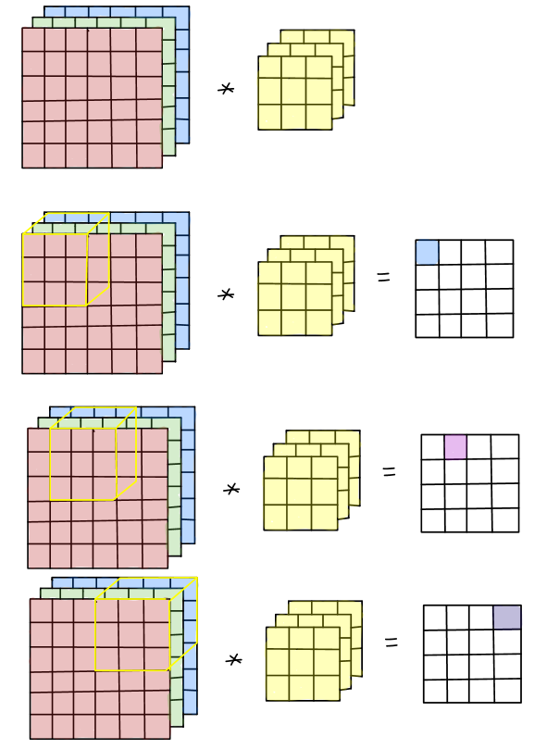
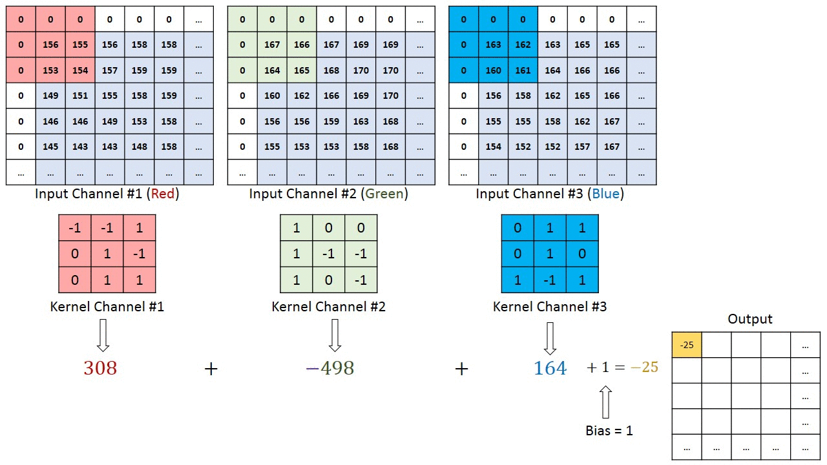
Volume convolutions
When input has n_{c} channels, such as RGB (n_{c}=3), filter/kernel is n_{f} x n_{f} x n_{c} and also summed over n_{c}
Example with padding and bias

Slide 27
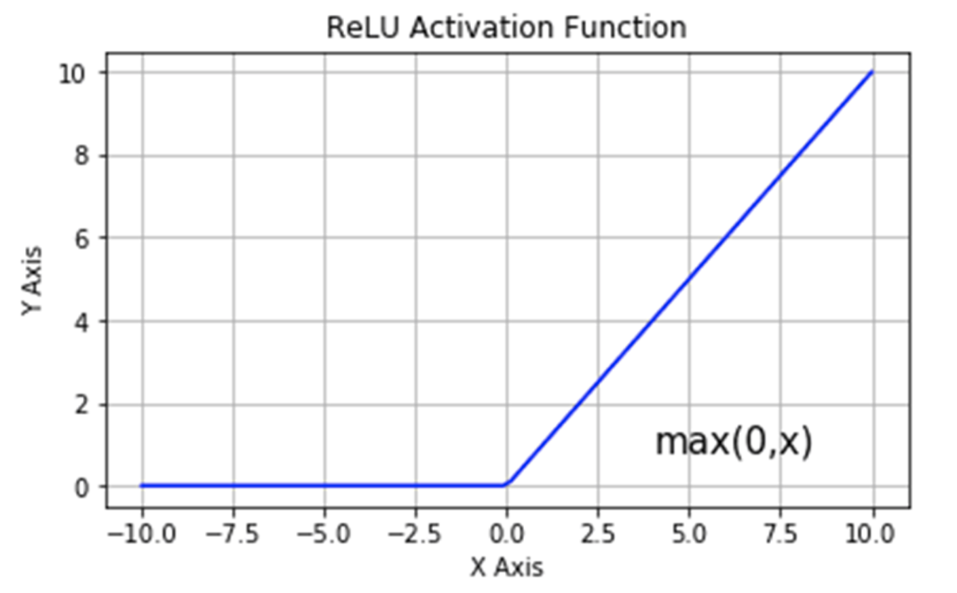

Activation function
Rectified Linear Units (RELU) more common than sigmoids in CNN
For RELU $g(z)$, with $z=x⋅Θ$ and $z<0$, $g(z)$ is exactly zero. Zero elements in weights matrix: sparse.
For $z>0$, $\frac{∂g(z)}{∂z}$ is constant
Sigmoid has vanishing gradients
Gradient descent more efficient

Slide 28
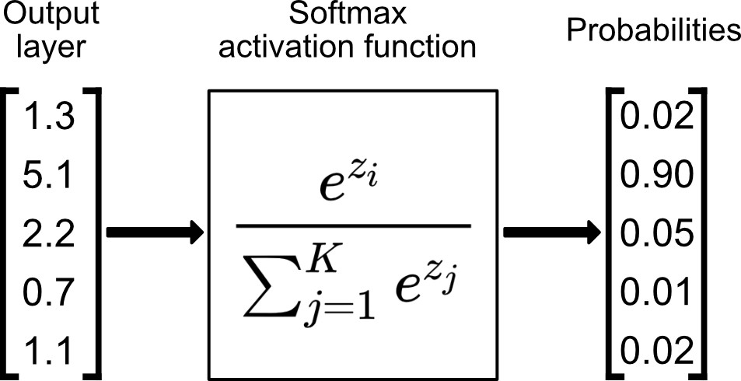
Softmax
For multi-class CNN, we use softmax instead of sigmoid activation function for the output layer
Instead of binary 0/1, outputs probabilities for any nr of classes

Slide 29
Putting it all Together

Slide 30
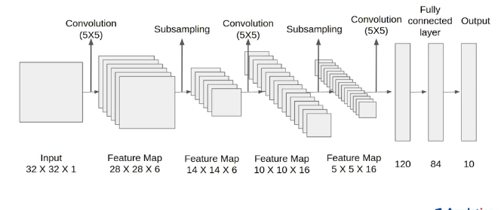
LeNet-5
One of the first CNN (1998, much more limited CPU power)

Slide 31
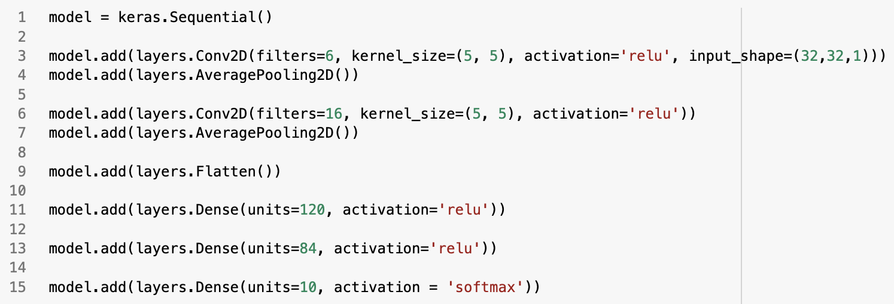
Python code
Nowadays, unbelievably easy, thanks to, e.g, Keras:

Slide 32
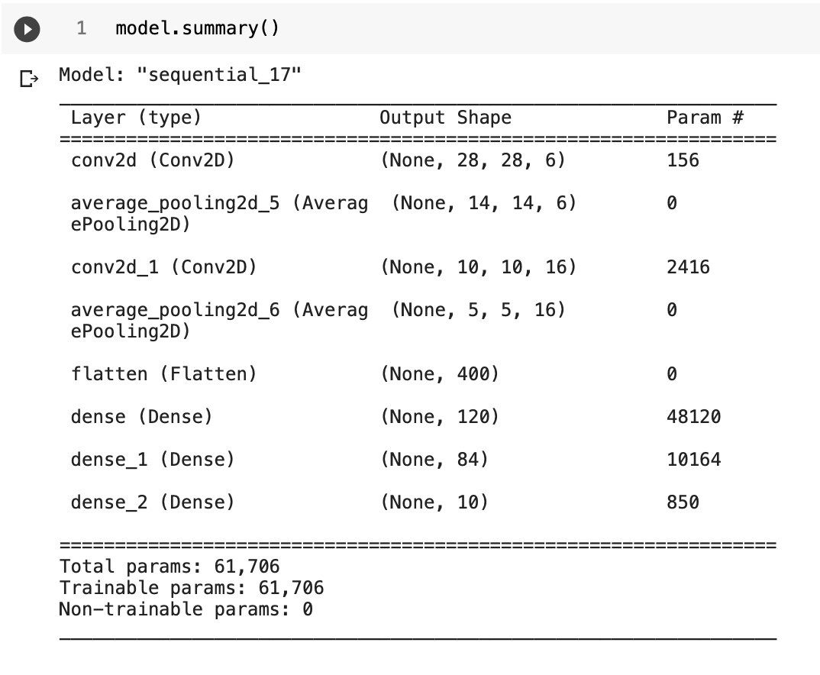
Python code
Can provide nice summary of, e.g., trainable parameters:

Slide 33
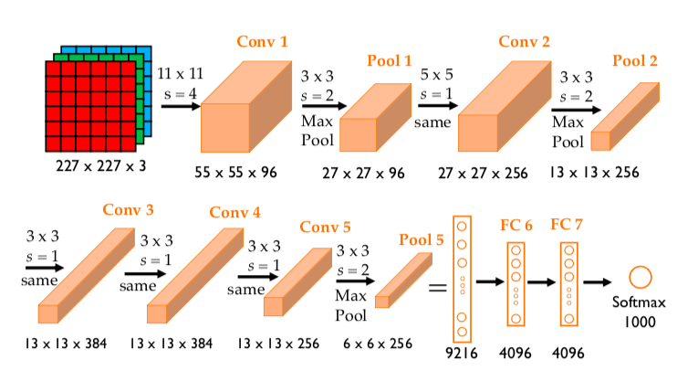
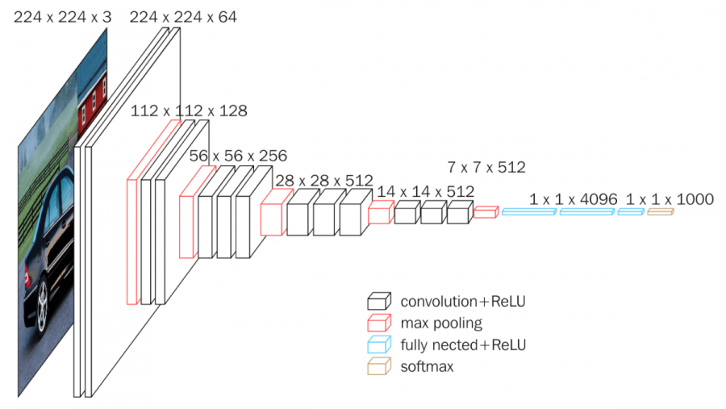
AlexNet & VGG-16
Other ‘classic’, deeper CNN
AlexNet: 62 million weights
VGG-16: 138 million

Slide 34
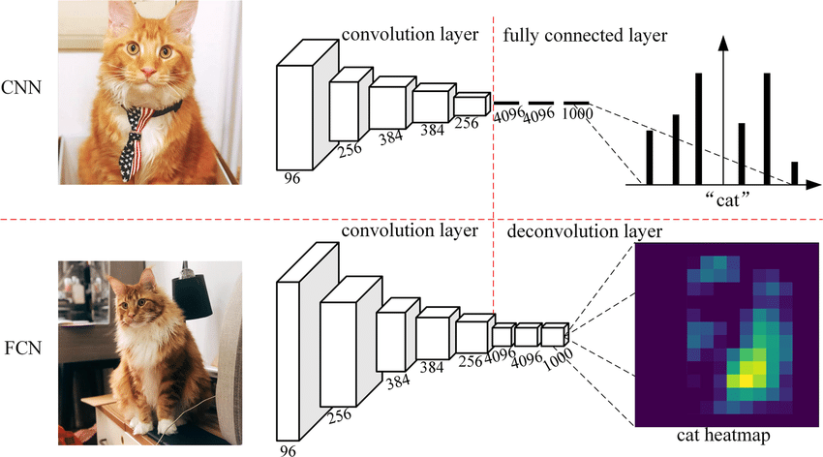
Fully Convolutional Neural Networks (FCN)
No fully-connected layers anywhere in NN
Allows for any input size

Slide 35
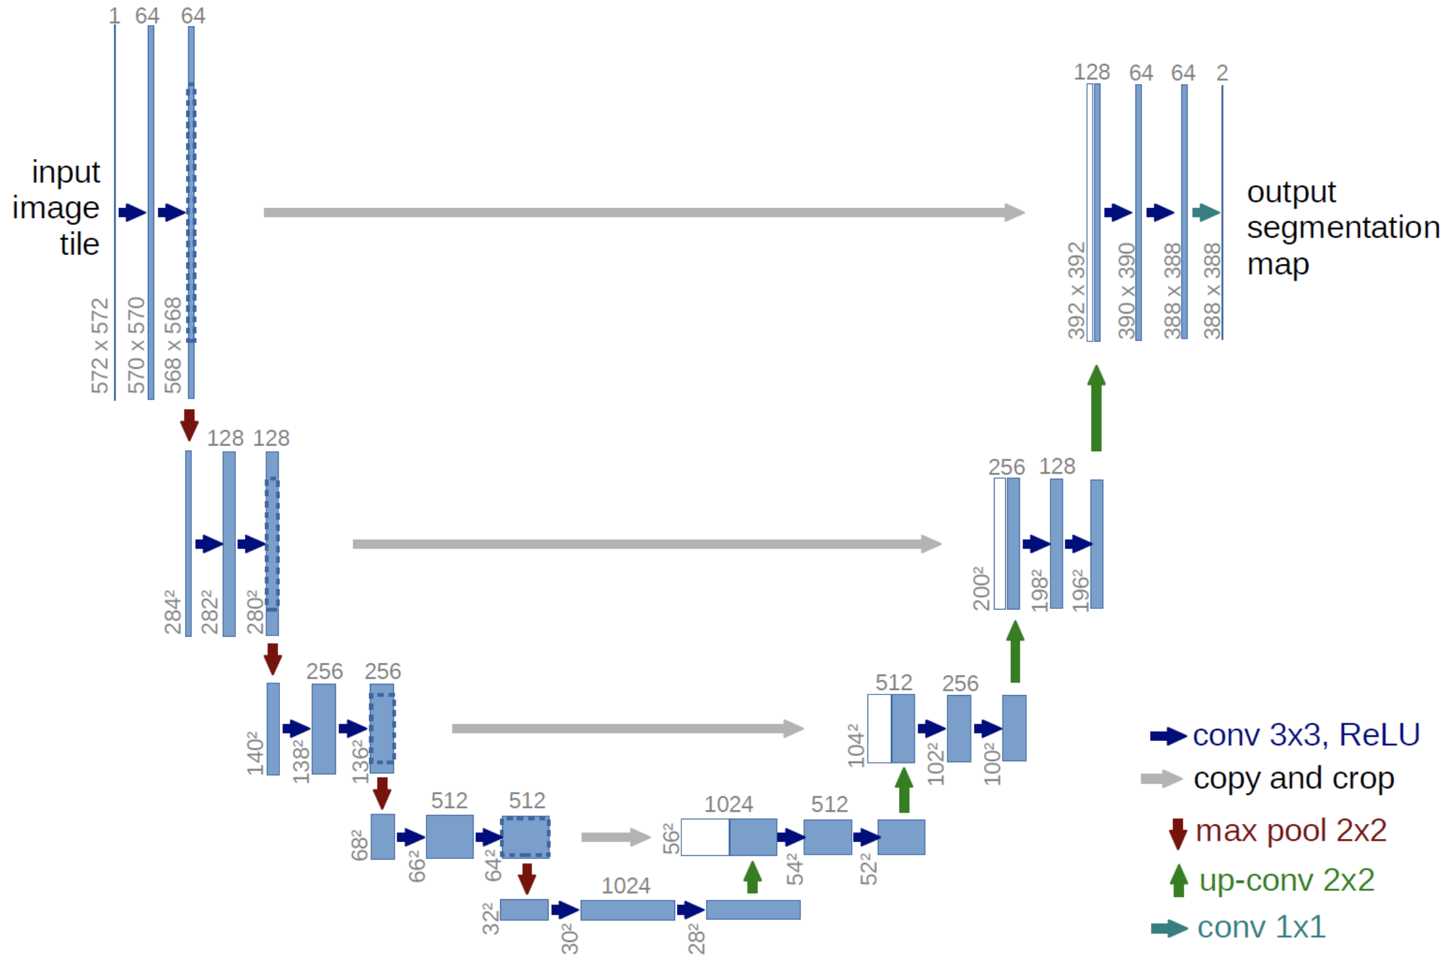
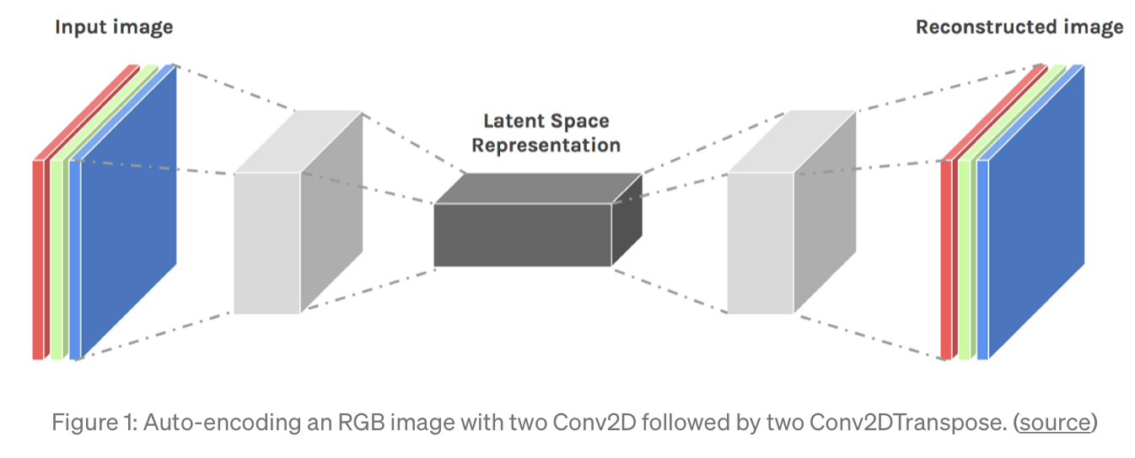
U-Nets for Segmentation
Auto-encoder -> bottleneck -> decoder

Slide 36
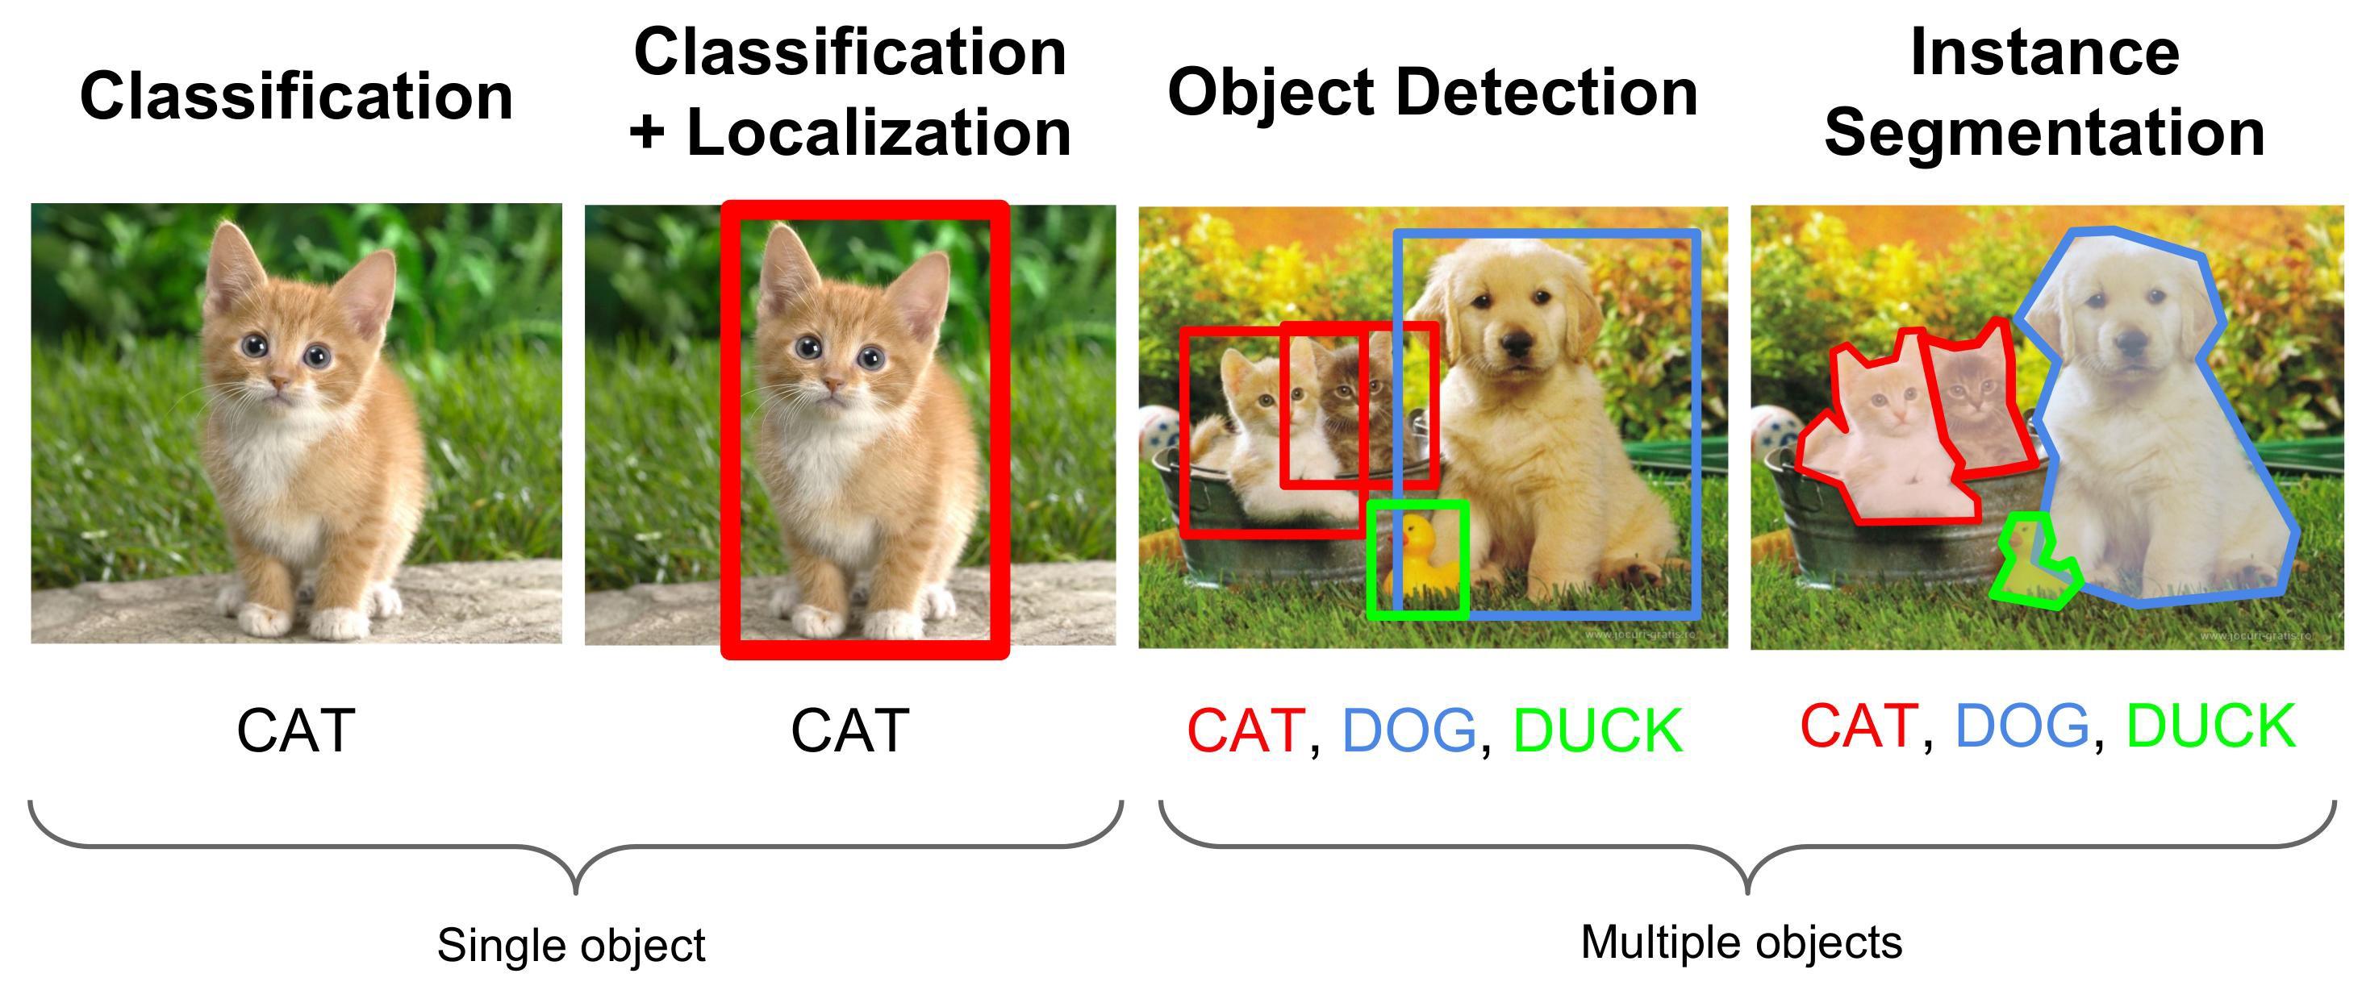
Different Computer Vision Tasks
Semantic or

Slide 37
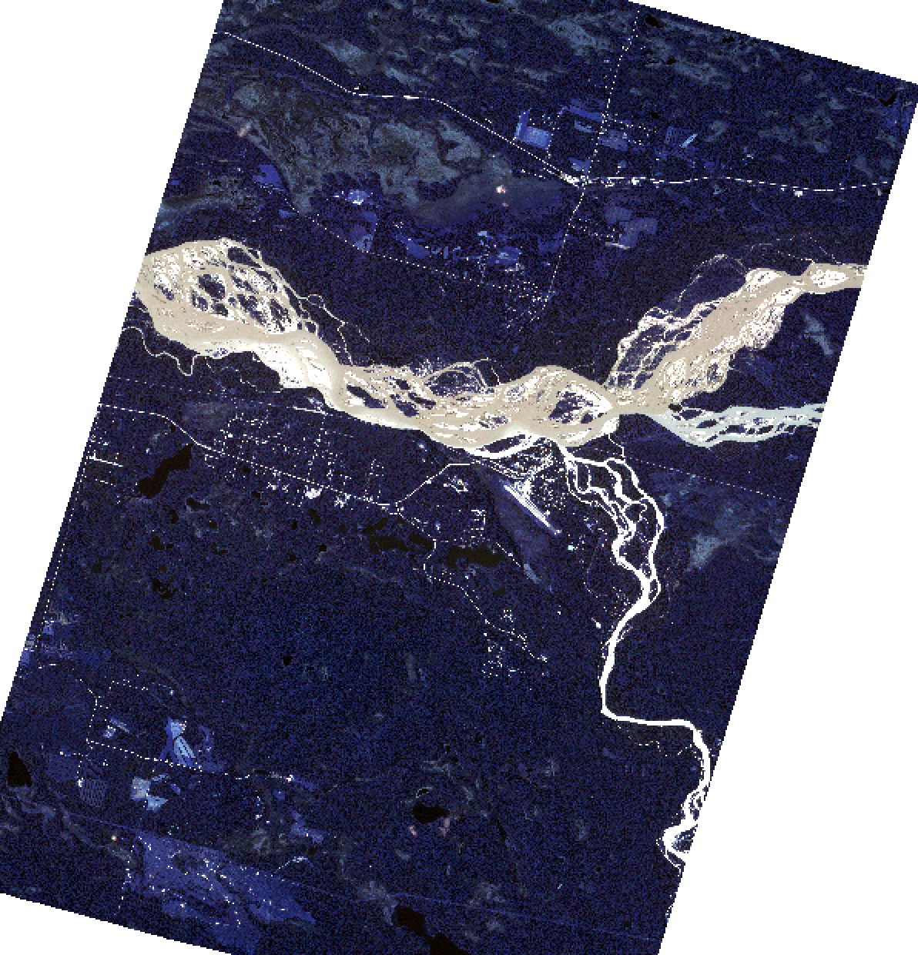
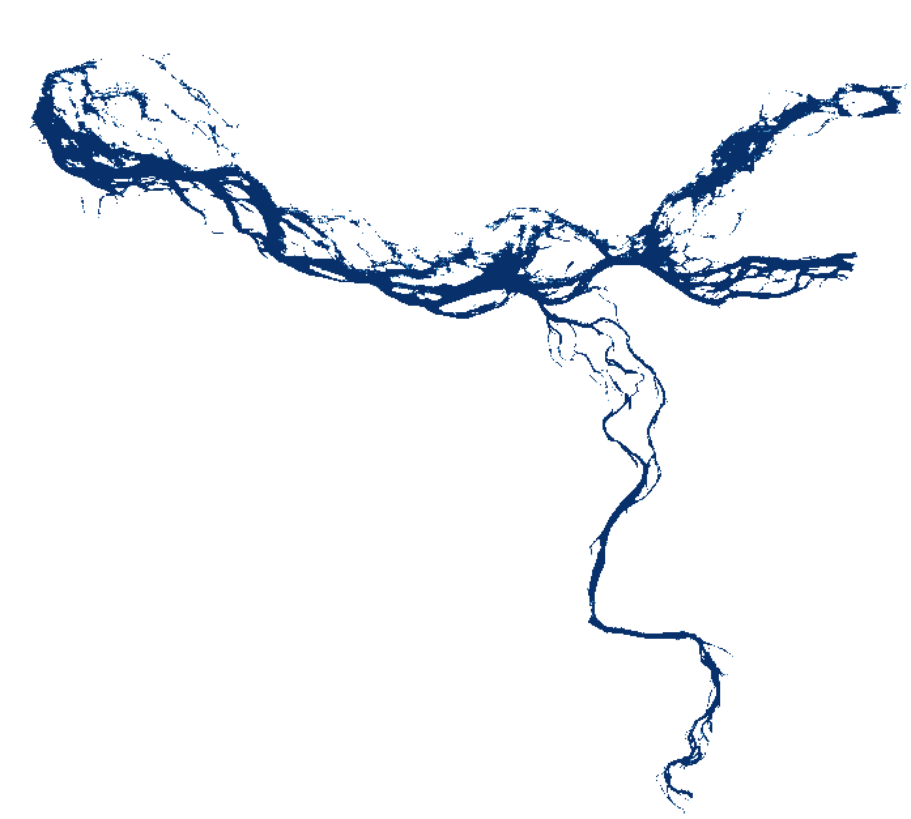
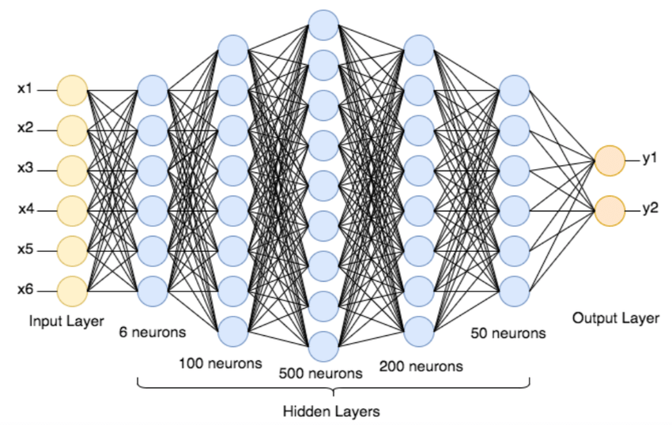
Water detection / Land Use
8,661 × 12,190 =
105,577,590 pixels × 1 – 8 spectral bands
For 1 data point (image)
Output/prediction is water/land

Slide 38
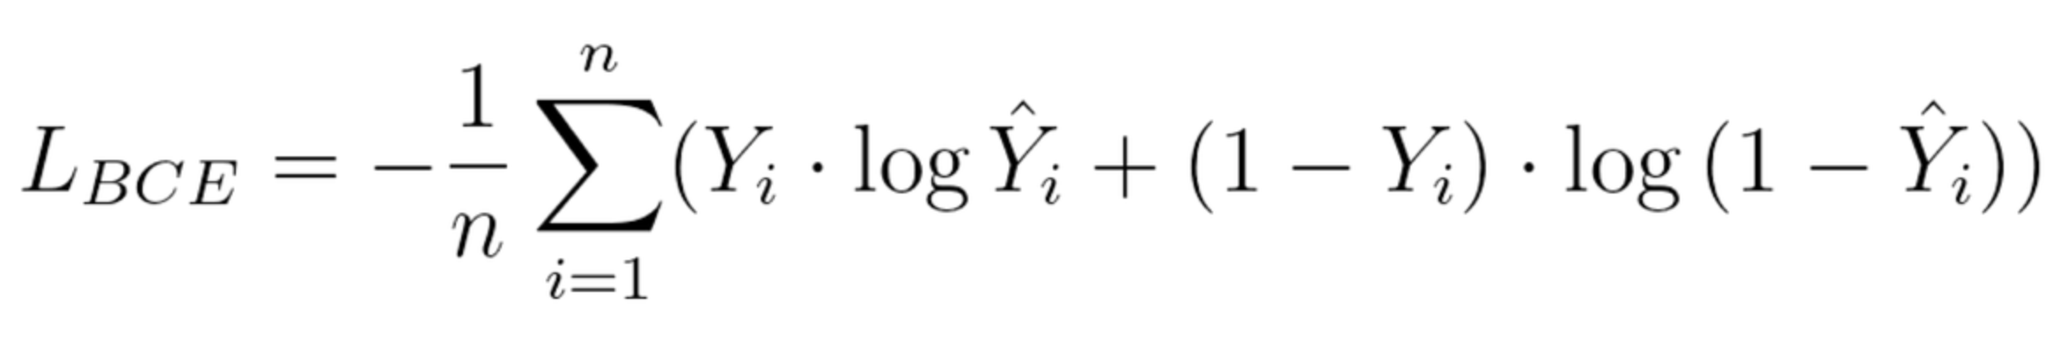
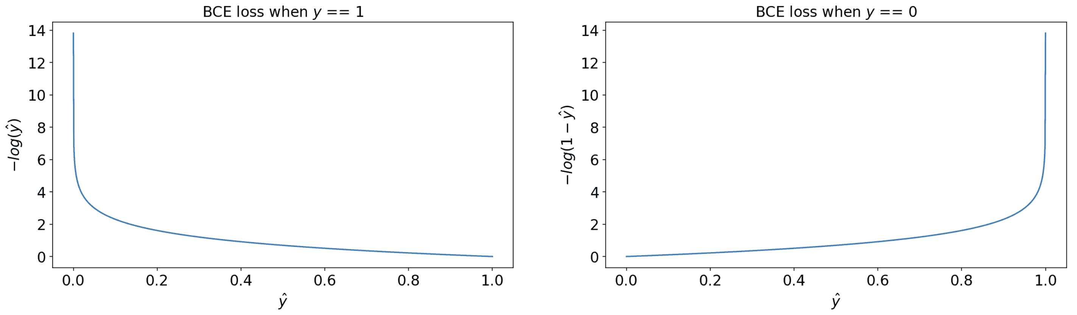
‘Accuracy’ Metrics for Segmentation
Binary cross entropy (BCE) loss = logistic loss function
Common choice, e.g., to minimize by gradient descent
Not that intuitive

Slide 39
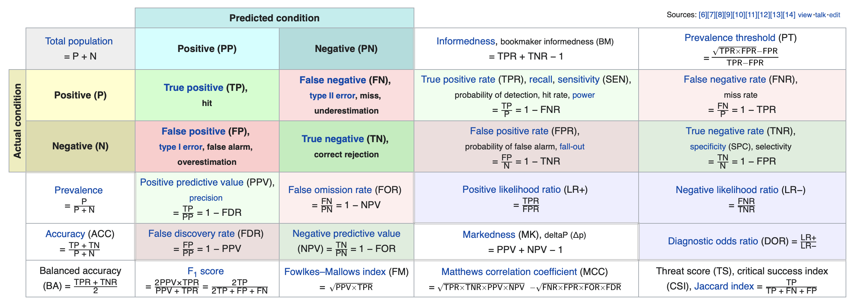
‘Accuracy’ Metrics for Segmentation

Slide 40
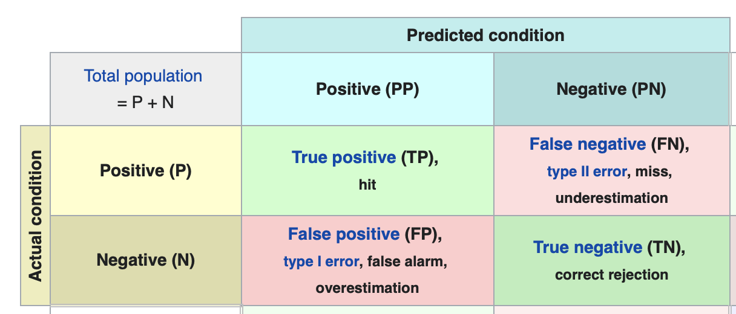
‘Accuracy’ Metrics for Segmentation
Confusion matrix

Slide 41

‘Accuracy’ Metrics for Segmentation
Precision: $\frac{TP}{TP+FP}$
What fraction of pixels predicted as 1 is actually labeled as 1.

Slide 42

‘Accuracy’ Metrics for Segmentation
Recall: $\frac{TP}{TP+FN}$
What fraction of pixels labeled as 1 is actually predicted as 1.

Slide 43

‘Accuracy’ Metrics for Segmentation
F1: $\frac{2 TP}{2 TP+FN+FP}= \frac{2 precision ∗recall}{precision+recall}$
Harmonic average of precision and recall

Slide 44
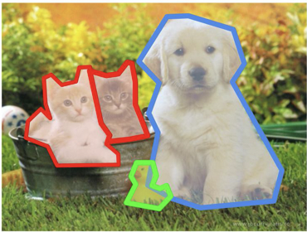
Questions:
What is precision, recall, and F1 score of this prediction:
Labels
Prediction
dog

Slide 45
Questions:
What is precision, recall, and F1 score of this prediction:
This is why F1 score is useful single metric of accuracy
Possible to directly optimize for F1: Dice loss = 1 – F1
Labels
Prediction
dog

Slide 46
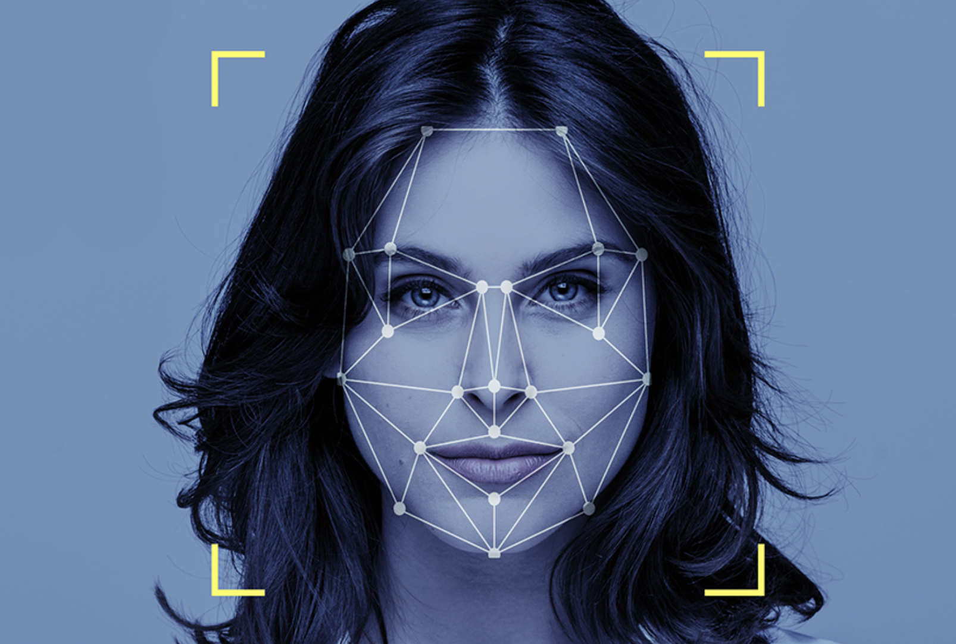
Conclusions
CNN are more efficient than ANN for computer vision tasks
Inspired by image/signal processing: extract features by small kernels
Let CNN model learn its own kernels/filters and keep combining those
Same parameters used in different parts of images: translation invariant
CNN learns complex features that we, humans, cannot even interpret...
CNN are (my) best example of true, almost magical, deep learning

Slide 47
Next weeks
AI in practice / research
Short black-board lectures on other ML/DL methods
Work on individual AI projects

