Slide 1
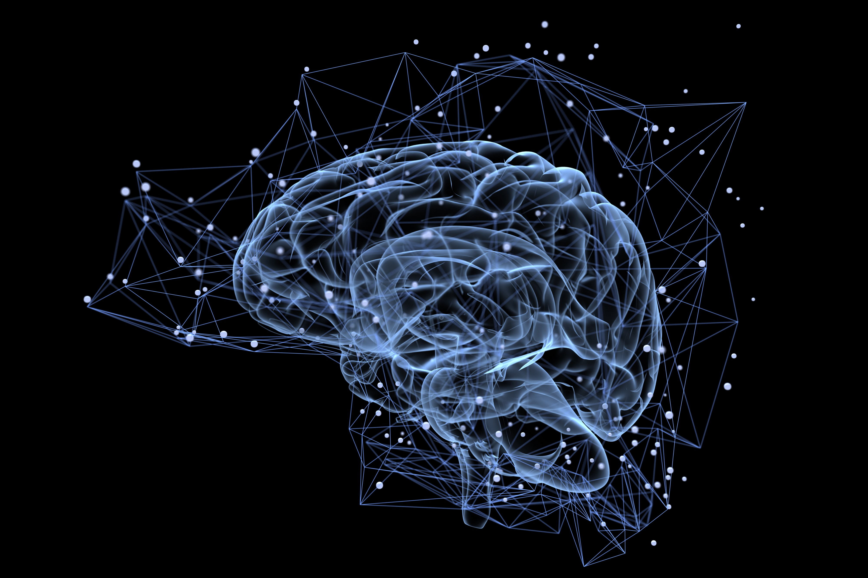
Artificial Intelligence in Earth Sciences
… and Geography, Geodesy, Civil and Environmental Engineering, etc.
ES5757, Tue-Thur 12.45-2.05pm
ML251 and ML356 Kresge Computer Lab

Slide 2

TA: Haniyeh Tajer
PhD student Earth Sciences and Astronomy
Studies exoplanets
McPherson building, room 4042
Office hours: Thursday 11am-12pm (email before?)

Slide 3
Why should you care about AI?
Some numbers:
300-350B$ spending by tech giants in 2025 alone! 1.8TB by 2030
78% of companies use AI, 100% jump in 2025, 56% higher wages
All sectors
Short term: accelerate your research

Slide 4
Goals
Learn how to program in Python
Use interactive Jupyter notebooks
Learn how powerful machine learning algorithms work (no black box)
Apply machine learning to Science & Engineering problems

Slide 5
Course Structure
Tuesdays: lectures on how ML/DL algorithms work: ML251
Remainder: hands-on implementation and applications: ML356, Kresge computer lab
  Weekly labs
  Final independent ML project
Some independent work expected between in-person sessions

Slide 6
Syllabus
Syllabus, lecture & lab notes shared on Carmen: https://osu.instructure.com/courses/189631
Week-to-week schedule may be adapted based on collective progress
Brief overview:

Slide 7
Week 1 (this week)
Set up google account and Colab(oratory) environment
Create your first Jupyter notebook
Work through tutorials of Python basics

Slide 8
Subsequent Weeks, Topics
Machine Learning terminology
  Artificial Intelligence vs Machine Learning vs Deep Learning
  Cost/loss functions, features, gradient descent methods, etc.
Linear numerical regression in one variable
Linear numerical regression in multiple (many!) variables
Non-linear numerical regression

Slide 9
Subsequent Weeks, Topics
Logistical regression = classification
Implement logistical regression of one, then multiple, variables
Other ML methods: Random Forests, Decision Trees, etc.

Slide 10
Subsequent Weeks, Topics
Neural Networks
  Perceptrons
  Artificial Neural Networks (ANN)
  (Fully) Convolutional Neural Networks
Applications: Remote Sensing with optical satellite imagery

Slide 11
Course Materials
Powerpoints of lectures
Jupyter notebooks with more detailed and interactive lecture notes
Jupyter notebooks for labs, applying ML/DL algorithms
Final assignment: solve a science problem with ML/DL from scratch

Slide 12
Evaluation
Finished jupyter notebooks of weekly labs uploaded to Carmen
Final independent project
Final grade based on participation (10%), completion of lab assignments (50%) and final project (40%).

Slide 13
Use of LLM AI
Encouraged, but be smart about it

Slide 14
AI / ML / DL Terminology

Slide 15
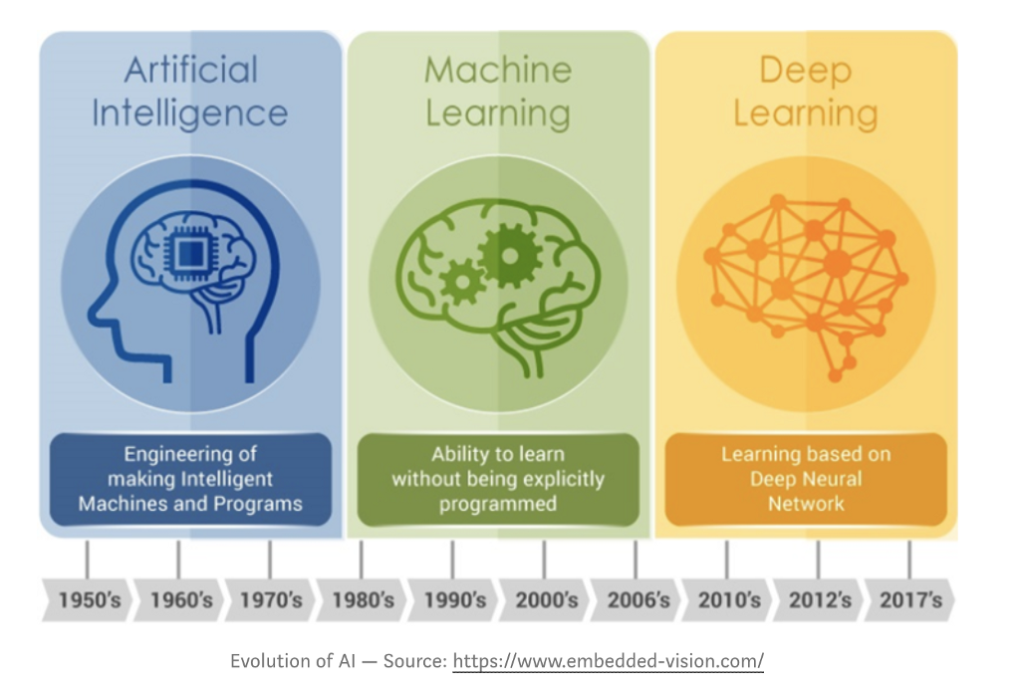
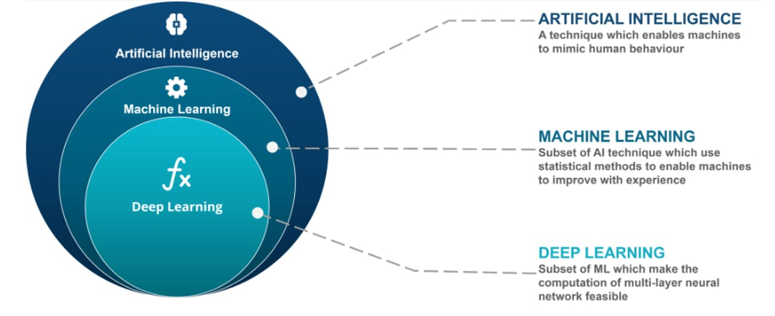
A bit of terminology

Slide 16
Definitions of Artificial Intelligence
Oxford:
“an area of study concerned with making computers copy intelligent human behavior.”
Webster:
“the capability of a machine to imitate intelligent human behavior”
Britannica:
“Research in AI has focused chiefly on the following components of intelligence: learning, reasoning, problem solving, perception, and using language.”

Slide 17
Definitions of Machine Learning
Oxford:
“the use and development of computer systems that are able to learn and adapt without following explicit instructions, by using algorithms and statistical models to analyze and draw inferences from patterns in data.”
Webster:
“the process by which a computer is able to improve its own performance (as in analyzing image files) by continuously incorporating new data into an existing statistical model”

Slide 18
Definitions of Deep Learning
Oxford:
“A type of machine learning considered to be in some way more dynamic or complete than others; esp. machine learning based on artificial neural networks in which multiple layers of processing are used to extract progressively more features from data.”
Webster:
“a form of machine learning in which the computer network rapidly teaches itself to understand a concept without human intervention by performing a large number of iterative calculations on an extremely large dataset”

Slide 19
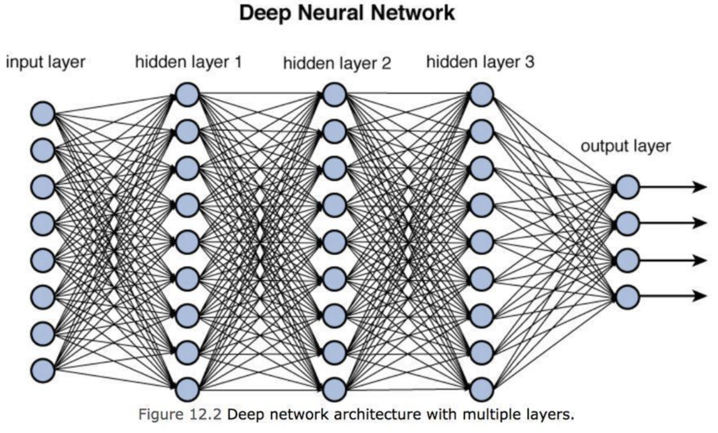
Definitions of Deep Learning
Type of ML that uses neural networks with many layers

Slide 20
Supervised learning

Slide 21
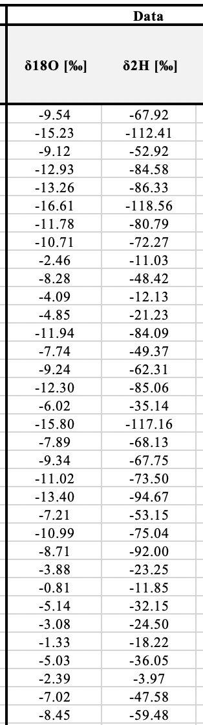
Numerical regression
Provide training data of features + target =
Independent vs dependent variables

Slide 22
Numerical regression
Use Machine Learning to fit model (hypothesis) to training data,
Minimizing error = loss, or cost function = e.g., RMSE or R²

Slide 23
Numerical regression
Use independent validation data to test how well model will generalize to make future predictions

Slide 24
Numerical regression more generally
Multiple / many features, e.g., precipitation, temperature, pressure etc.
Higher-order polynomial models or other functions (exponential etc.)
Neural networks can find extremely complex non-linear functions of one more many input features.

Slide 25
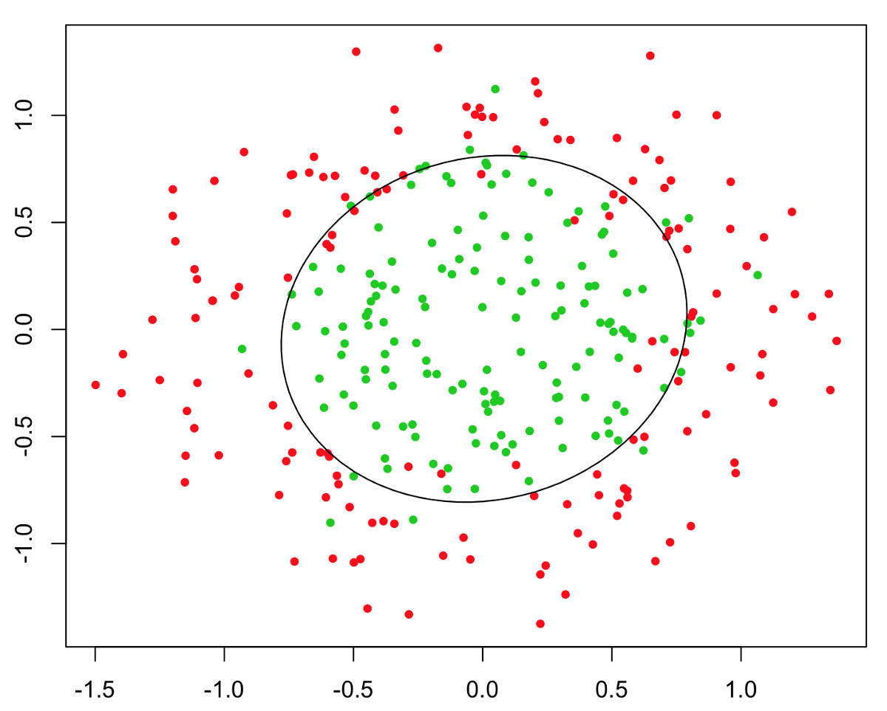
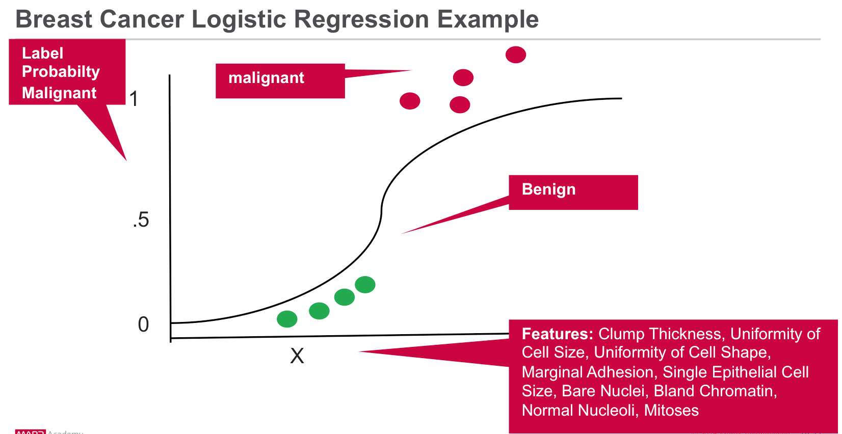
Logistical regression
Instead of continuous predictions, discrete predictions into 2 or more categories: classification
NLP example: Spam filter

Slide 26
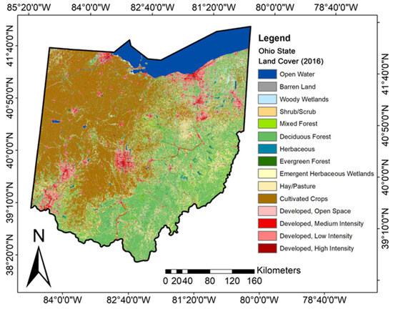
Land-Use-Land-Cover (LUCL) Classification

Slide 27
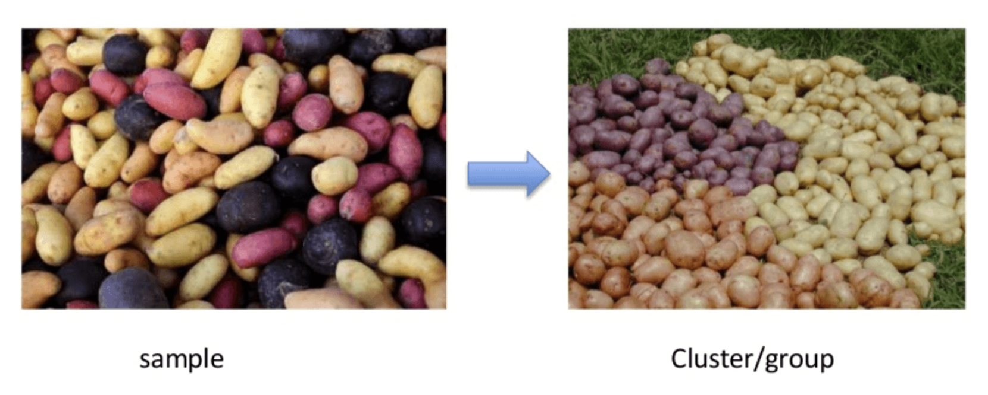
Unsupervised Learning
Feed computer data, often massive amounts, and let it find patterns.
Different statistical algorithms, such as Principal Component Analyses, clustering algorithms (e.g., k-means)

Slide 28
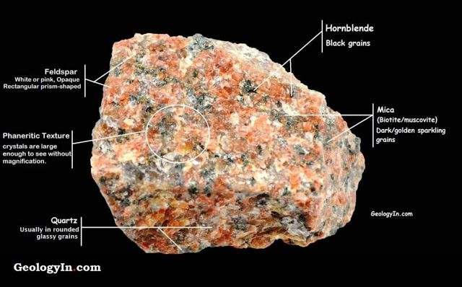
Unsupervised Learning
Find different mineral facies in images of rocks

Slide 29
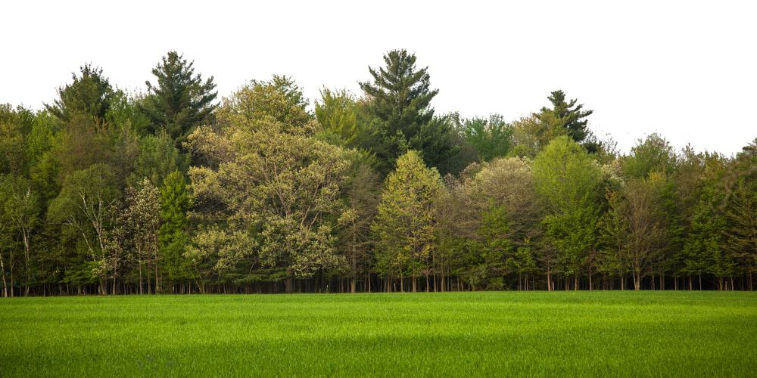
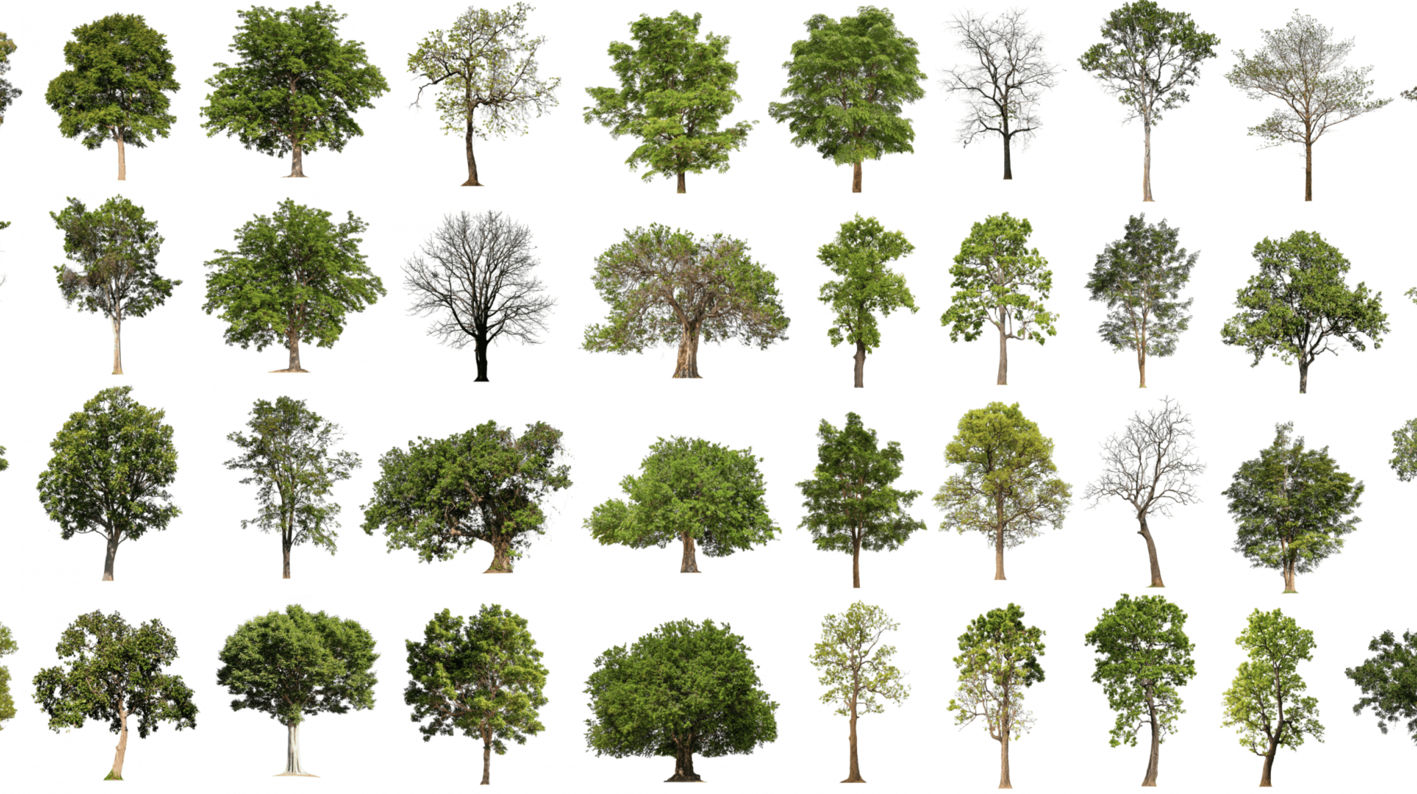
Unsupervised Learning
Identify different tree categories

Slide 30
Supervised Learning
Identify different specific tree species, learn from labeled training data
Make predictions for new input data
Compute error and optimize
Provide more labeled training data
iterate
birch
oak
aspen
birch
oak
hickory

Slide 31
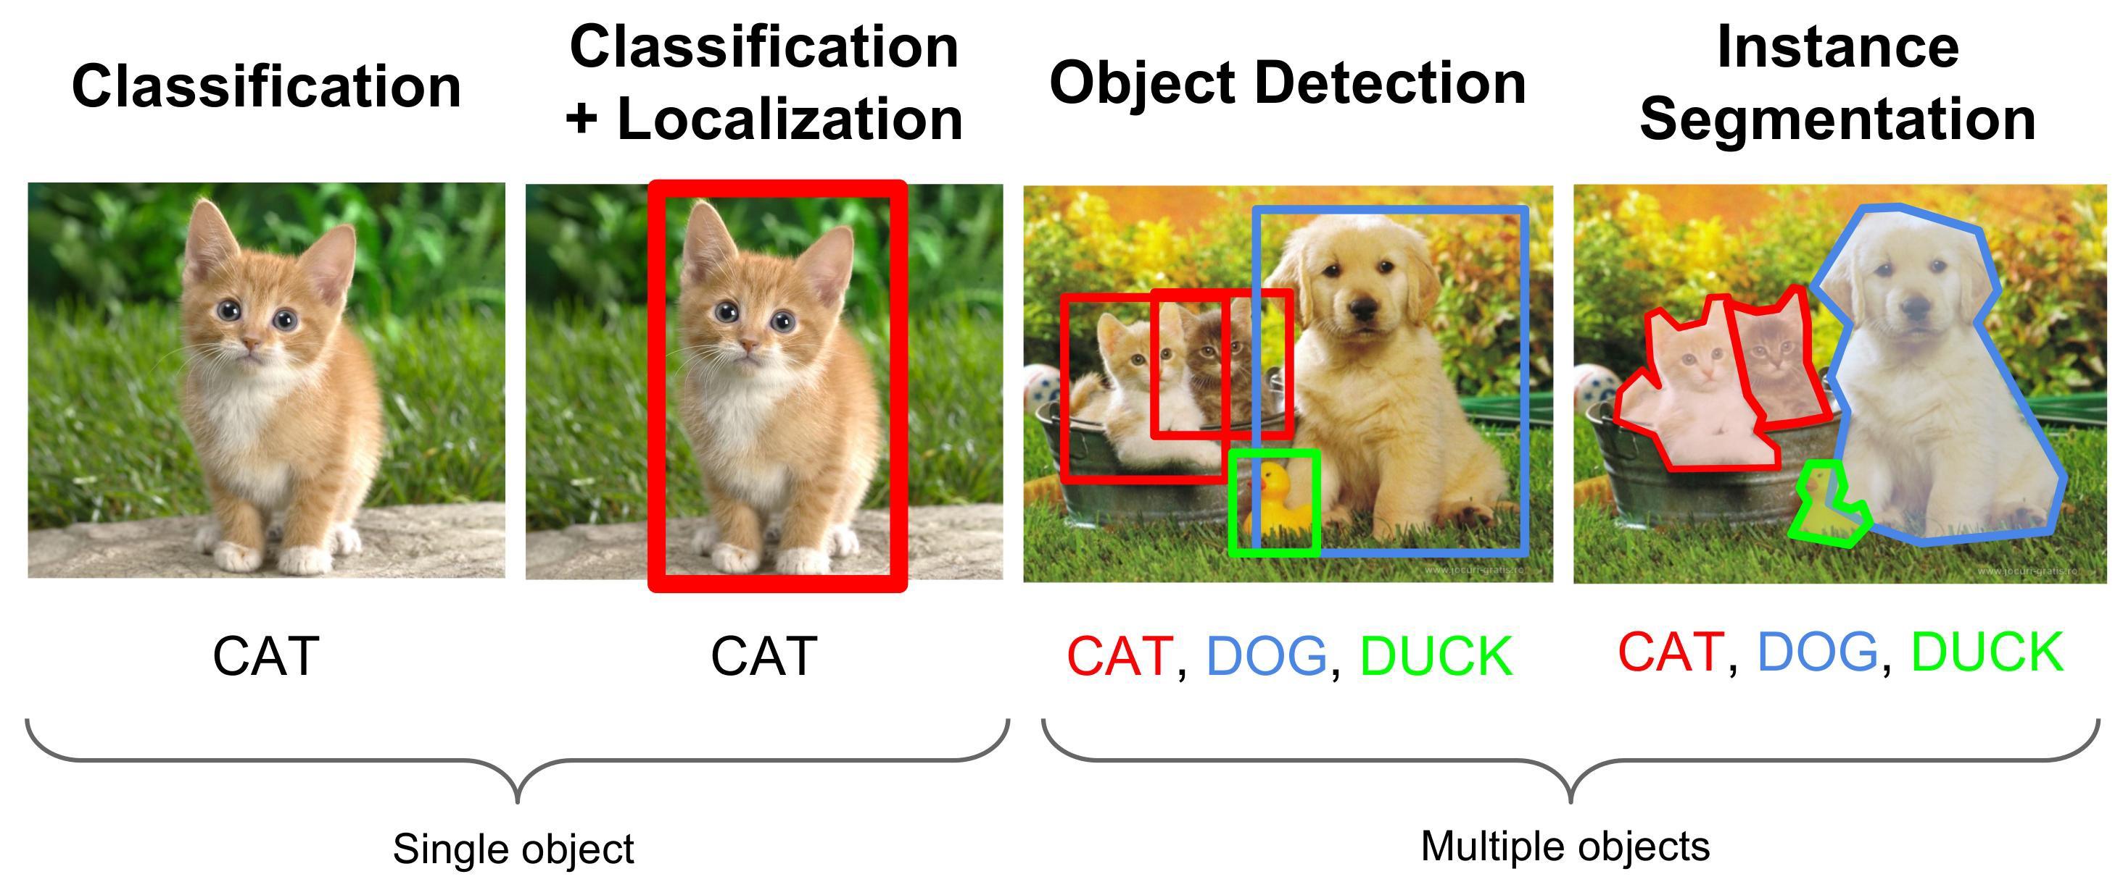
Supervised learning in computer vision
Tasks of increasing complexity in computer vision

Slide 32
How machine learning works
Decision process: based on labeled or unlabeled input data, make numerical or classification prediction
Error/loss/cost function: evaluate accuracy of predictions
Model optimization: reduce errors between predictions and known values by autonomously adjusting fitting weights

Slide 33
Underfitting and overfitting
Underfitting: model/hypothesis is not complex enough to fit data.
  Example: fitting linear function to quadratic data
Overfitting: model is too complex for data.
  Example: fitting quadratic, or higher polynomial, function to linear data
Test: how well does model perform on new data, especially extrapolating
To reduce overfitting, use simple model and/or increase training data
‘Feature engineering’ and regularization

Slide 34
What’s next?
Today/Thursday: Lab time to familiarize with Jupyter and Python
Follow tutorial instructions on Canvas.
Complete “Getting to Know You” Quiz on Carmen
Next week: First ML algorithms for Linear Regression

