Slide 1
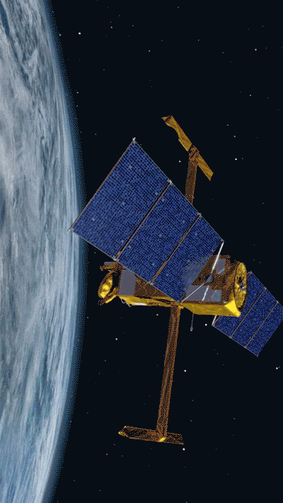
Lecture 2
Linear Numerical Regression

Slide 2
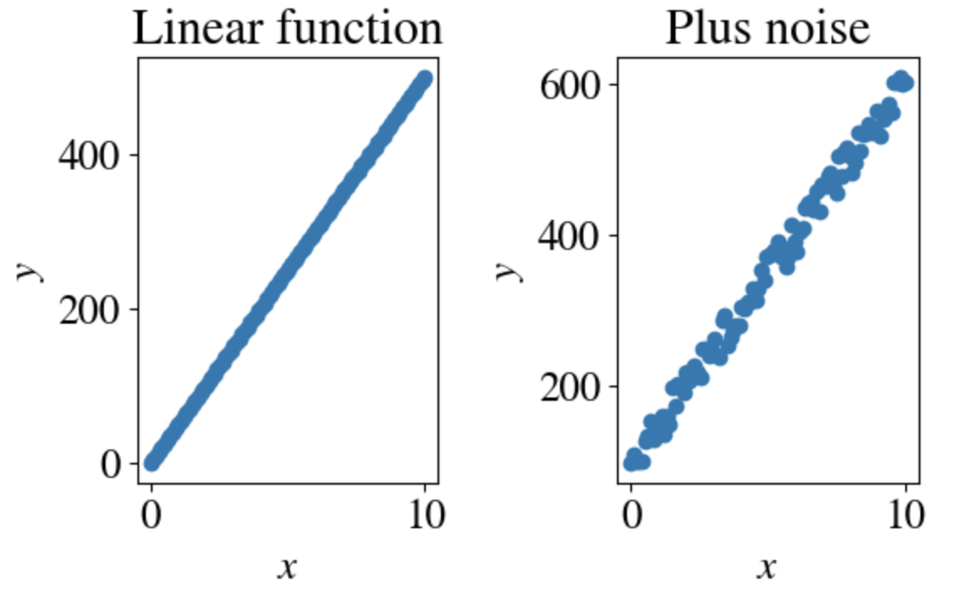
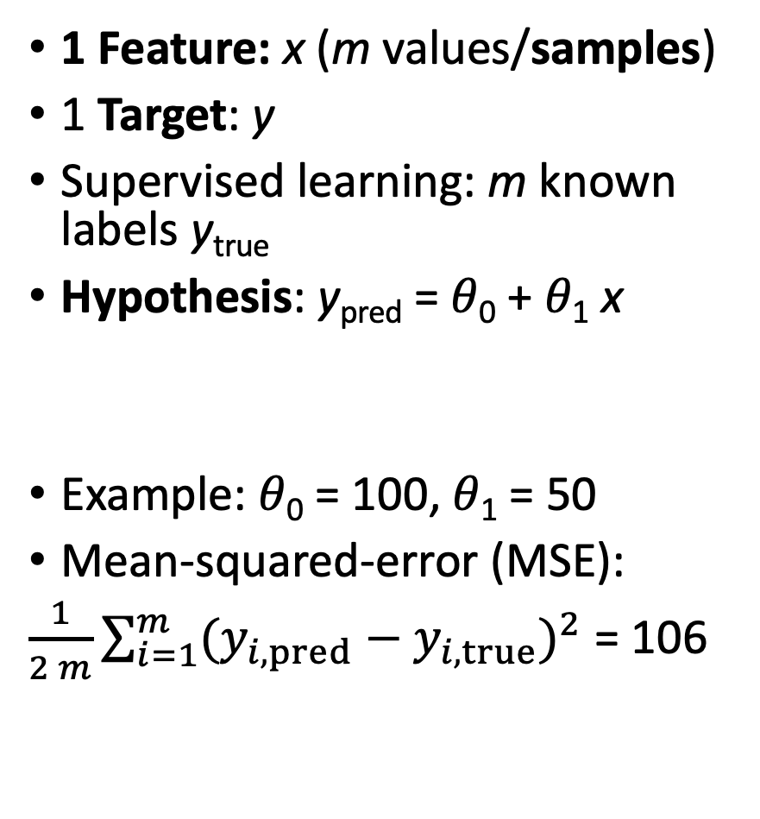
Problem Statement
1 Feature: x (m values/samples)
1 Target: y
Supervised learning: m known labels y_{true}
Hypothesis: y_{pred} = 𝜃₀ + 𝜃₁ x
Example: 𝜃₀ = 100, 𝜃₁ = 50
Mean-squared-error (MSE):
$\frac{1}{2 m}\sum_{i=1}^{m}{{(y_{i,pred}−y_{i,true})}^{2}}$ = 106

Slide 3
Objective of Linear Regression:
Fit linear function to (generally noisy) data, i.e.:
Find slope (𝜃₁ ) & intersect (𝜃₀) with smallest MSE between y_{true} and y_{pred} = 𝜃₀ + 𝜃₁ x for feature x.
How?

Slide 4
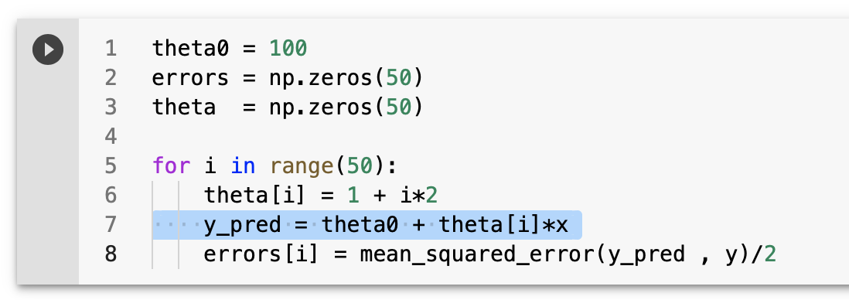
Brute force fit of slope
Simplest example, consider known intercept 𝜃₀ = 100 and only fit 𝜃₁:

Slide 5
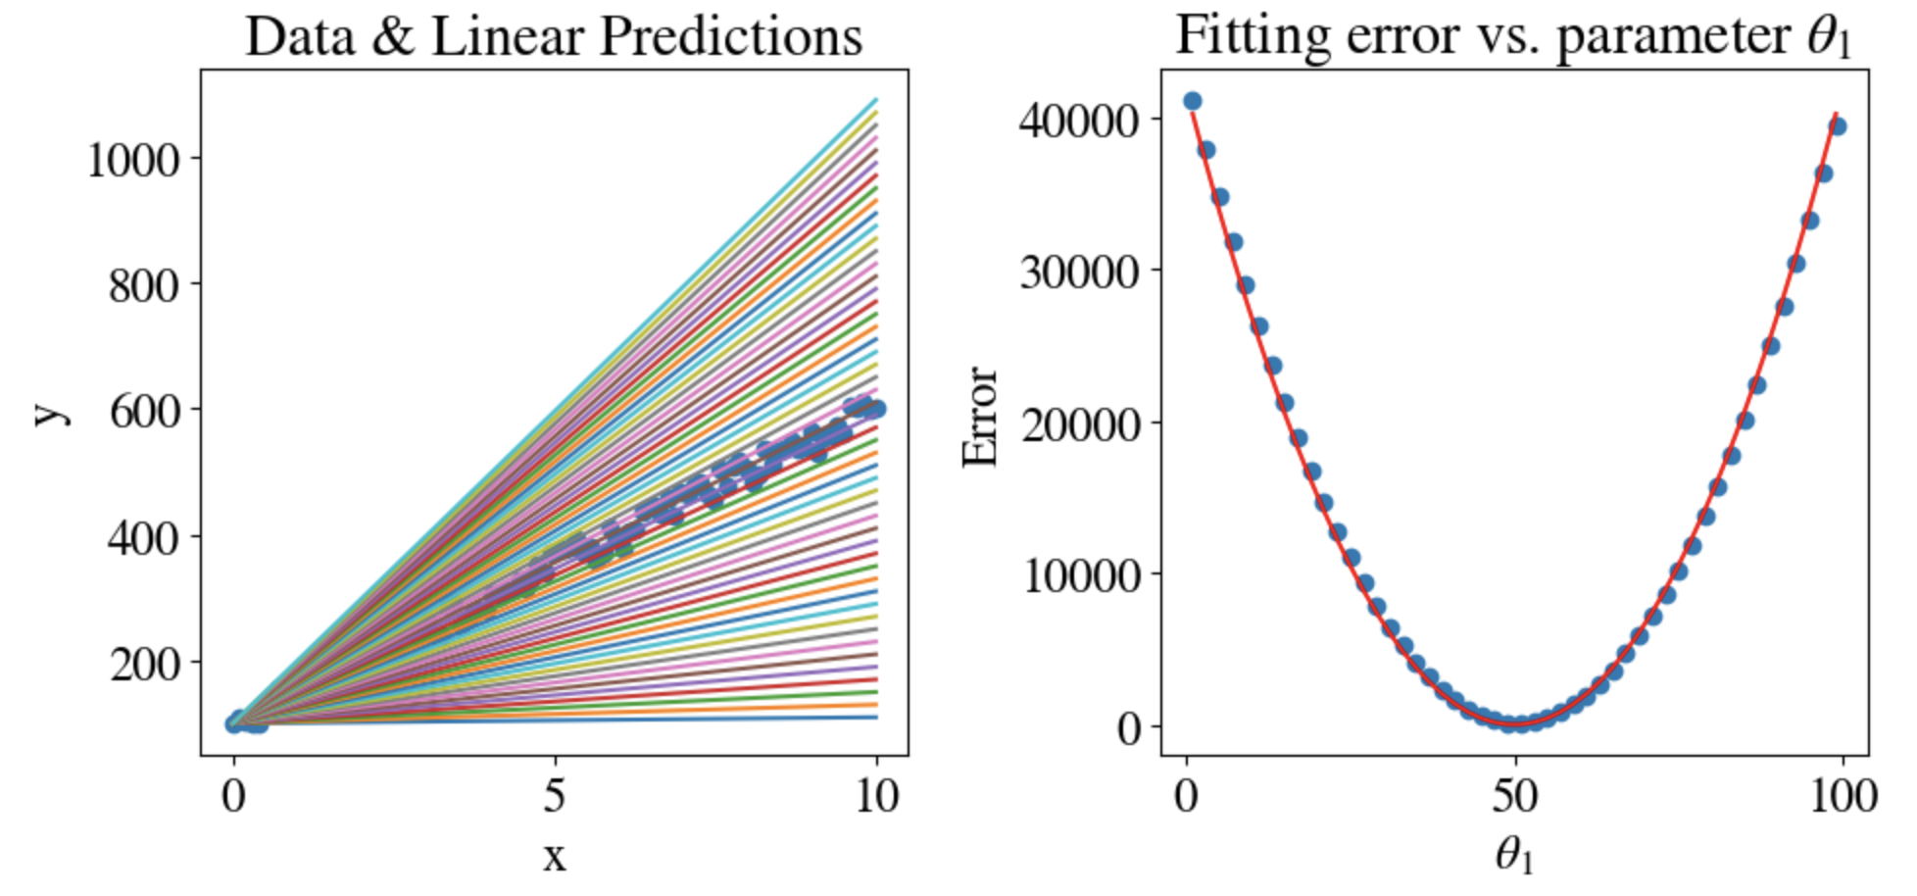
Result
Best fit: 𝜃₁ = 51.0
CPU time: 650 ms
MSE = 105.8

Slide 6
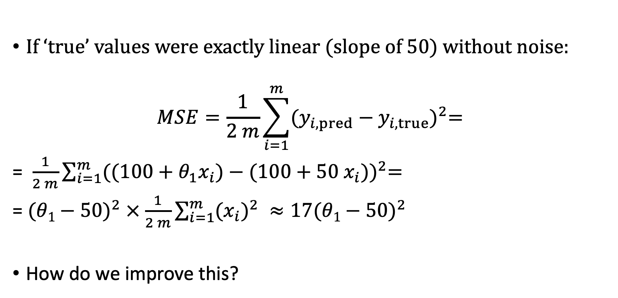
Interpretation of error plot
If ‘true’ values were exactly linear (slope of 50) without noise:
$$MSE=\frac{1}{2 m}\sum_{i=1}^{m}{{(y_{i,pred}−y_{i,true})}^{2}= }$$
= $\frac{1}{2 m}\sum_{i=1}^{m}{{(({100+θ_{1}x}_{i})−{(100+50 x}_{i}))}^{2}= }$
= ${(θ1−50)}^{2} ×$ $\frac{1}{2 m}\sum_{i=1}^{m}{{(x_{i})}^{2} }≈17{(θ1−50)}^{2}$
How do we improve this?

Slide 7
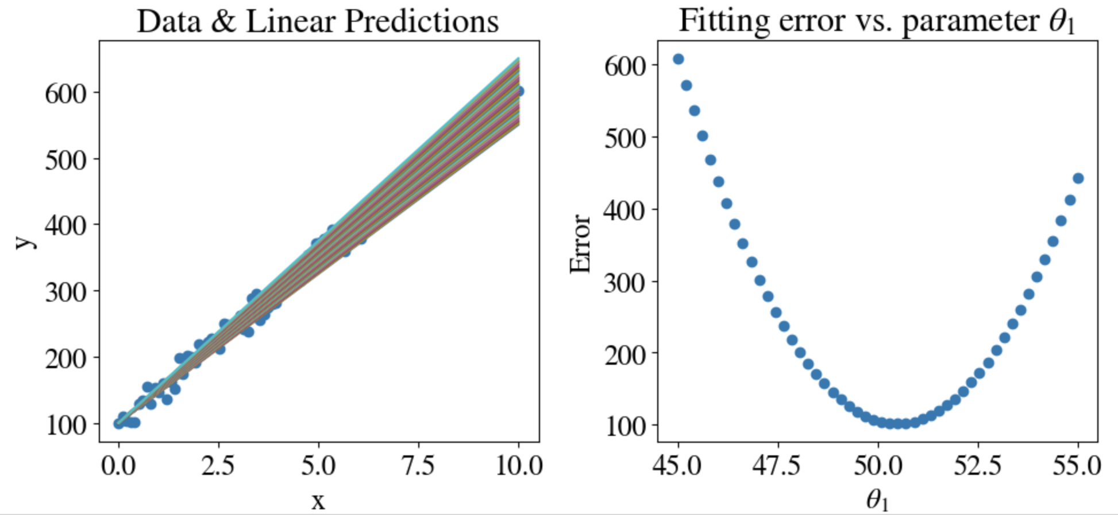
Try narrower range
Best fit: 𝜃₁ = 50.5
CPU time: 650 ms
MSE = 101.6
45 < 𝜃₁ < 55, again in 50 steps

Slide 8
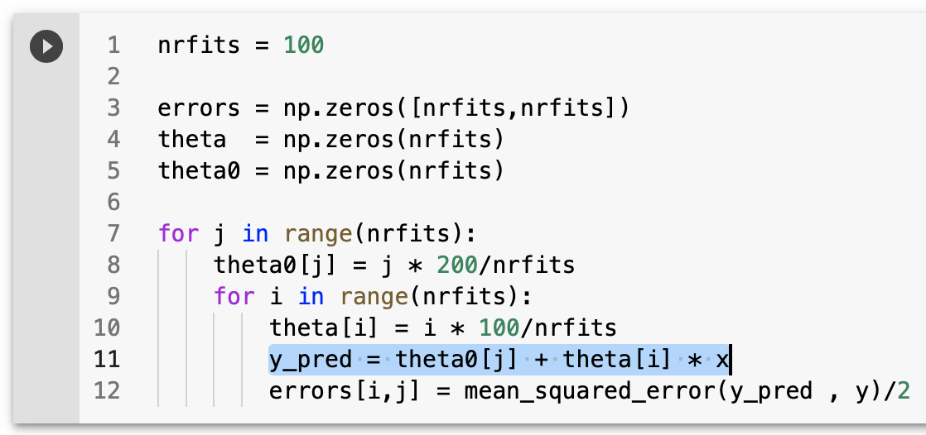
Brute force fit of slope and intercept
Better:
theta0 = np.linspace(0,200,nrfits)
theta = np.linspace(0,100,nrfits)

Slide 9
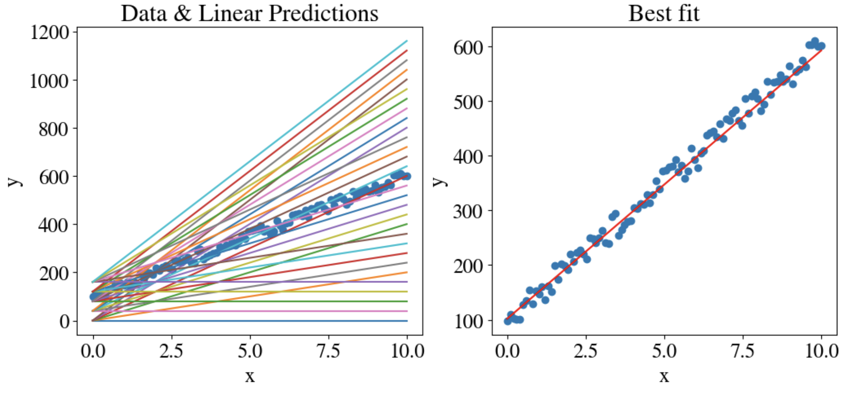
Result
Best fit: 𝜃₀ = 102, and 𝜃₁ = 49
10,000 tries
CPU time: 5.1 s
MSE = 102.2

Slide 10
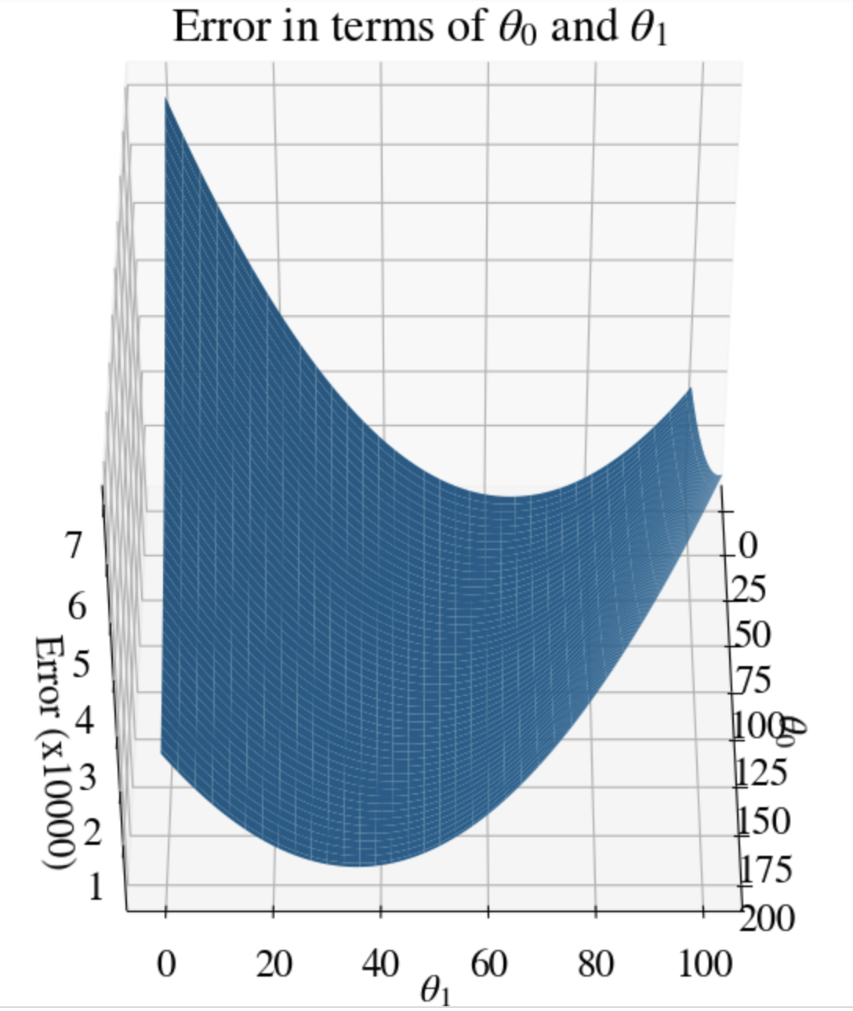
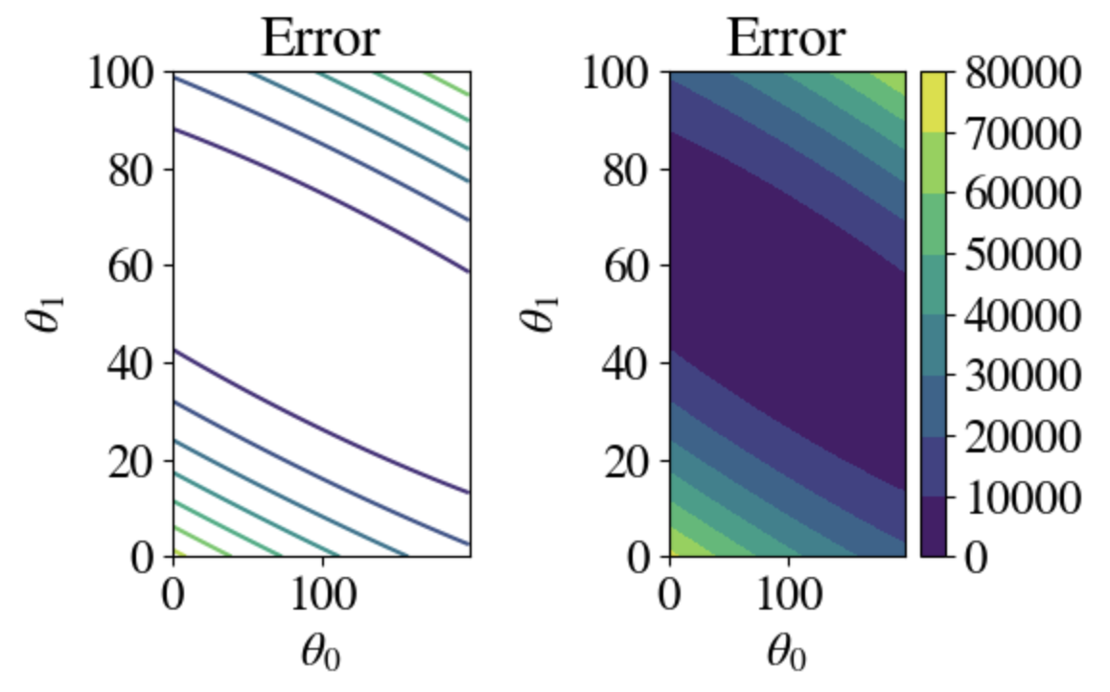
MSE in 2D

Slide 11
Gradient Descent Method

Slide 12
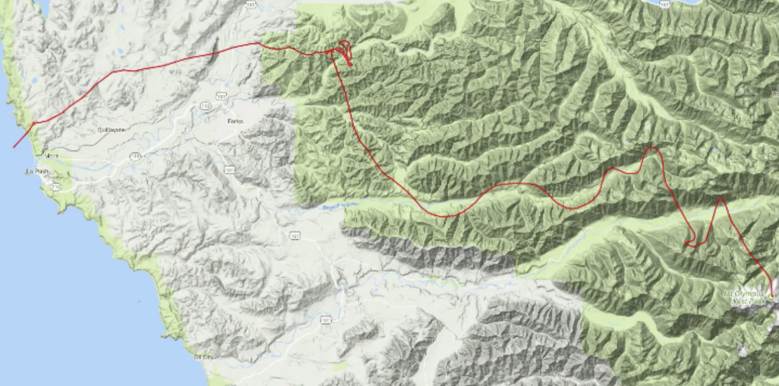
Navigating out of mountainous terrain

Slide 13
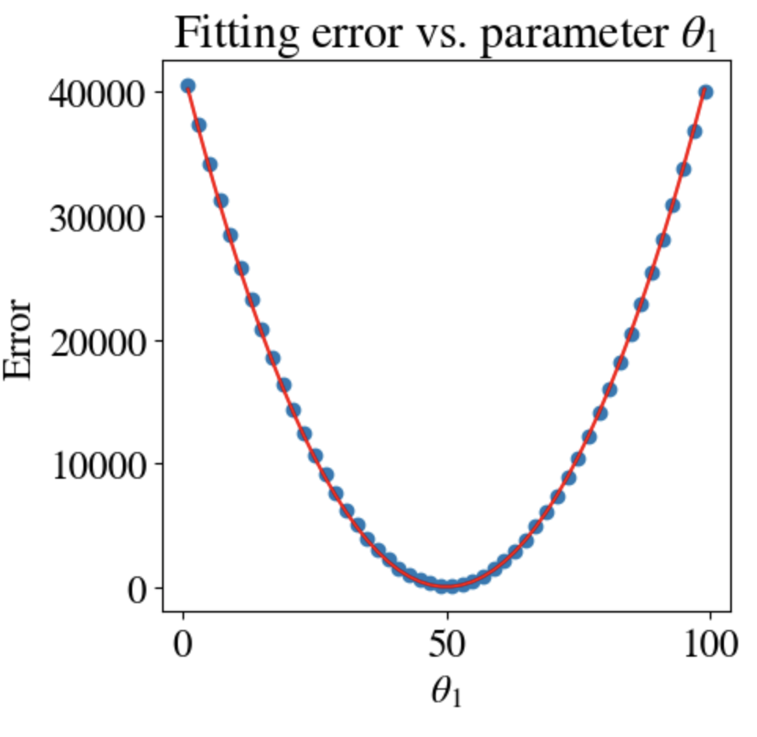
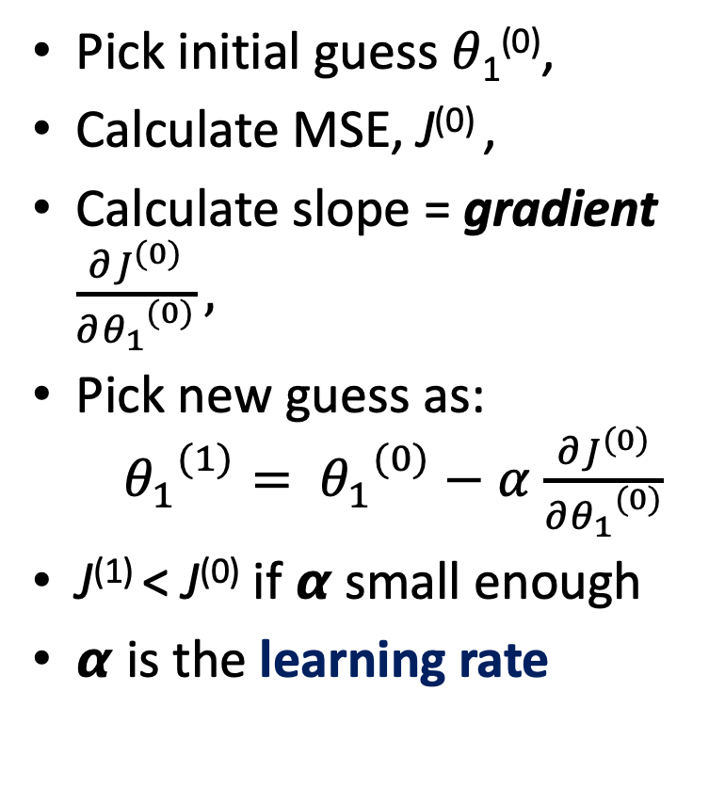
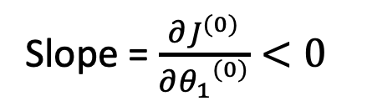
Pick initial guess 𝜃₁⁽⁰⁾,
Calculate MSE, J⁽⁰⁾ ,
Calculate slope = gradient $\frac{∂J^{(0)}}{∂{θ_{1}}^{(0)}},$
Pick new guess as: ${{ θ}_{1}}^{(1)}= {θ_{1}}^{(0)}−α$ $\frac{∂J^{(0)}}{∂{θ_{1}}^{(0)}}$
J⁽¹⁾ < J⁽⁰⁾ if 𝞪 small enough
𝞪 is the learning rate
J⁽⁰⁾
Slope = $\frac{∂J^{(0)}}{∂{θ_{1}}^{(0)}}<0$
𝜃₁⁽⁰⁾
𝜃₁⁽¹⁾

Slide 14
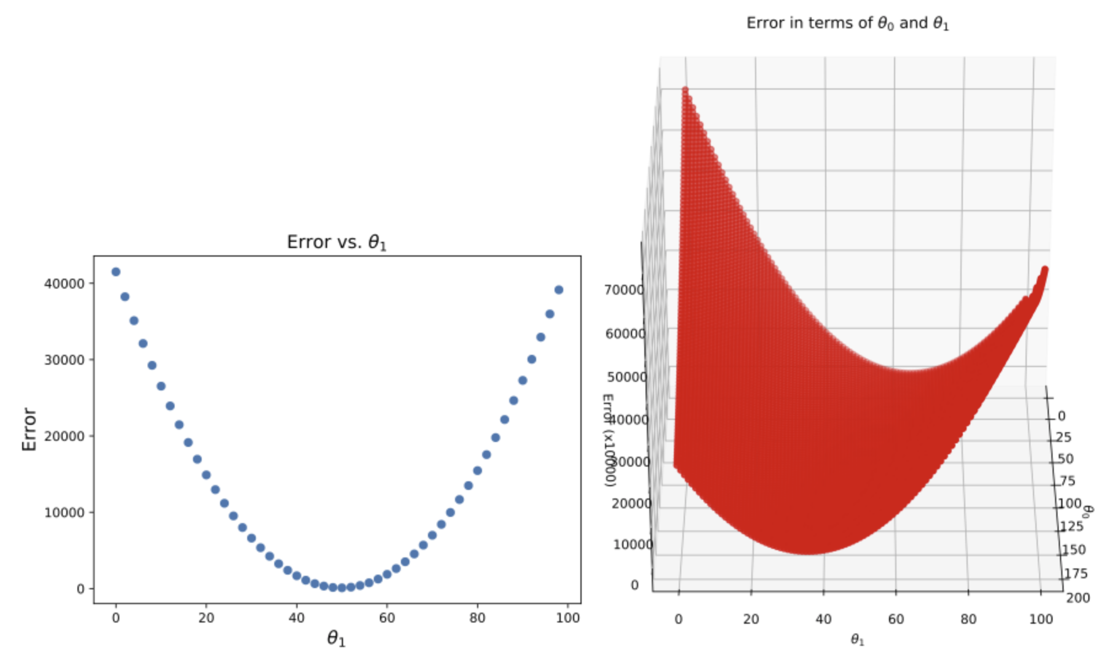
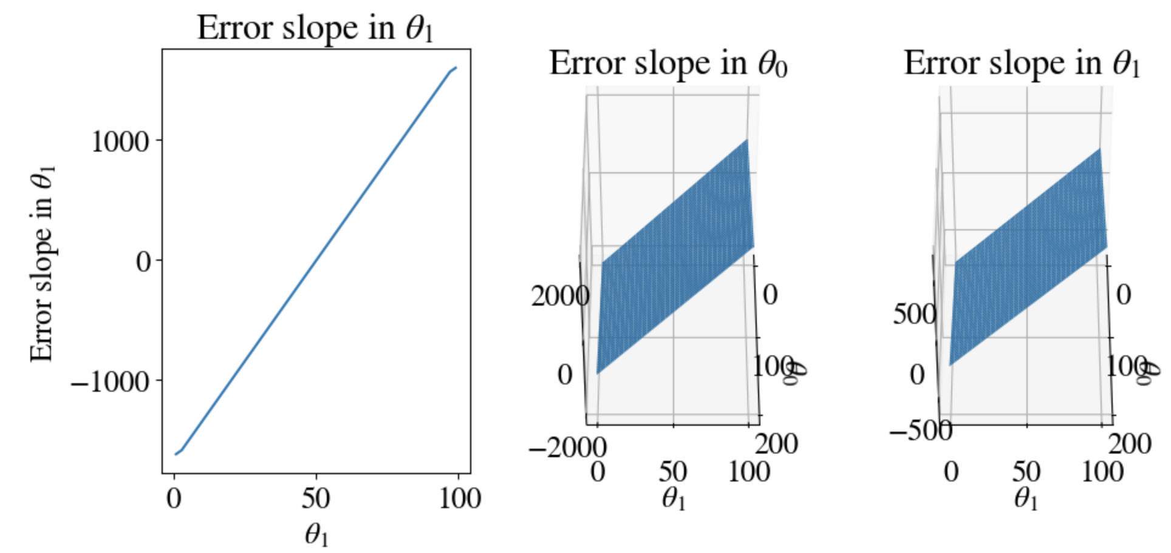
Use derivative
MSE is quadratic in 𝜃₀ and 𝜃₁, so slope/gradient of errors is linear in 𝜃₀ and 𝜃₁

Slide 15
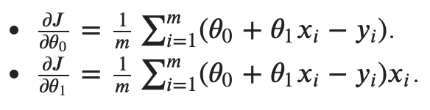
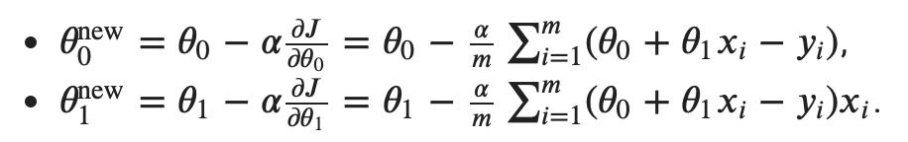
Explicit equations

Slide 16
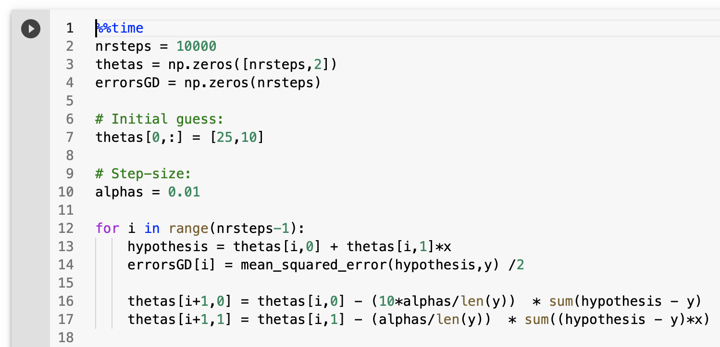
Python code
Still using many steps
Note: examples all start with ‘bad’ initial guess
Learning rate (hyper-parameter)
Only 1 loop!
Cheating with
10x learning rate

Slide 17
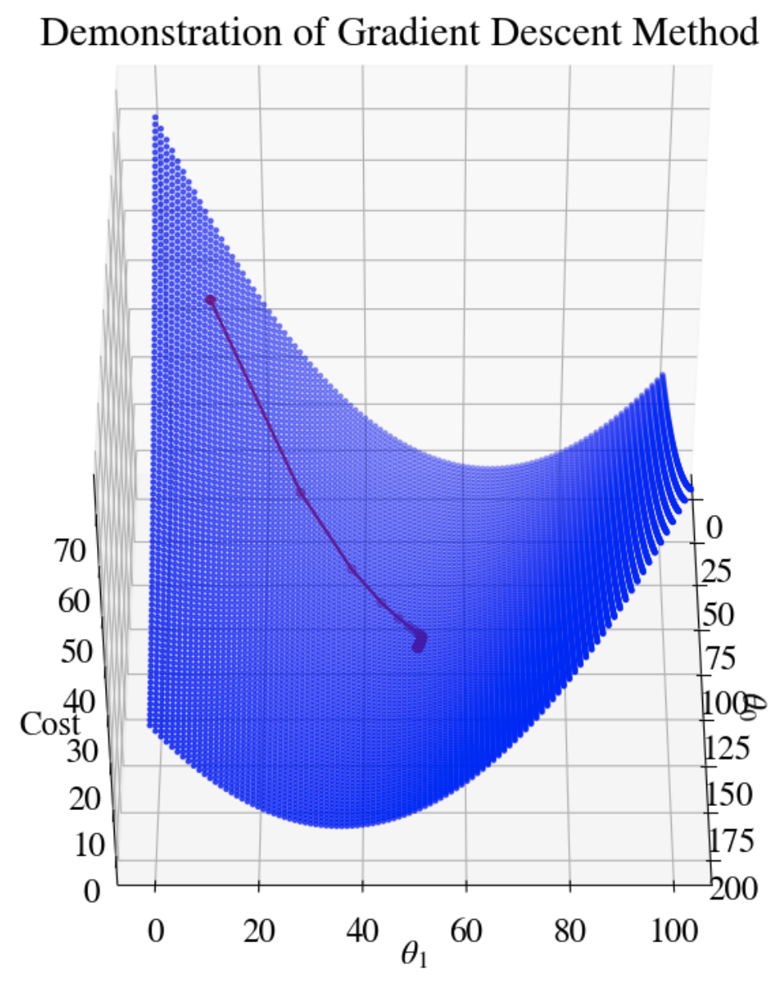
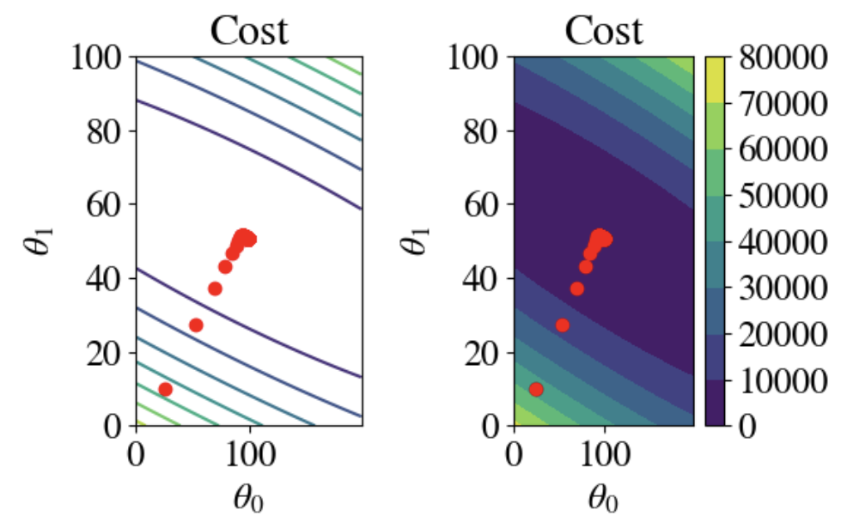
How did we do?
Best fit: 𝜃₀ = 89.9, and 𝜃₁ = 50.7
10,000 tries
CPU time: 3.6 s
MSE = 101.4

Slide 18
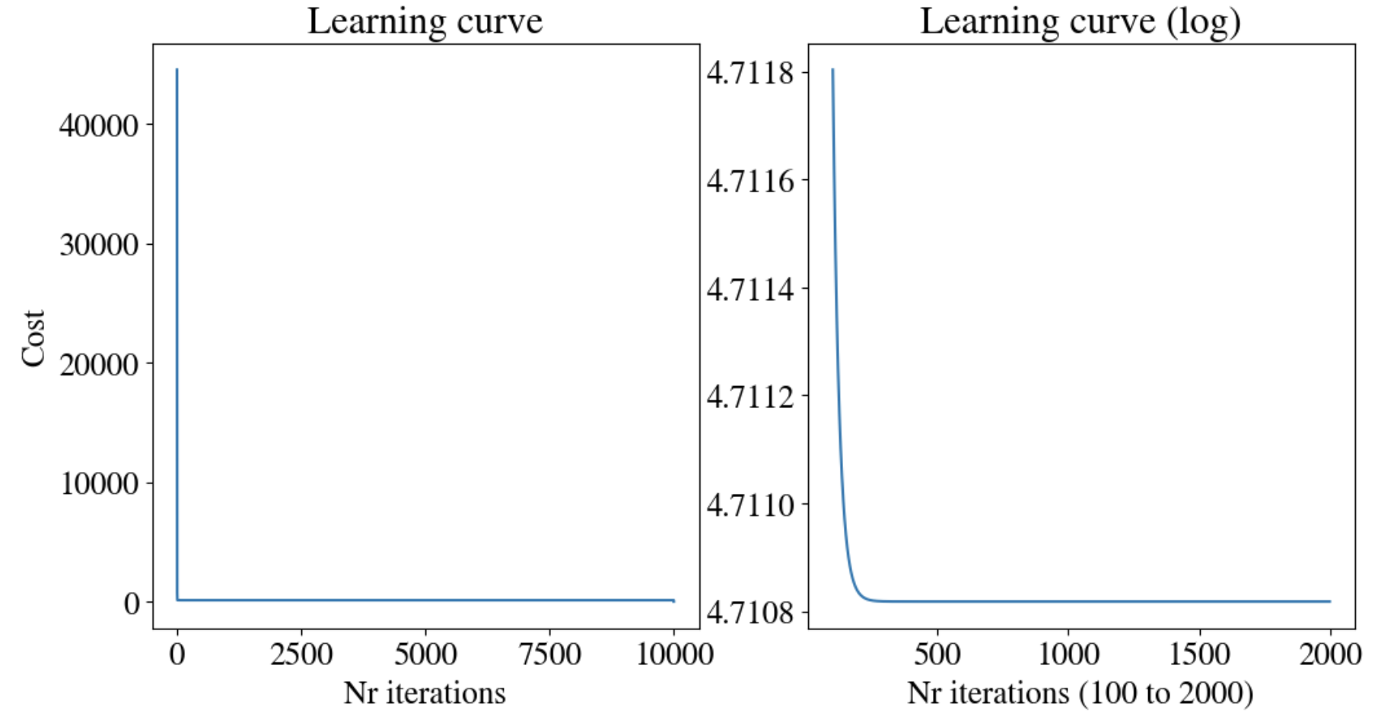
Learning curve
Plot error as function of nr of iterations
Clearly, best fit was already found after few iterations

Slide 19
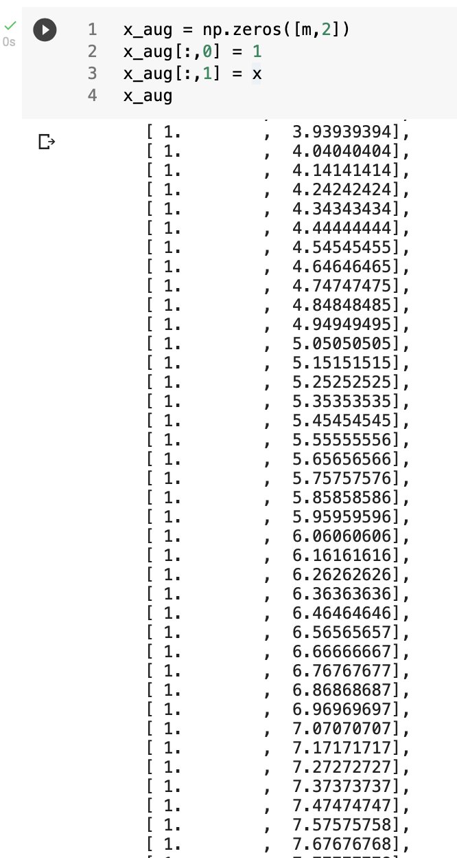

Vectorization
Add a column of all ones to the feature array x (‘bias’)
Define 2-element vector 𝜃 = [𝜃₀ , 𝜃₁ ]
Then hypothesis (prediction) becomes simply:
Vector y = h(x, 𝜃 ) = x ∙ 𝜃
And 2D gradient is
$\left(\frac{∂J}{∂θ_{0}},\frac{∂J}{∂θ_{1}}\right)=∇J=\left(h\left(x,θ\right)−y\right)⋅x=\left(x⋅θ−y\right)⋅x$

Slide 20
Python code for non-vectorized GD

Slide 21
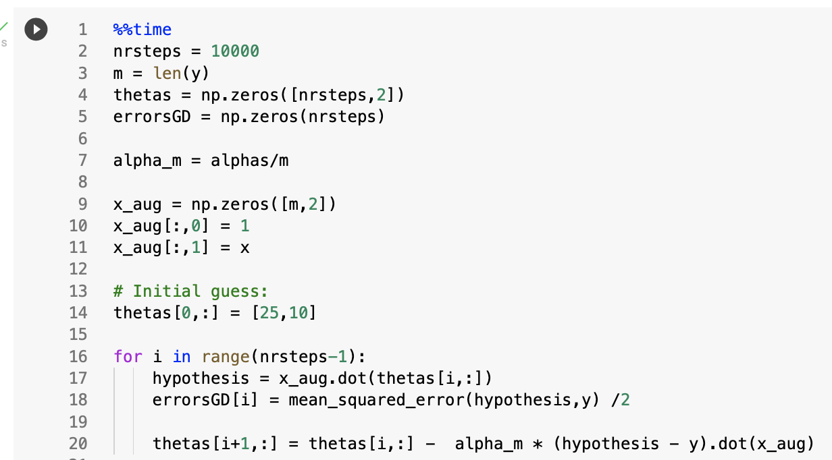
Python code for vectorized gradient descent

Slide 22
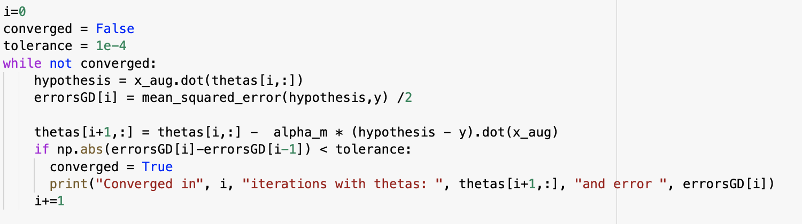
One more optimization
Track changes, i.e., incremental reduction in MSE error, and stop when error is below certain tolerance (‘while-loop’):

Slide 23
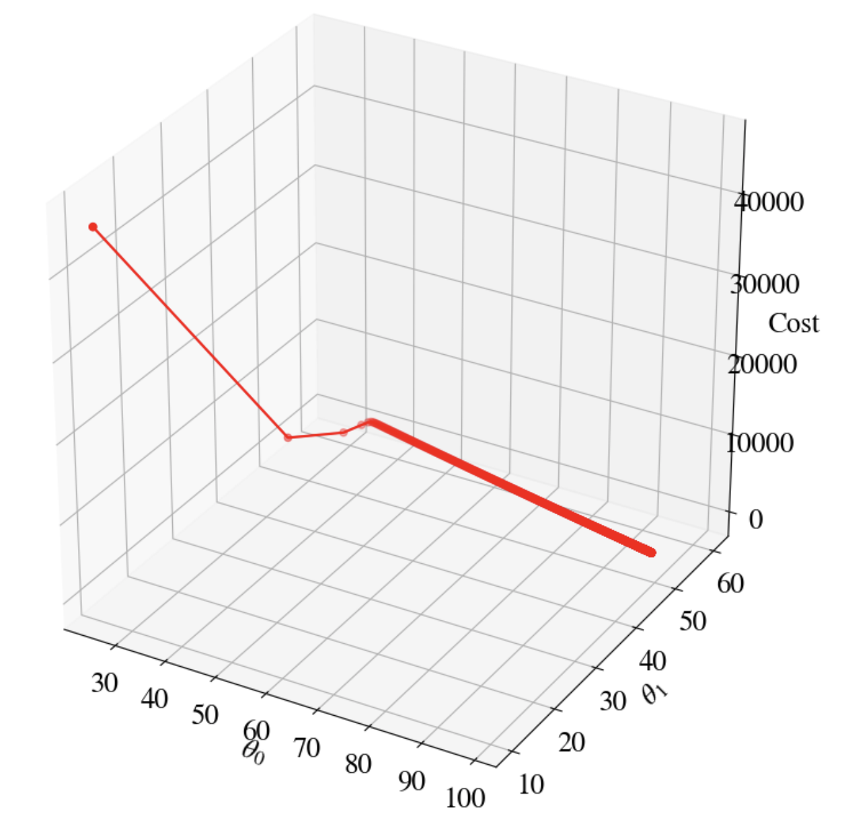
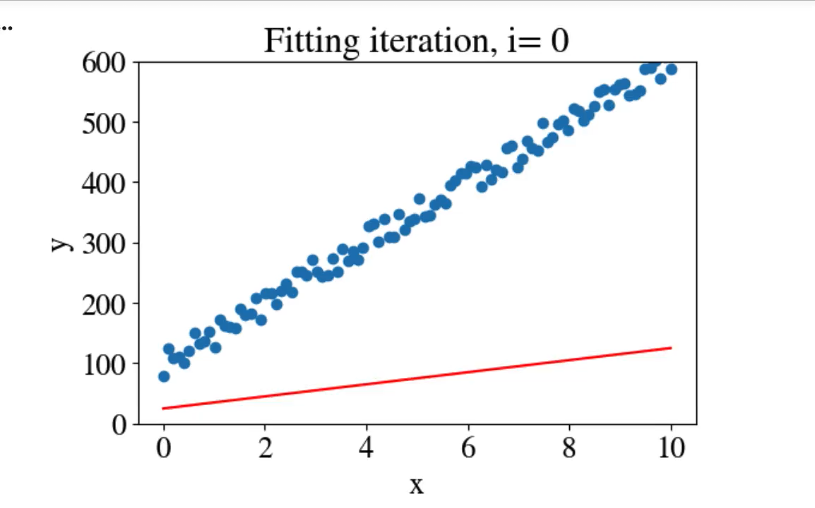
How did we do?
Best fit: 𝜃₀ = 98.7, and 𝜃₁ = 50.7
10,000 tries => 1,099 tries
CPU time: 5.1 s => 248 ms
MSE = 102.2 => 101.4

Slide 24
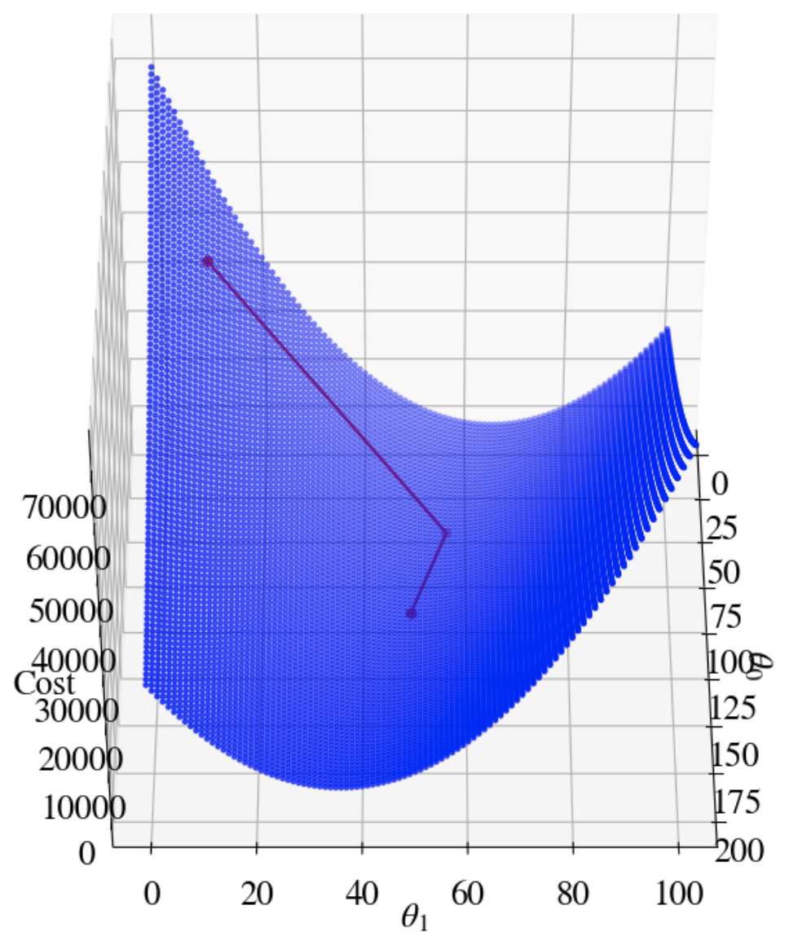
Even faster!
Use second derivative to determine adaptive learning rate 𝝰
(Truncated) Newton method
Best fit: 𝜃₀ = 98.9, and 𝜃₁ = 50.7
10,000 tries => 2 steps (!!!)
CPU time: 5.1 s => 5 ms (1/1000×)
MSE = 102.2 => 101.4

Slide 25
Stochastic Gradient Descent

Slide 26
Stochastic Gradient Descent
Many ML problems involve (many) thousands of features (columns of input data) and millions of data points (rows of input data)
Gradient Descent can require too much RAM
Key idea behind stochastic GD: Only fit to 1 point at a time!
  Initial guess of slope and intercept 𝜃 = [𝜃₀⁽⁰⁾ , 𝜃₁⁽⁰⁾ ]
  Randomly pick a point (x_{i}, y_{i,true}) and predict target y_{i,pred} = 𝜃₀⁽⁰⁾ + 𝜃₁⁽⁰⁾ x_{i}
  Compute MSE error J⁽⁰⁾ and its derivatives, only w.r.t. that single point
  Update fitting parameters to 𝜃 = [𝜃₀⁽¹⁾ , 𝜃₁⁽¹⁾ ]
  Return to Step 2 and iterate/loop through all points x_{i}
  If accuracy is not satisfactory after looping through all points, set [𝜃₀⁽⁰⁾ , 𝜃₁⁽⁰⁾] to last values and start again from Step 1

Slide 27
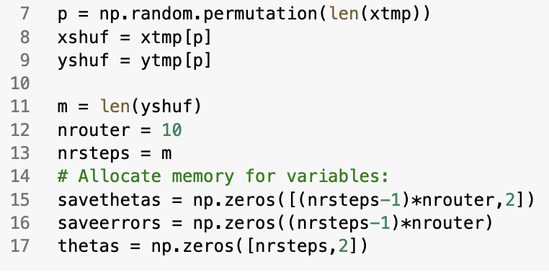
Python code I/II
Randomly shuffle (x_{i}, y_{i,true}) pairs and set aside memory for 𝜃 and errors

Slide 28
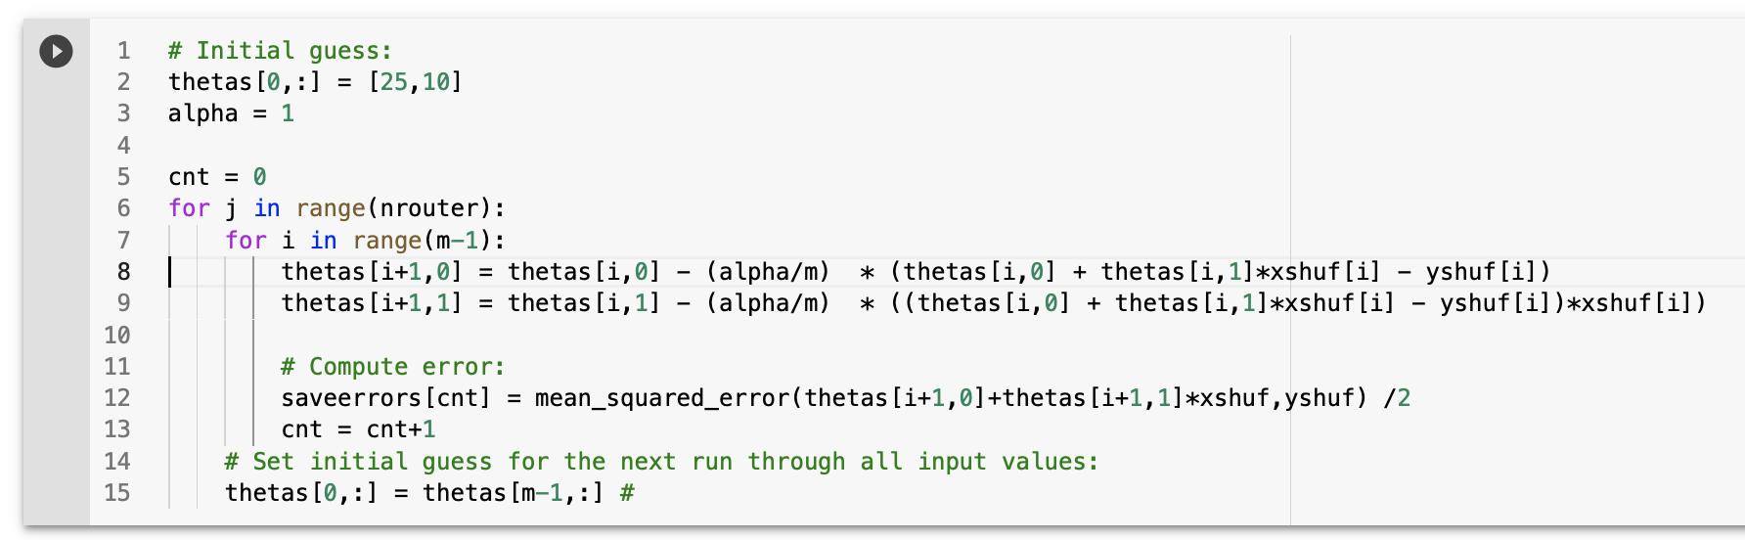
Python code II/II
Non-vectorized implementation:
Only 1 point!

Slide 29
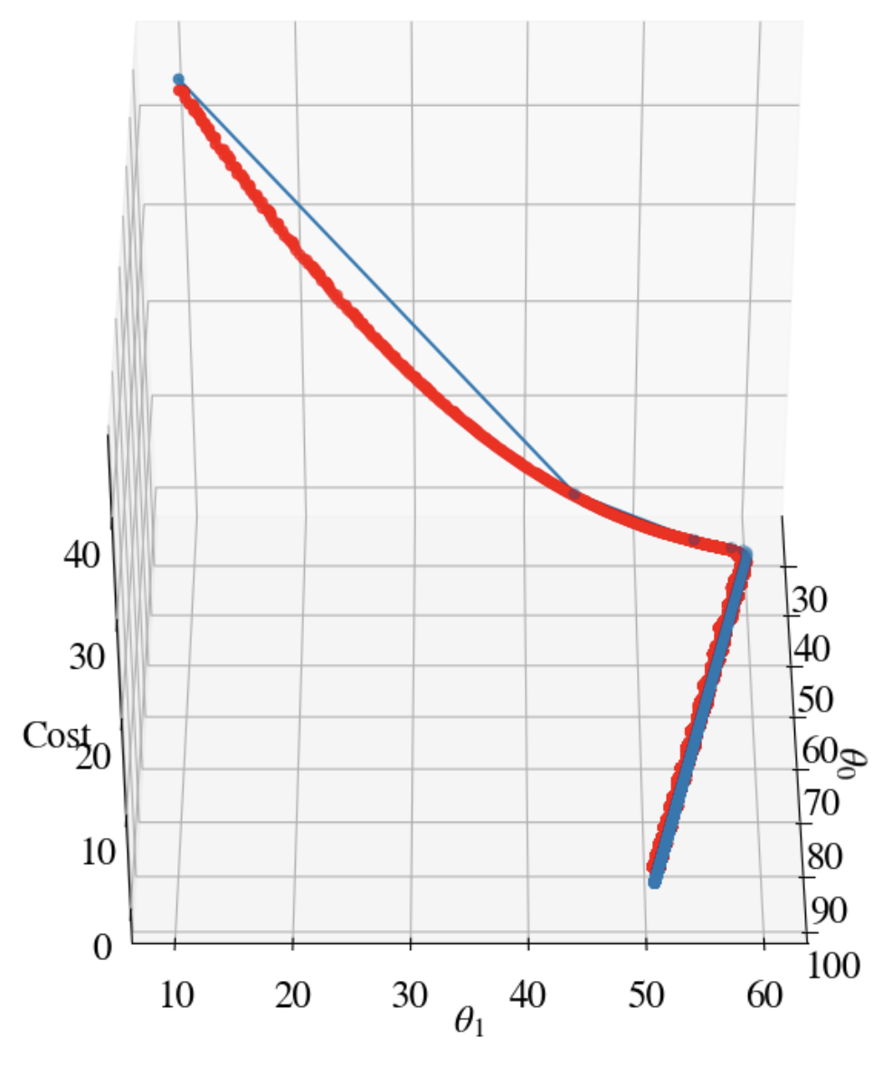
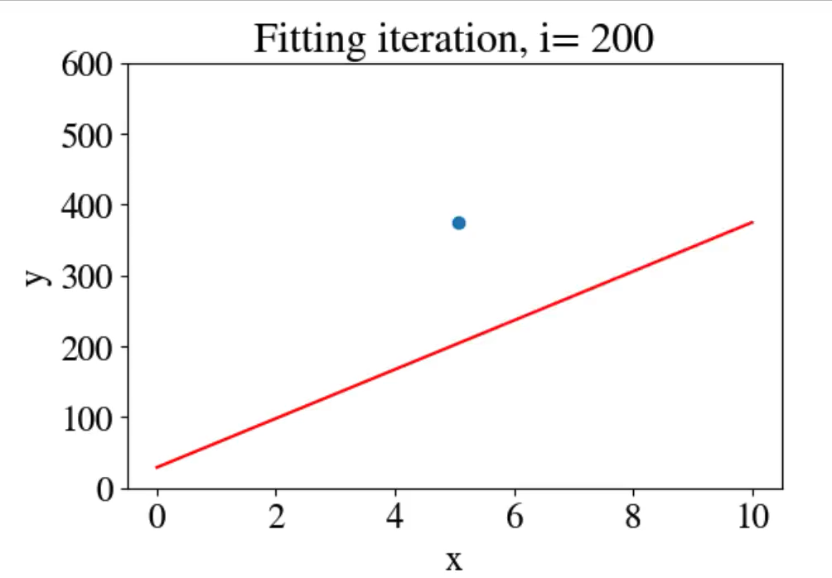
Best fit: 𝜃₀ = 94.4, and 𝜃₁ = 50.9
100,000 tries ☹
CPU time: 23 s ☹
MSE = 110.4 ☹
Regular GD
Stochastic GD

Slide 30
Mini-Batch Gradient Descent

Slide 31
Mini-Batch Gradient Descent
Best of both worlds:
Instead of fitting to all points at once (regular gradient descent), or to a single point at a time (stochastic gradient descent), fit to small mini-batches in each iteration
Example: for 1,000 data-points, loop through 100 iterations that each fit to 10 points
Repeat if error still too large (using 𝜃 from previous pass as new initial guess)

Slide 32
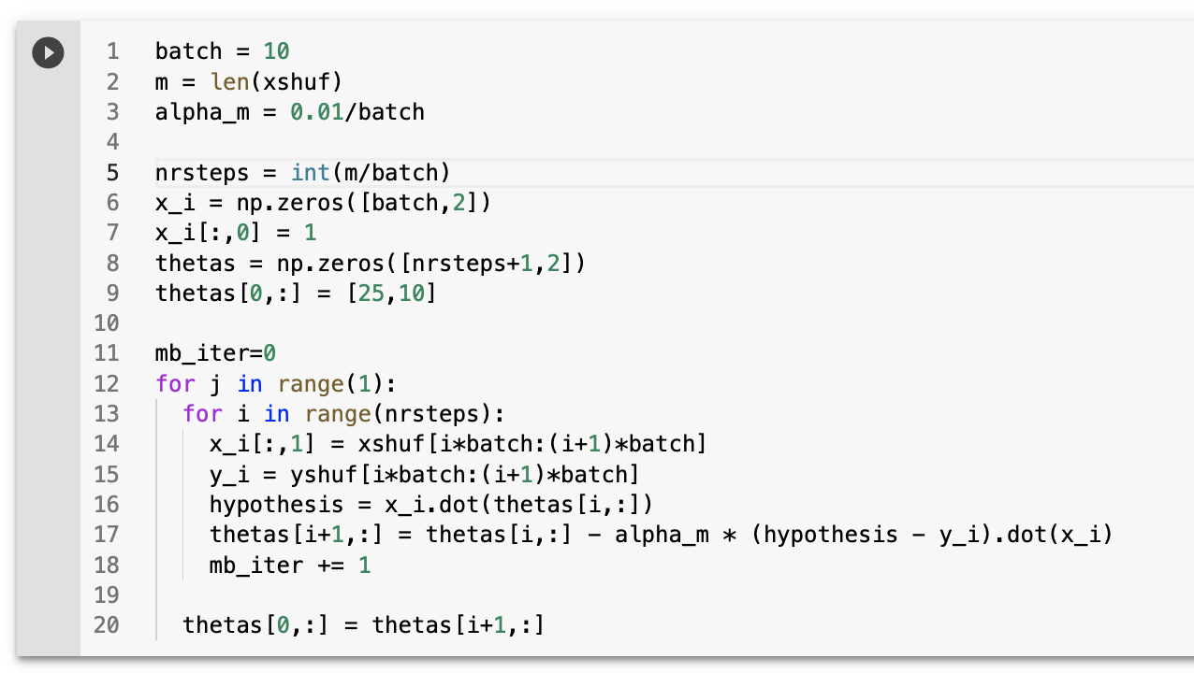
Python code
Vectorized
Batches of 10 points
Single pass
Vectorized

Slide 33
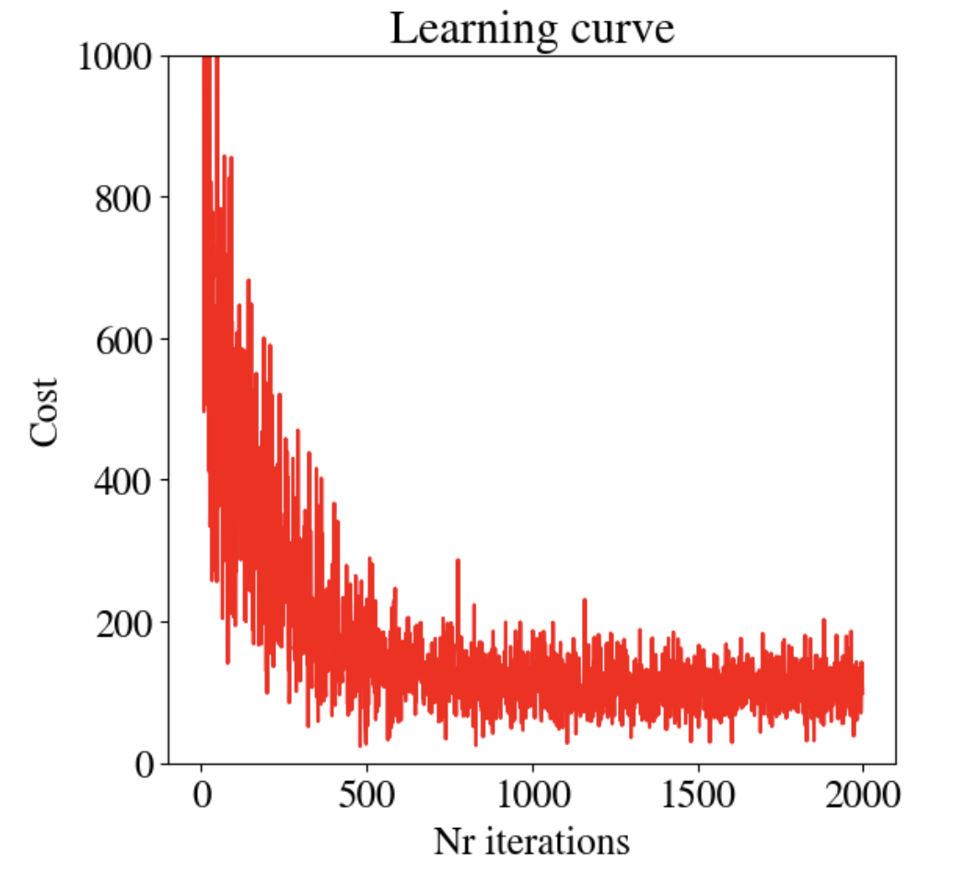
Learning curve
Noisier than before
Error for each batch of 10 points can be higher/lower, but still converge to global minimum

Slide 34
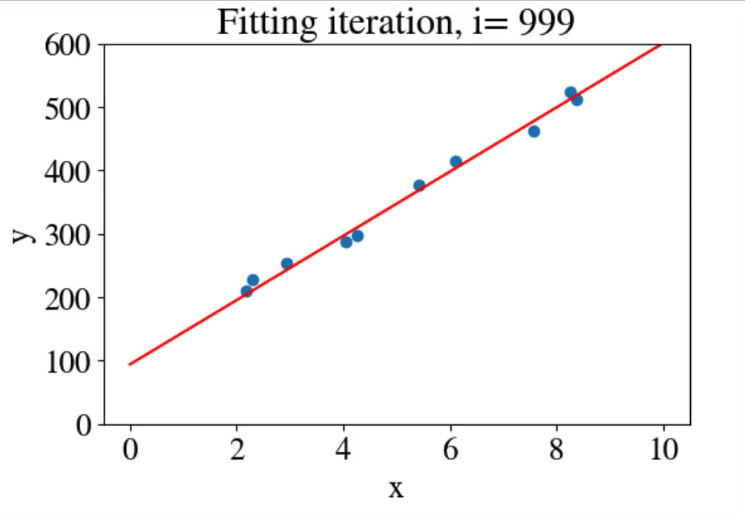
How did we do?
Two passes:
Memory efficient
CPU efficient (10× faster than vectorized regular GD)
Accurate
Best fit: 𝜃₀ = 99.4, and 𝜃₁ = 49.8
2,000 tries ☺
CPU time: 15.2 ms ☺
MSE = 107.5 ☺

Slide 35
Summary

Slide 36
Summary
Linear regression fits linear hypothesis to labeled features + targets
Double nested loop of trials for slope and intercept is inefficient
Gradient Descent methods (GD) takes advantage of error derivatives: slopes of the error landscape
Standard GD uses a user-defined learning rate that can be too small (slow convergence) or too large (overshooting)
Accelerated GD uses second derivative as adaptive learning rate
Stochastic GD fits 1 point at a time for less memory
(Mini-)Batch GD fits, say, 10 points per batch: more efficient when memory allows

