Slide 1

Lecture 4
Multivariate &
Non-Linear Numerical Regression

Slide 2
First, Multivariate Linear Regression

Slide 3
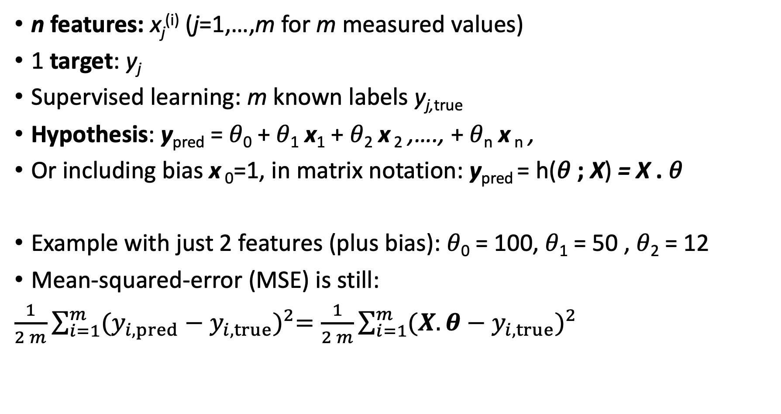
Problem Statement
n features: x_{j}^{(i)} (j=1,…,m for m measured values)
1 target: y_{j}
Supervised learning: m known labels y_{j,true}
Hypothesis: y_{pred} = 𝜃₀ + 𝜃₁ x₁ + 𝜃₂ x ₂ ,…., + 𝜃_{n} x _{n} ,
Or including bias x ₀=1, in matrix notation: y_{pred} = h(𝜃 ; X) = X . 𝜃
Example with just 2 features (plus bias): 𝜃₀ = 100, 𝜃₁ = 50 , 𝜃₂ = 12
Mean-squared-error (MSE) is still:
$\frac{1}{2 m}\sum_{i=1}^{m}{{(y_{i,pred}−y_{i,true})}^{2}=\frac{1}{2 m}\sum_{i=1}^{m}{{(X.θ−y_{i,true})}^{2}}}$

Slide 4
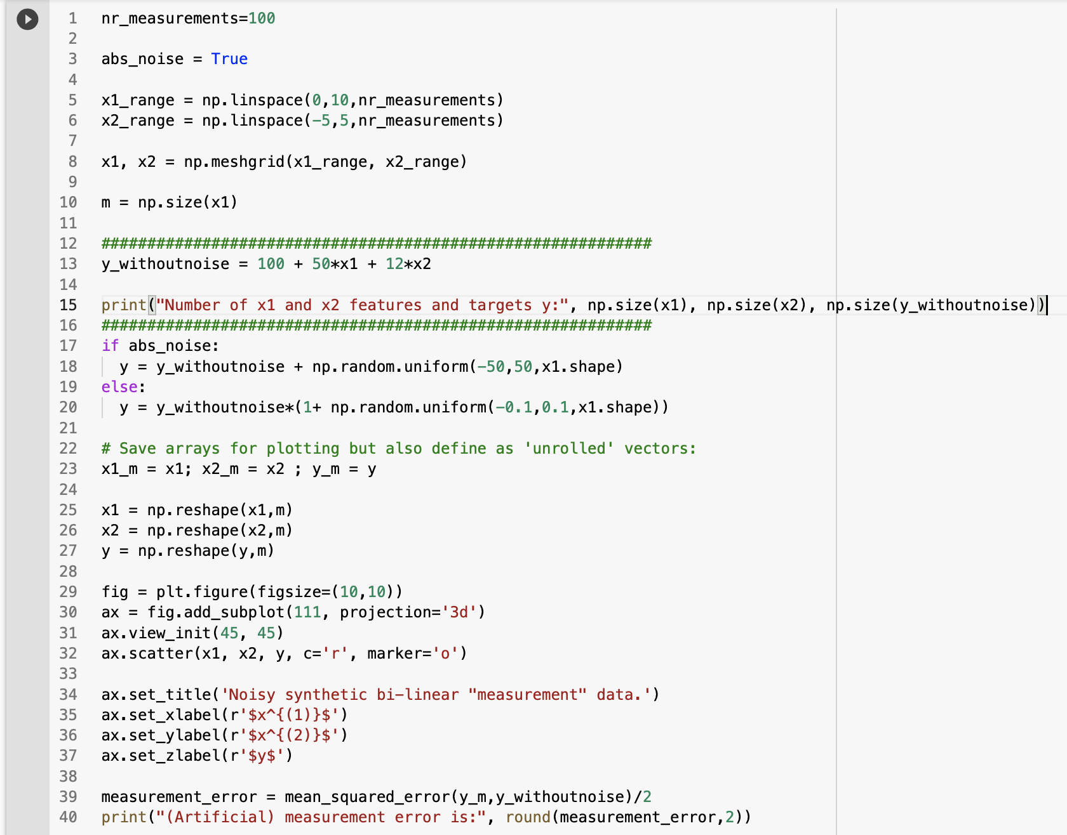
100 values of each feature
100 × 100 = 10,000 combinations
Example linear function in 2 features
10,000-length feature vectors

Slide 5
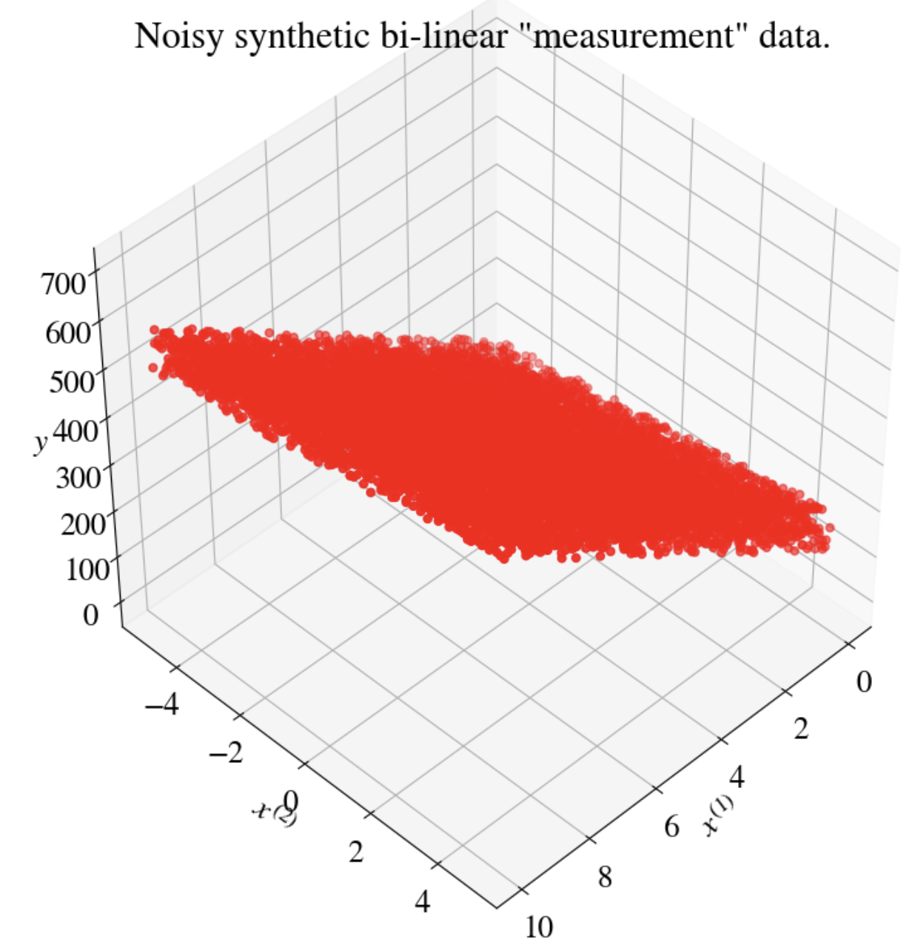
Plot of data
Experimental error:
MSE = 420.6

Slide 6
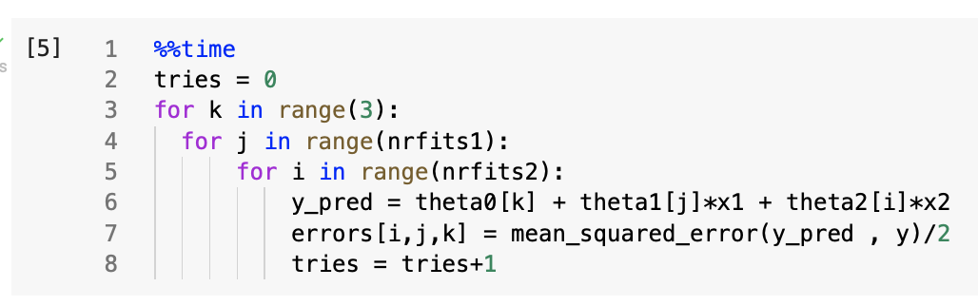
Brute force fitting
3 nested loops,
100 values each of intercept and 2 slopes = 1,000,000 possible combinations!
Instead, for visualization, only try 3 intercepts (30,100,150)
Results:
  𝜃₀ = 100, 𝜃₁ = 49.6, 𝜃₂ = 12
  MSE = 414.3
  CPU time = 18 s ☹

Slide 7
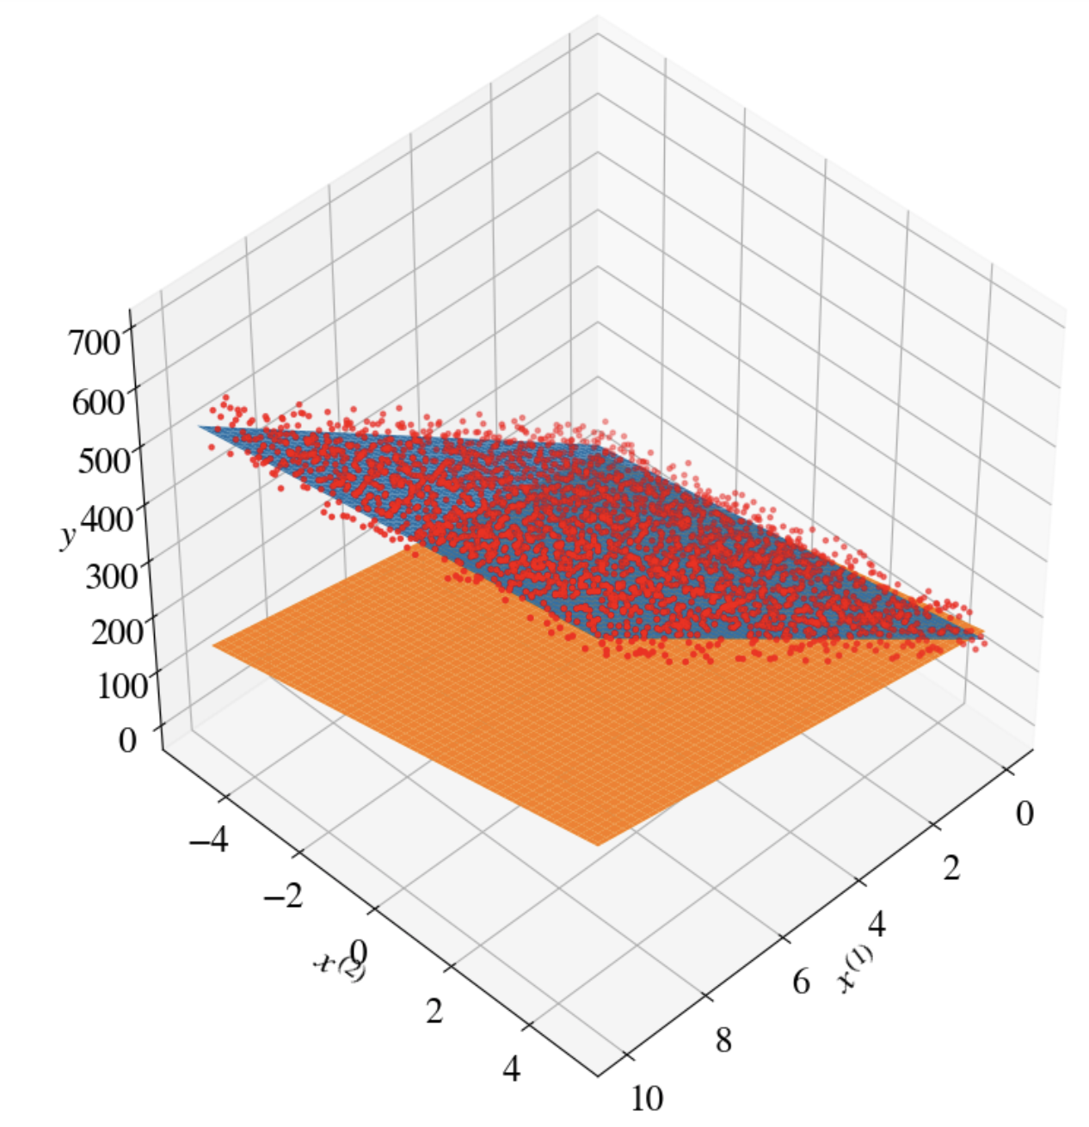
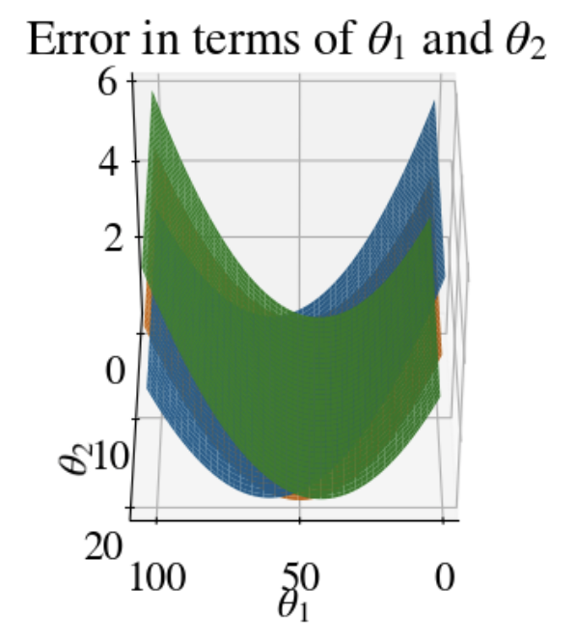
Visualization of fits

Slide 8
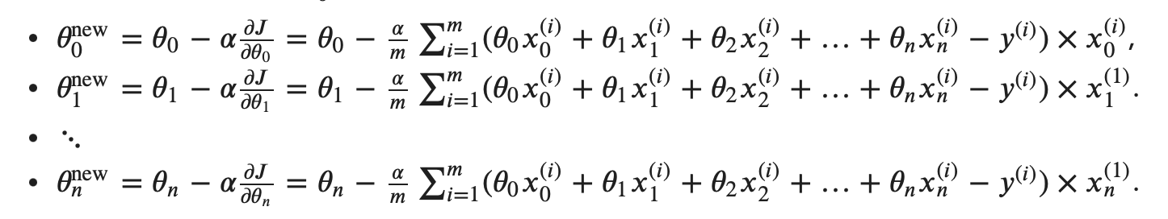
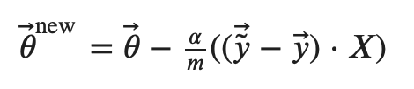
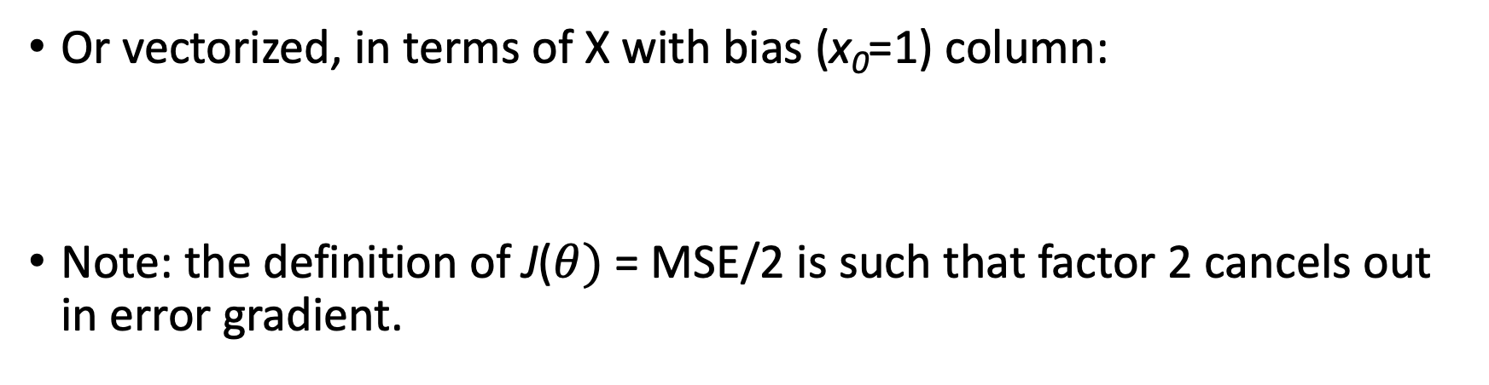
Gradient descent
Or vectorized, in terms of X with bias (x₀=1) column:
Note: the definition of J($θ)$ = MSE/2 is such that factor 2 cancels out in error gradient.

Slide 9
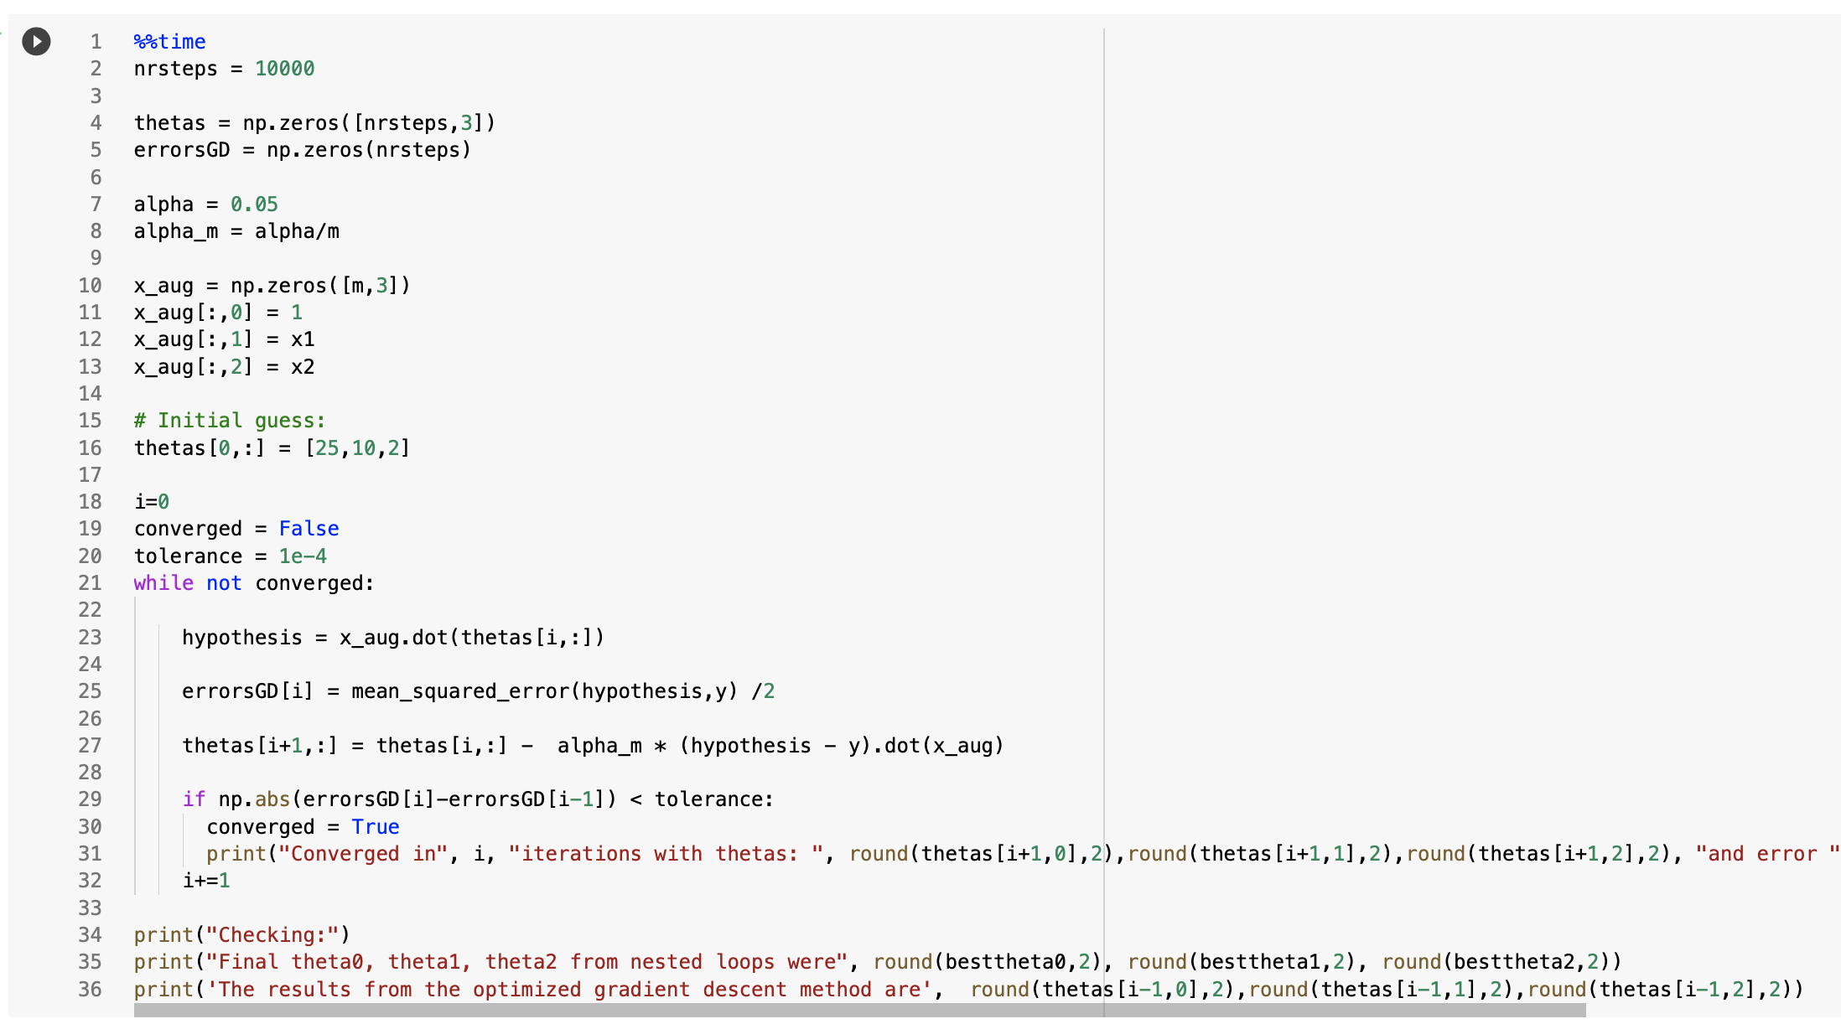
Python code for multivariate gradient descent
Bias and features
While-loop until tolerance
vectorized
Identical to univariate gradient descent!

Slide 10
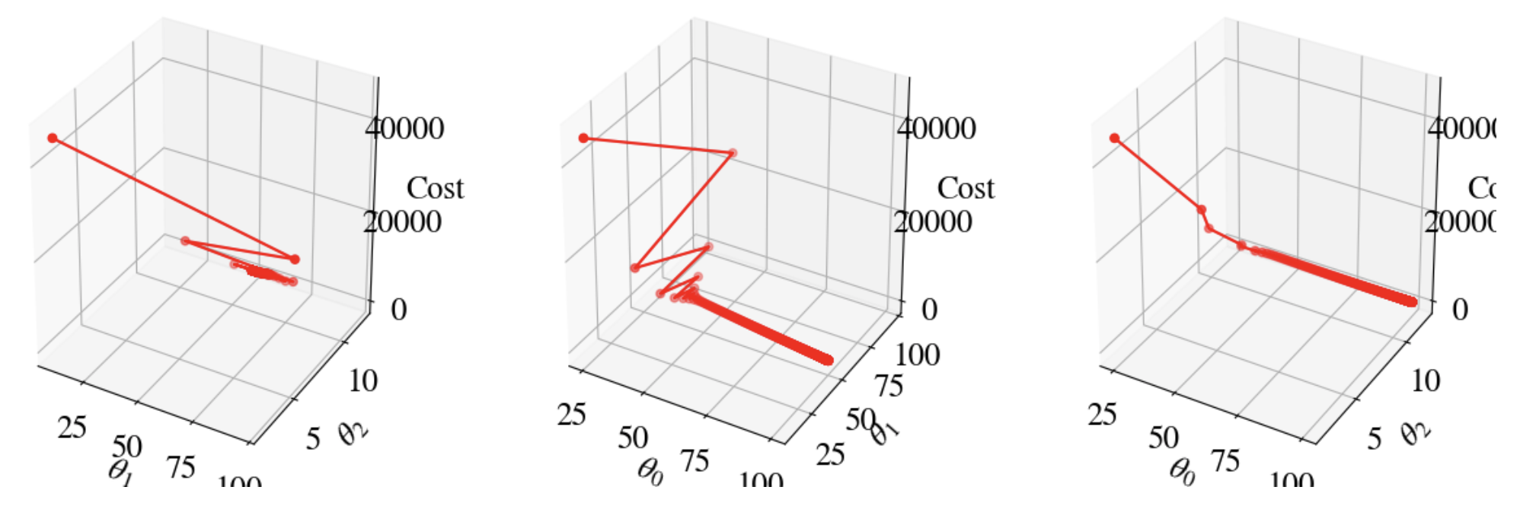
How did we do?
477 iterations (trials for combinations of 𝜃₀, 𝜃₁, 𝜃₂),
𝜃₀ = 99.9, 𝜃₁ = 50.02, 𝜃₂ = 11.95,
MSE = 411.8
CPU time: 206 ms ☺ (100x faster)

Slide 11
Accelerated gradient descent
3 iterations (trials for combinations of 𝜃₀, 𝜃₁, 𝜃₂),
𝜃₀ = 100.1, 𝜃₁ = 49.99, 𝜃₂ = 11.95,
MSE = 411.8
CPU time: 36.4 ms ☺, is 360× faster!
Unlike brute-force nested loops, nr of iterations of GD does not increase much for additional features.

Slide 12
Non-Linear Multivariate Regressions

Slide 13
Problem statement
First, consider non-linear regression in 1 variable (univariate):
Hypothesis: y = 𝜃₀ + 𝜃₁ x + 𝜃₂ x² + 𝜃₃ x³ + … + 𝜃_{n} x^{n}
How do we use ML numerical regression to fit this?
Embarrassingly simple: just define each term as separate feature, and then do same multivariate linear regression!
Features: x₀ = 1, x₁ = x, x₂ = x², …, x_{n} = x^{n}.
Think of spreadsheet with n feature columns. One target vector.

Slide 14
How far can we push this?
We can also try models like:
y = 𝜃₀ + 𝜃₁ x + 𝜃₂ x² + 𝜃₃ sin(x) + 𝜃₄ log(x) + 𝜃₃ exp(x/2) … + 𝜃_{n} x^{n}
as long as...: the relation is linear in fitting parameters 𝜃, such that our loss/cost function J(𝜃) is quadratic in 𝜃 and loss gradient is linear in 𝜃.
So, what’s an example of a model that does not work with this approach?
Answer: models like y = cos(𝜃₁ x) , y = exp(x/𝜃₁), y = (𝜃₁ x)² etc.

Slide 15
Simple example: quadratic function in one variable/feature

Slide 16
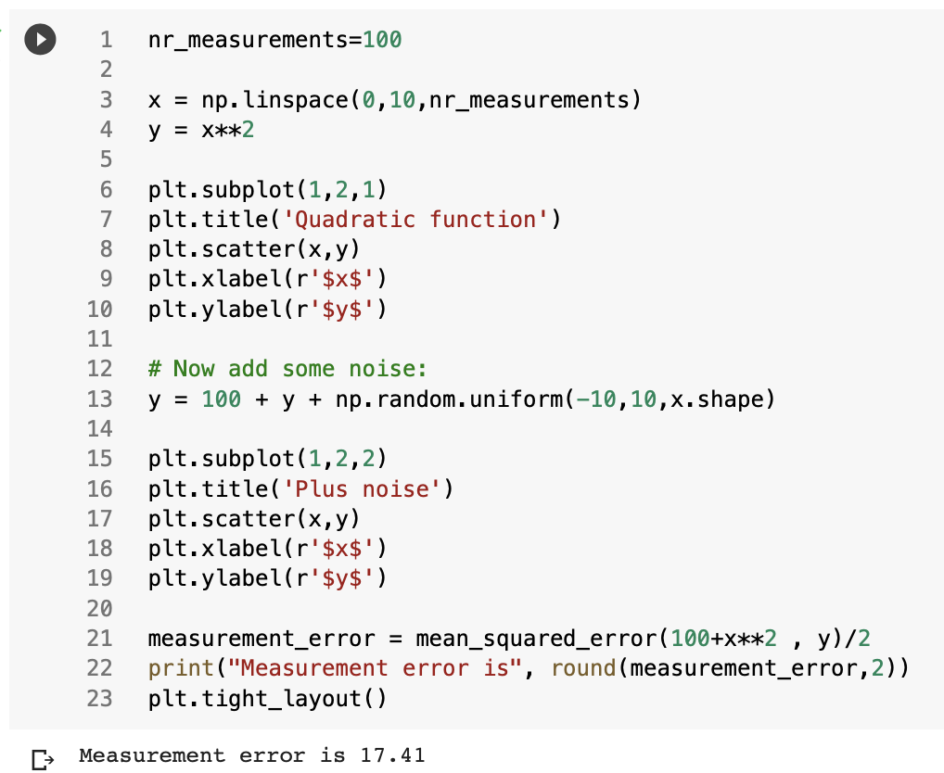
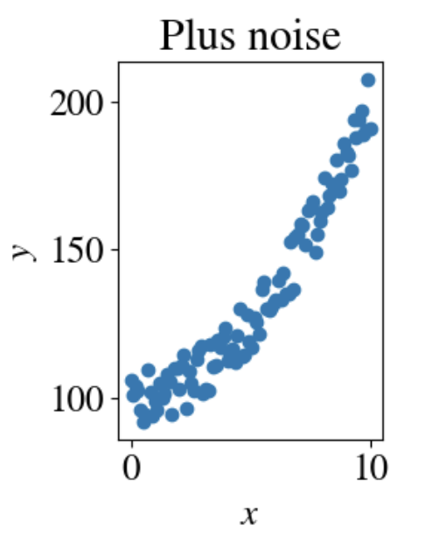

Slide 17
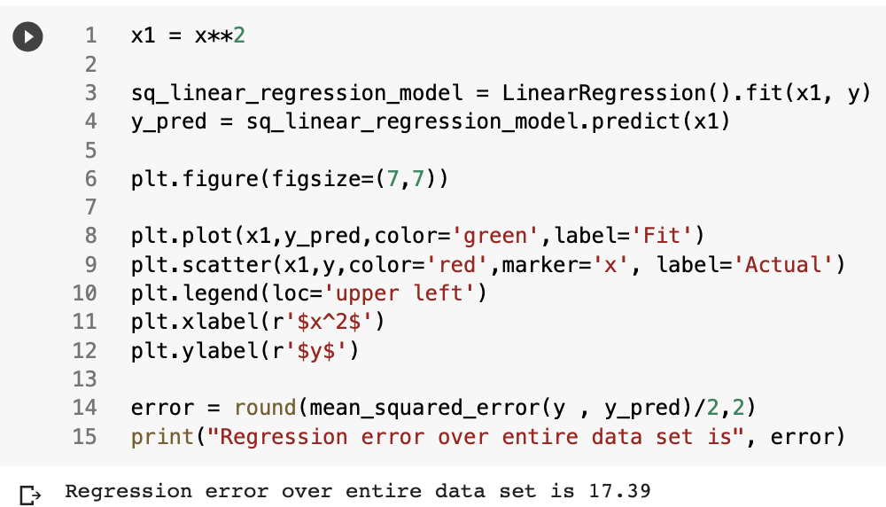
Fit with linear regression from scikit-learn
Define feature x₁ = x² and perform linear fit

Slide 18
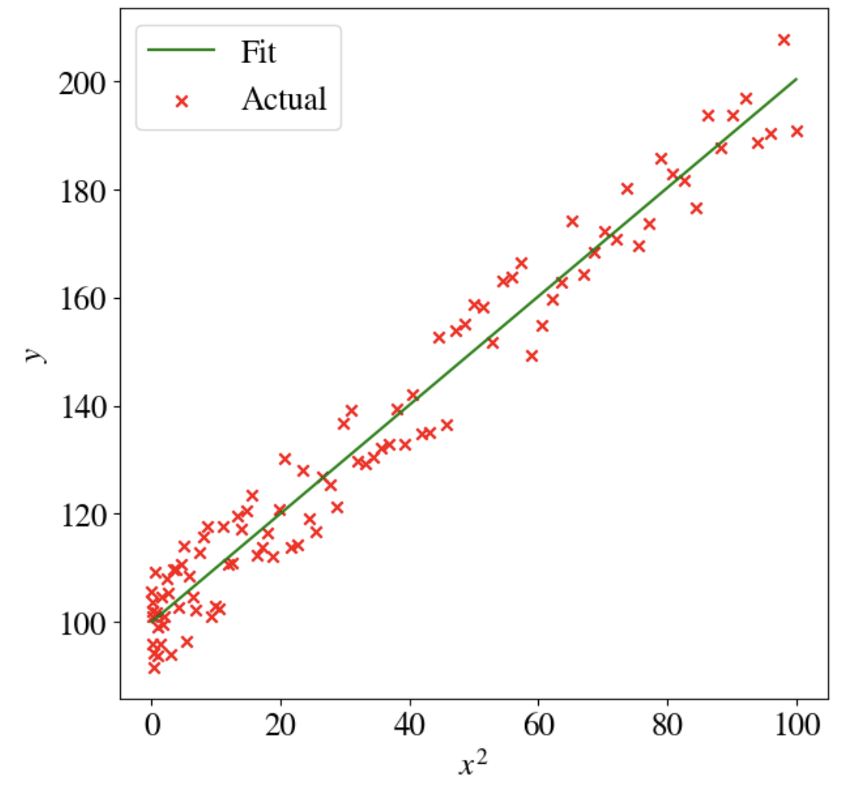
Result
Plotted as y vs feature x²:

Slide 19
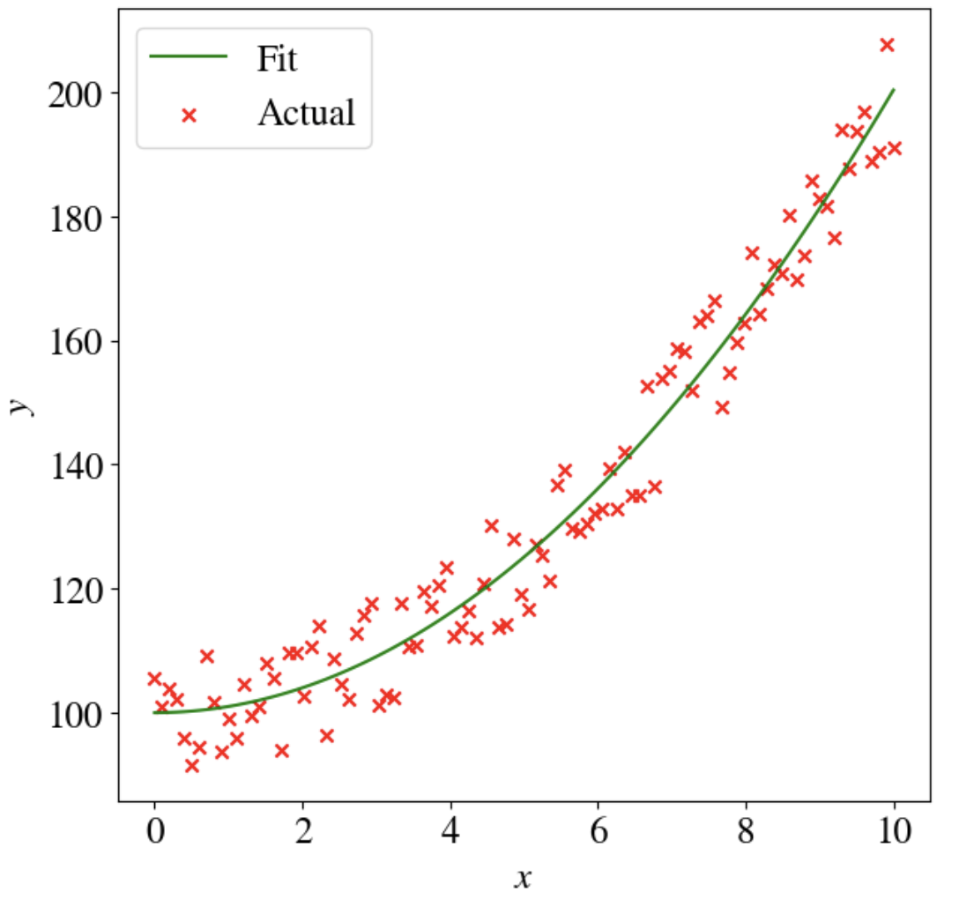
Result
Plotted as y vs feature x
Optimized/best fit finds:
𝜃₀ = 100, 𝜃₁ = 1
MSE = 17.4

Slide 20
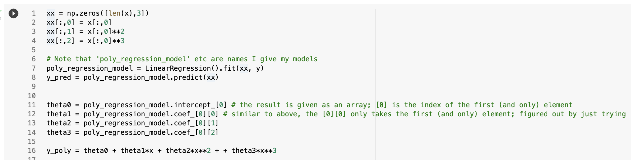
Higher-order polynomial
Often we don’t know what order to fit, so let’s try full 3rd order polynomial: y = 𝜃₀ + 𝜃₁ x + 𝜃₂ x² + 𝜃₃ x³
Note, LinearRegression does not need bias

Slide 21
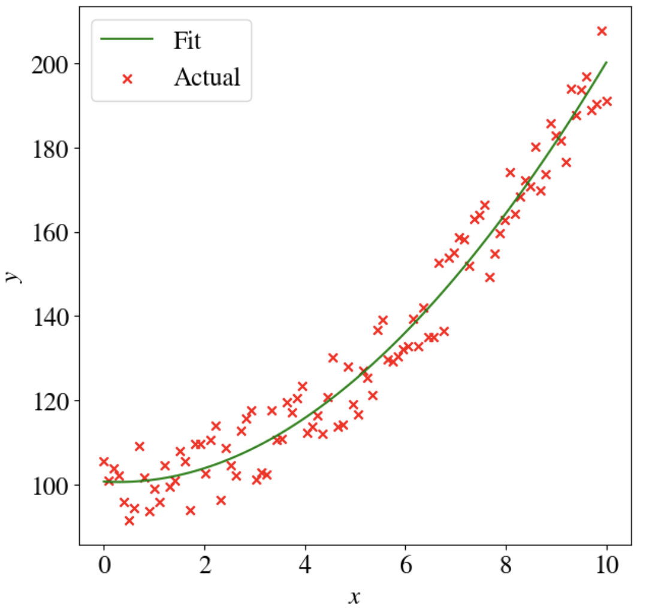
Results
𝜃₀ = 100.7, 𝜃₁ = -0.68,
𝜃₂ = 1.15, 𝜃₂ = -0.01,
MSE = 17.4
CPU = 0.6 s
Basically same results, but without knowing a priori

Slide 22
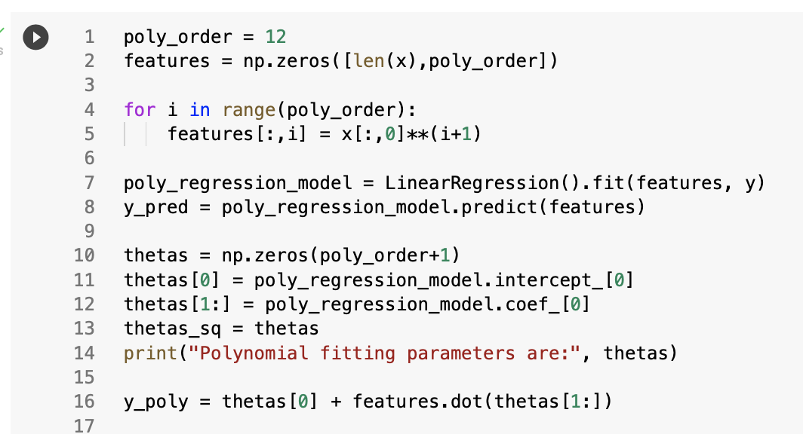
What about 12th order polynomial!?

Slide 23
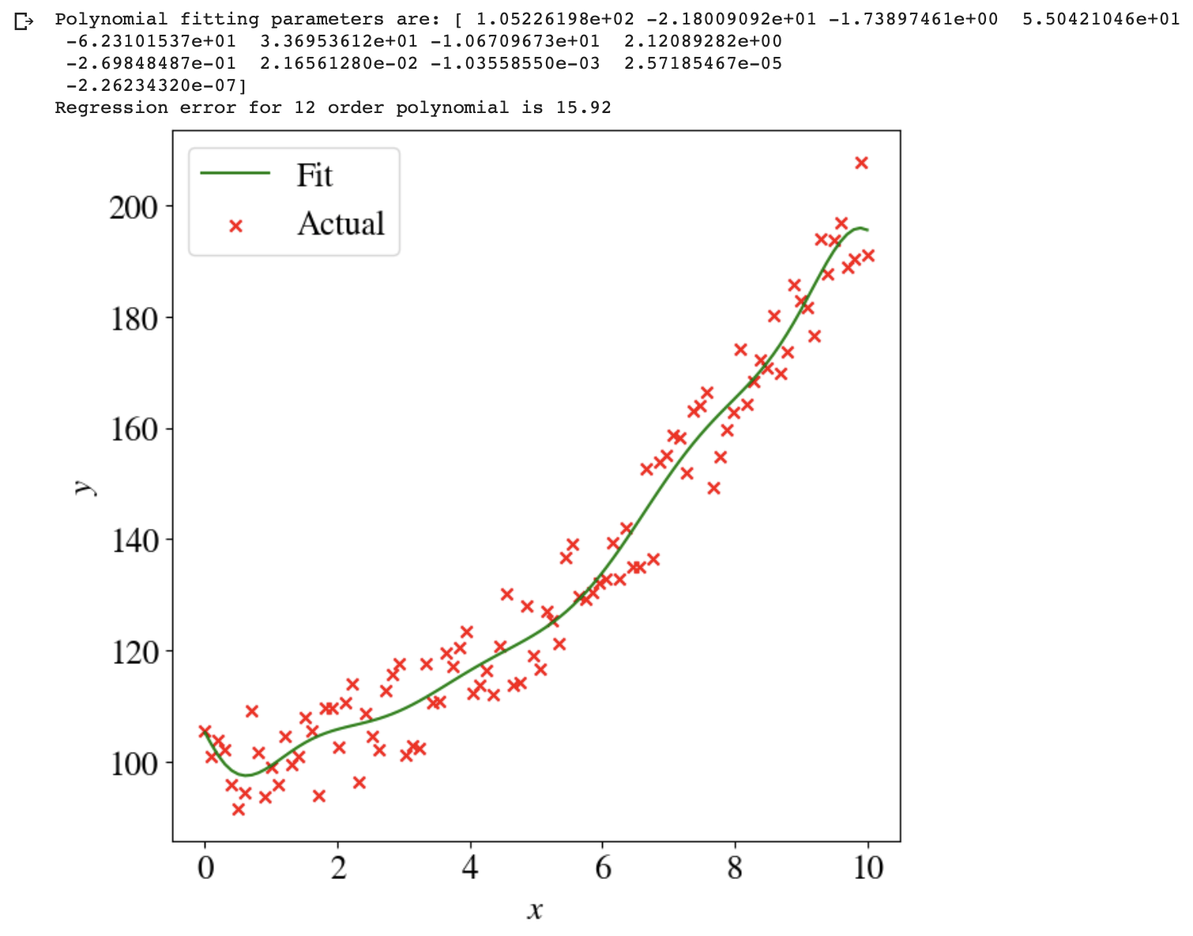
'Better’ fit with MSE = 15.9, but risk of overfitting! (more on that later)

Slide 24
Power of polynomial fitting
Any function can be approximated by polynomial (Taylor expansion)
Demonstration: fit y = sin(x) with 12th-order polynomial

Slide 25
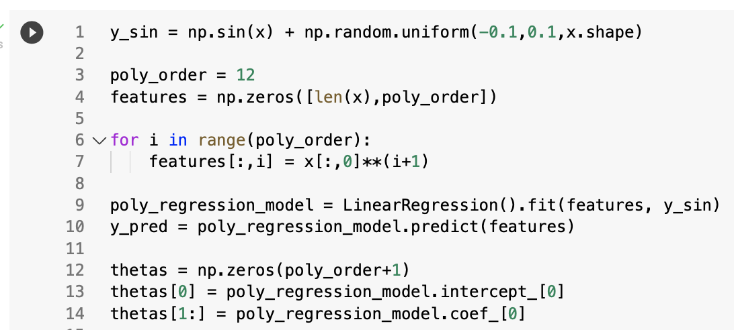
Power of polynomial fitting

Slide 26
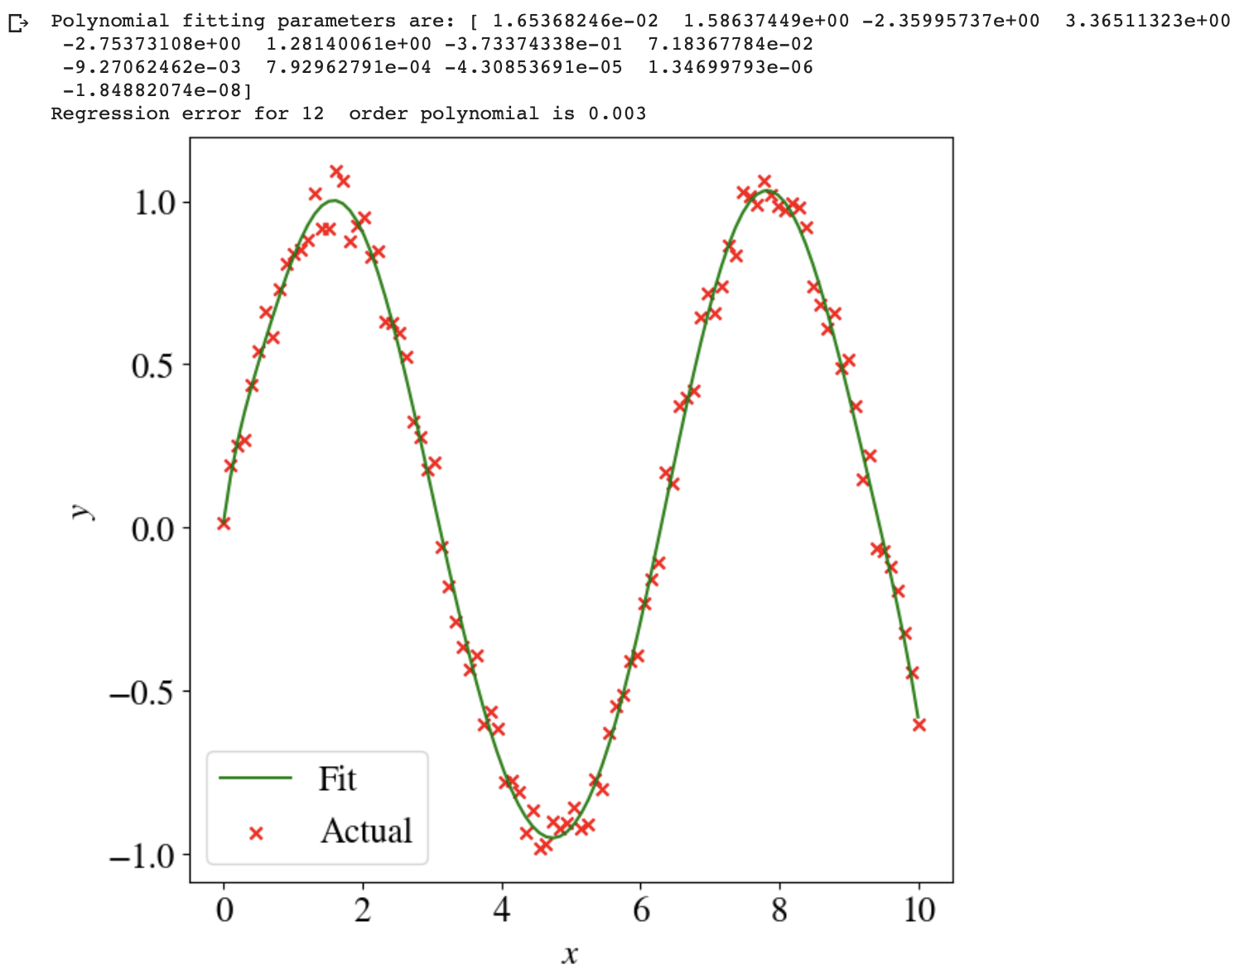
Results

Slide 27
Underfitting and Overfitting

Slide 28
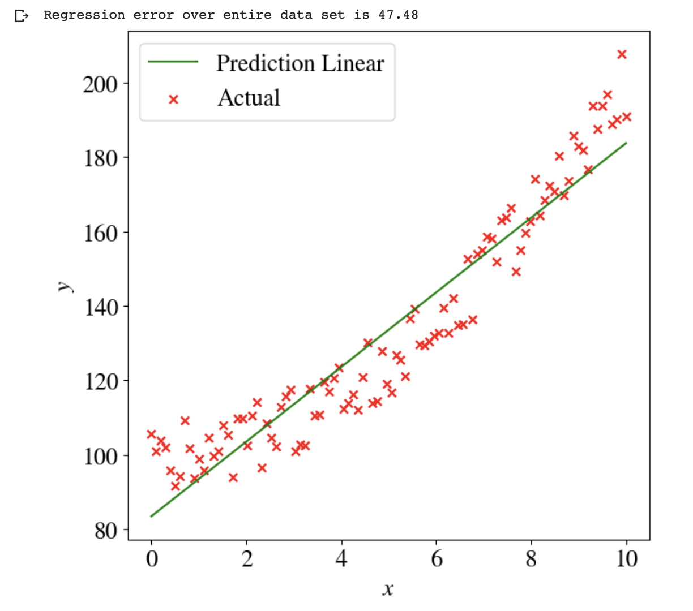
Underfitting
Model (hypothesis) not complex enough for data
E.g., linear model to fit quadratic data

Slide 29
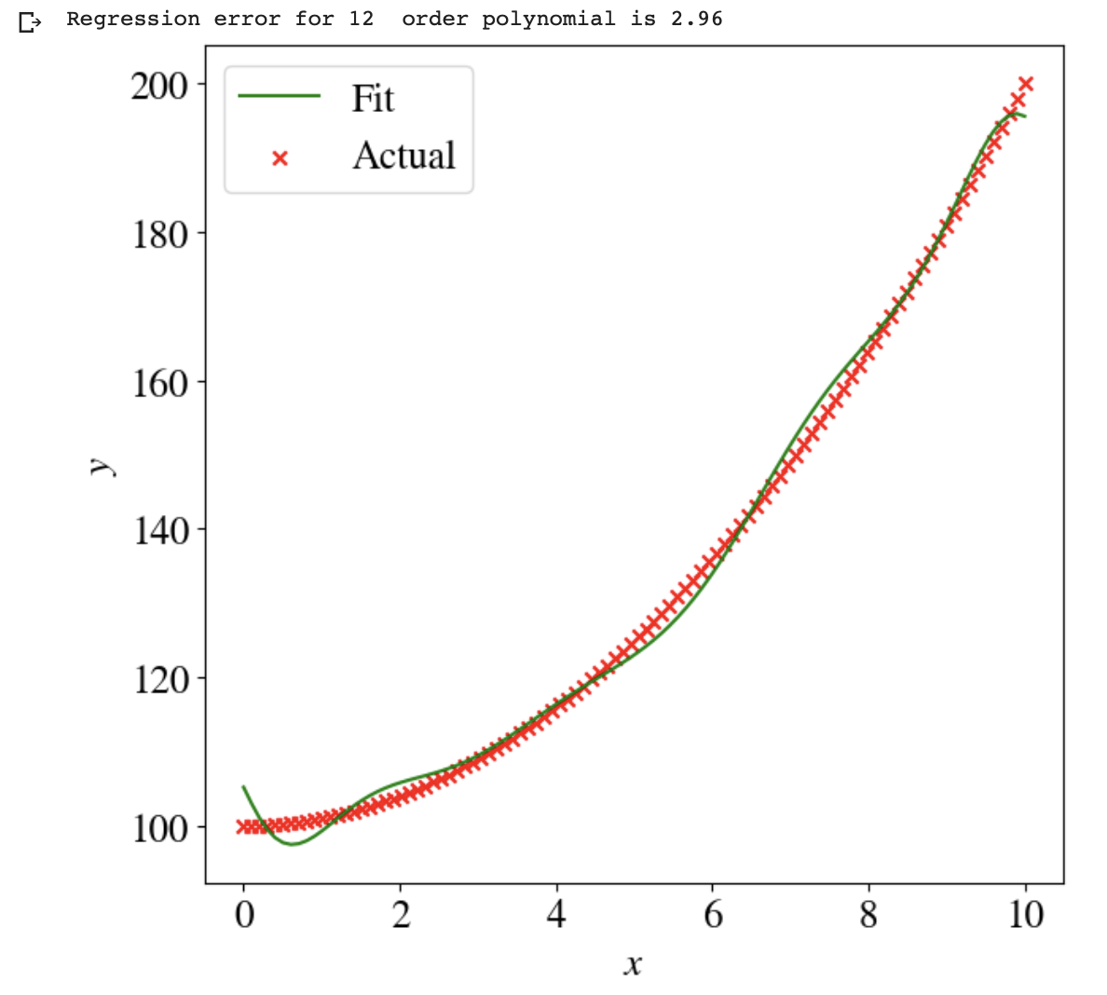
Overfitting
Too complex for (amount of) training data
How to know?
Compare MSE for training data vs. MSE for independent validation data

Slide 30

Example
12th order polynomial fitted to 0<x<10
Make predictions of 0<x<11
MSE increases from 3 to 62!

Slide 31
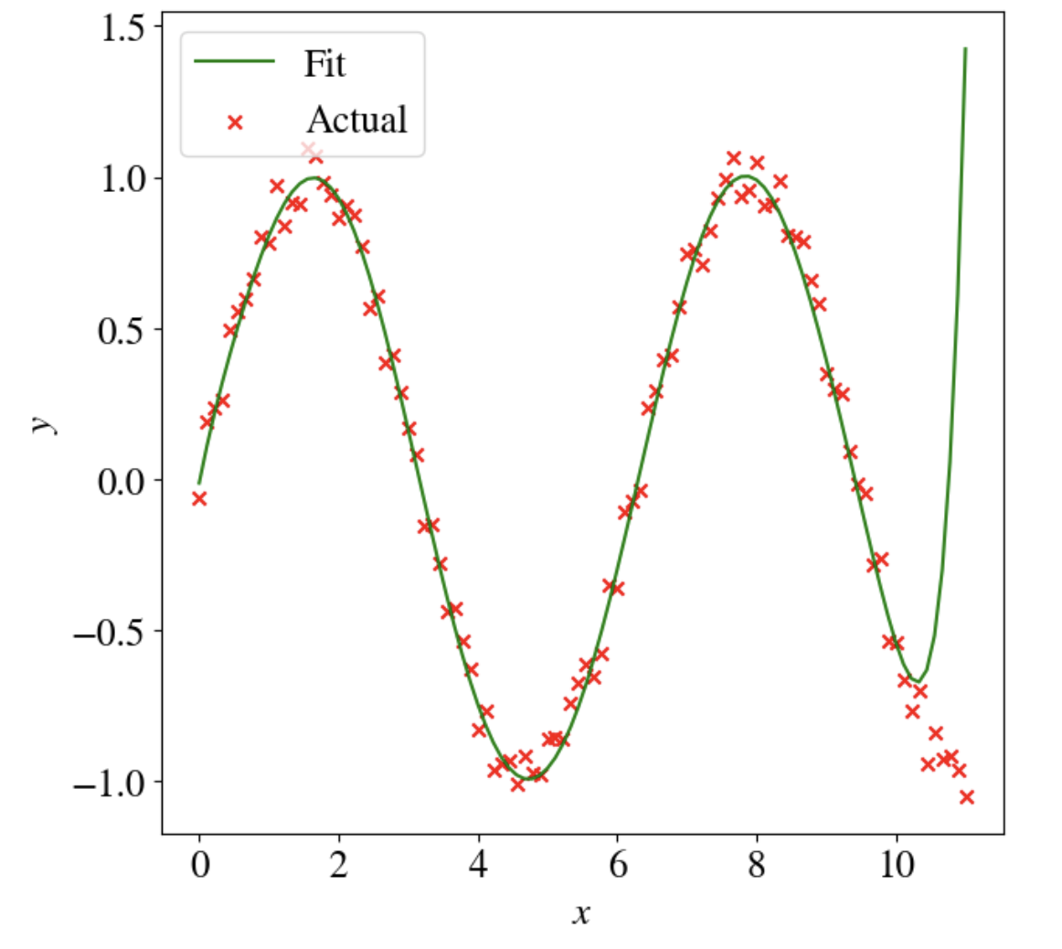
Another example
12th order polynomial to fit sine
Fit between 0<x<10,
Predict for 0<x<11
Overfitting can be reduced by regularization (other lecture)
But, extrapolation outside of range of training data is often problematic

Slide 32
Multivariate non-linear regression

Slide 33
Multivariate non-linear regression
Simple example: 4th order polynomial in 2 (initial) features
Say temperature T and pressure p
y = 𝜃₀ + 𝜃₁ T + 𝜃₂ p + 𝜃₃ T² + 𝜃₄ p² + 𝜃₅ T p + 𝜃₆ T³ + 𝜃₇ p³ + 𝜃₈ T p² + 𝜃₉ T² p + 𝜃₁₀ p⁴ + 𝜃₁₁ T⁴ + 𝜃₁₂ T² p² + 𝜃₁₃ T³ p + 𝜃₁₄ T p³
Need to define 14 features
Cross-product terms add up!
Gradient descent can handle many features, but
Mini-batch GD quickly becomes attractive for higher-order polynomial in multiple (physical) features

Slide 34
Summary
Non-linear multivariate numerical regression ML algorithms are identical to univariate linear regression,
Just need to define (many) new features,
Polynomial regression can approximate any function,
Beware of under- and overfitting.

Slide 35
Lecture Notes & Lab(s)
Lecture notes:
  Week_3_Lecture_Part1_Multivariate_Linear.ipynb
  Week_3_Lecture_Part2_Multivariate_Nonlinear.ipynb
Labs:
  Week_3_Lab_Part1_Multivariate_Linear.ipynb
  Week_3_Lab_Part2_Multivariate_Non_Linear.ipynb
Maybe start with lab 2 in class (bit harder) and do lab 1 (easier) at home, or lab 1 today and lab 2 on Thursday in class.

Slide 36
Next Week
Logistic regression (univariate and multivariate, linear and non-linear)
These are classification schemes of a target variable that can only have discrete categories (e.g., satellite image pixel is land/water/grass).

