Slide 1

Lecture 5
Classification by Logistic Regression

Slide 2
Problem statement
Given one or more features, predict a discrete target y
Target labels y for different classes, y = 0, 1, 2,…, N
Examples:
  Spam filter, classes: regular email (y=0) or spam (y=1),
  Computer vision: picture is of cat (y=0), dog (y=1), llama (y=3), etc.,
  Computer vision: image pixels are water, agriculture, forest fire, etc.
  Weather: cloudy, rainy, sunny, stormy,
  Mineralogy: grain is feldspar, quartz, olivine, …
  Hydrology/glaciology: water is liquid, ice, vapor, snow.
Binary or multiclass classification
Features can be continuous/numerical or discrete/categorical

Slide 3
First, Univariate Binary Classification

Slide 4
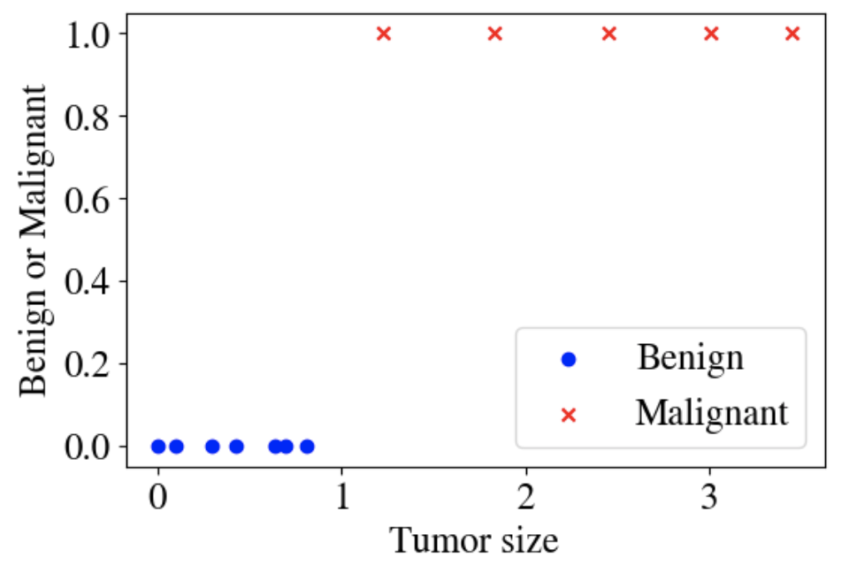
Example
Continuous feature x is tumor size,
Classes are either benign (y = 0) or malignant (y = 1)

Slide 5
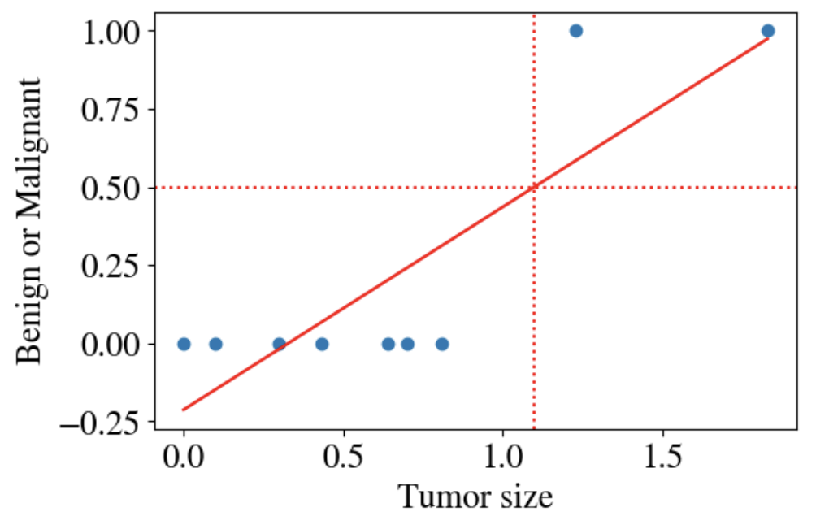
Numerical regression fit?
Let’s say we tried to predict benign/malignant with linear model:
y = -0.21 + 0.65 x, R²=0.72
We could threshold as
  Malignant for y > 0.5, x = 1.1,
  Benign for y < 0.5, x = 1.1
But…

Slide 6
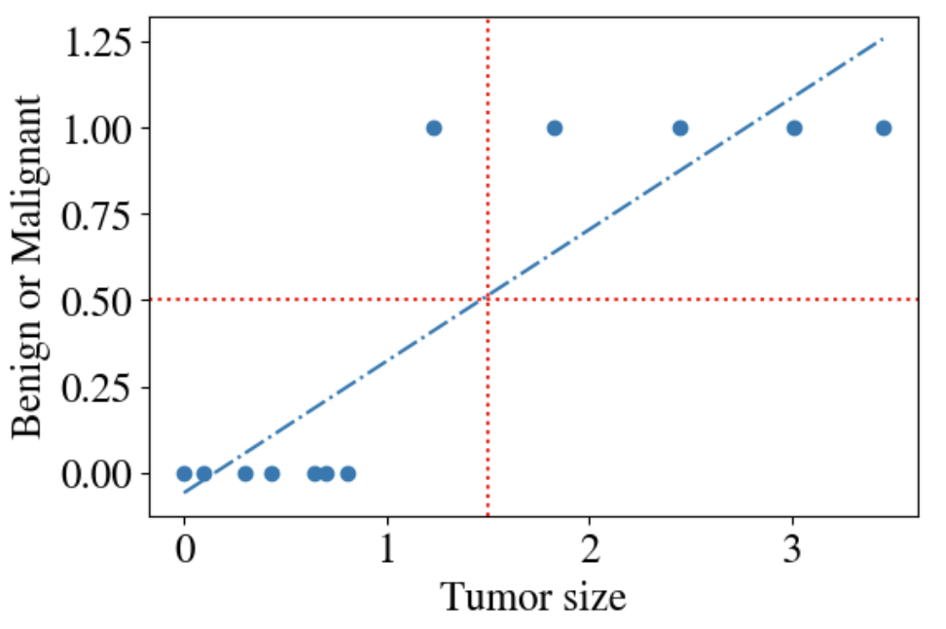
Numerical regression fit?
What happens when we have few more measurements:
Threshold of y = 0.5 doesn’t work!
Also, y < 0 and y > 1 for some x
For any polynomial model
Numerical regression no good.

Slide 7
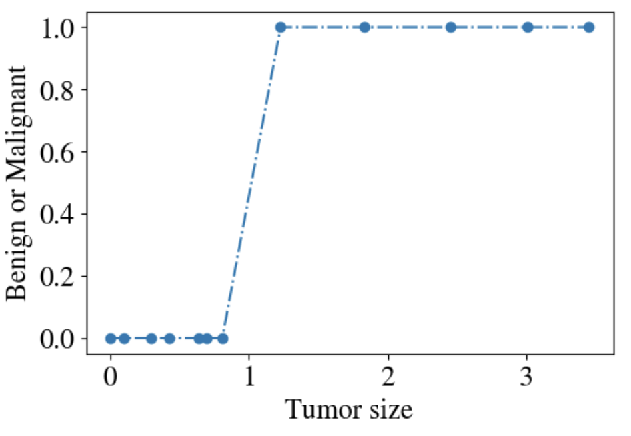
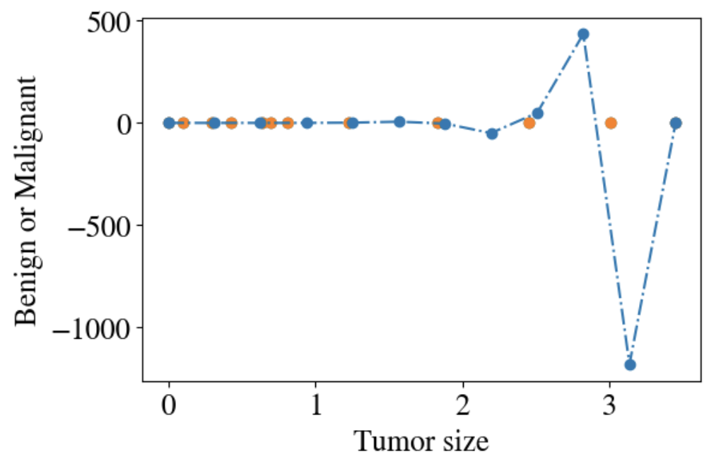
15th order polynomial fit
Looks great!
Until we add few more measurements:

Slide 8
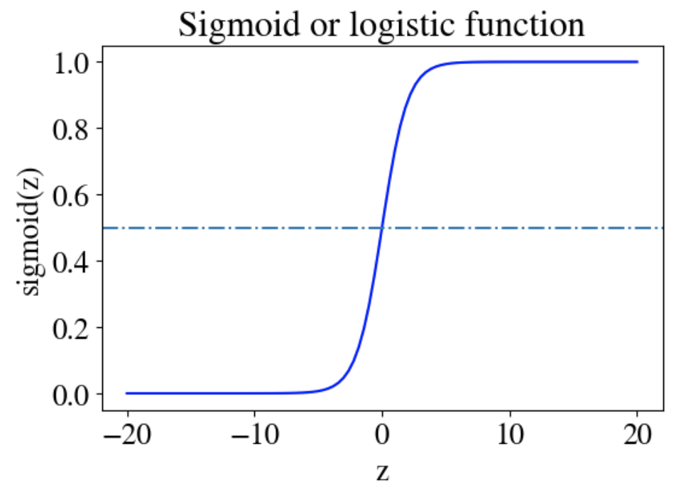

We need a new model hypothesis!
Solution: sigmoid = logistic function: $y= g\left(z\right)= \frac{1}{1+e^{−z}}$
g(0) = 0.5 for z = 0
g(z > 0) quickly approaches 1
g(z < 0) quickly approaches 0
0 < g(z) < 1 for all -∞ < z < ∞
Continuous probability around z = 0
Fits the bill to predict binary y!

Slide 9
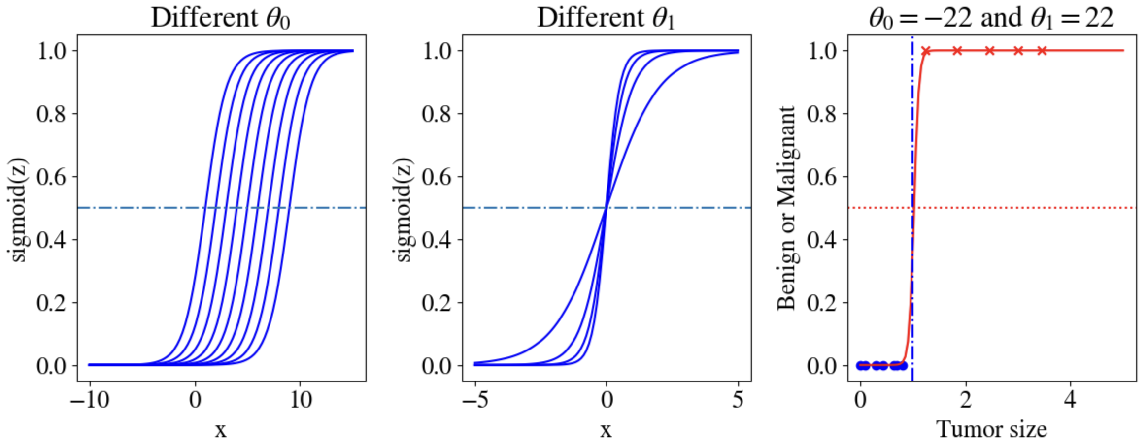

Logistic regression hypothesis
We can tune (= fit) sigmoid by specifying $y=h\left(x;θ\right)=g(X⋅θ)$, e.g.:
$y= \frac{1}{1+e^{−(θ_{0}+θ_{1}x)}}$, $θ_{0}$ shifts the ‘intercept’, $θ_{1}$ changes slope in center

Slide 10
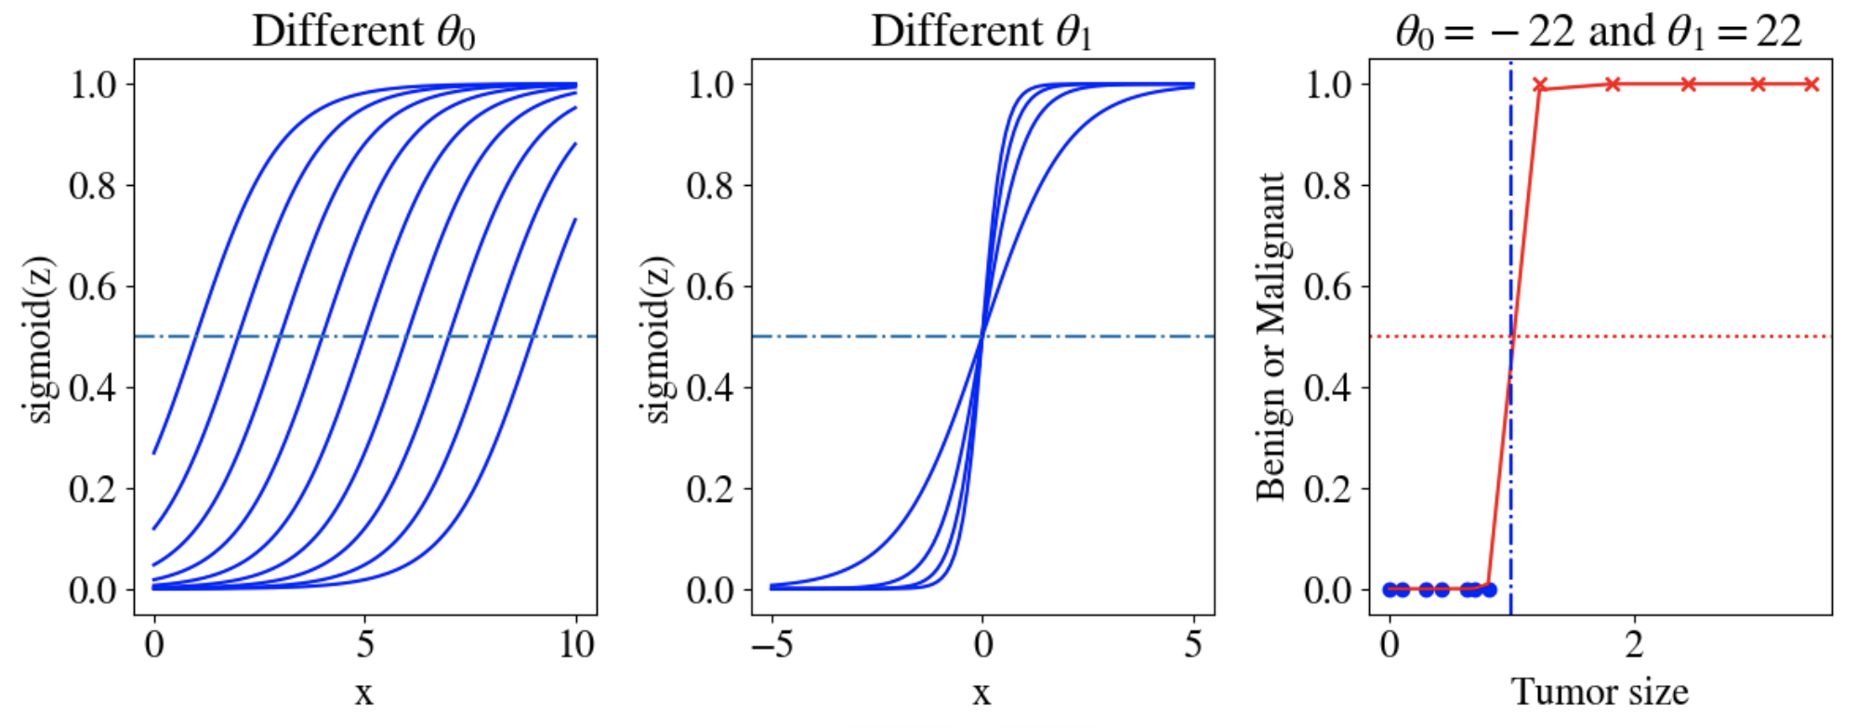

Logistic regression hypothesis
Note that g(z) = 0.5 for $z=0=θ_{0}+θ_{1}x⇒x=−\frac{θ_{0}}{θ_{1}}$
In this case, fit has $θ_{0}=−22, θ_{1}=22$ , so $g\left(z=0\right)=g\left(x=1\right)=0.5$

Slide 11
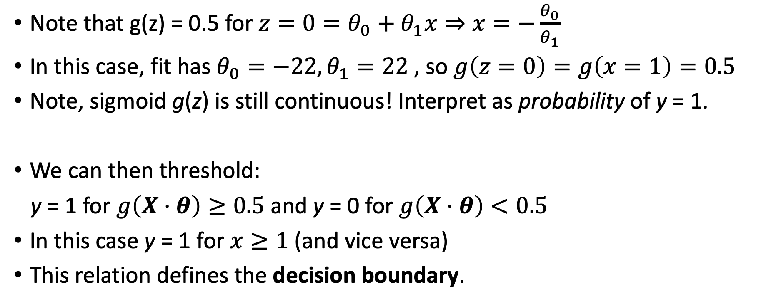
Logistic regression hypothesis
Note that g(z) = 0.5 for $z=0=θ_{0}+θ_{1}x⇒x=−\frac{θ_{0}}{θ_{1}}$
In this case, fit has $θ_{0}=−22, θ_{1}=22$ , so $g\left(z=0\right)=g\left(x=1\right)=0.5$
Note, sigmoid g(z) is still continuous! Interpret as probability of y = 1.
We can then threshold:
y = 1 for $g\left(X⋅θ\right)≥0.5$ and y = 0 for $g\left(X⋅θ\right)<0.5$
In this case y = 1 for $x≥1$ (and vice versa)
This relation defines the decision boundary.

Slide 12
Multivariate Linear Logistic Regression

Slide 13
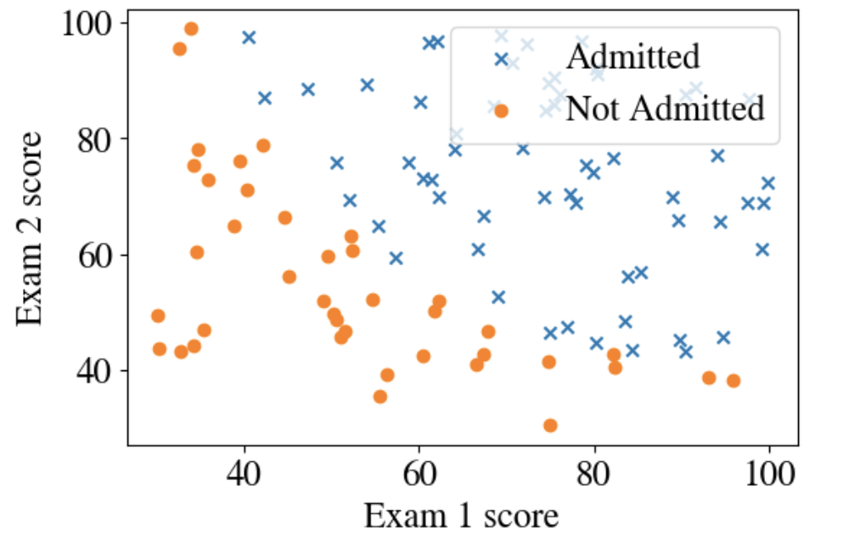

Two features x₁ and x₂
College admission (y = 1, stars) or rejection (y = 0, circles) based on 2 (continuous) exam scores
Hypothesis:
$h\left(x;θ\right)=g\left(θ_{0}+θ_{1}x_{1}+θ_{2}x_{2}\right)$

Slide 14
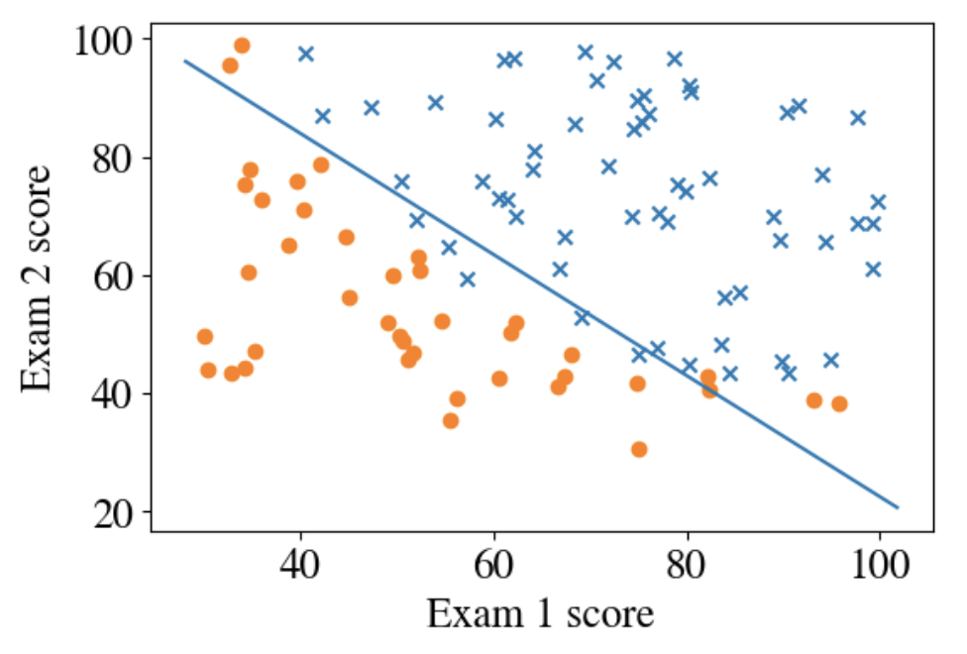

Fitting results
Best for for $θ_{0}=−25, θ_{1}=0.2, θ_{2}=0.2,$
Decision boundary for $X⋅θ=0:$
$0.2 x_{1}+0.2 x_{2}=25$ or
$x_{1}+ x_{2}=125$
This parameterizes shown line

Slide 15
Multivariate Non-Linear Logistic Regression

Slide 16
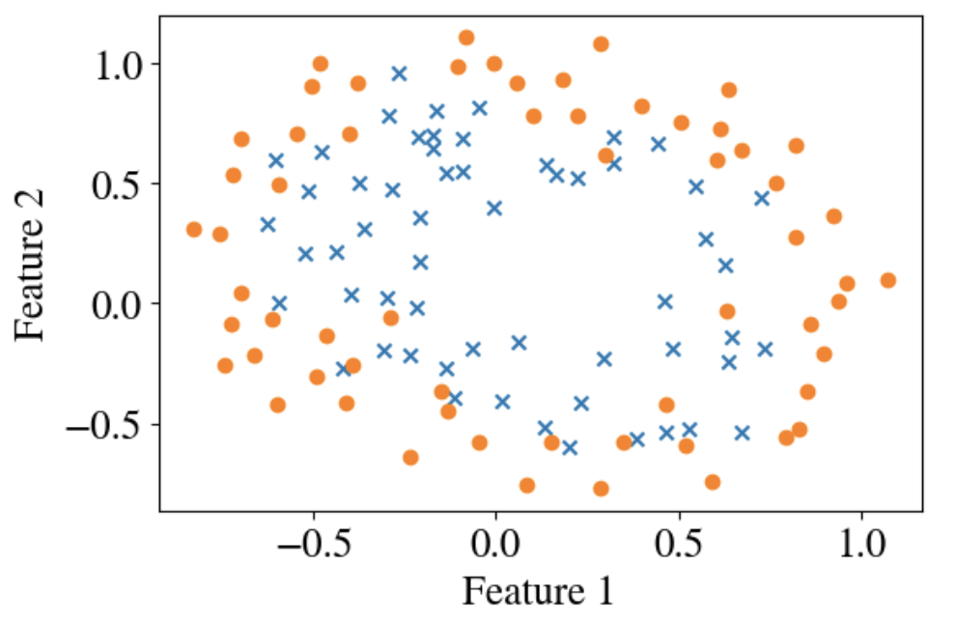
Non-linear data
Task: separate crosses for y = 1 from circles for y = 0
Clearly, a straight line won’t do
Need non-linear model!

Slide 17
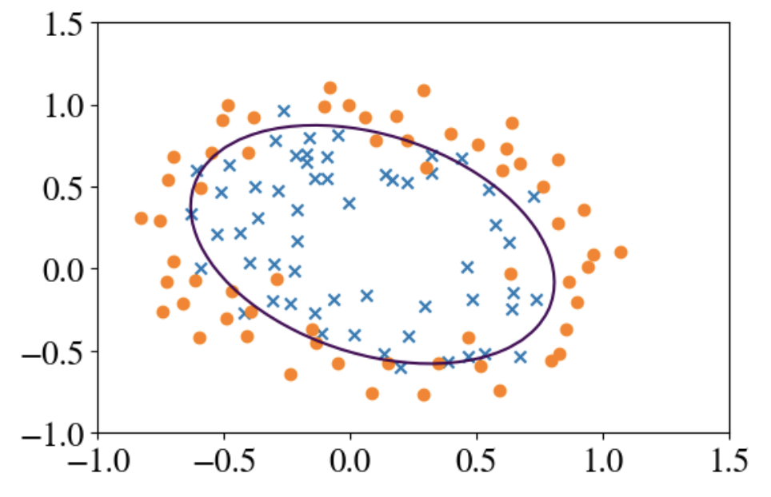

Same as for numerical regression!
Try n polynomial features: x₀ = 1, x₁=(feature 1)² , x₂=(feature 2)², etc.
Decision boundary given by:
$\sum_{i=1}^{n}{θ_{i}x_{i}=0}$
For 2nd order, this gives an ellipse
${θ_{1}x}_{1}^{2}+{θ_{2}x}_{2}^{2}={−θ}_{0}$

Slide 18
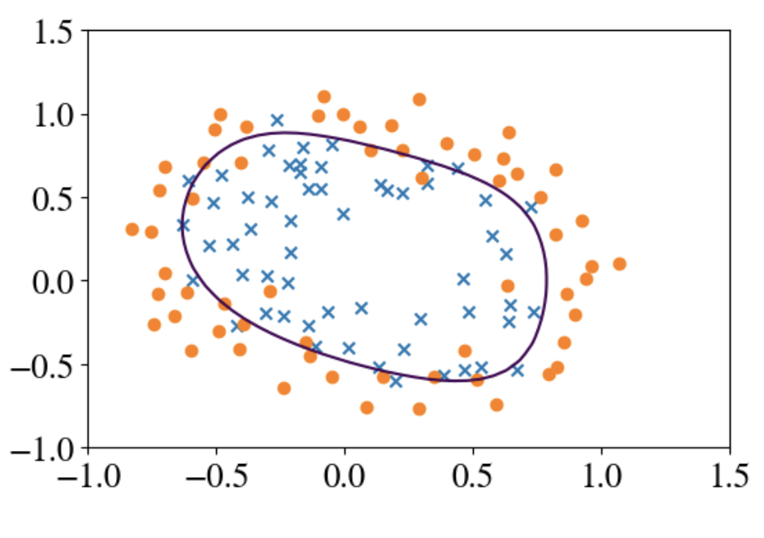

Same as for numerical regression!
Try n polynomial features: x₀ = 1, x₁=(feature 1)² , x₂=(feature 2)², etc.
Decision boundary given by:
$\sum_{i=1}^{n}{θ_{i}x_{i}=0}$
6th order polynomial

Slide 19
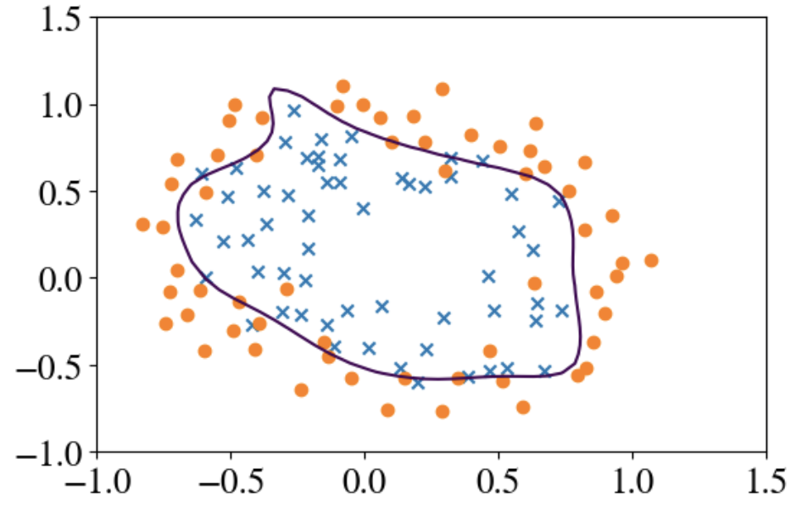

Same as for numerical regression!
Try n polynomial features: x₀ = 1, x₁=(features 1)² , x₂=(features 2)², etc.
Decision boundary given by:
$\sum_{i=1}^{n}{θ_{i}x_{i}=0}$
12th order polynomial
Overfitting!

Slide 20
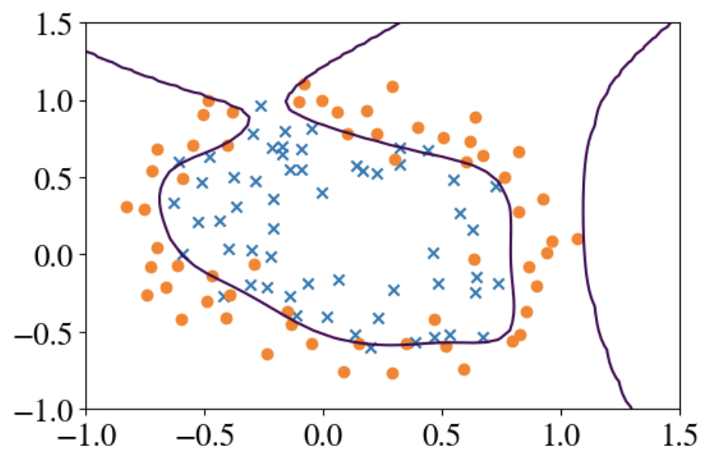

Same as for numerical regression!
Try n polynomial features: x₀ = 1, x₁=(features 1)² , x₂=(features 2)², etc.
Decision boundary given by:
$\sum_{i=1}^{n}{θ_{i}x_{i}=0}$
24th order polynomial
Overfitting!

Slide 21
So how do we find best fit?

Slide 22
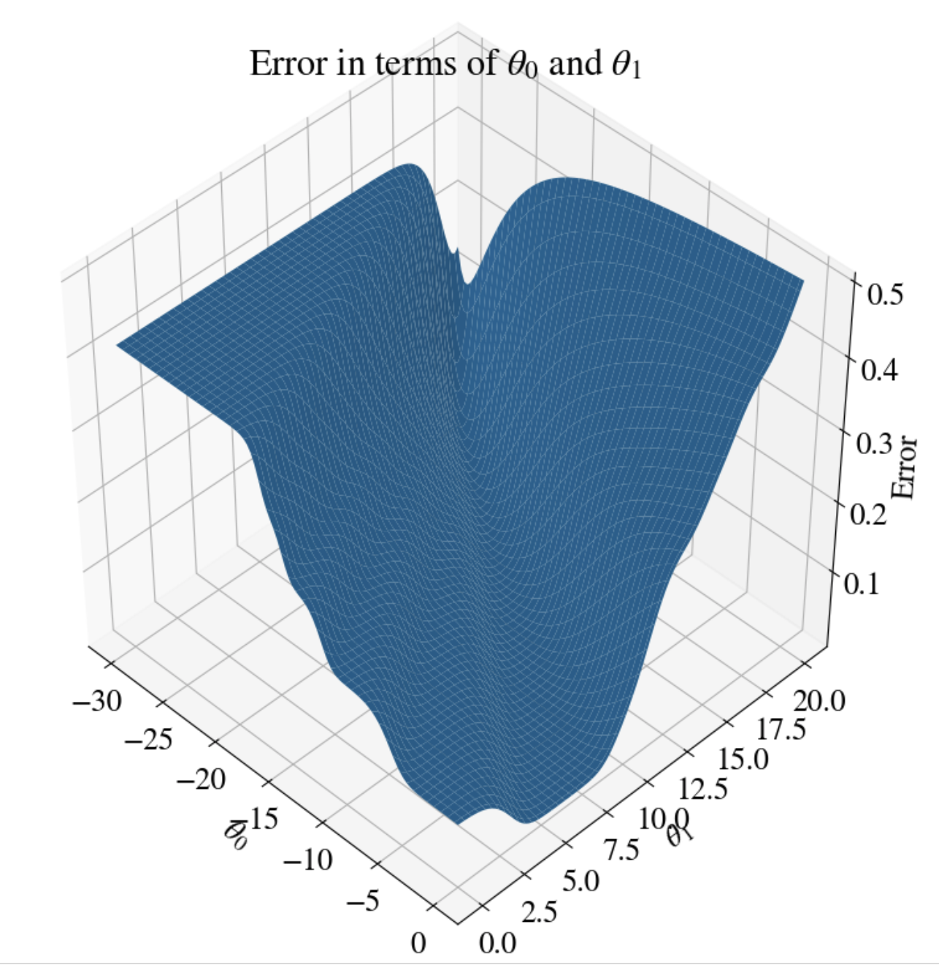

Error = Cost Function
Mean-Squared-Error MSE would be:
MSE $= \frac{1}{m}\sum_{i=1}^{m}{{\left(h\left(x;θ\right)−y_{true}\right)}^{2}}=\frac{1}{m}\sum_{i=1}^{m}{{\left(\frac{1}{1+e^{−\sum{θ_{j}x_{j,i}}}}−y_{true}\right)}^{2}}$
Messy!

Slide 23
Not convex
Many local minima,
Will not converge to global minimum
We need different measure of accuracy/error, i.e., a different cost function.

Slide 24
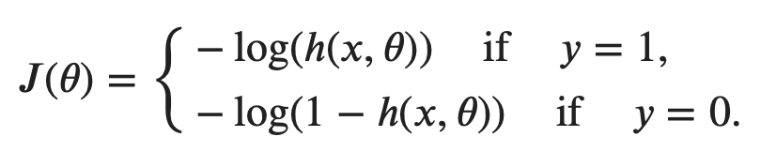

Cost function of logistic regression
Remember, true y can only be 0 or 1
We define the error between a prediction/hypothesis given by $h\left(x;θ\right)=g\left(X⋅θ\right)$, and true values y, as:

Slide 25
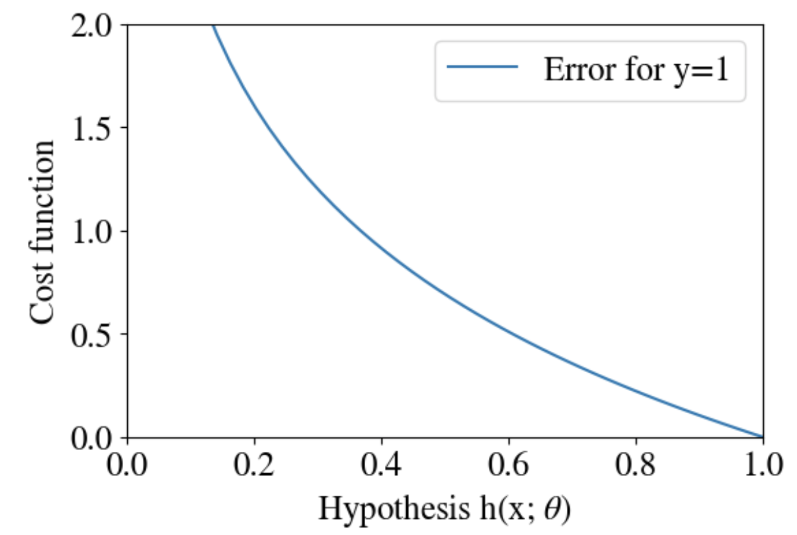
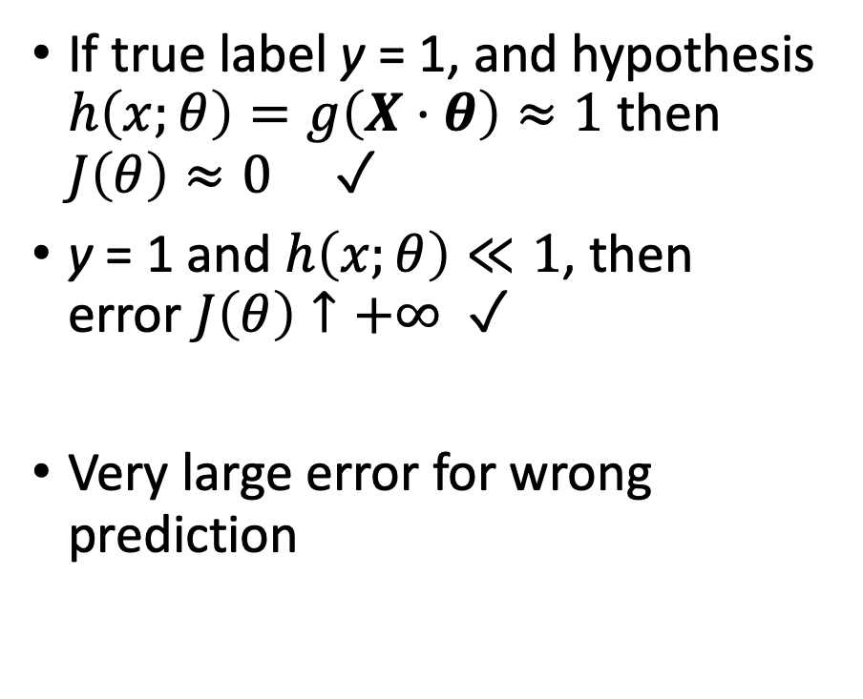
What does this look like?
If true label y = 1, and hypothesis $h\left(x;θ\right)=g\left(X⋅θ\right)≈1$ then $J\left(θ\right)≈0$ ✓
y = 1 and $h\left(x;θ\right)≪1$, then error $J\left(θ\right)↑+∞$ ✓
Very large error for wrong prediction

Slide 26
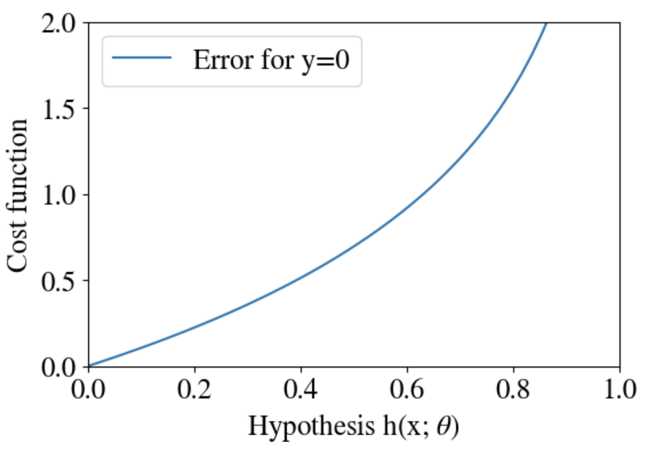
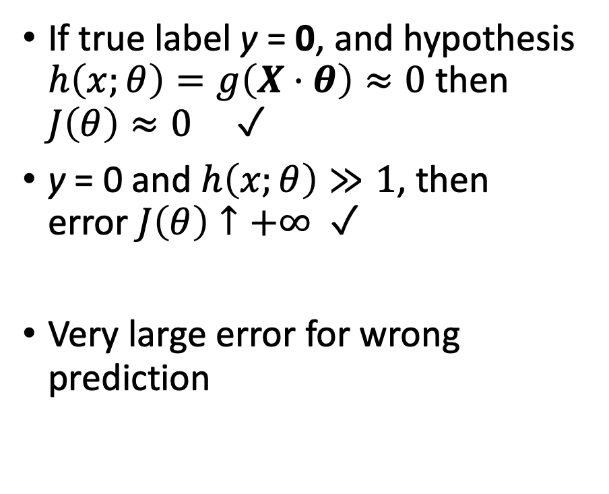
What does this look like?
If true label y = 0, and hypothesis $h\left(x;θ\right)=g\left(X⋅θ\right)≈0$ then $J\left(θ\right)≈0$ ✓
y = 0 and $h\left(x;θ\right)≫1$, then error $J\left(θ\right)↑+∞$ ✓
Very large error for wrong prediction

Slide 27
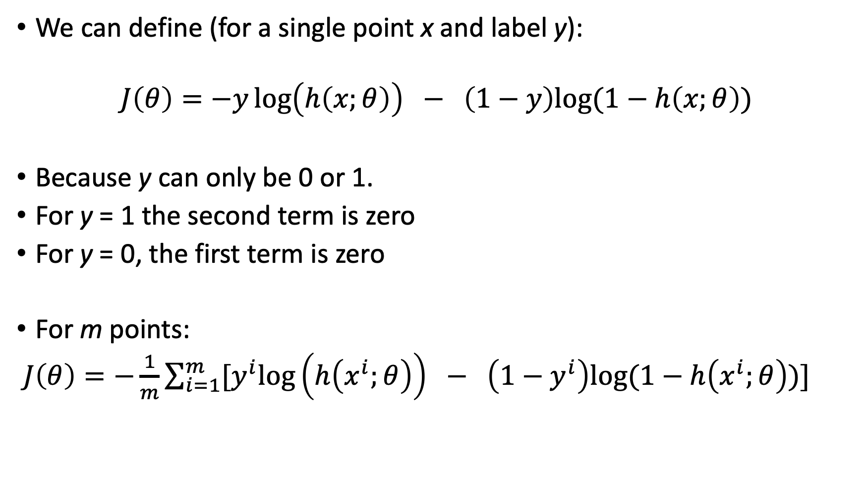
More elegant way to write cost function
We can define (for a single point x and label y):
$$J\left(θ\right)=−y\log\left(h\left(x;θ\right)\right) − \left(1−y\right)log⁡(1−h\left(x;θ\right))$$
Because y can only be 0 or 1.
For y = 1 the second term is zero
For y = 0, the first term is zero
For m points:
$J\left(θ\right)=−\frac{1}{m}\sum_{i=1}^{m}{{[y}^{i}\log\left(h\left(x^{i};θ\right)\right) − \left(1−y^{i}\right)log⁡(1−h\left(x^{i};θ\right))\text{]} }$

Slide 28
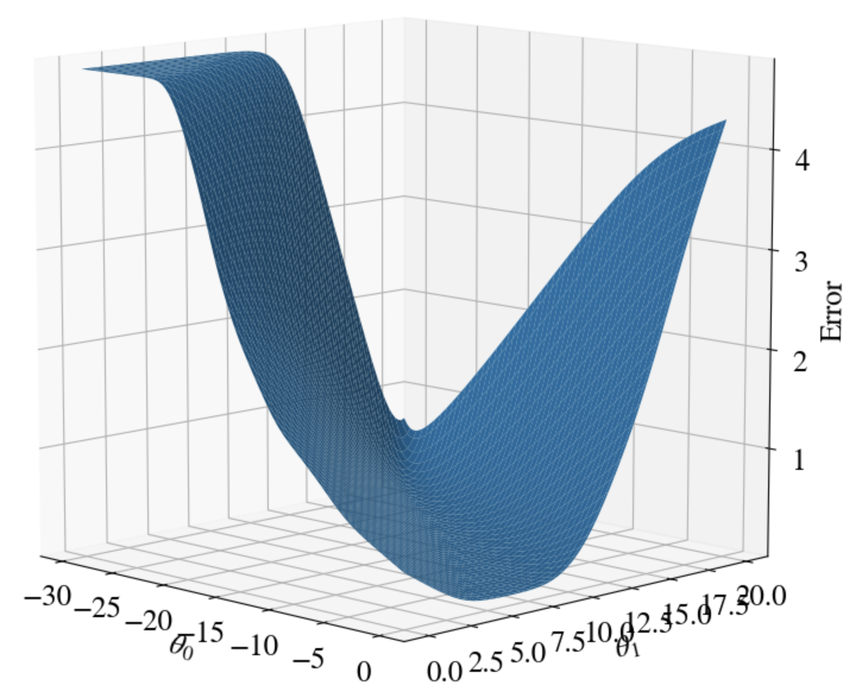

Illustration of logistic cost function
Shown for two features
$θ_{0}$ and $θ_{1}$
Convex!
One minimum
Machine Learning task:
Find minimum of cost function

Slide 29
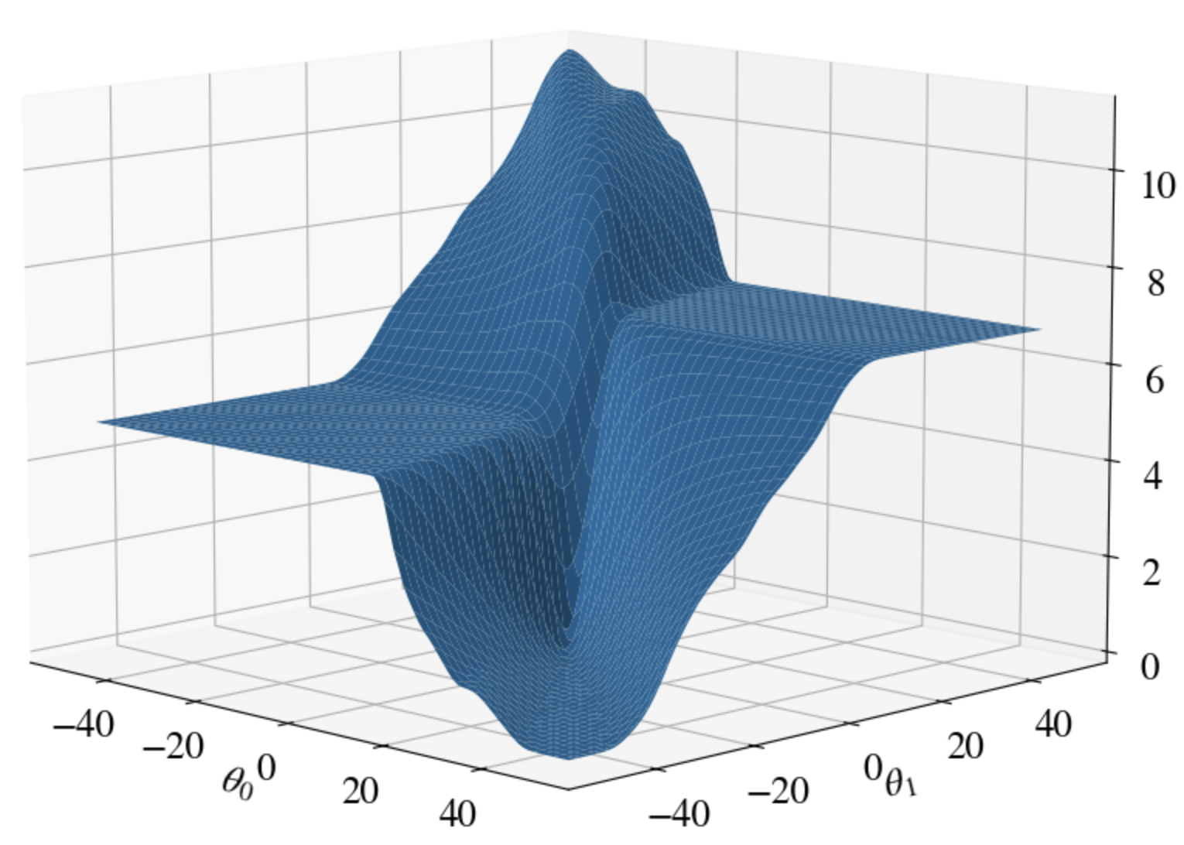

Subtlety
“Vanishing gradients”
When ${|θ}_{1}|$ >> 0 and |$θ_{0}|≫0$

Slide 30
Gradient Descent for Logistic Regression

Slide 31
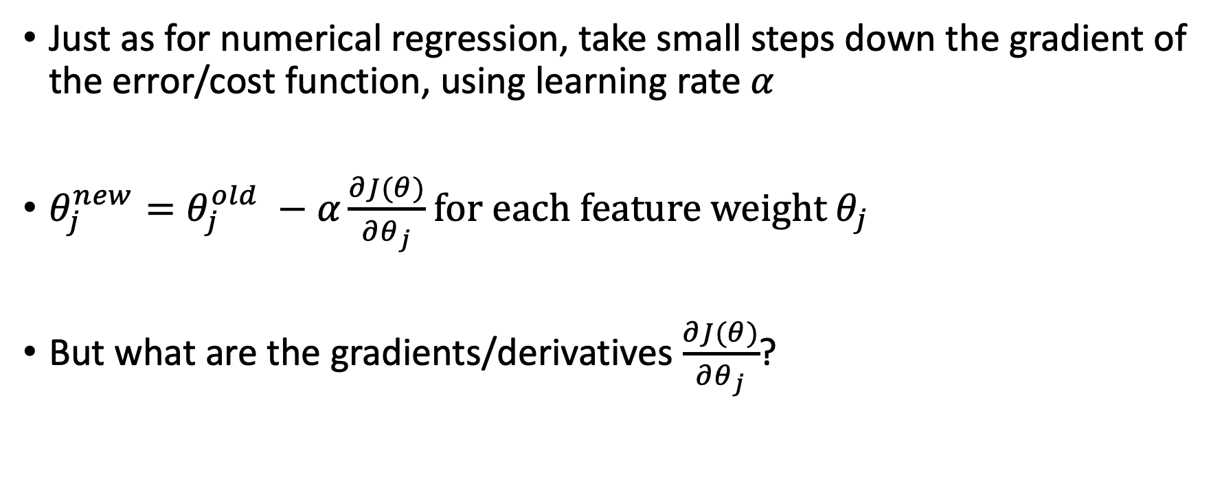
Gradient Descent
Just as for numerical regression, take small steps down the gradient of the error/cost function, using learning rate $α$
$θ_{j}^{new}=θ_{j}^{old} −α\frac{∂J(θ)}{∂θ_{j}}$ for each feature weight $θ_{j}$
But what are the gradients/derivatives $\frac{∂J(θ)}{∂θ_{j}}$?

Slide 32
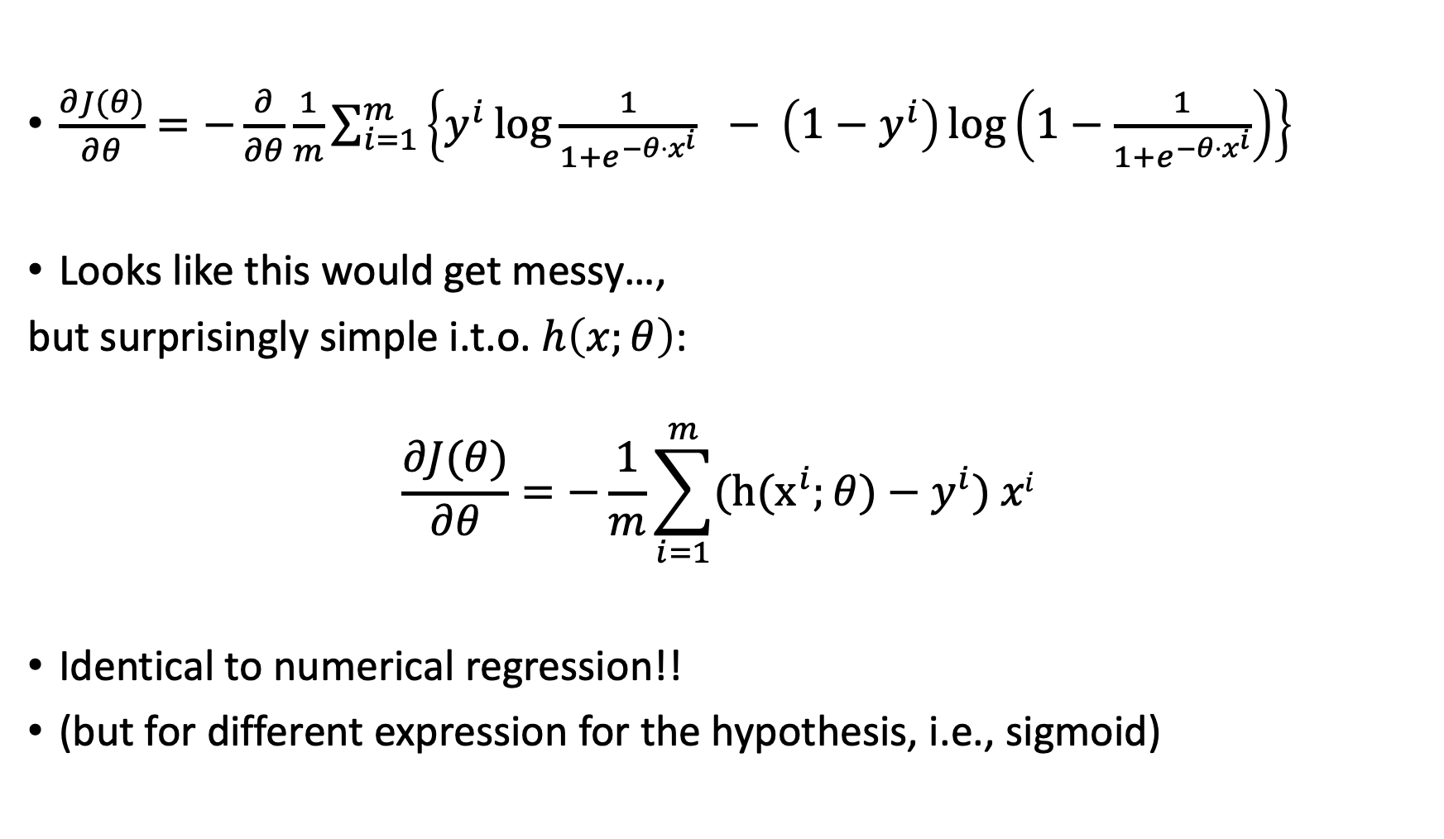
Cost Function Gradients
$\frac{∂J(θ)}{∂θ}=−\frac{∂}{∂θ}\frac{1}{m}\sum_{i=1}^{m}{\left\{y^{i}\log{\frac{1}{1+e^{−θ⋅x^{i}}}} − \left(1−y^{i}\right)\log\left(1−\frac{1}{1+e^{−θ⋅x^{i}}}\right)\right\} }$
Looks like this would get messy…,
but surprisingly simple i.t.o. $h\left(x;θ\right)$:
$$\frac{∂J(θ)}{∂θ}=−\frac{1}{m}\sum_{i=1}^{m}{{\text{(}\text{h}\text{(}\text{x}}^{i};θ)−y^{i}) xi }$$
Identical to numerical regression!!
(but for different expression for the hypothesis, i.e., sigmoid)

Slide 33
Python Code for Logistic Regression

Slide 34
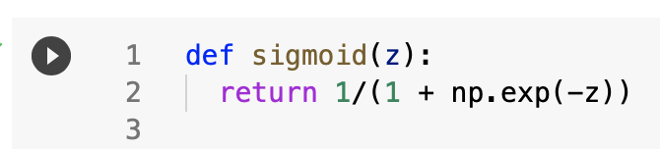
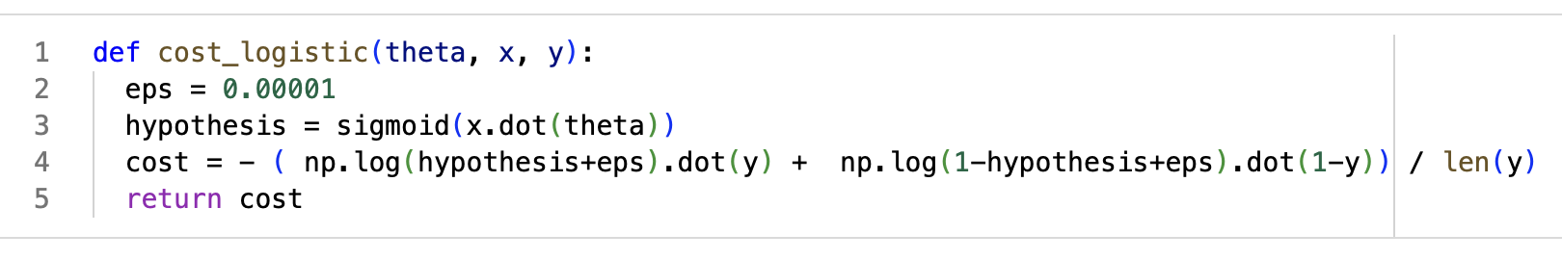
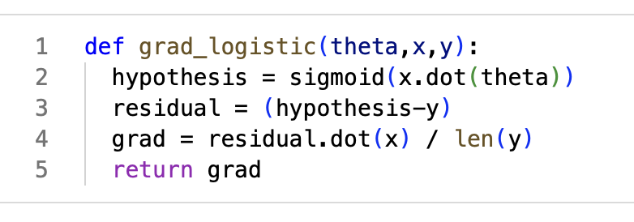
Hypothesis, Cost Function and its Gradient
Add small 𝝐 to avoid taking log(0)

Slide 35
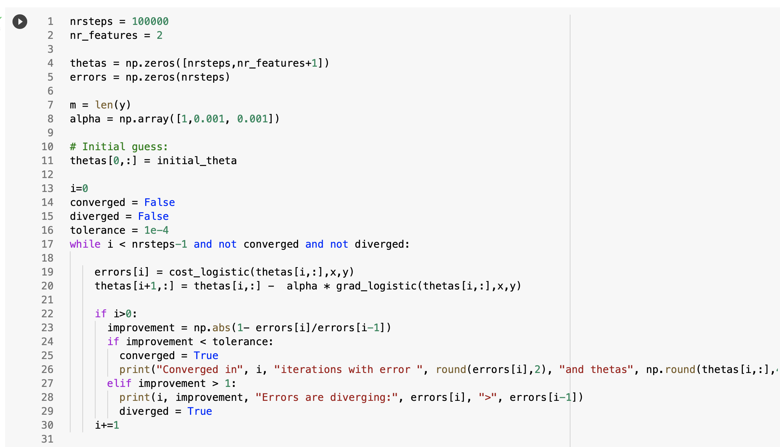
Vectorized Gradient Descent in while-loop
Identical to Numerical Regression!

Slide 36
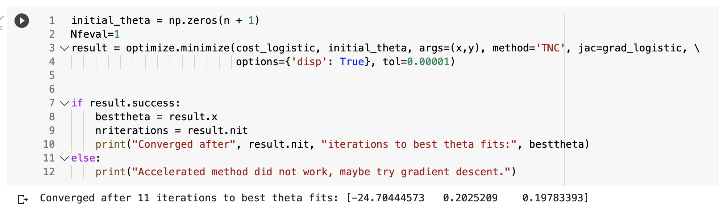
Accelerated Gradient Descent
Any minimization algorithms for numerical regression also work for logistic regression. Only need the cost function and gradient as input:

Slide 37
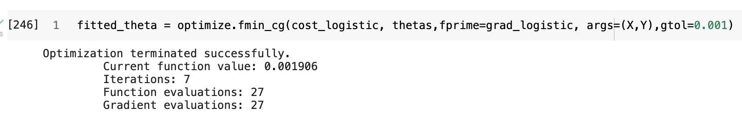
Accelerated Gradient Descent
Any minimization algorithms for numerical regression also work for logistic regression. Only need the cost function and gradient as input:

Slide 38
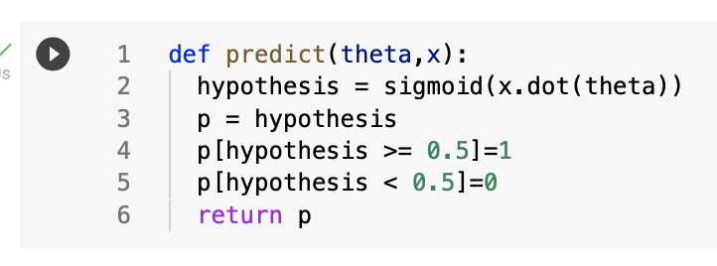
Binary Prediction
Our sigmoid hypothesis gives a continuous probability of y = 1
To turn this into a binary classification, we can use simple threshold:

Slide 39
Non-Linear Logistic Regression

Slide 40
Non-Linear Logistic Regression
Identical to generalization to non-linear numerical regression
Simply define polynomial features and run linear logistic regression
Gradient descent, accelerated GD, stochastic GD, mini-batch GD, all the same!

Slide 41
How about Multiple Classes??

Slide 42
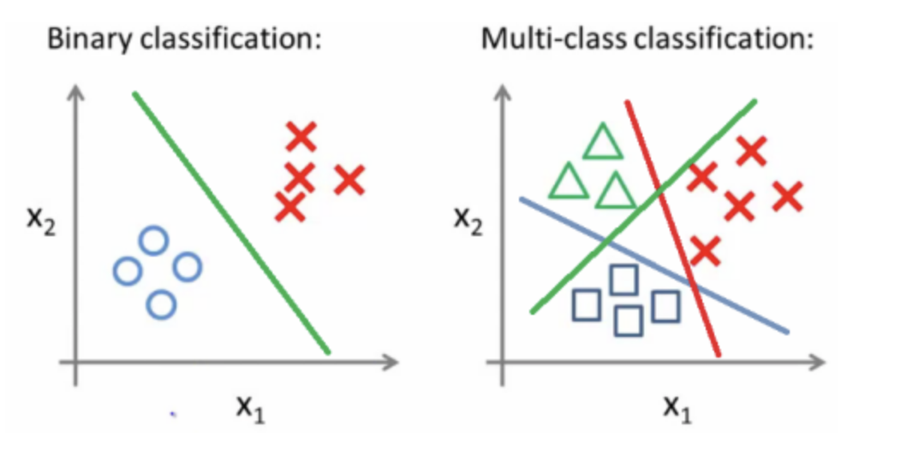
One-vs-All Classification
Surprisingly simple solution: loop over number of classes and solve/fit each as ‘yes’ (y = 1) or ‘no’ (y = 0) only for that class!

Slide 43
Conclusions

Slide 44
Conclusions
Logistic regression classifies data into discrete labels y,
Requires a different hypothesis: instead of fitting a polynomial function, we fit a sigmoid function of such a polynomial
A different logistic cost function approaches 0 for correct prediction and infinity for wrong prediction
Gradient of this cost function looks same as for numerical regression
We can fit multiple classes with a ‘one-versus-all’ trick
In terms of logistic cost function & gradient, all numerical regression machine learning methods work the same for classification!

Slide 45
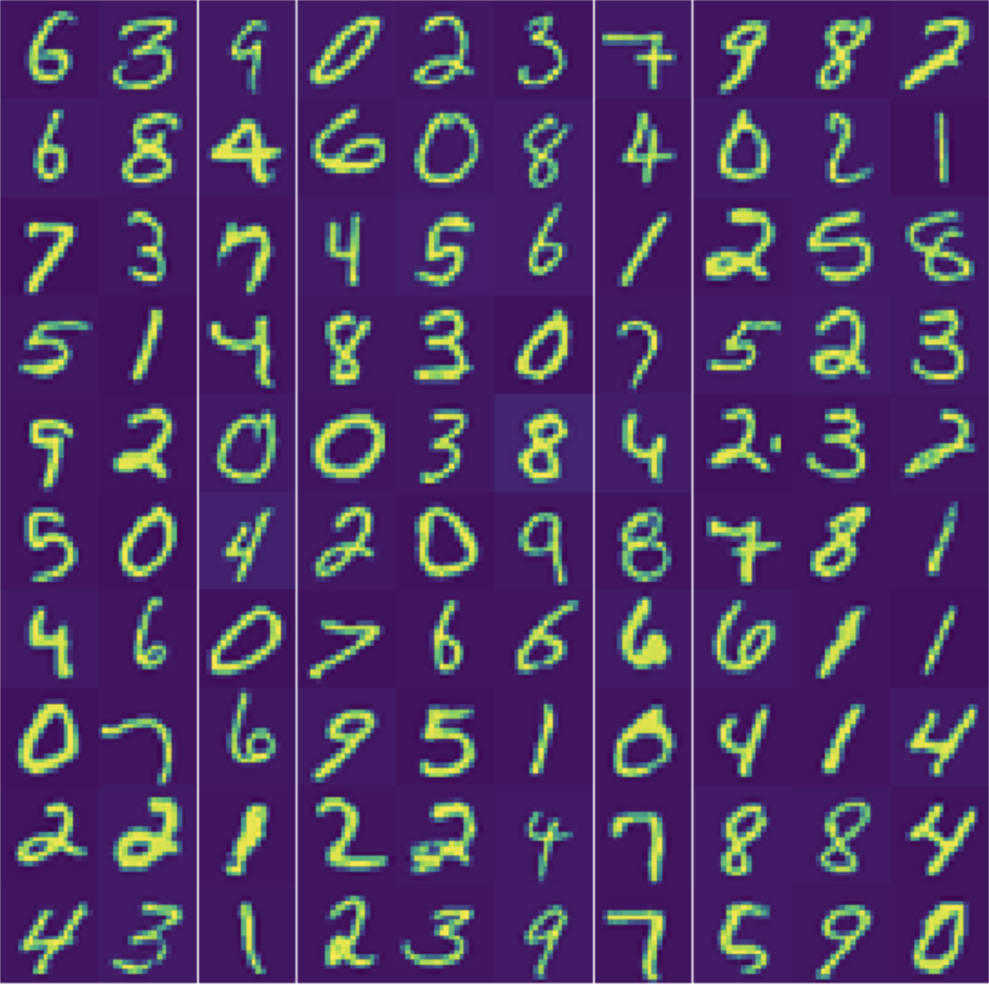
Lecture Notes & Lab(s)
Lecture notes:
  Week_4_Lecture_Logistic_Regression_Classification.pptx .pdf
  Week_4_Lecture_Logistic_Regression_Classification.ipynb
Labs:
  Week_4_Lab_Logistic_Regression.ipynb

