Slide 1
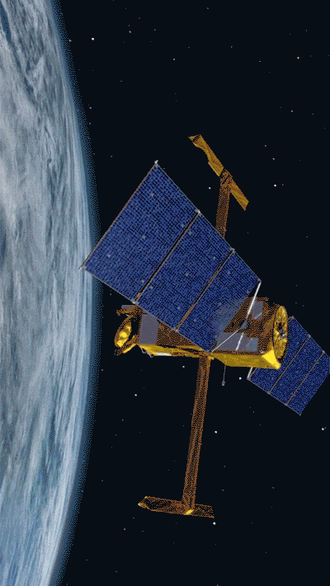
Lecture 5
Machine Learning Pipelines

Slide 2
Overview
Data preprocessing pipelines
  Categorical features
  Missing feature values
  Feature scaling
How to handle underfitting/overfitting?
  Lasso & Ridge Regularization
  Feature selection

Slide 3
Categorical features

Slide 4
Example
Course Number | Credit hrs | Days | Times | Instructor | Average grade | SEI score | Topic |  | Course popularity
5194 | 2 | Wed | 9.20am – 10.15am | Joachim Moortgat | NaN | NaN | Programming | … | 8.1
5751 | 4 | Tue-Thur | 9.35am - 11.35am | Joachim Moortgat | 87% | 4.9 | Programming | … | 7.1
5663 | 3 | Tue-Thur | 11.10am - 12.30pm | Franklin Schwartz | 66% | 5 | Sustainability | … | 6.3
5780 | 4 | Mon-Wed-Fri | 9.10am - 10.05am 2.40pm - 5.30pm | Derek Sawyer | 90% | 4.7 | Seismology | … | 6.8
5641 | 2 | Tue-Thur | 12.45pm - 2.35pm | Yanlan Liu | 80% | 5 | Programming | … | 8
⋮ | ⋮ | ⋮ | ⋮ | ⋮ | ⋮ | ⋮ | ⋮ | ⋮ | ⋮
5651 | 3 | Tue-Wed-Thur | 9.35 - 10.55am and 2.20pm - 4.10pm | Audrey Sawyer | 85% | 5 | Hydrogeology | … | 9

Slide 5
Categorical features
Features like ‘instructor’ contain strings: called categorical features
ML algorithms are purely algebra on arrays, need only numbers
How do we turn categorical features into numbers?

Slide 6
One-Hot-Encoding
SEI/5 | Hrs per week/5 | Morning class | Moortgat | Schwartz | D Sawyer | Y. Liu | A Sawyer |  | Course popularity
0.98 | 0.4 | 1 | 1 | 0 | 0 | 0 | 0 | … | ?
0.98 | 0.8 | 1 | 1 | 0 | 0 | 0 | 0 | … | 7.1
1 | 0.6 | 0 | 0 | 1 | 0 | 0 | 0 | … | 6.3
0.94 | 0.8 | 0 | 0 | 0 | 1 | 0 | 0 | … | 6.8
1 | 0.4 | 1 | 0 | 0 | 0 | 1 | 0 | … | 8
⋮ | ⋮ | ⋮ | ⋮ | ⋮ | ⋮ | ⋮ | ⋮ | ⋮ | ⋮
1 | 0.6 | 1 | 0 | 0 | 0 | 0 | 1 | … | 9

Slide 7
Impute missing values

Slide 8
Example
Course Number | Credit hrs | Days | Times | Instructor | Average grade | SEI score | Topic |  | Course popularity
5194 | 2 | Wed | 9.20am – 10.15am | Joachim Moortgat | NaN | NaN | Programming | … | 8.1
5751 | 4 | Tue-Thur | 9.35am - 11.35am | Joachim Moortgat | 87% | 4.9 | Programming | … | 7.1
5663 | 3 | Tue-Thur | 11.10am-12.30pm | Franklin Schwartz | 66% | 5 | Sustainability | … | 6.3
5780 | 4 | Mon-Wed-Fri | 9.10am-10.05am 2.40pm-5.30pm | Derek Sawyer | 90% | 4.7 | Seismology | … | 6.8
5641 | 2 | Tue-Thur | 12.45pm-2.35pm | Yanlan Liu | 80% | 5 | Programming | … | 8
⋮ | ⋮ | ⋮ | ⋮ | ⋮ | ⋮ | ⋮ | ⋮ | ⋮ | ⋮
5651 | 3 | Tue-Wed-Thur | 9.35-10.55am and 2.20pm-4.10pm | Audrey Sawyer | 85% | 5 | Hydrogeology | … | 9
Options: replace missing numerical feature values with, e.g., mean/median
Replace categorical feature values with, e.g. most common, or separate class
from sklearn.impute import SimpleImputer
Or..: use ML to estimate missing values

Slide 9
Feature Scaling

Slide 10
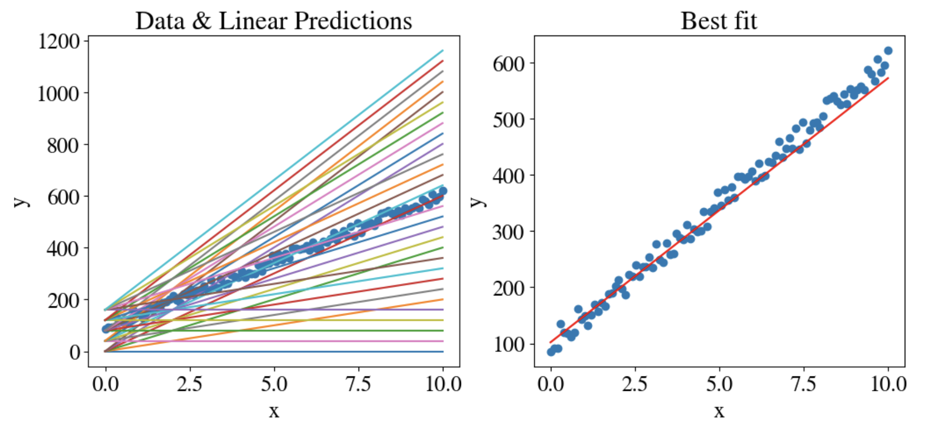

Recap: Simplest Univariate Linear Regression
Fit `best’ intercept and slope of linear model to (noisy) measurements
In this case: $y=θ_{0}x_{0}+θ_{1}x_{1}=102+47 x_{1}$, for $0<x_{1}<10$

Slide 11
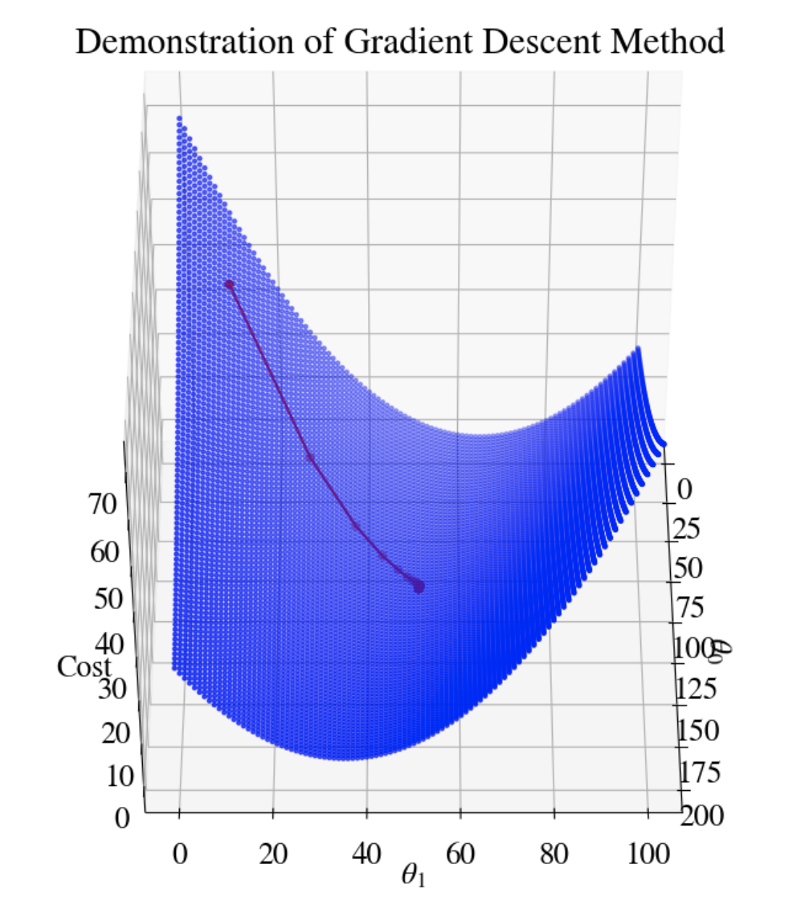
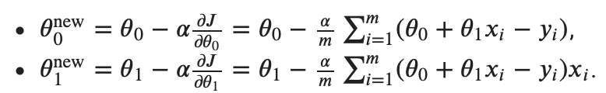
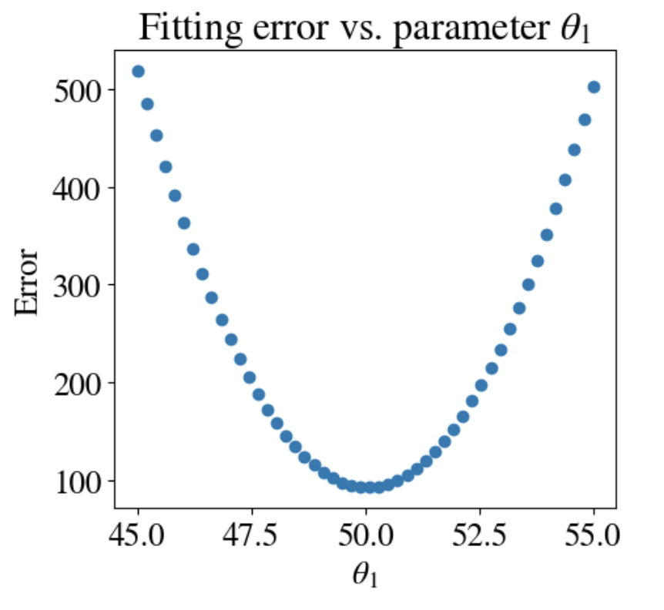
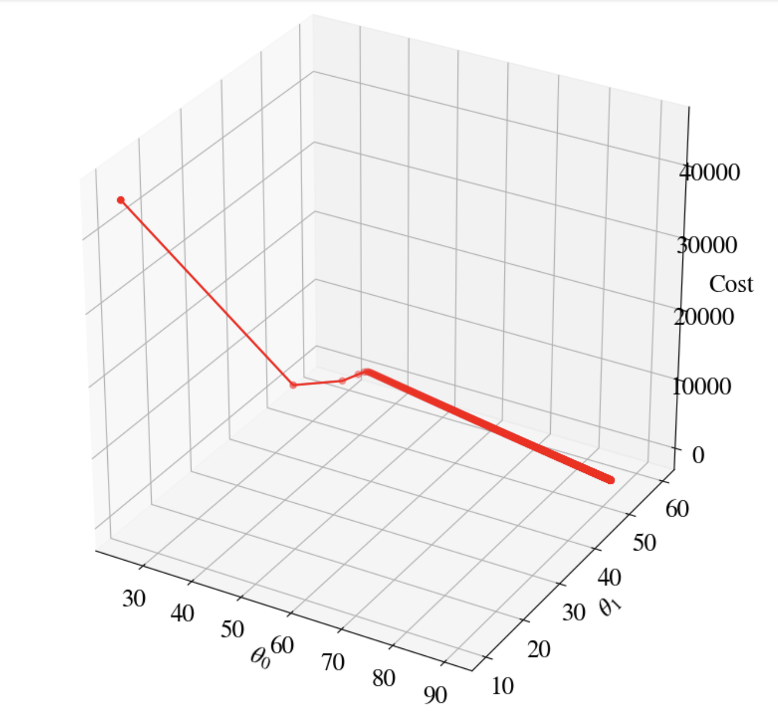


Machine Learning as Minimization Schemes
Find minimum of mean-squared or logistic errors
$${\hat{y}}_{i}$$
$${\hat{y}}_{i}$$

Slide 12

Challenge & Solution
Gradient descent methods (and others) do not converge if error gradient in one feature is much larger/smaller than in other feature(s)
Also affects sensitivity of fit to each feature
Solution: `min-max’ feature scaling:
(e.g., sklearn.preprocessing.MinMaxScaler )

Slide 13
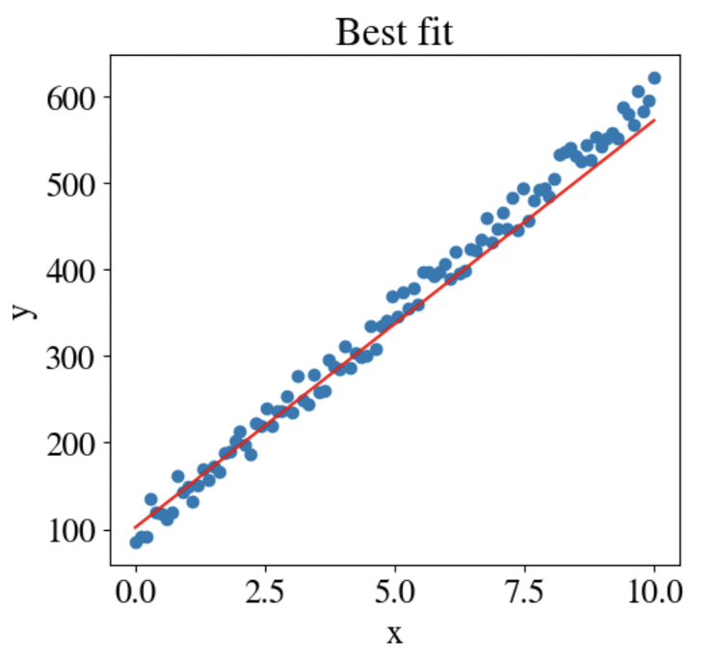
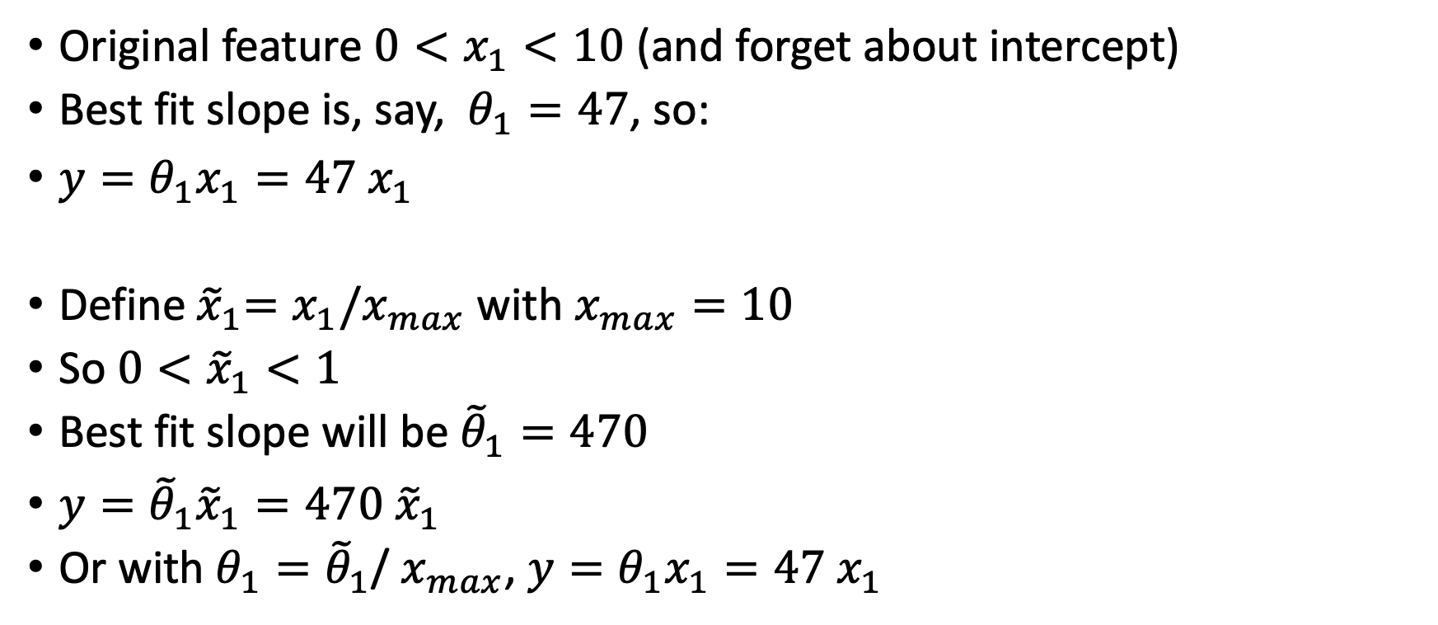
Example
Original feature $0<x_{1}<10$ (and forget about intercept)
Best fit slope is, say, $θ_{1}=47$, so:
$y=θ_{1}x_{1}=47 x_{1}$
Define${ \tilde{x}}_{1}=x_{1}/x_{max}$ with $x_{max}=10$
So $0<{\tilde{x}}_{1}<1$
Best fit slope will be ${\tilde{θ}}_{1}=470$
$y={\tilde{θ}}_{1}{\tilde{x}}_{1}=470 {\tilde{x}}_{1}$
Or with $θ_{1}={\tilde{θ}}_{1}$/ $x_{max}$, $y=θ_{1}x_{1}=47 x_{1}$

Slide 14
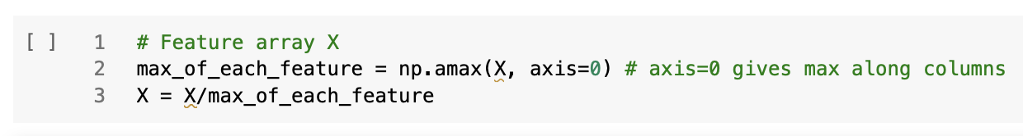
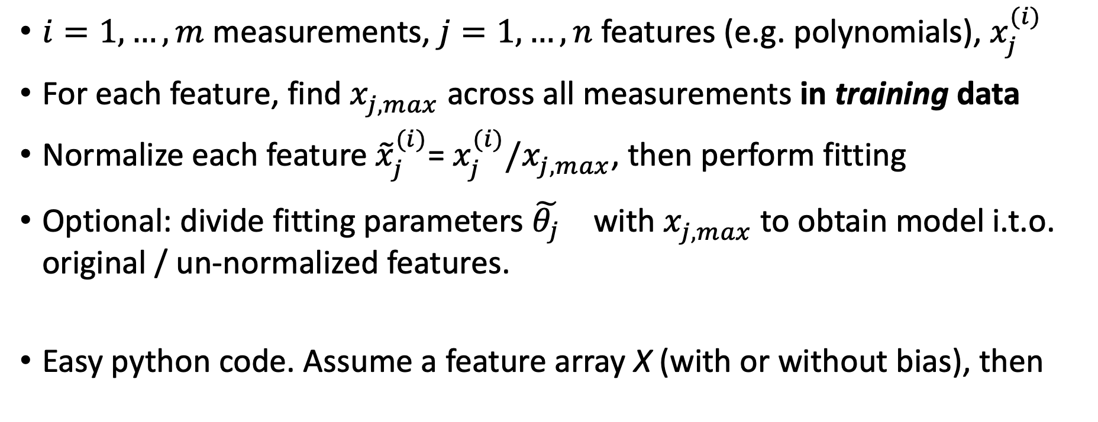
Generalization
$i=1,…,m$ measurements, $j=1,…,n$ features (e.g. polynomials), $x_{j}^{(i)}$
For each feature, find $x_{j,max}^{}$ across all measurements in training data
Normalize each feature ${\tilde{x}}_{j}^{(i)}$= $x_{j}^{(i)}/x_{j,max}^{}$, then perform fitting
Optional: divide fitting parameters ${\tilde{θ_{j}}}^{}$ with $x_{j,max}^{}$ to obtain model i.t.o. original / un-normalized features.
Easy python code. Assume a feature array X (with or without bias), then

Slide 15
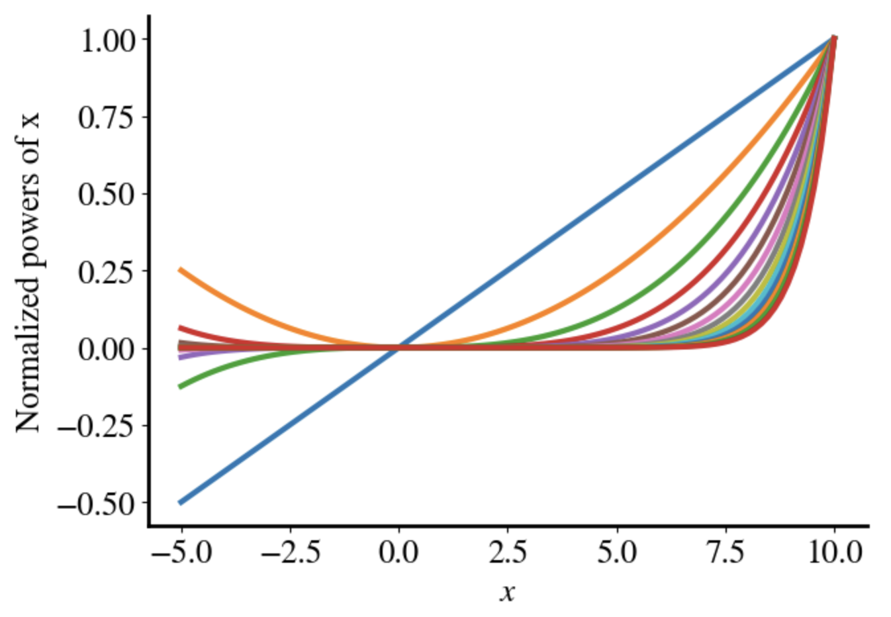
Rescaled Polynomial Features

Slide 16
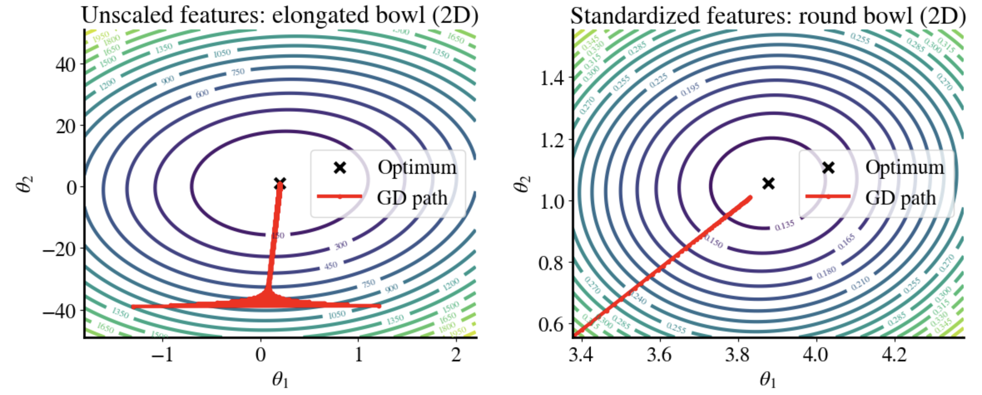


Impact on Gradient Descent
$$0<x_{1}<20, 0<x_{2}<1$$
$$0<x_{1}<1, 0<x_{2}<1$$

Slide 17
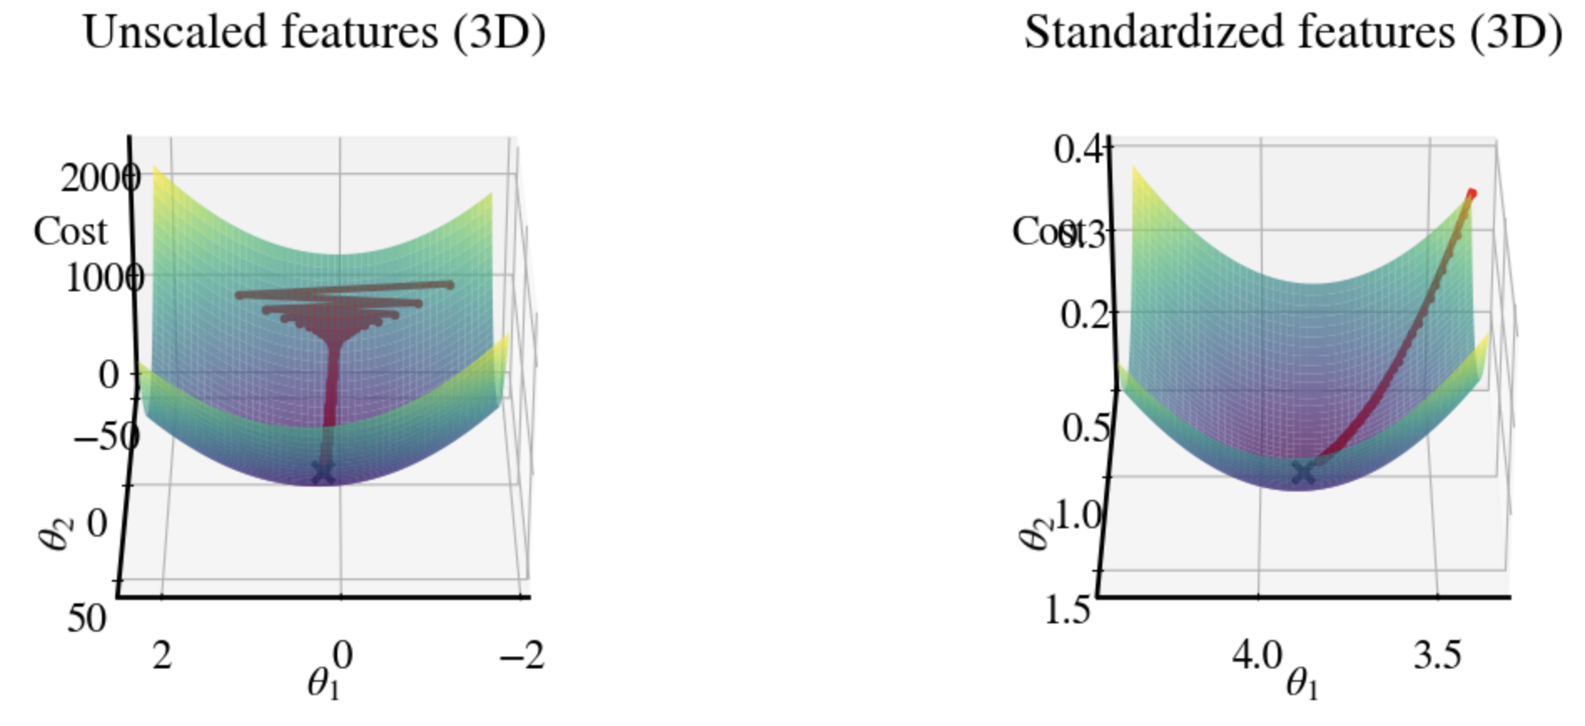
Impact on Gradient Descent

Slide 18
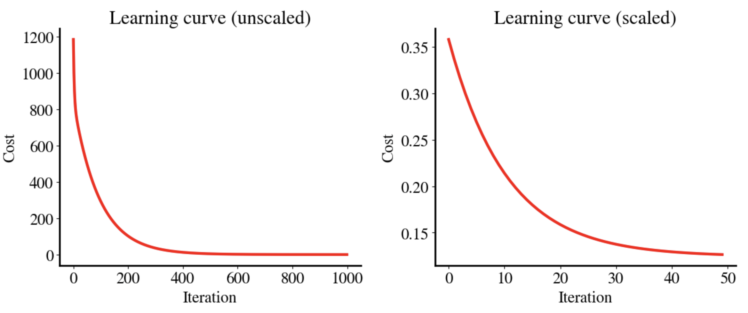
Learning Curves

Slide 19
Complementary Solution
Different and adaptive learning rates for different features
During gradient descent, keep track of gradients in each features
Adjust learning rates accordingly
Idea behind common optimization schemes like ‘Adam’

Slide 20
Summary: Pipelines
For ‘Big Data’, data preprocessing generally done in (on-the-fly) pipelines
  Feature engineering: what features to (not) include?
  Data acquisition, e.g. from web, HPC storage, data center
  Fuse multimodal data into suitable python structure (e.g., pandas)
  Fix NaN, impute missing values, one-hot-encode categorical values; output pure numerical numpy array
  Or xarray for geospatial data where pixels have coordinates and metadata
  Remove outliers or reduce noise
  Feature scaling; for satellite imagery perhaps histogram matching
  Crop/clip data into smaller chunks if necessary for RAM memory
  Image/data augmentation: generate additional synthetic training data
  Split into training and test data; consider K-fold CV training-validation splits
  Select hyperparameters and optimize during CV (next week), etc.

