Slide 1

Lecture 6
Cross-Validation &
Lasso and Ridge Regularization

Slide 2
Overview
How to handle underfitting/overfitting?
  Meaning of bias and variance
  Cross-validation
  Lasso & Ridge Regularization
  Feature selection

Slide 3
Underfitting/Overfitting
= Bias & Variance

Slide 4
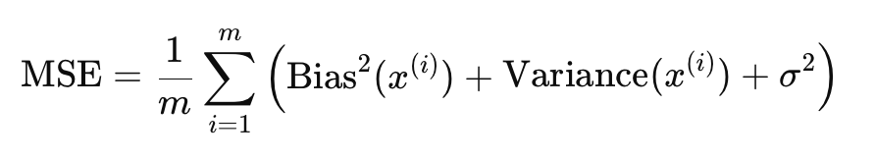
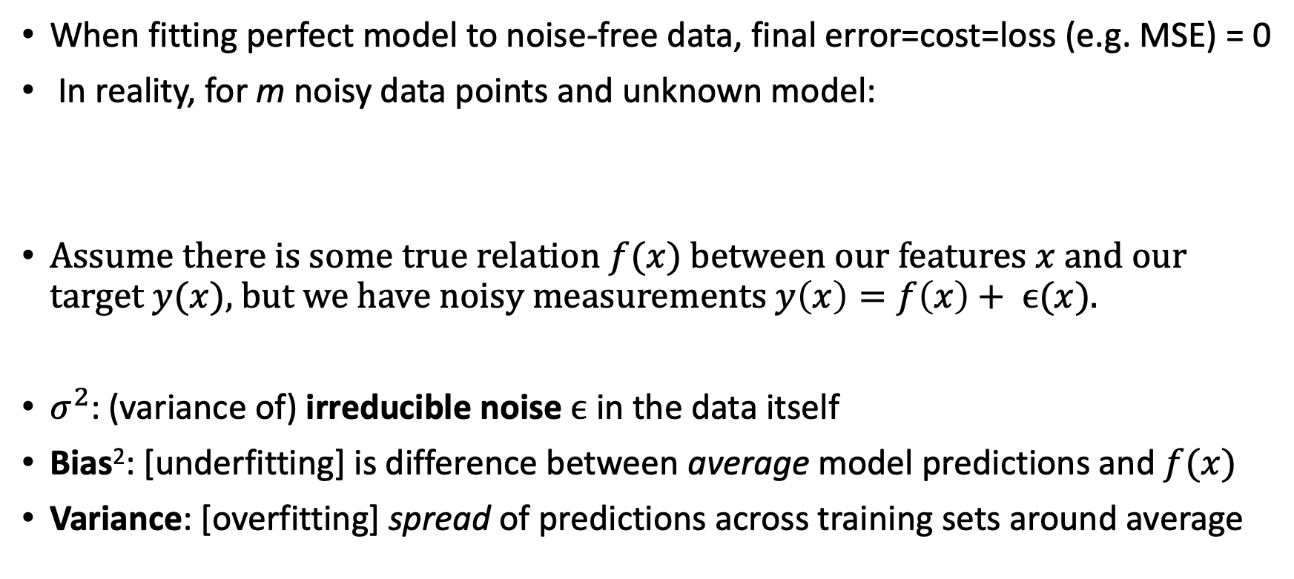
Bias, Variance, and Irreducible Noise
When fitting perfect model to noise-free data, final error=cost=loss (e.g. MSE) = 0
In reality, for m noisy data points and unknown model:
Assume there is some true relation $f(x)$ between our features $x$ and our target $y(x)$, but we have noisy measurements $y\left(x\right)=f\left(x\right)+ ϵ(x)$.
$σ^{2}$: (variance of) irreducible noise $ϵ$ in the data itself
Bias²: [underfitting] is difference between average model predictions and $f(x)$
Variance: [overfitting] spread of predictions across training sets around average

Slide 5
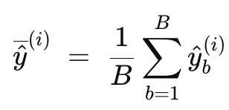
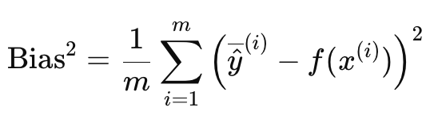
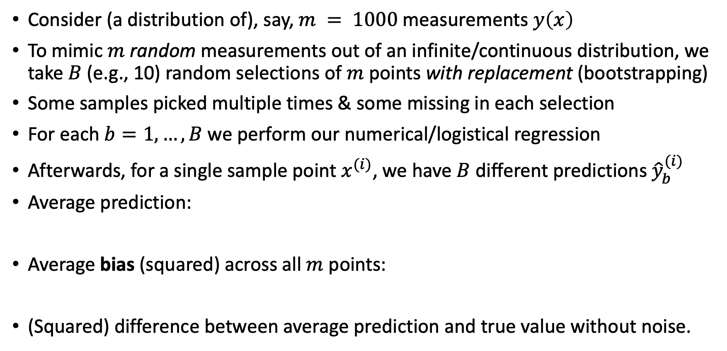
Bias – Precise Definition
Consider (a distribution of), say, $m = 1000$measurements $y\left(x\right)$
To mimic $m$ random measurements out of an infinite/continuous distribution, we take $B$ (e.g., 10) random selections of $m$ points with replacement (bootstrapping)
Some samples picked multiple times & some missing in each selection
For each $b=1, …, B$ we perform our numerical/logistical regression
Afterwards, for a single sample point $x^{(i)}$, we have $B$ different predictions ${\hat{y}}_{b}^{(i)}$
Average prediction:
Average bias (squared) across all $m$ points:
(Squared) difference between average prediction and true value without noise.

Slide 6
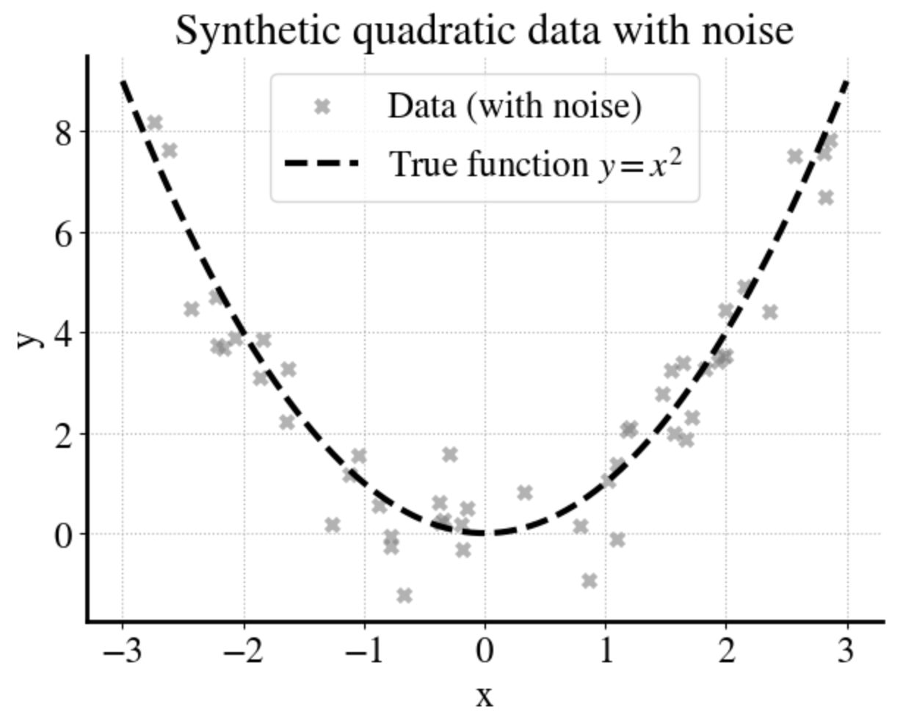

Illustration
$$m=50$$

Slide 7
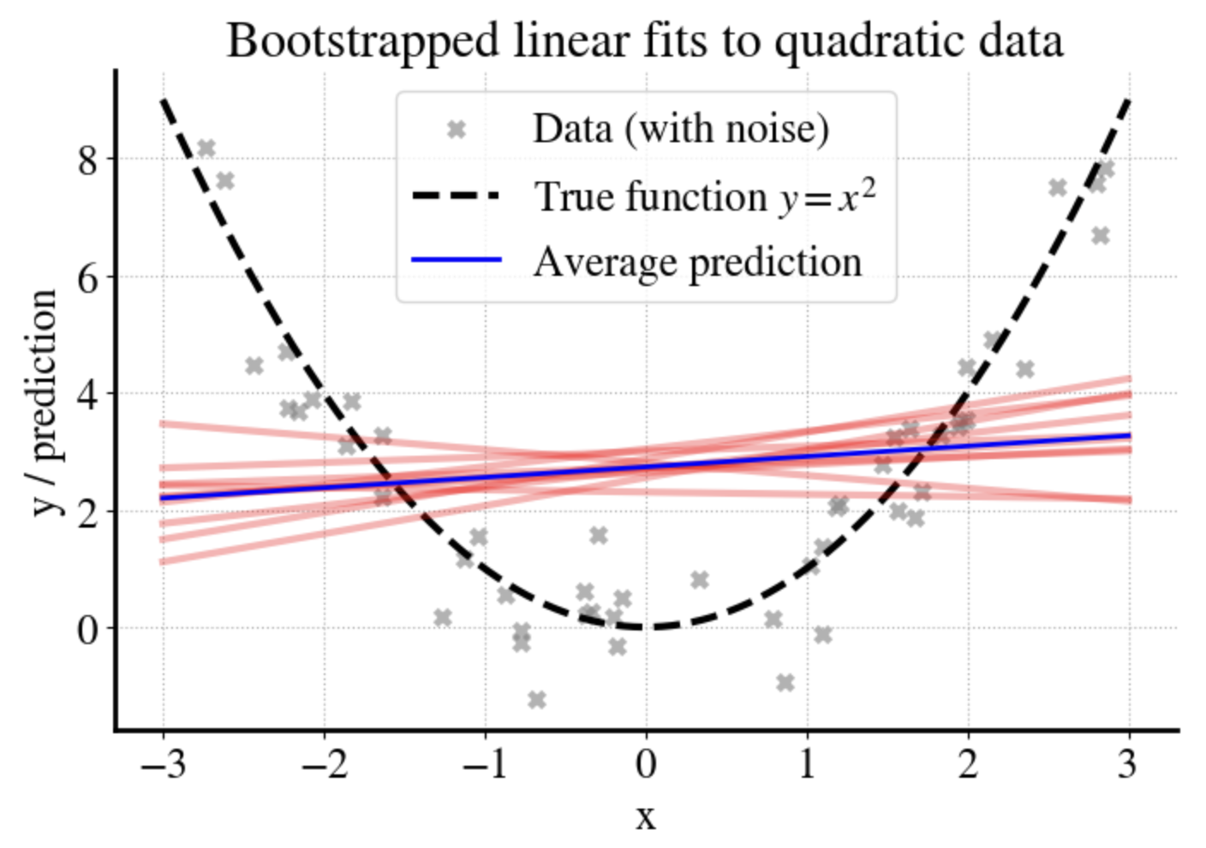
Illustration

Slide 8
Illustration

Slide 9
MSE on training and test data converge when increasing m, but plateau at ‘large’ value: underfitting!

Slide 10
Learning Curve

Slide 11
Bias Summary
Bias is due to model not being sophisticated enough
Increasing amount of (training/validation) data does not help
Solutions:
  More complex model, such as higher-order polynomial, neural network, decision trees, etc.
  Or! Additional features (e.g., not just pressure but also temperature, etc.).

Slide 12
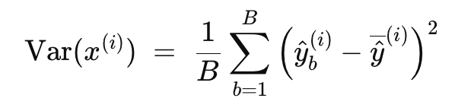
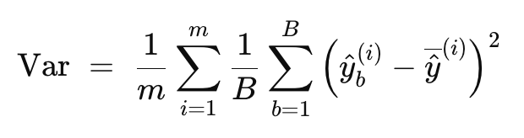
Variance – Precise Definition
Consider same definitions for m samples and B training data samples
Variance is ‘spread’ of individual model predictions around the averaged model prediction across B sets of training data, with ‘spread’ defined just like a MSE:
For one measurement point:
(doesn’t care about true value)
Across all measurements:
Analogy: imagine throwing 20 darts at a dart board:
  Bias is distance between average location of darts and bullseye (‘intercept’)
  Variance is the spread in the darts around their average location

Slide 13
Illustration
6th order polynomial fits

Slide 14
MSE on training and test data very different for small m, overfitting, but converge and reduce to zero for very large m.

Slide 15
Increasing m Does Feature Selection!
2 runs

Slide 16
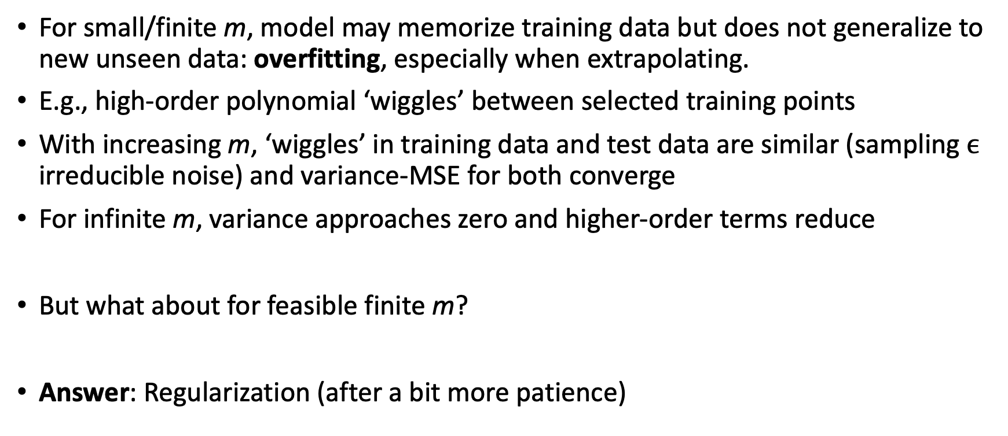
Variance Summary
For small/finite m, model may memorize training data but does not generalize to new unseen data: overfitting, especially when extrapolating.
E.g., high-order polynomial ‘wiggles’ between selected training points
With increasing m, ‘wiggles’ in training data and test data are similar (sampling $ϵ$ irreducible noise) and variance-MSE for both converge
For infinite m, variance approaches zero and higher-order terms reduce
But what about for feasible finite m?
Answer: Regularization (after a bit more patience)

Slide 17
Nuance
Every model has some bias/variance/measurement errors
High-bias, low-variance suggests underfitting
Low-bias, high-variance suggests overfitting

Slide 18
High-Bias, Low-Variance Example

Slide 19
High-Variance, Low-Bias Example

Slide 20
Cross-Validation

Slide 21
Cross-Validation
Objective of ML algorithms is to find a model for a problem based on limited data (e.g., measurements) to make predictions for other conditions
Model that fits training data but doesn’t generalize to new data is useless
In supervised learning, when we have (labeled) measurements we can ‘fake’ future measurements by splitting into training and hold-out validation data.
Fit model to training data, predict for validation data, report MSE on the latter.
One such split is generally not sufficient for small/finite m.
Solution: K-fold cross-validation, i.e. do train:validation split K times to get better statistics on model generalizability.

Slide 22
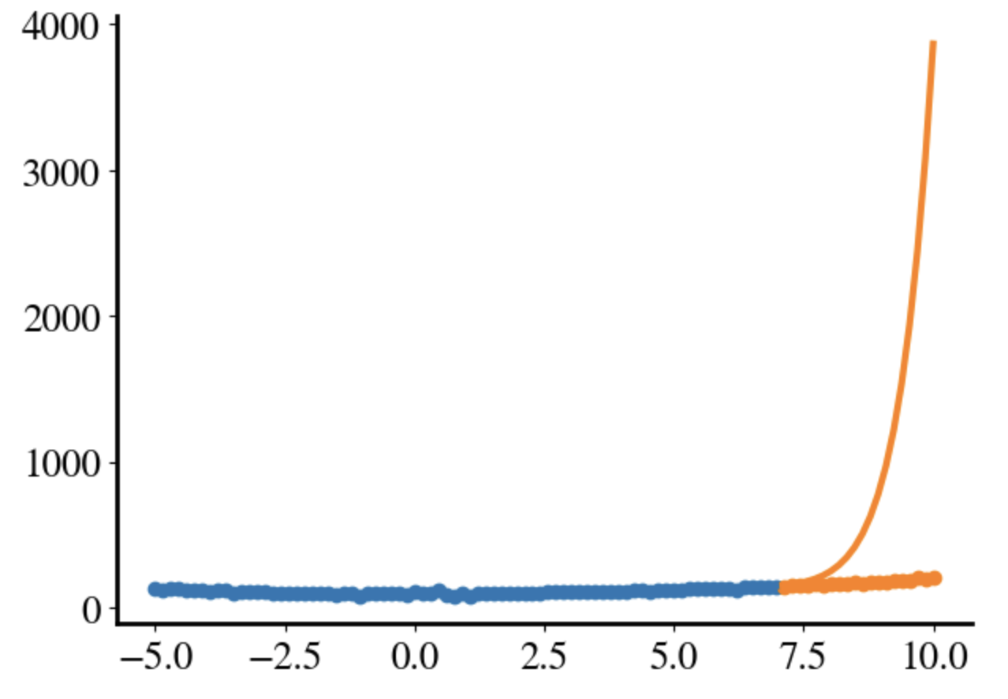
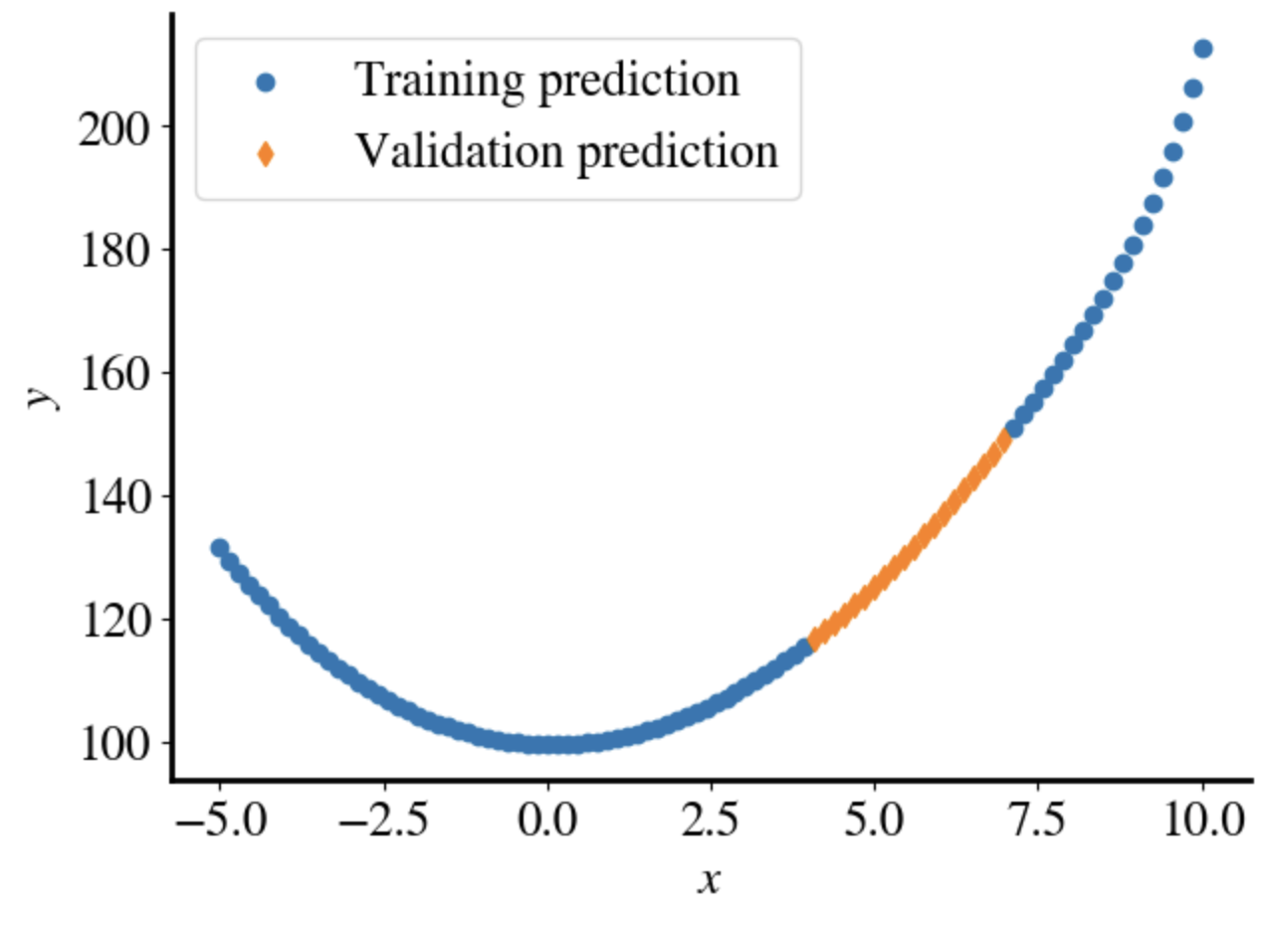
Example: fit 15th–order polynomial to x² data
Remember, extrapolation always problematic so randomize before split

Slide 23
Example: fit 15th–order polynomial to x² data
5-fold cross-validation. Fits all look good, but completely different polynomials!

Slide 24
Example: fit 15th–order polynomial to x² data
5-fold cross-validation: Validation errors generally larger than training errors:
Overfitting!

Slide 25
Regularization
Ridge & Lasso Regularized Numeric or Logistic Regression

Slide 26
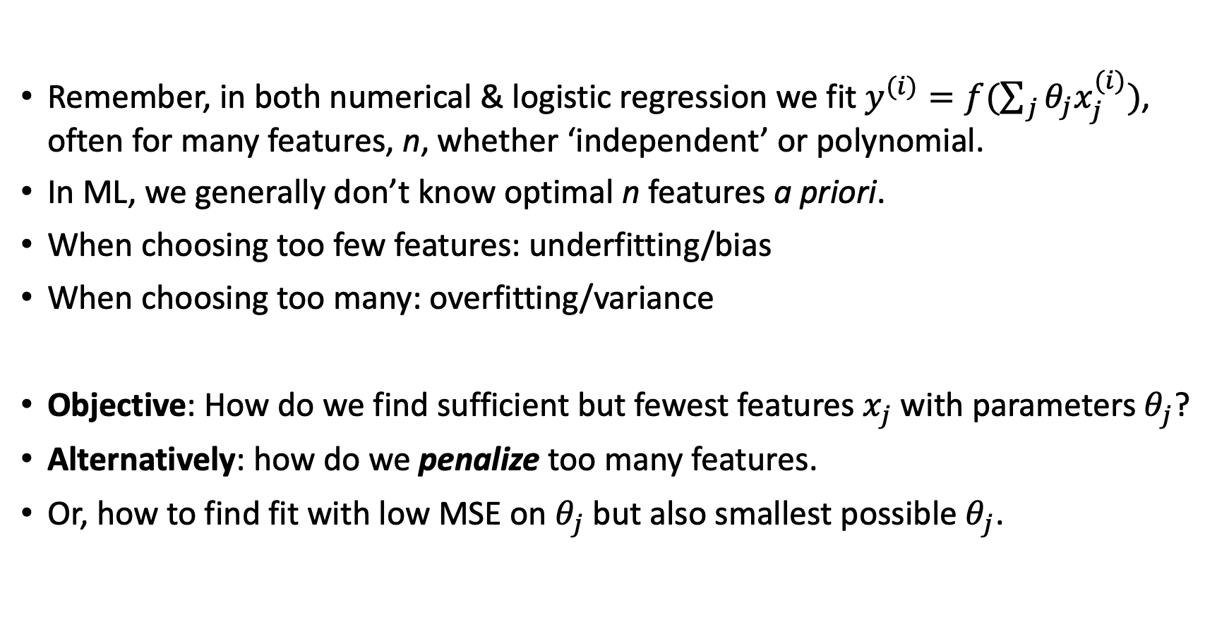
Problem Statement
Remember, in both numerical & logistic regression we fit $y^{(i)}=f(\sum_{j}{θ_{j}x_{j}^{(i)})}$, often for many features, n, whether ‘independent’ or polynomial.
In ML, we generally don’t know optimal n features a priori.
When choosing too few features: underfitting/bias
When choosing too many: overfitting/variance
Objective: How do we find sufficient but fewest features $x_{j}$ with parameters $θ_{j}$?
Alternatively: how do we penalize too many features.
Or, how to find fit with low MSE on $θ_{j}$ but also smallest possible $θ_{j}$.

Slide 27

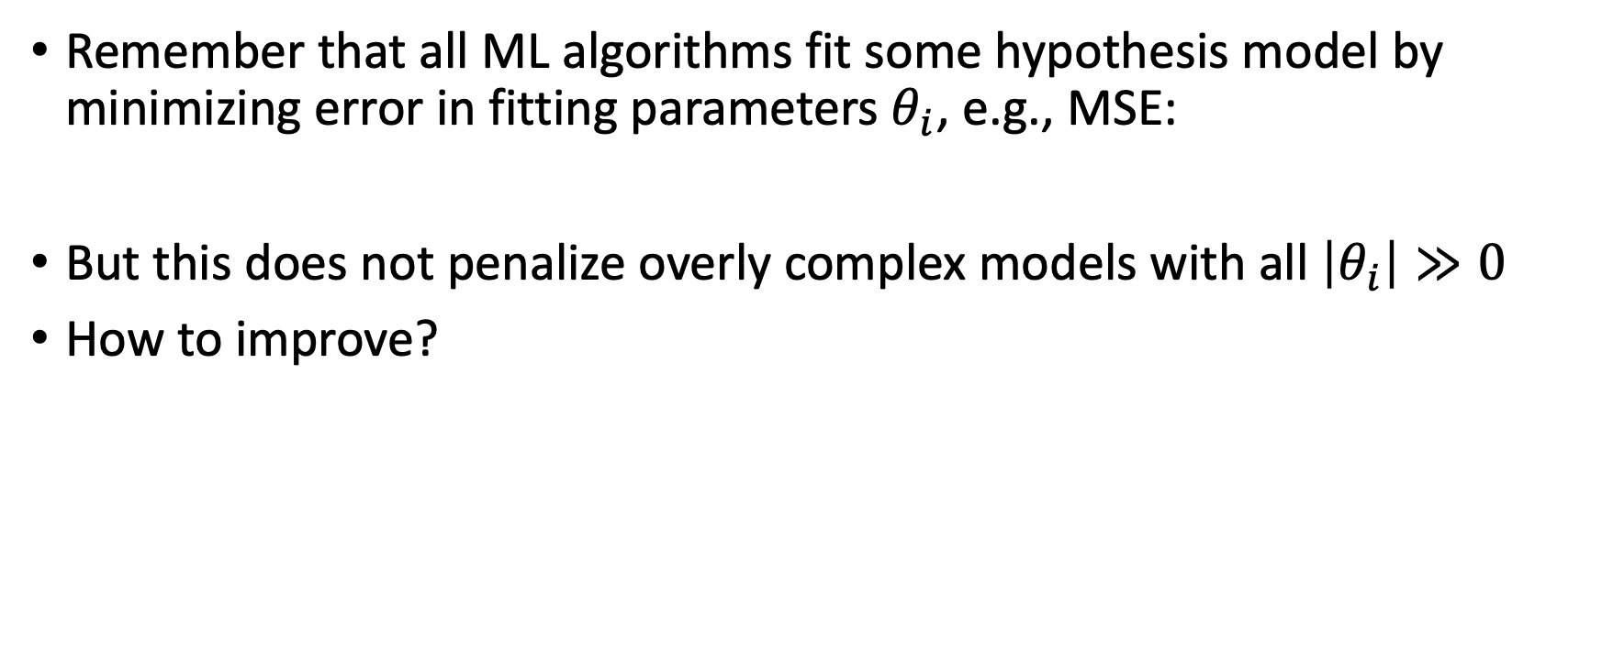
Conceptual Idea
Remember that all ML algorithms fit some hypothesis model by minimizing error in fitting parameters $θ_{i}$, e.g., MSE:
But this does not penalize overly complex models with all $\left|θ_{i}\right|≫0$
How to improve?

Slide 28


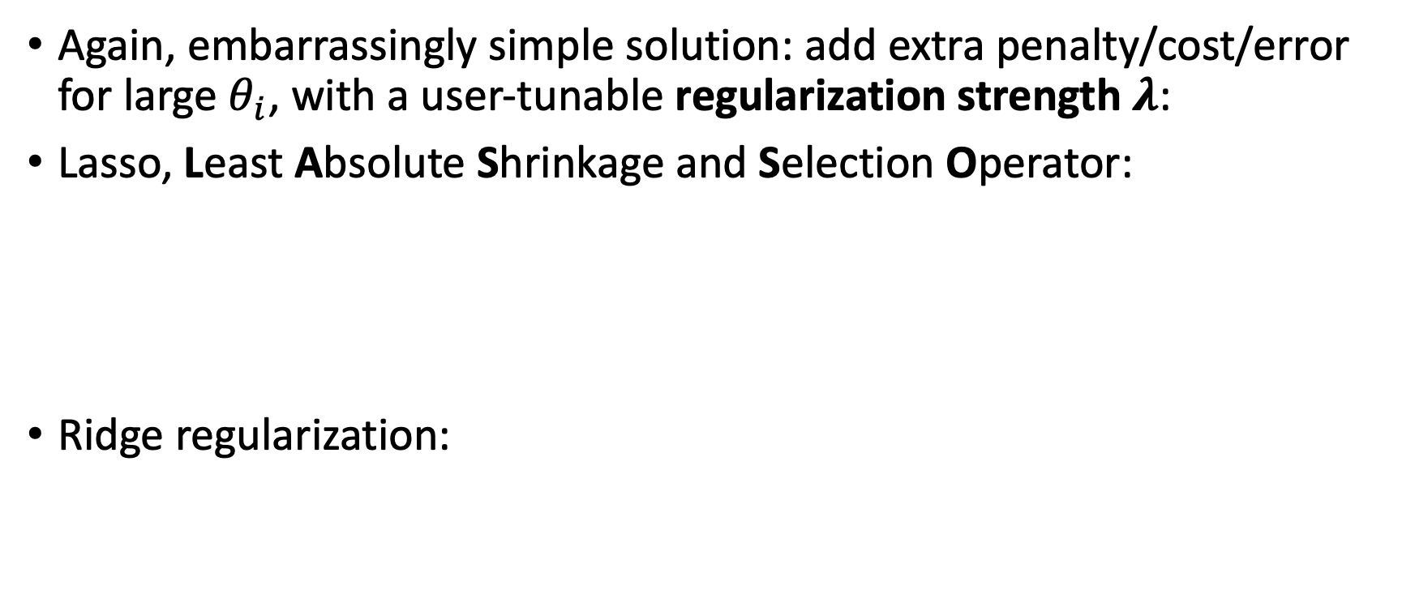
Regularization
Again, embarrassingly simple solution: add extra penalty/cost/error for large $θ_{i}$, with a user-tunable regularization strength 𝝀:
Lasso, Least Absolute Shrinkage and Selection Operator:
Ridge regularization:

Slide 29
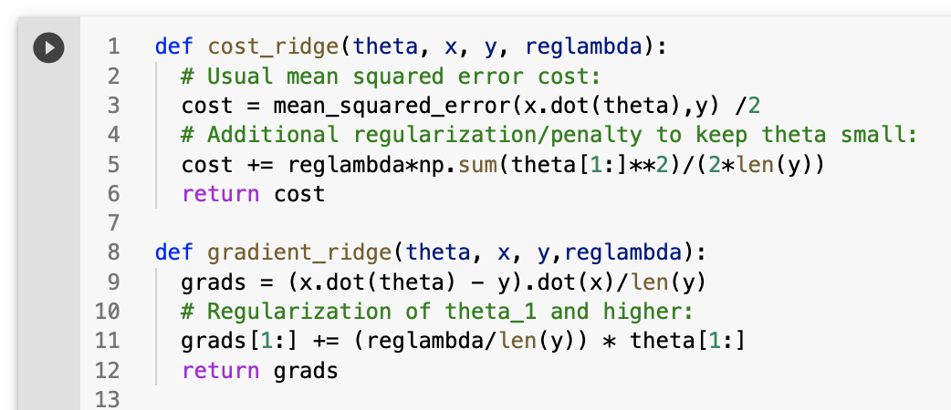
Full Python code for Ridge regression
Cost and cost gradient

Slide 30
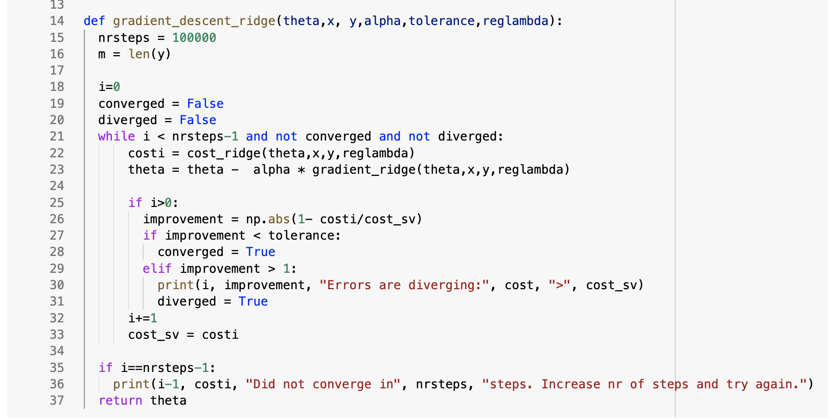

Slide 31
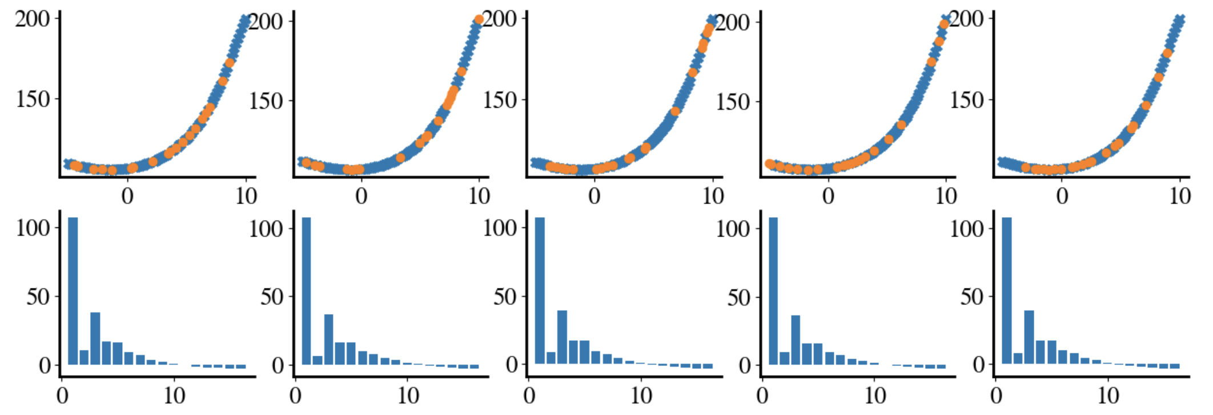
Example: Ridge Regression (still 15th order poly)
5-fold cross-validation with 𝝀=1
See how higher-order terms are much smaller (but not zero)

Slide 32
Remember, without regularization
5-fold cross-validation. Fits all look good, but completely different polynomials!

Slide 33
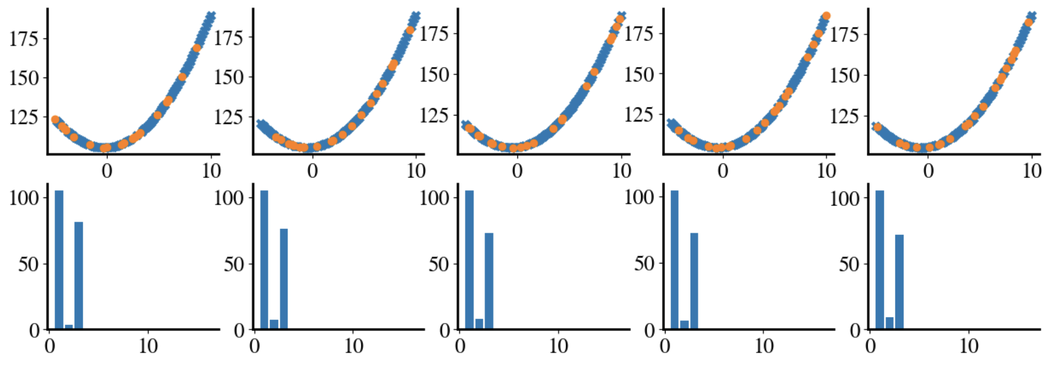
Example: Lasso Regression
For 𝝀=1, all terms beyond quadratic are exactly zero
True automatic feature selection!!

Slide 34
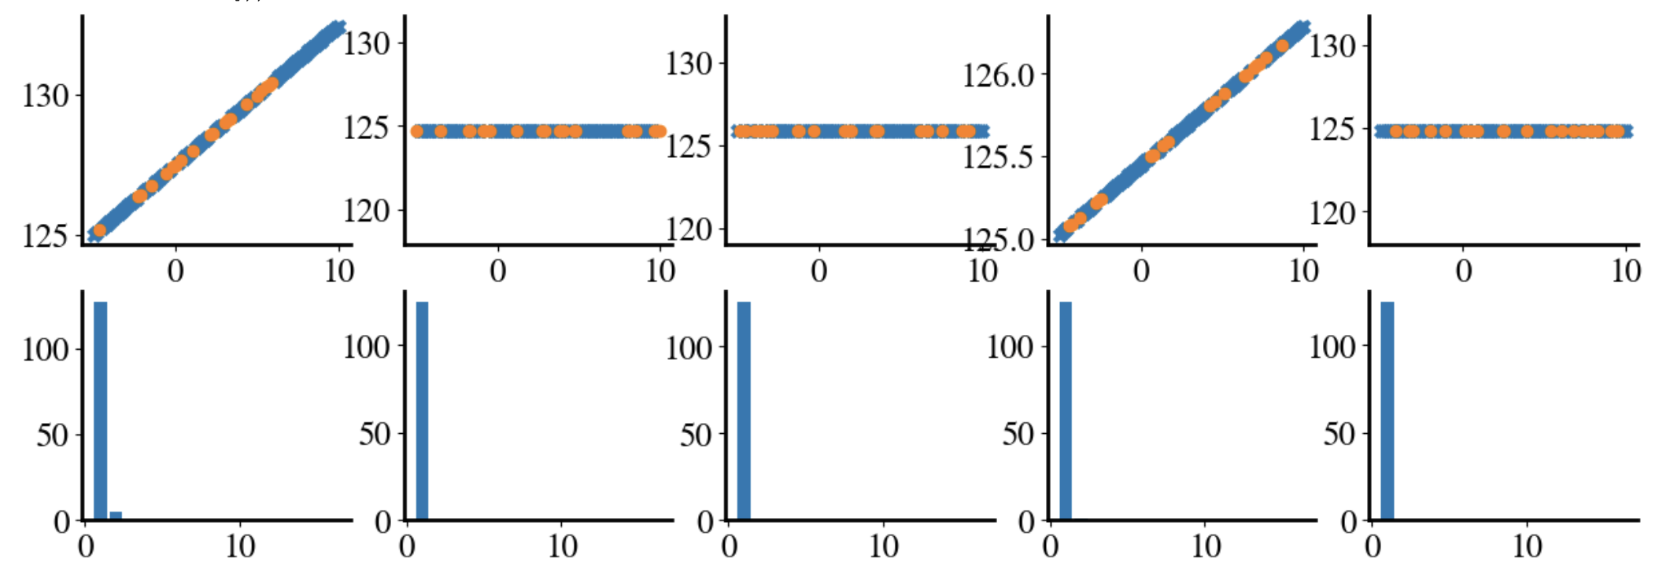
Example: Lasso Regression
For 𝝀=10, all terms beyond linear are zero…
Too much regularization: needs tuning

Slide 35
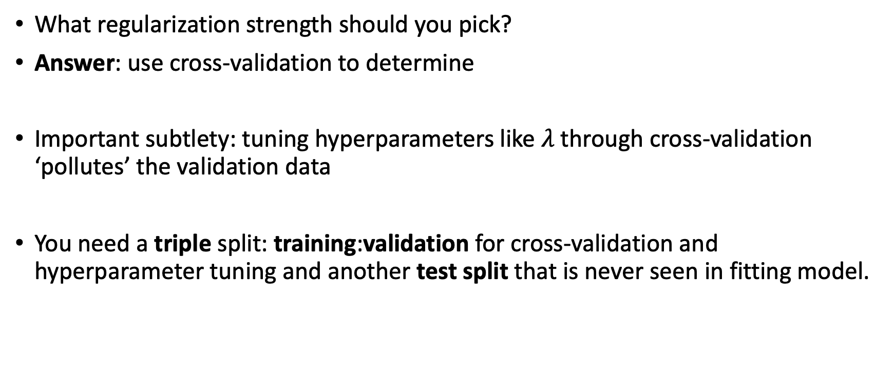
Subtlety
What regularization strength should you pick?
Answer: use cross-validation to determine
Important subtlety: tuning hyperparameters like $λ$ through cross-validation ‘pollutes’ the validation data
You need a triple split: training:validation for cross-validation and hyperparameter tuning and another test split that is never seen in fitting model.

Slide 36
So why can Lasso, but not Ridge, eliminate features?

Slide 37
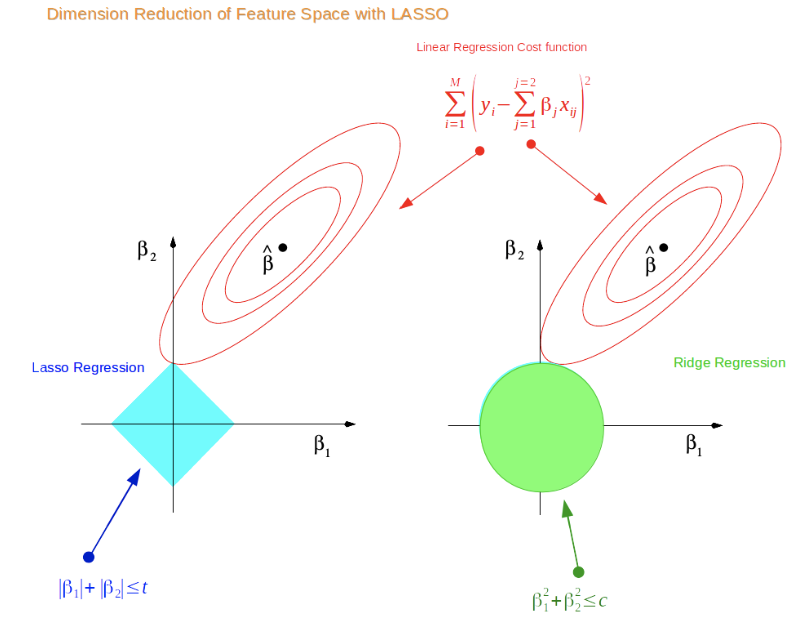
Least Absolute Shrinkage and Selection Operator

Slide 38
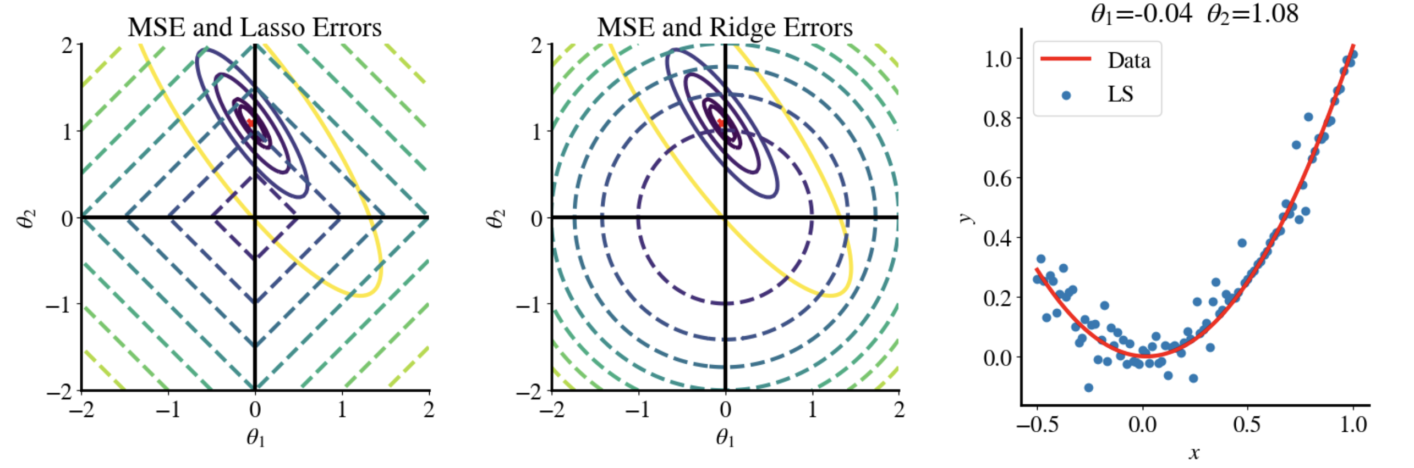
Without regularization
Quadratic term
Linear term

Slide 39
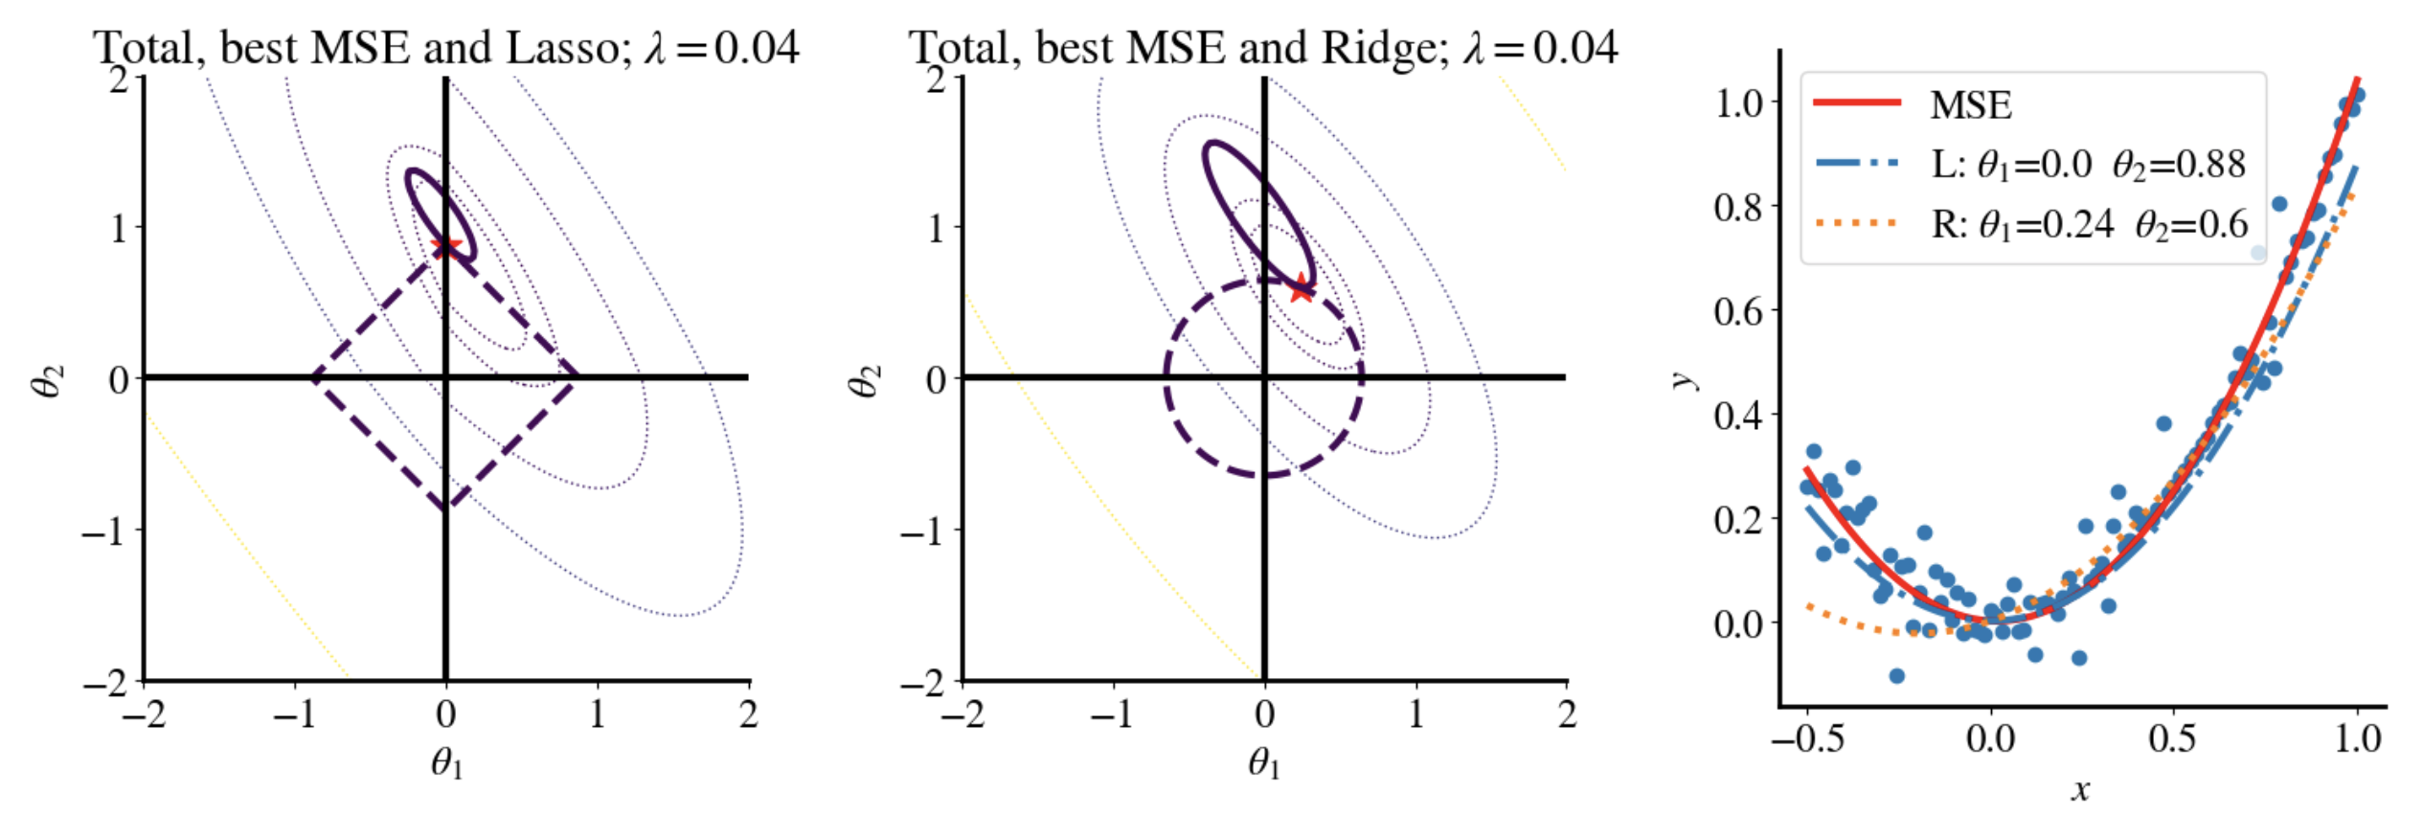
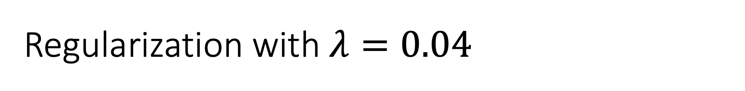
Regularization with $λ=0.04$
Lasso eliminated linear term!

Slide 40
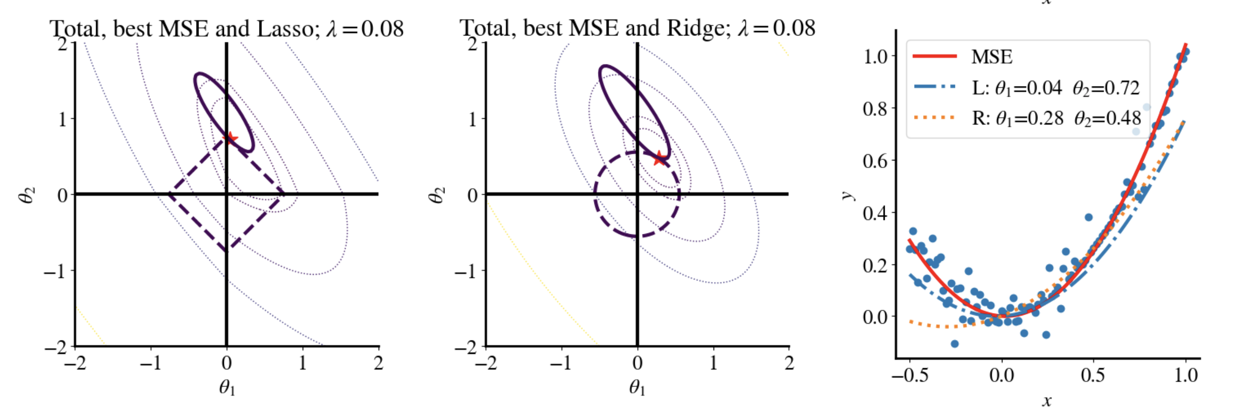
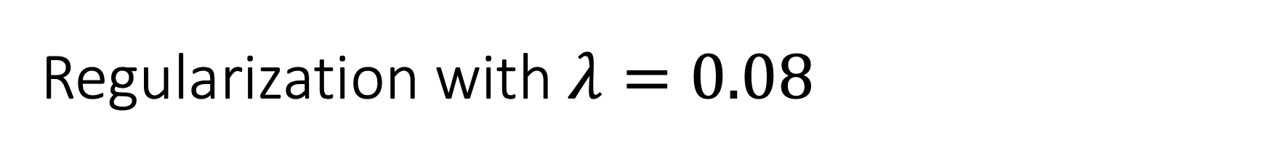
Regularization with $λ=0.08$

Slide 41
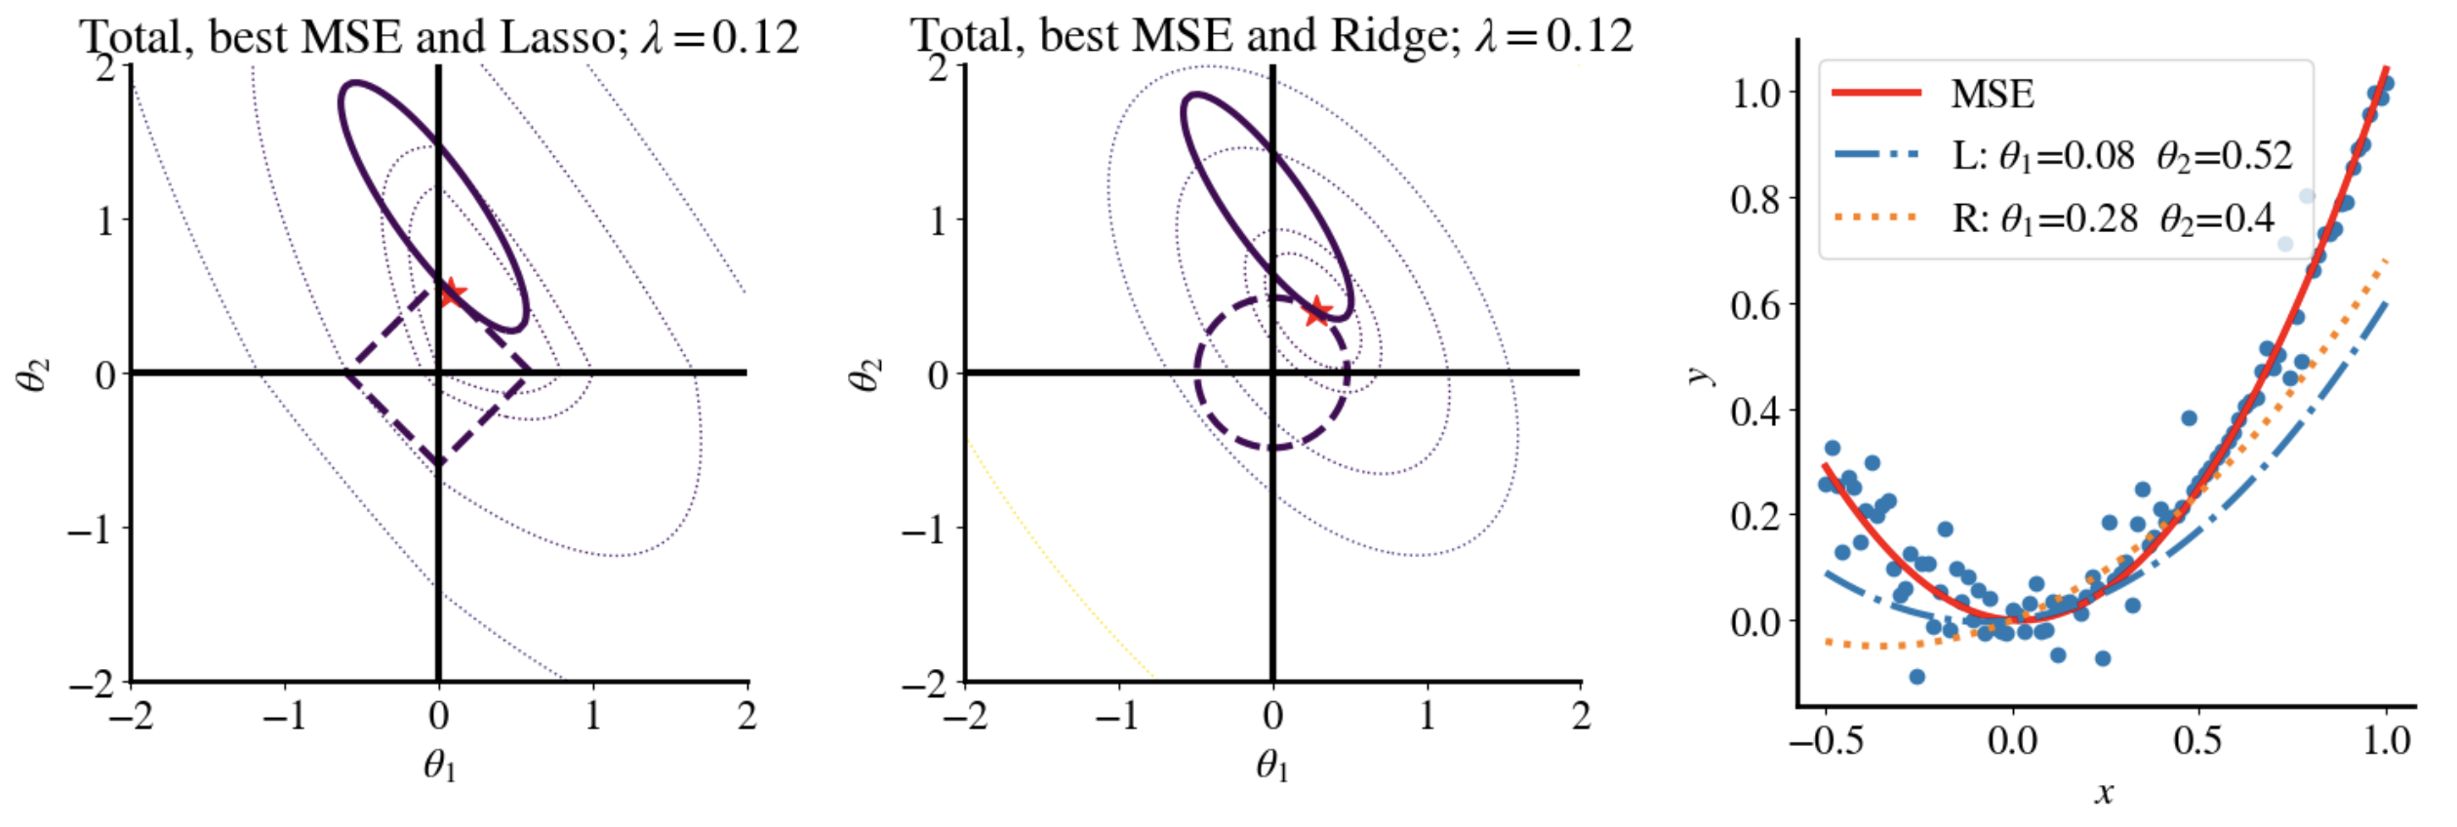
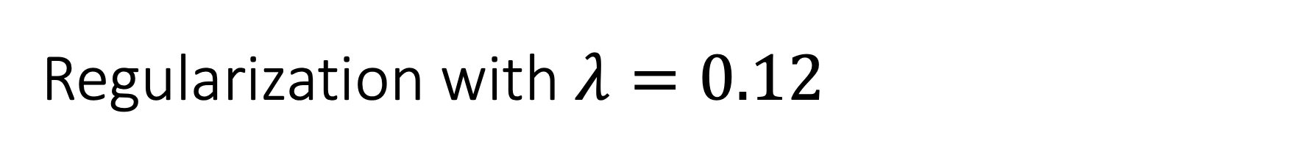
Regularization with $λ=0.12$

Slide 42
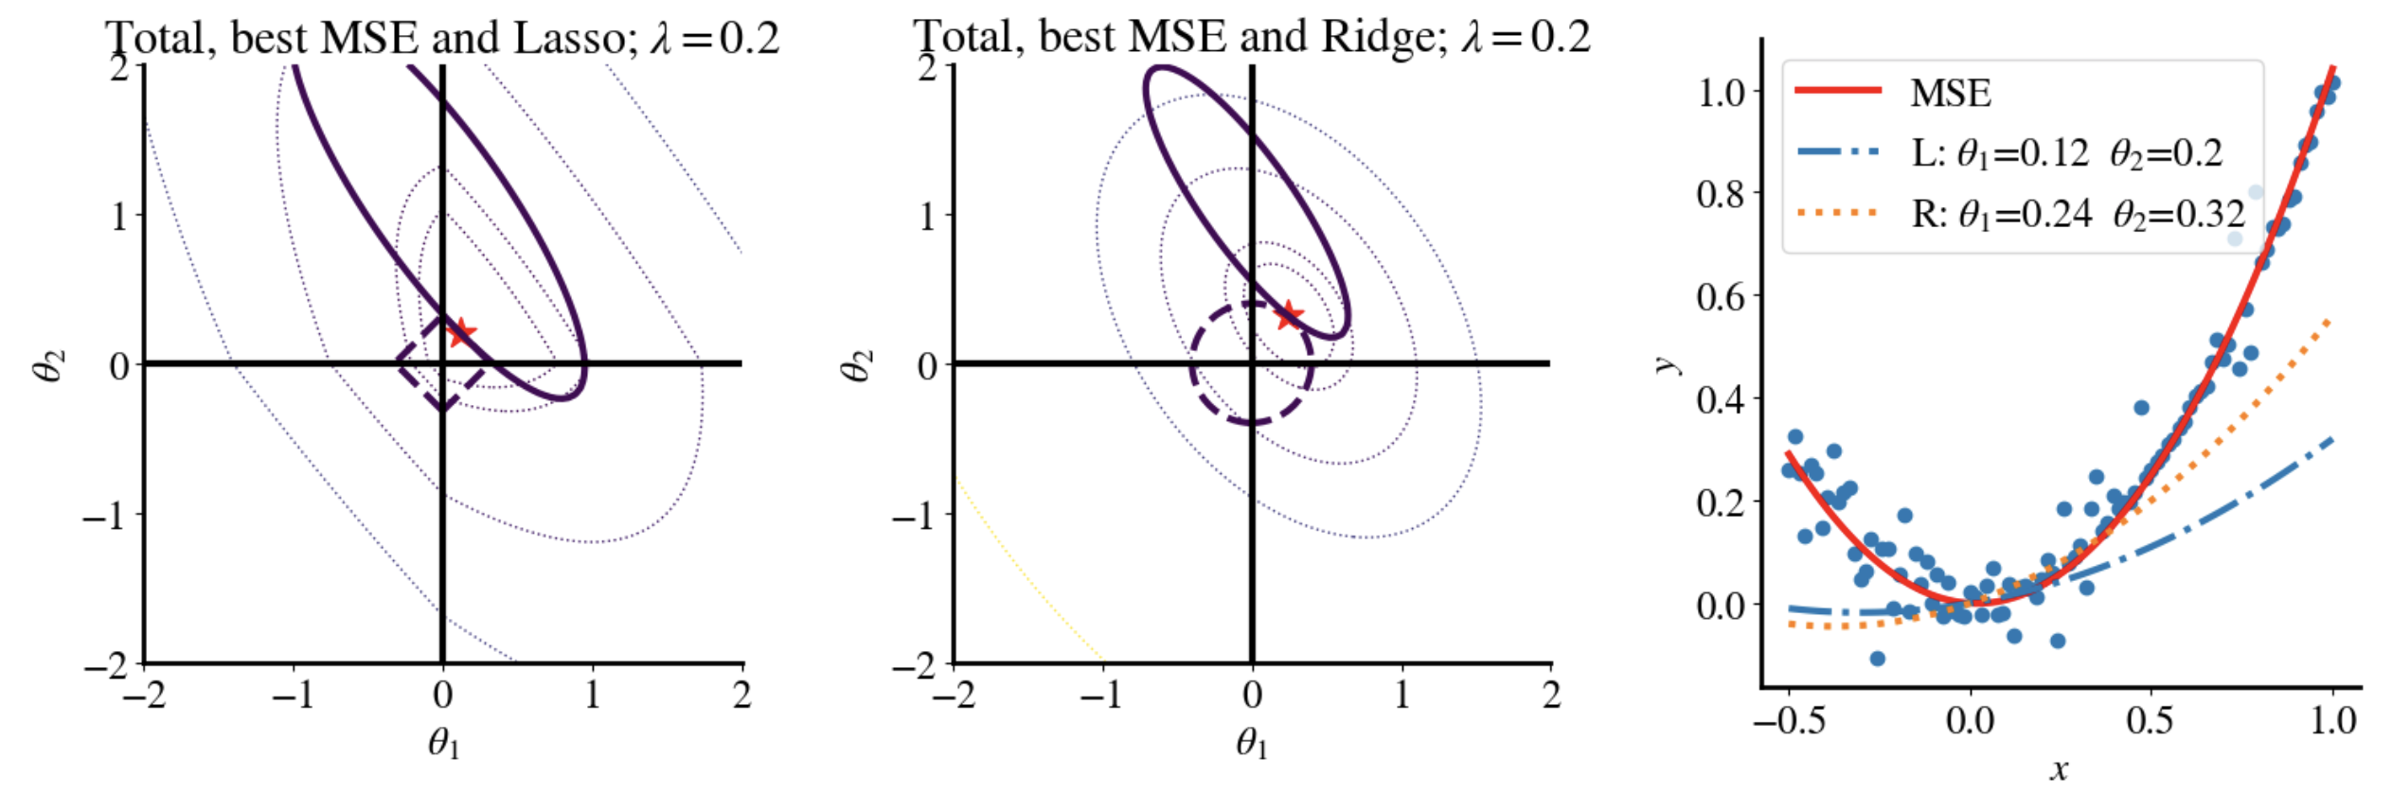
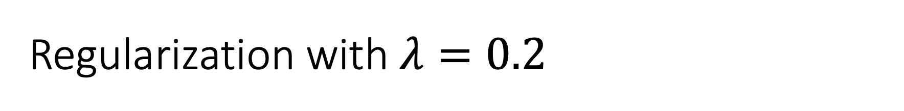
Regularization with $λ=0.2$

Slide 43
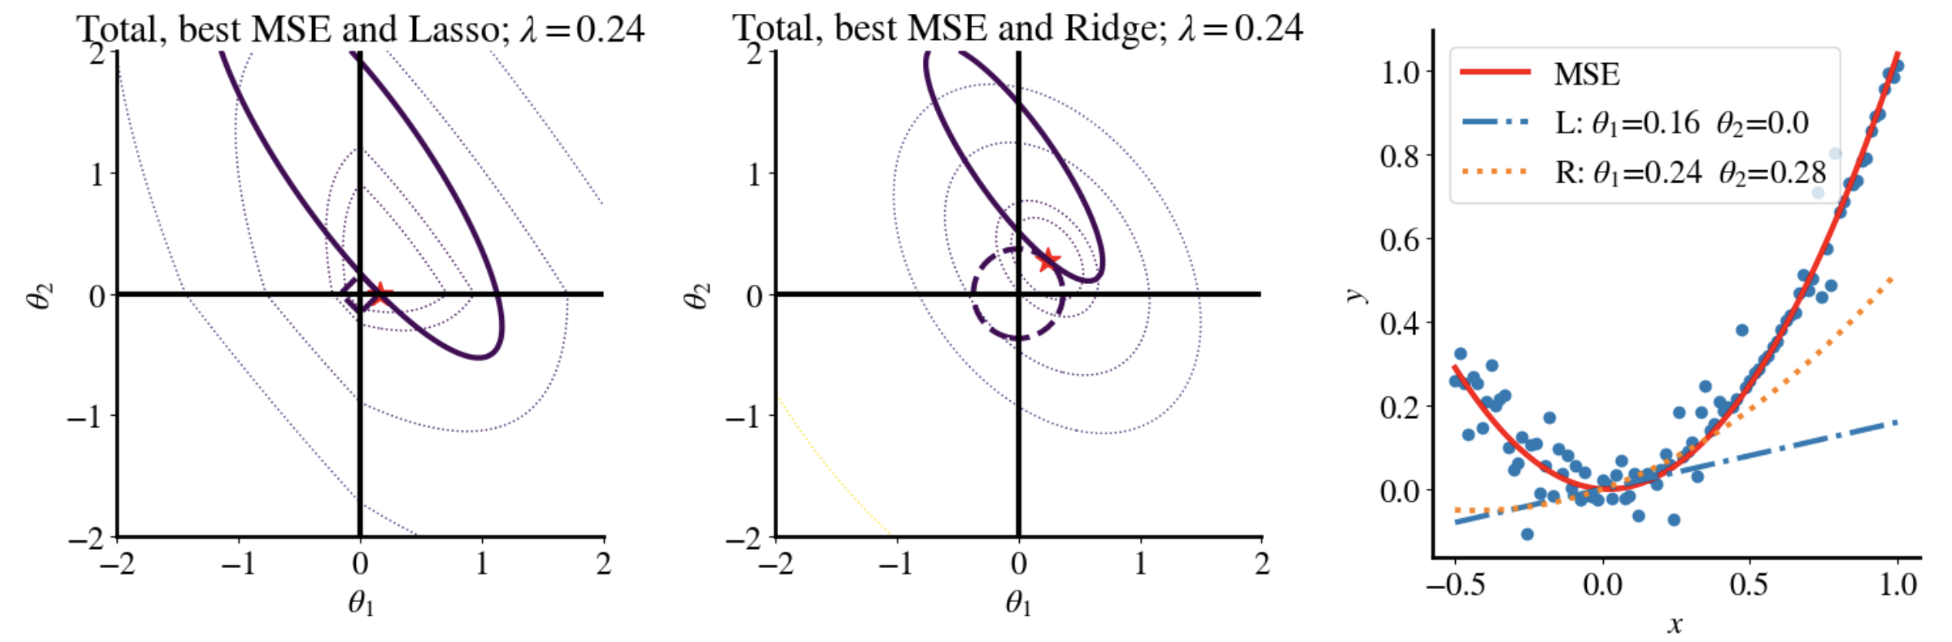
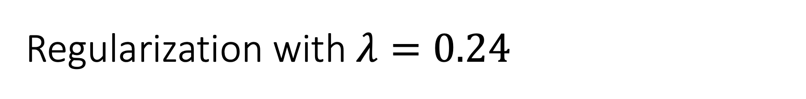
Regularization with $λ=0.24$
Lasso eliminated quadratic term!

Slide 44
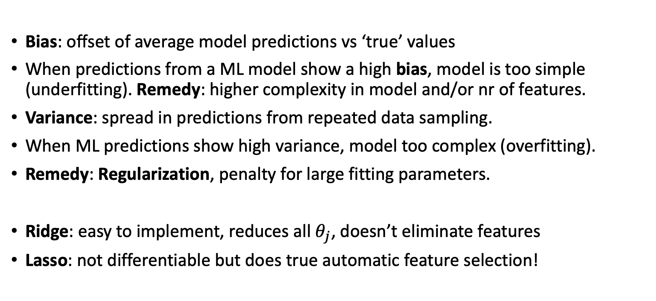
Summary
Bias: offset of average model predictions vs ‘true’ values
When predictions from a ML model show a high bias, model is too simple (underfitting). Remedy: higher complexity in model and/or nr of features.
Variance: spread in predictions from repeated data sampling.
When ML predictions show high variance, model too complex (overfitting).
Remedy: Regularization, penalty for large fitting parameters.
Ridge: easy to implement, reduces all $θ_{j}$, doesn’t eliminate features
Lasso: not differentiable but does true automatic feature selection!

