Slide 1
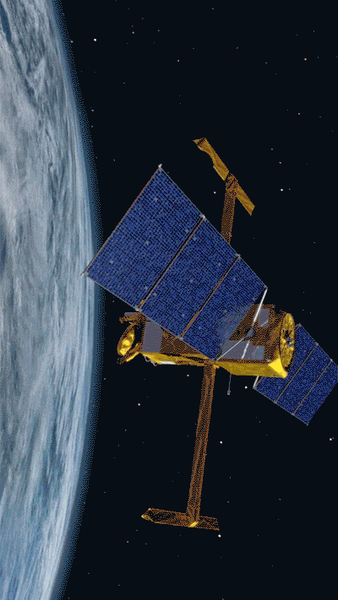
Lecture 10
Artificial Neural Networks

Slide 2
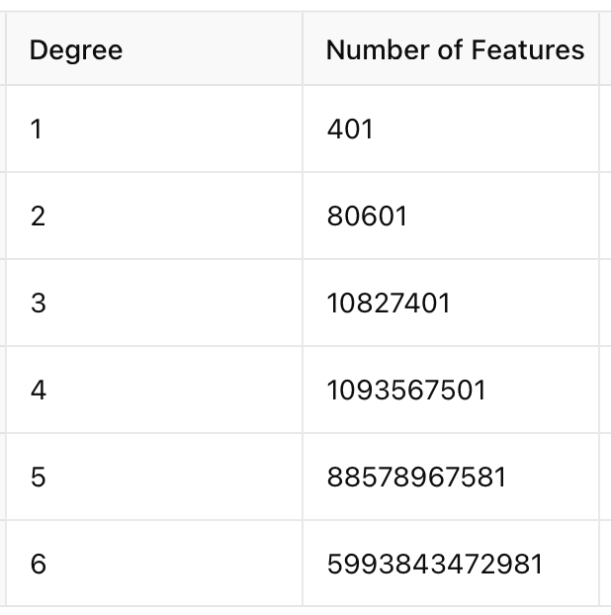
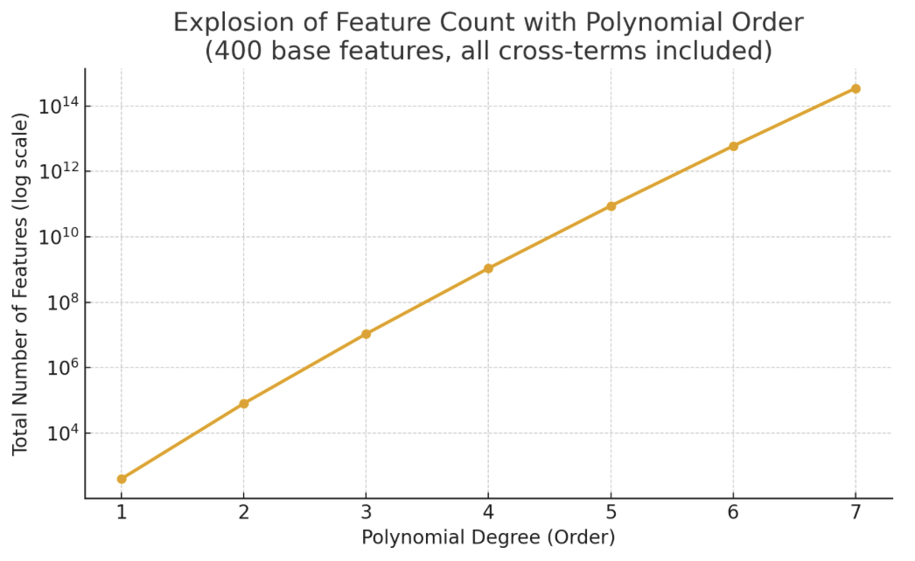
Why yet another algorithm?
Linear numerical and logistic regression often insufficiently complex
Polynomials become too expensive, especially due to cross-terms
Need more efficient way to introduce high degree of non-linearity: neural networks

Slide 3
Model Representation

Slide 4
Inspired by the human brain

Slide 5
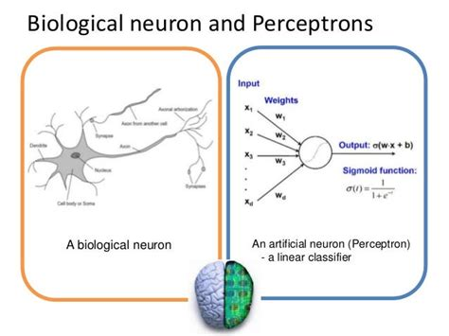
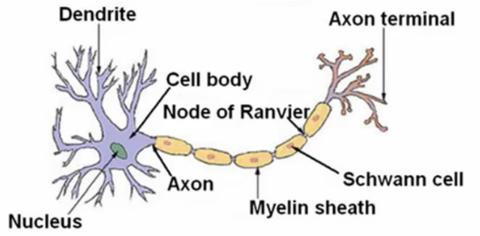
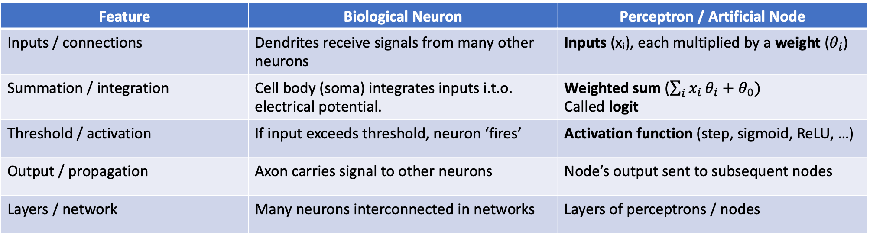
Perceptron or Logistic Unit
Feature | Biological Neuron | Perceptron / Artificial Node
Inputs / connections | Dendrites receive signals from many other neurons | Inputs (xᵢ), each multiplied by a weight ($θ_{i}$)
Summation / integration | Cell body (soma) integrates inputs i.t.o. electrical potential. | Weighted sum (${\sum_{i}{x_{i}}θ}_{i}+θ_{0})$ Called logit
Threshold / activation | If input exceeds threshold, neuron ‘fires’ | Activation function (step, sigmoid, ReLU, …)
Output / propagation | Axon carries signal to other neurons | Node’s output sent to subsequent nodes
Layers / network | Many neurons interconnected in networks | Layers of perceptrons / nodes
Single Neuron in Brain

Slide 6
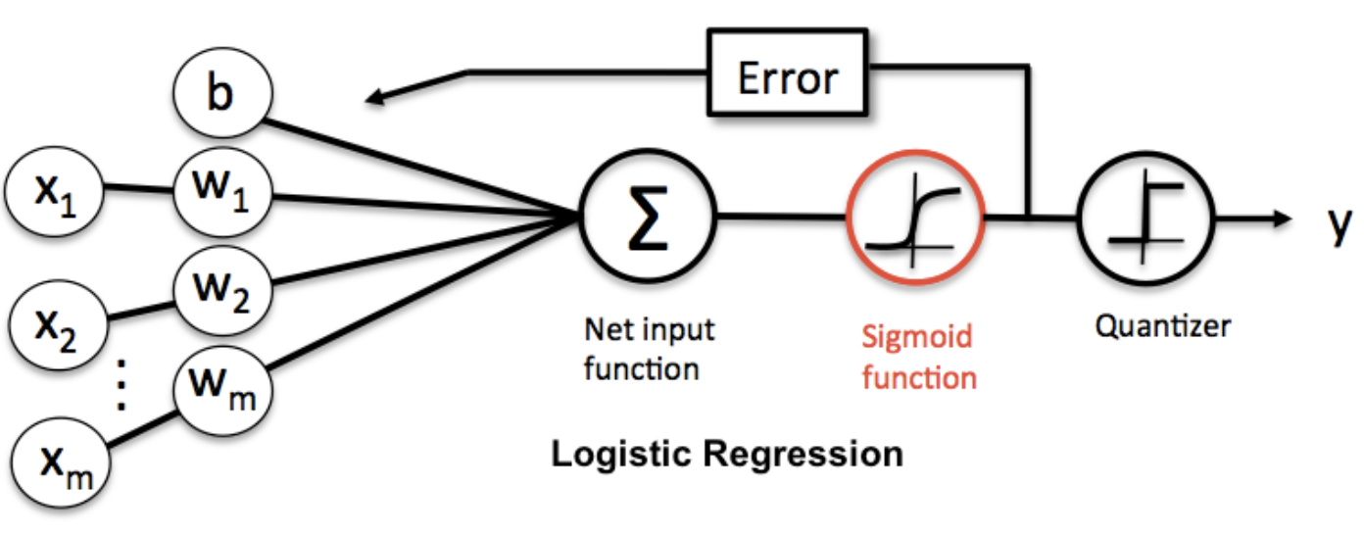
Logistic Regression as Single Neuron/Perceptron
Binary logistic regression:
1 input dendrite per feature, 1 sigmoid soma, 1 output axion.

Slide 7
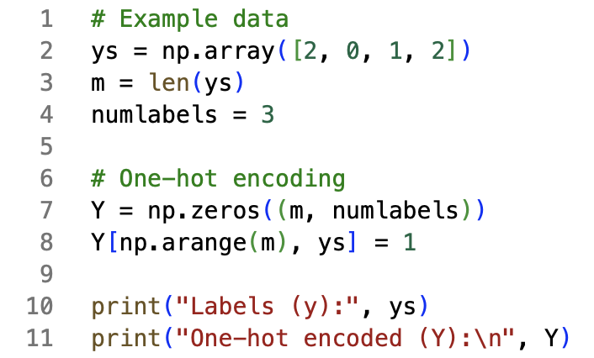
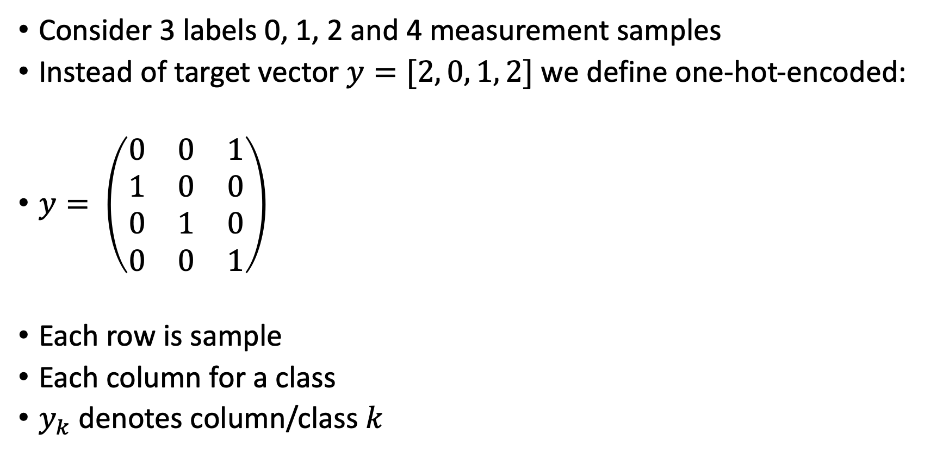
Subtlety. One-Hot-Encoding of Target
Consider 3 labels 0, 1, 2 and 4 measurement samples
Instead of target vector $y=[2, 0, 1, 2]$ we define one-hot-encoded:
$y= \left(\begin{matrix}0 & 0 & 1 \\ 1 & 0 & 0 \\ 0 & 1 & 0 \\ 0 & 0 & 1\end{matrix}\right)$
Each row is sample
Each column for a class
$y_{k}$ denotes column/class $k$

Slide 8
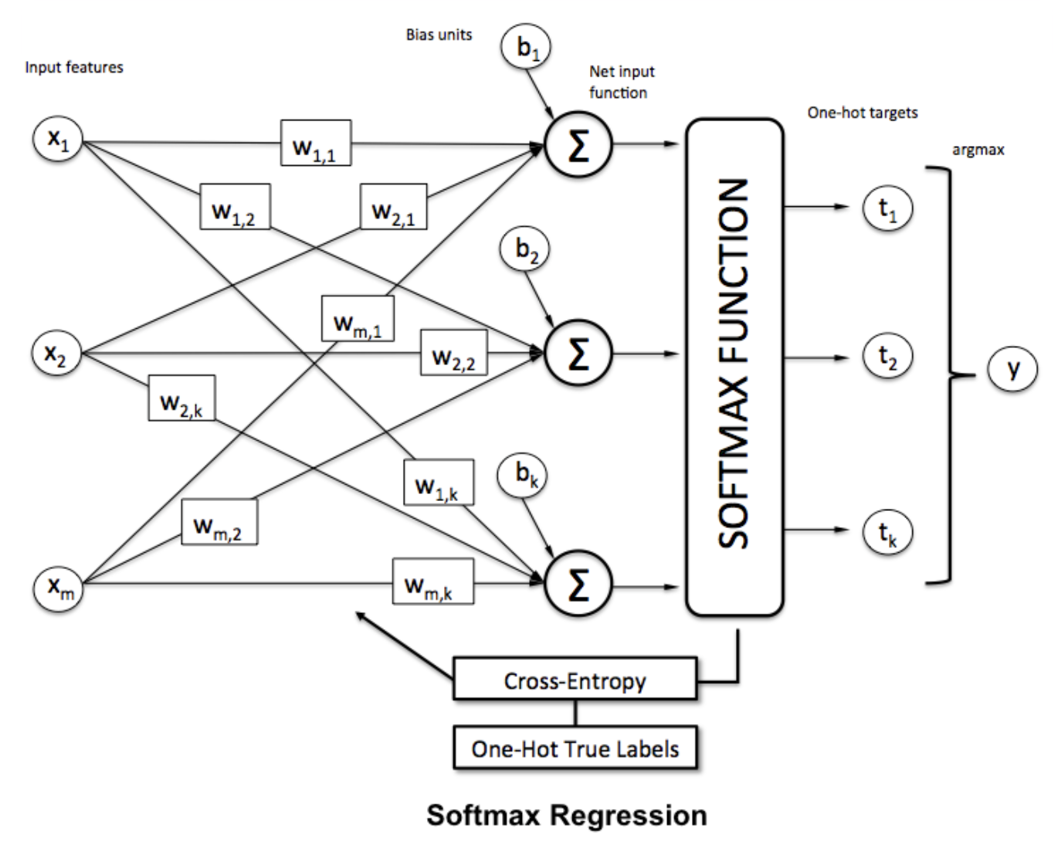
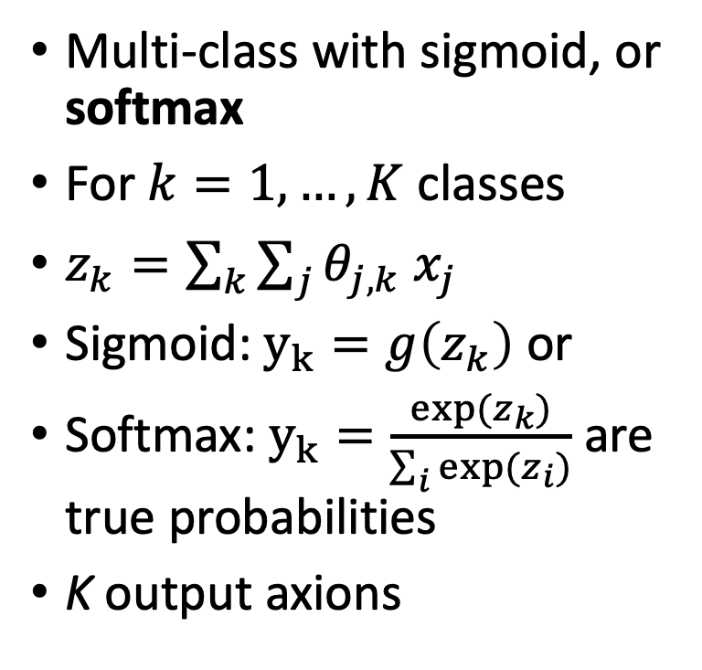
Logistic Regression as Single Neuron/Perceptron
Multi-class with sigmoid, or softmax
For $k=1, …, K$ classes
$z_{k}=\sum_{k}{\sum_{j}{θ_{j,k} x_{j}}}$
Sigmoid: $y_{k}=g\left(z_{k}\right)$ or
Softmax: $y_{k}=\frac{exp⁡(z_{k})}{\sum_{i}{exp⁡(z_{i})}}$ are true probabilities
K output axions

Slide 9
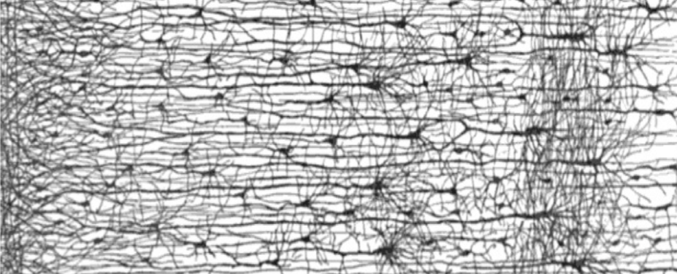
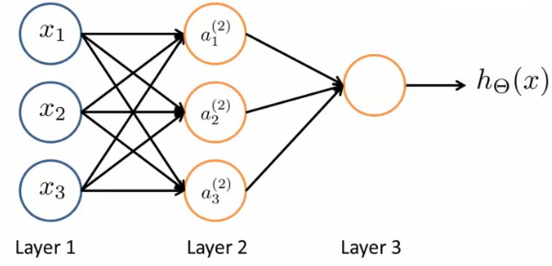
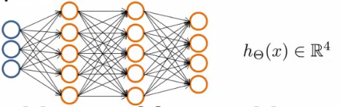
Artificial Neural Network
Combine multiple logistic units:
x₀
a₀
Multiclass: 0, 1, 2, 4, etc (probability)
Binary classification: 0 or 1

Slide 10
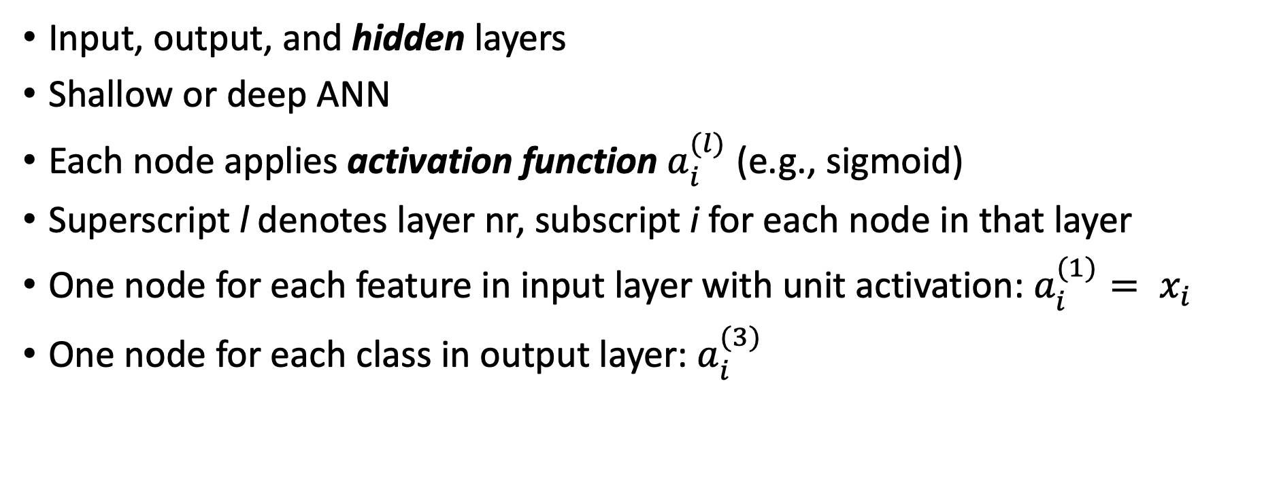
Nomenclature
Input, output, and hidden layers
Shallow or deep ANN
Each node applies activation function $a_{i}^{(l)}$ (e.g., sigmoid)
Superscript l denotes layer nr, subscript i for each node in that layer
One node for each feature in input layer with unit activation: $a_{i}^{(1)}= x_{i}$
One node for each class in output layer: $a_{i}^{(3)}$

Slide 11
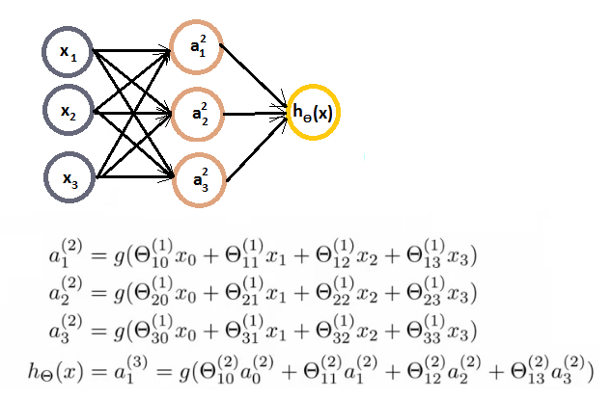

Algebra of Binary ANN Classification
Fitting parameters, or weights, are now arrays: $Θ_{ji}^{(l)}$ where i is node in layer l and j is node in layer l+1
In this example: $Θ_{}^{(1)}$is 3×4 and $Θ_{}^{(2)}$ is 1×4 vector, for binary output
(bias not shown)

Slide 12
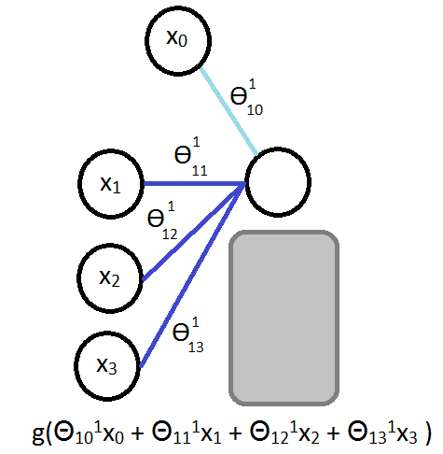
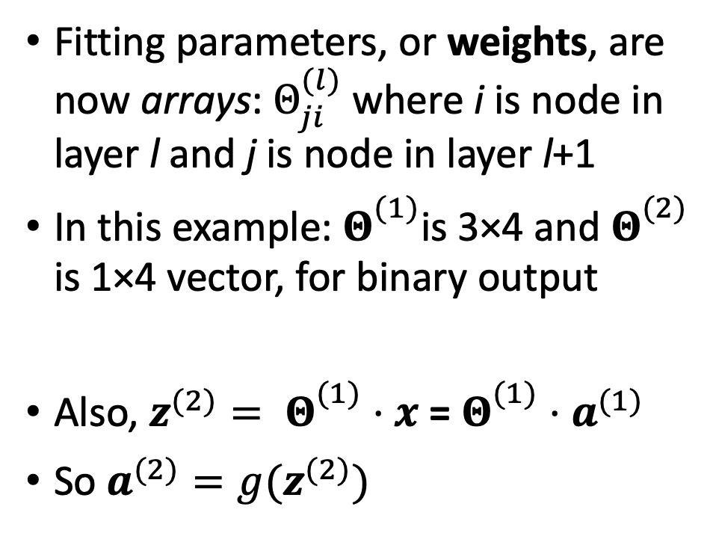
Algebra of Binary ANN Classification
Fitting parameters, or weights, are now arrays: $Θ_{ji}^{(l)}$ where i is node in layer l and j is node in layer l+1
In this example: $Θ_{}^{(1)}$is 3×4 and $Θ_{}^{(2)}$ is 1×4 vector, for binary output
Also, $z^{(2)}= Θ_{}^{(1)}⋅x$ = $Θ_{}^{(1)}⋅a^{(1)}$
So $a^{(2)}=g(z^{(2)})$

Slide 13
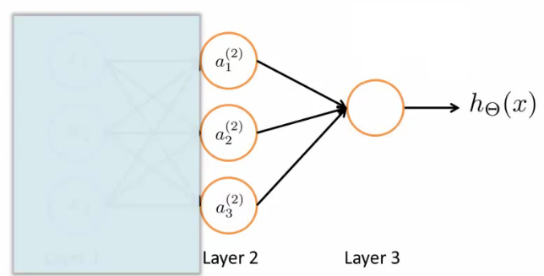

Intuition
Note: last step is identical to logistic regression, but i.t.o. $a^{(2)}$ ‘features’
First step creates many new non-linear features
Model automatically learns which non-linear features are useful

Slide 14
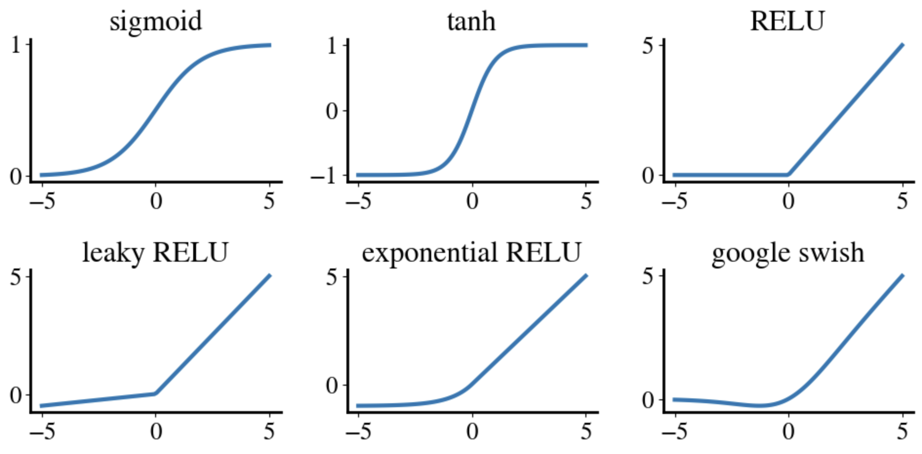
Different activation functions for hidden layers

Slide 15
Forward Propagation

Slide 16
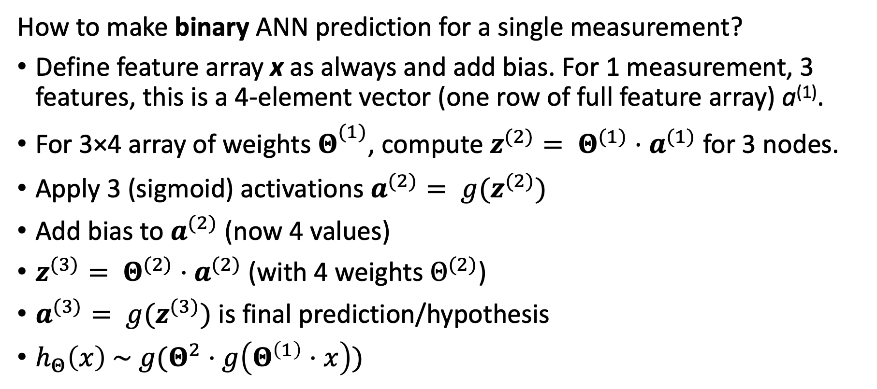
Forward propagation
How to make binary ANN prediction for a single measurement?
Define feature array x as always and add bias. For 1 measurement, 3 features, this is a 4-element vector (one row of full feature array) a⁽¹⁾.
For 3×4 array of weights $Θ_{}^{(1)}$, compute $z^{(2)}= Θ^{(1)}⋅a^{(1)}$ for 3 nodes.
Apply 3 (sigmoid) activations $a^{(2)}= {g(z}^{(2)})$
Add bias to $a^{(2)}$ (now 4 values)
$z^{(3)}= Θ^{(2)}⋅a^{(2)}$ (with 4 weights $Θ^{(2)}$)
$a^{(3)}= {g(z}^{(3)})$ is final prediction/hypothesis
$h_{Θ}\left(x\right) \sim g(Θ^{2}⋅g\left(Θ^{\left(1\right)}⋅x\right))$
x₀
a₀

Slide 17
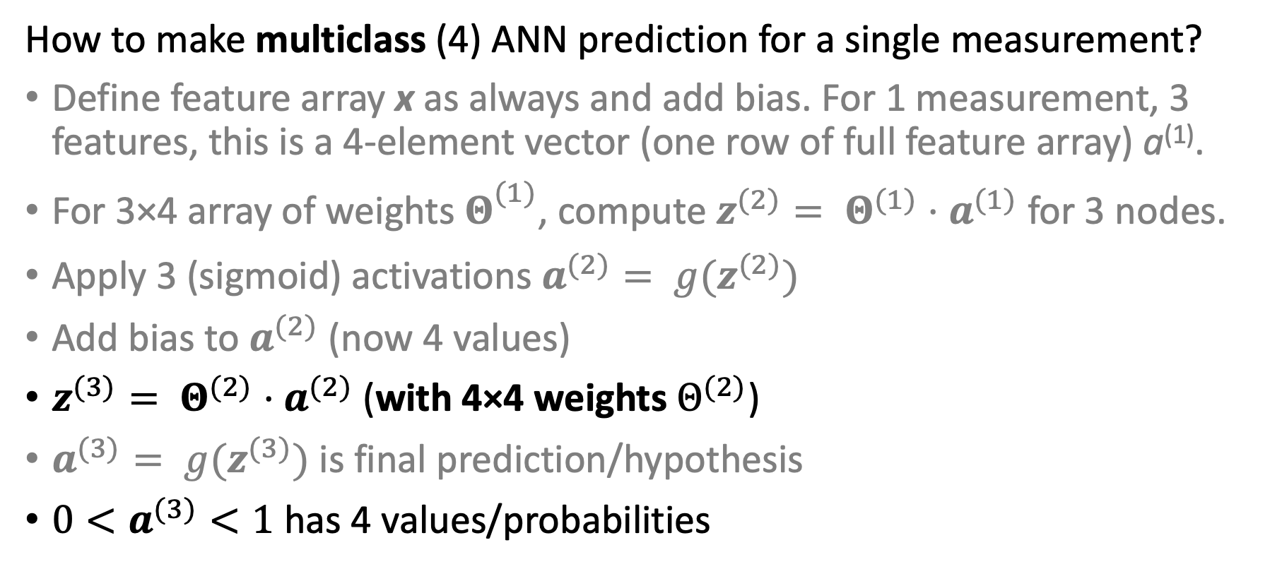
Forward propagation
How to make multiclass (4) ANN prediction for a single measurement?
Define feature array x as always and add bias. For 1 measurement, 3 features, this is a 4-element vector (one row of full feature array) a⁽¹⁾.
For 3×4 array of weights $Θ_{}^{(1)}$, compute $z^{(2)}= Θ^{(1)}⋅a^{(1)}$ for 3 nodes.
Apply 3 (sigmoid) activations $a^{(2)}= {g(z}^{(2)})$
Add bias to $a^{(2)}$ (now 4 values)
$z^{(3)}= Θ^{(2)}⋅a^{(2)}$ (with 4×4 weights $Θ^{(2)}$)
$a^{(3)}= {g(z}^{(3)})$ is final prediction/hypothesis
${0<a}^{(3)}<1$ has 4 values/probabilities

Slide 18
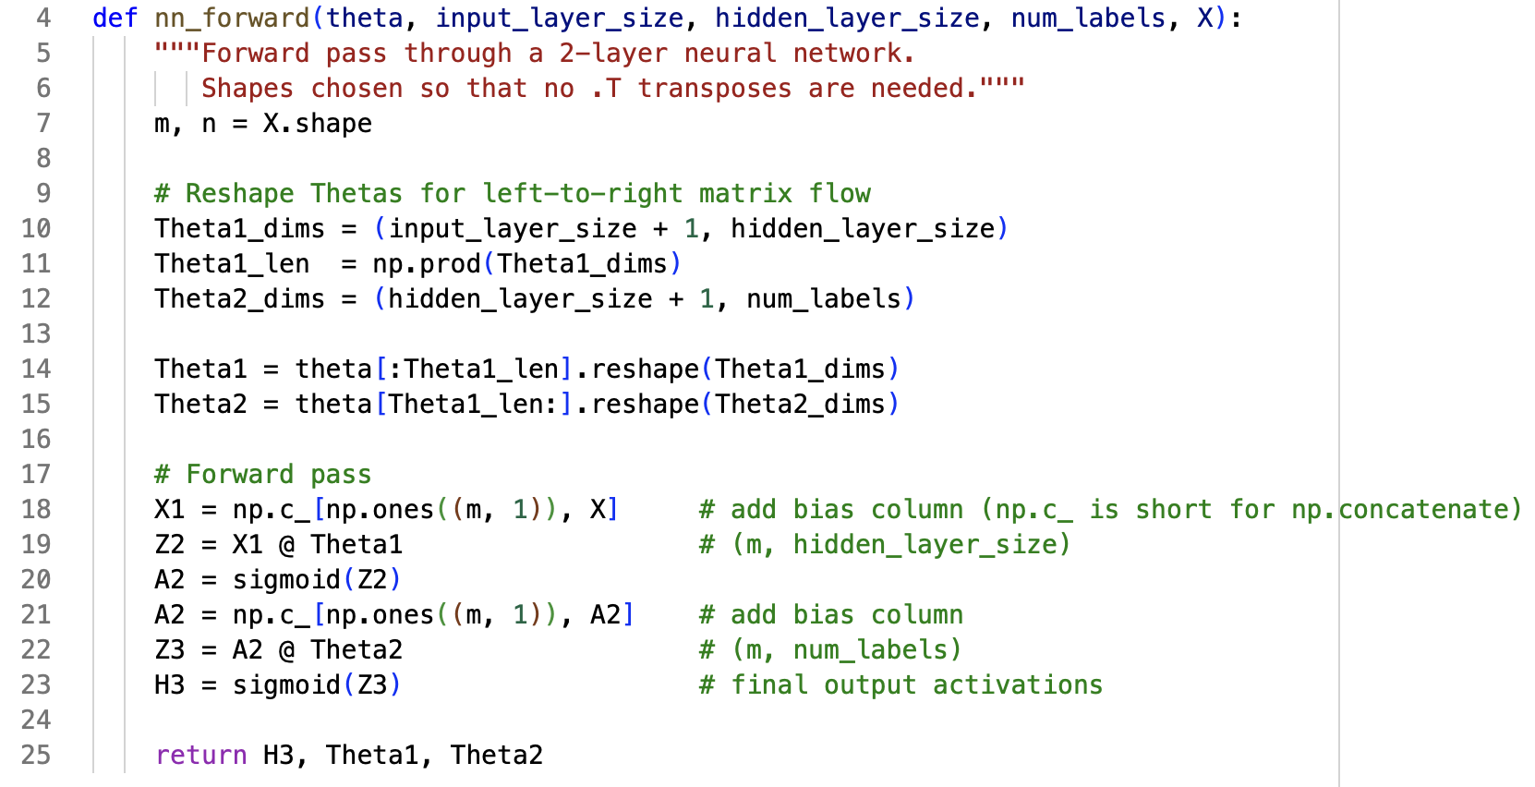
Forward Propagation - Code
Note: hypothesis / output is probability for each class!

Slide 19
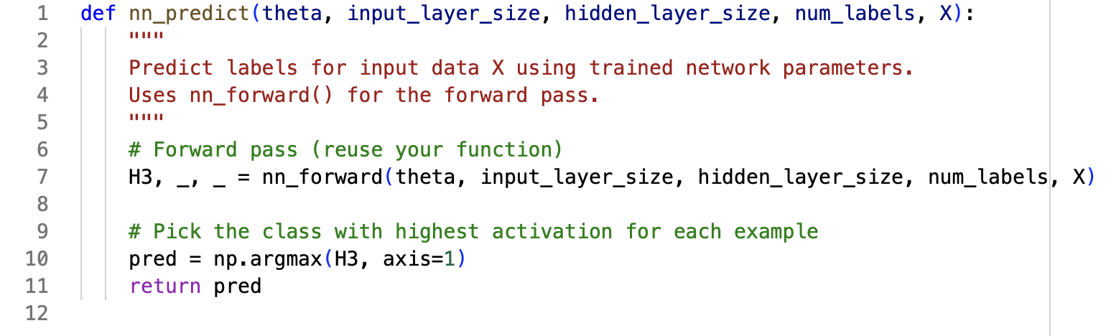
Probabilities -> Integer Class Labels
Pick class with highest probability

Slide 20
ANN Algorithm

Slide 21
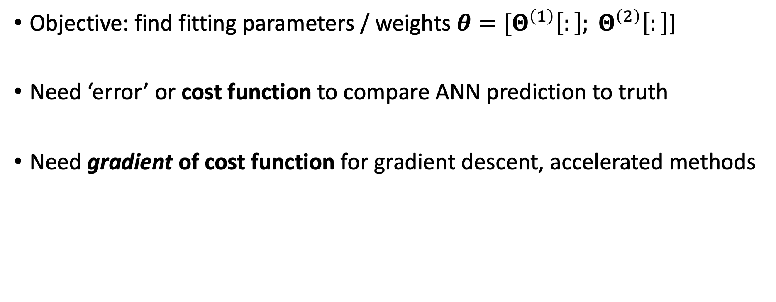
Same approach as always
Objective: find fitting parameters / weights $θ=[Θ^{\left(1\right)}\left[:\right]; Θ^{\left(2\right)}\left[:\right]$]
Need ‘error’ or cost function to compare ANN prediction to truth
Need gradient of cost function for gradient descent, accelerated methods

Slide 22

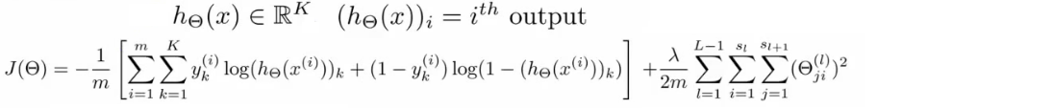

Cost function for ANN
Remember logistic cost function (with Ridge regularization):
Cost function (cross-entropy) for ANN is simply:
With extra sum over different classes:

Slide 23
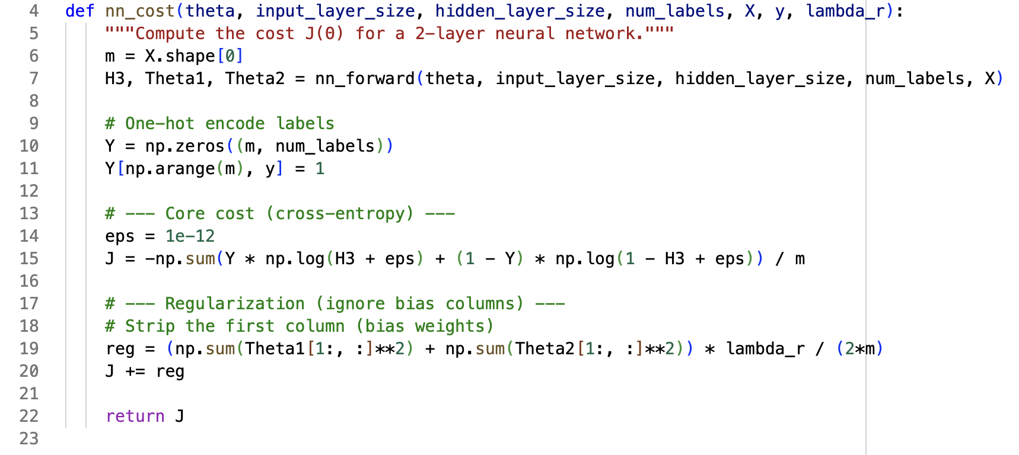
Cross-Entropy Cost + Ridge Regularization

Slide 24
Backward Propagation

Slide 25
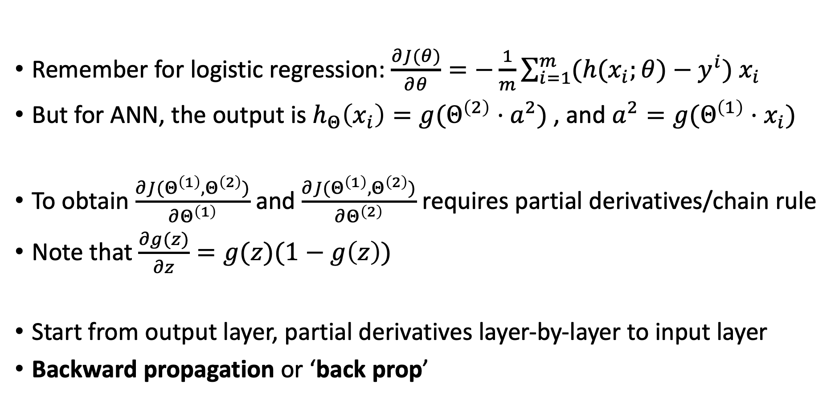
Gradients of ANN cost function
Remember for logistic regression: $\frac{∂J(θ)}{∂θ}=−\frac{1}{m}\sum_{i=1}^{m}{(h(x_{i};θ)−y^{i}) x_{i} }$
But for ANN, the output is $h_{Θ}\left(x_{i}\right)=g(Θ^{\left(2\right)}⋅a^{2})$, and $a^{2}=g(Θ^{\left(1\right)}⋅x_{i})$
To obtain $\frac{∂J(Θ^{\left(1\right)},Θ^{\left(2\right)})}{∂Θ^{\left(1\right)}}$ and $\frac{∂J(Θ^{\left(1\right)},Θ^{\left(2\right)})}{∂Θ^{\left(2\right)}}$ requires partial derivatives/chain rule
Note that $\frac{∂g(z)}{∂z}=g(z)(1−g\left(z\right))$
Start from output layer, partial derivatives layer-by-layer to input layer
Backward propagation or ‘back prop’

Slide 26
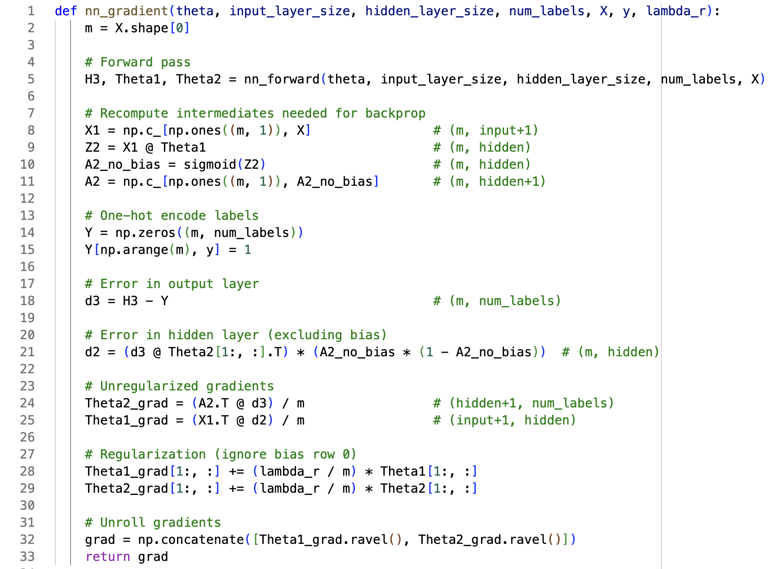
Same terms as forward propagation
Needed to compute derivatives
Same one-hot-encode
Chain rule derivatives
of error contributions
of each layer
Derivative of Ridge term
Return one long vector of all gradients

Slide 27
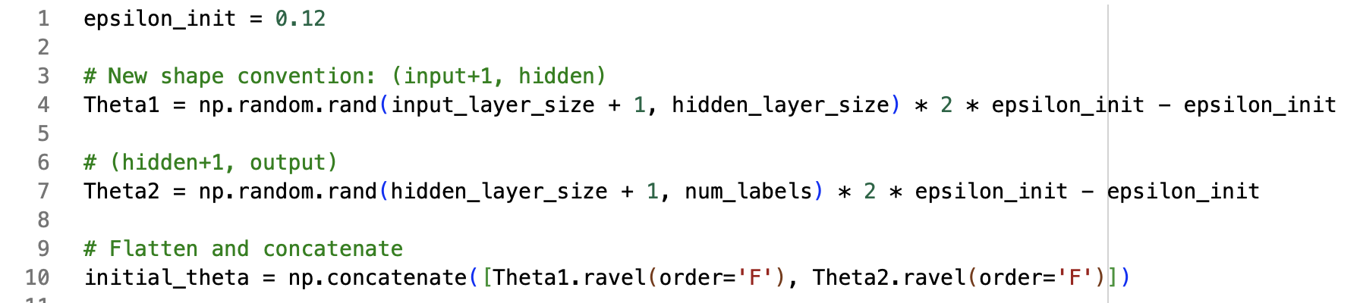

Final detail
Unlike for logistic and numerical regression, we cannot start with initial guess of 0 for all $θ=[Θ^{\left(1\right)}\left[:\right]; Θ^{\left(2\right)}\left[:\right]$];
If all initial guesses are the same, the values for all the nodes in each layer are the same (even after back-prop) and ANN will perform like regular logistic regression
Solution: small random values as first guess

Slide 28
Putting all together

Slide 29
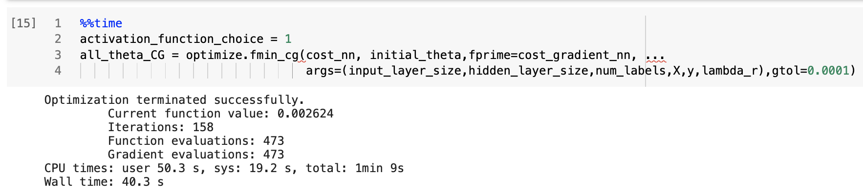
How to train ANN?
Same as every numerical & logistic regression before!
Use any function to minimize cost function, e.g. conjugate gradient:

Slide 30
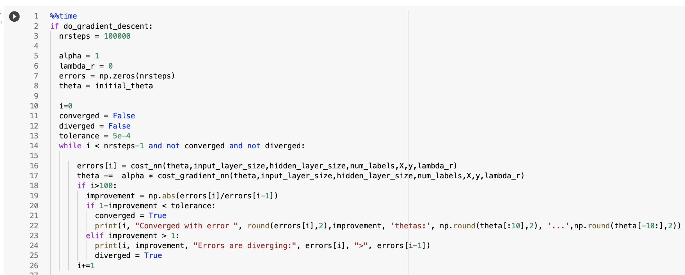
Or our own Gradient Descent!

Slide 31
Conclusions
ANN combine multiple logistic units to make non-linear predictions
Input layer has one node per feature, plus bias
Output layer has one node per class (no need for one-vs-all)
Multiple ‘hidden’ layers can have any nr of nodes
Each hidden node takes a different linear combination of outputs from previous layer and applies non-linear activation function
Effectively, this creates/learns new complex features, and deletes others

Slide 32
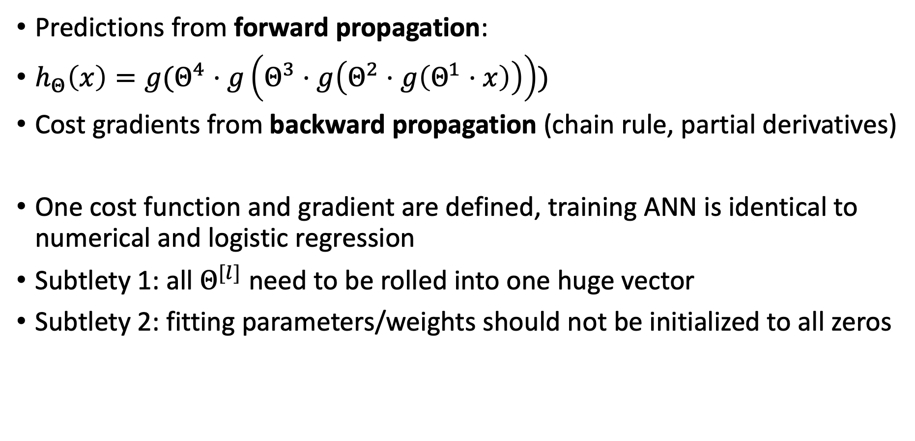
Conclusions
Predictions from forward propagation:
$h_{Θ}\left(x\right)=g(Θ^{4}⋅g\left(Θ^{3}⋅g\left(Θ^{2}⋅g\left(Θ^{1}⋅x\right)\right)\right))$
Cost gradients from backward propagation (chain rule, partial derivatives)
One cost function and gradient are defined, training ANN is identical to numerical and logistic regression
Subtlety 1: all $Θ^{[l]}$ need to be rolled into one huge vector
Subtlety 2: fitting parameters/weights should not be initialized to all zeros

